Slide 1
Customer Orders Analysis
A Data Visualization Project

Slide 2
Introduction
This project analyzes customer orders dataset, focusing on sales, profit, categories, and regions. The goal is to uncover trends and insights for business decisions.
The dataset is a Sales Orders dataset that contains detailed transactional information about customer purchases.
It includes 9,994 records and 21 attributes, covering various aspects of the sales process such as order details, shipping information, customer demographics, product categories, sales revenue, discounts, and profit margins.
The data represents orders from different regions, states, and cities within the United States, allowing for a wide range of business analyses.

Slide 3
Dataset Overview
• Contains customer orders, sales, profit, and regional details
• Helps understand business performance across customers and regions
• Key attributes:
• Order Date
• Sales
• Profit
• Category
• Customer Name
• Region

Slide 4
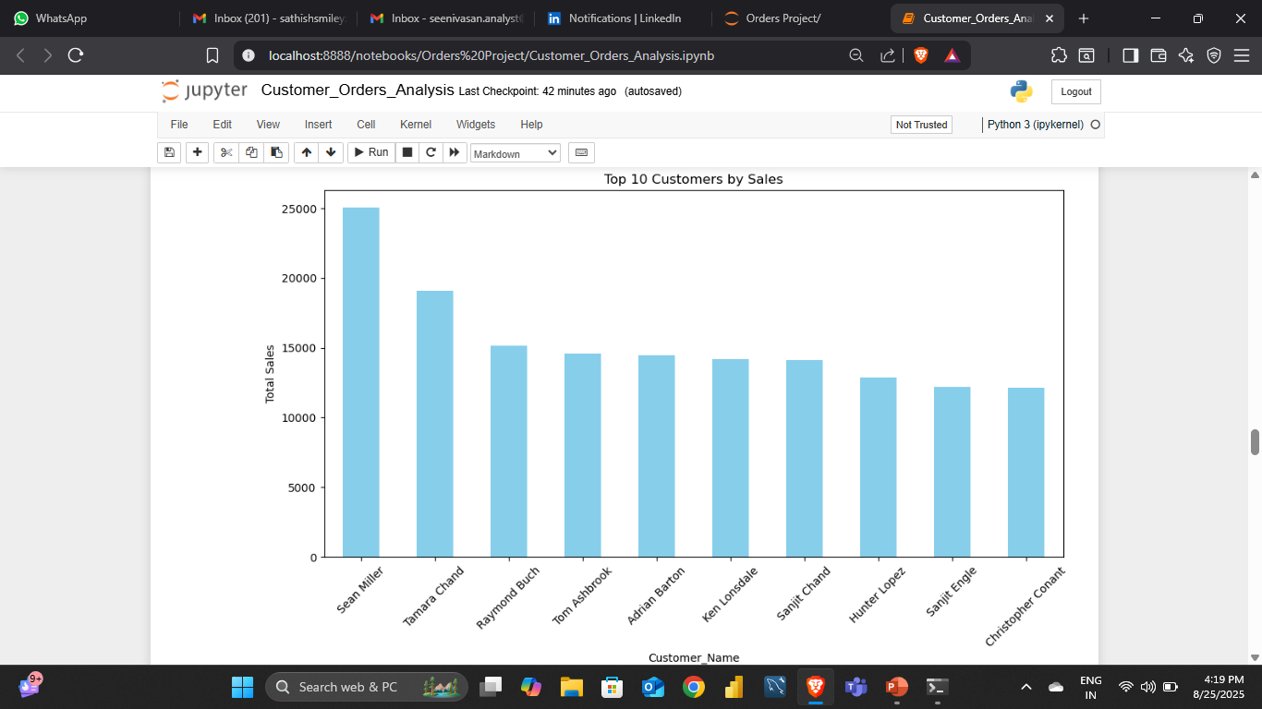
Top 10 Customers by Sales

Slide 5
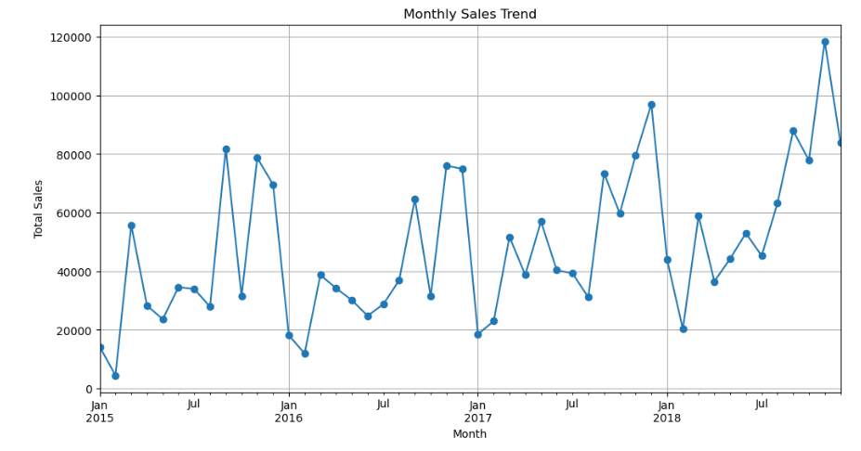
Monthly Sales Trend

Slide 6
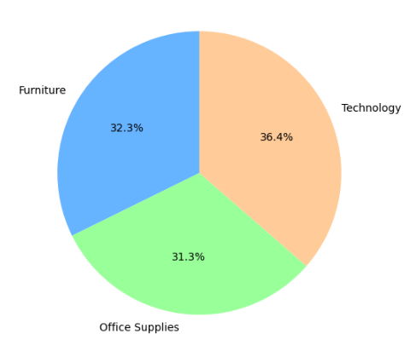
Sales by Category

Slide 7
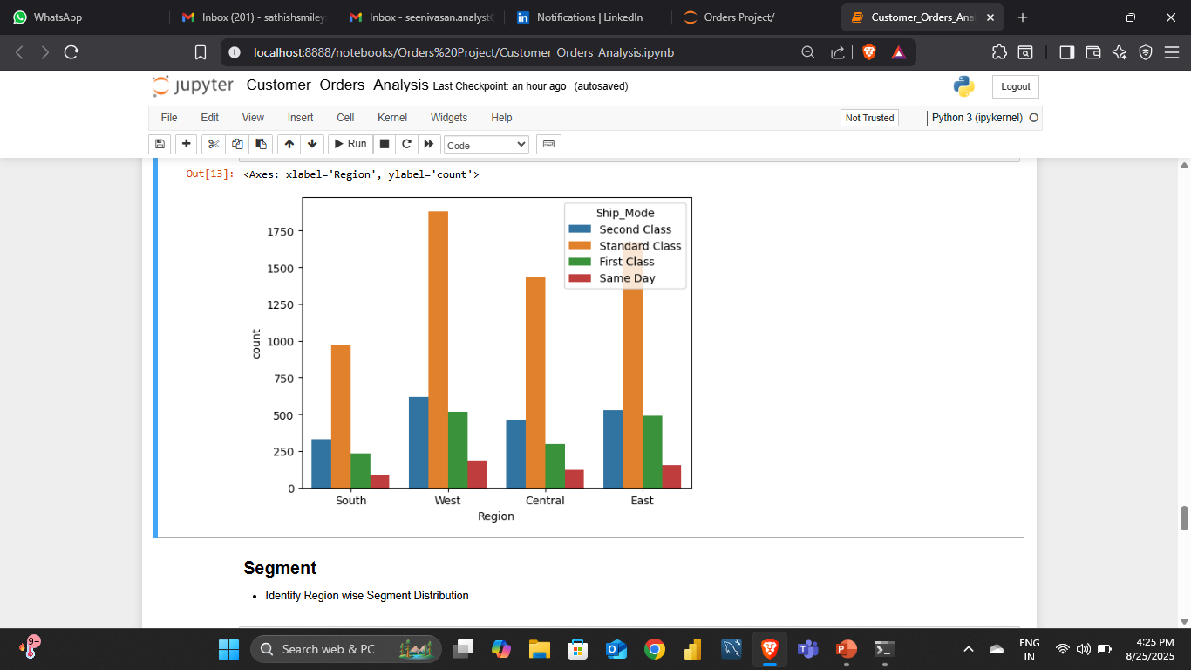
Ship Mode by Region

Slide 8
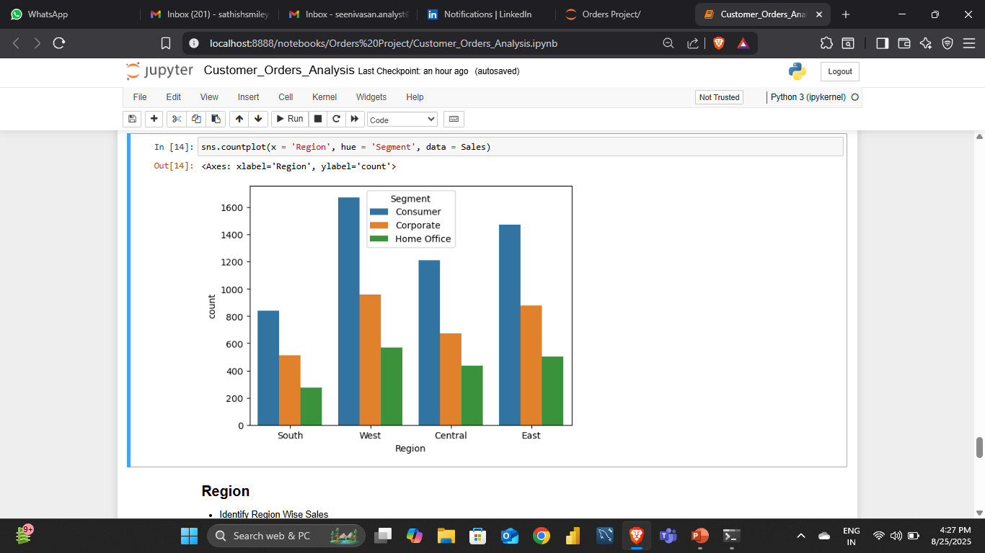
Region wise Segment Distribution

Slide 9
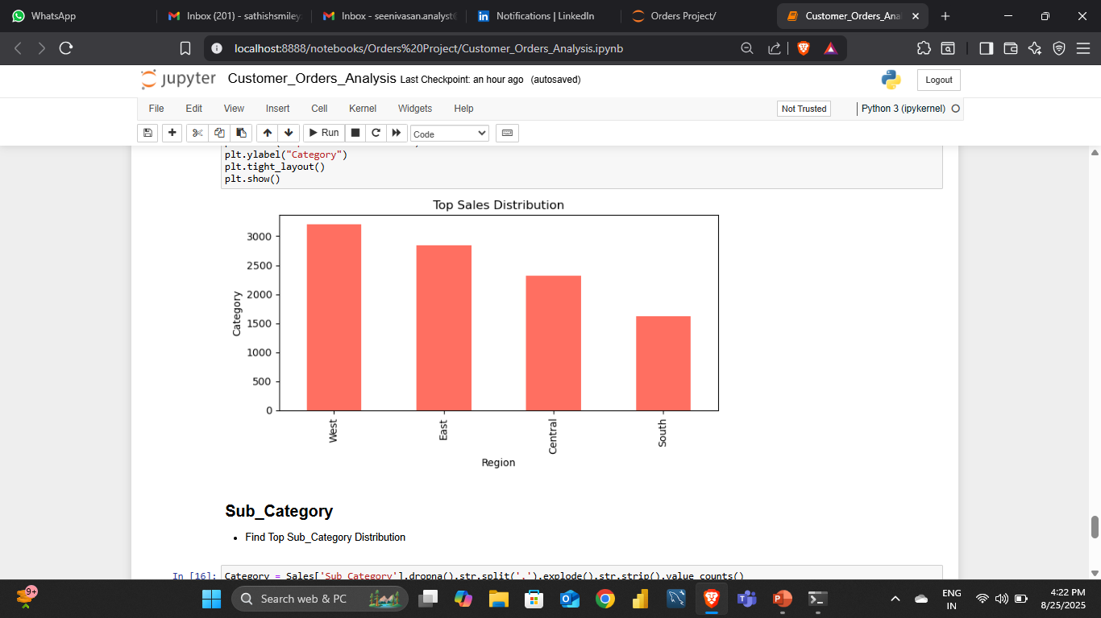
Regional Sales

Slide 10
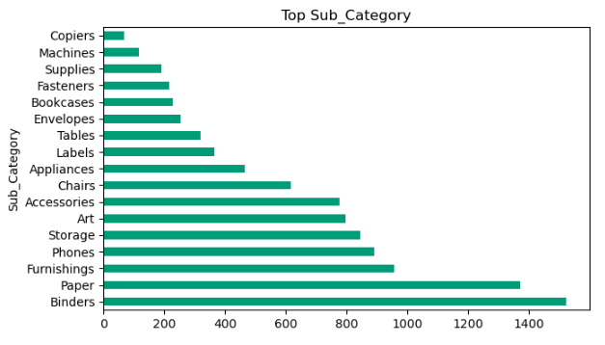
Sub Category Distribution

Slide 11
Key Insights
• Monthly trends highlight sales seasonality
• Top customers drive major sales
• Category distribution shows top-performing segments
• Regional differences in sales performance
• Profitability is not always proportional to sales

Slide 12
Conclusion & Future Work
• This analysis provides a clear view of customer order
trends.
• Future work may include:
• Forecasting sales using machine learning
• Customer segmentation analysis
• Profitability optimization strategies

