Slide 1
Exploratory data analysis (Python)
– IMDB Movies, rating and user data

Slide 2
We look for some questions to answer and analyze. Below are some questions:
How to merge datasets and different merge techniques
List of movies that are rated most by users
List of movies highest rated by users
In ratings, how to address ratings sparsity problem
Plot distributions
Identify different age groups and technique of binning
Subgrouping and unstacking
Differences in ratings by gender
Which kind of movies mostly accepted by male, female child and old.

Slide 3
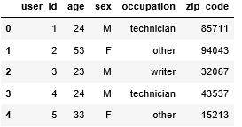
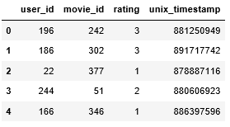
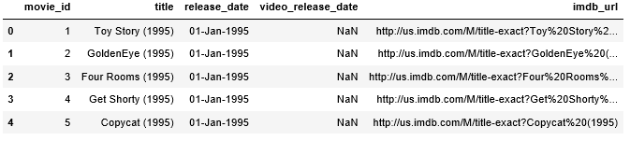
Data Set:
We use 3 data sets users details(u.user), user ratings (u.data) and imdb movies details(u.item)
separately for EDA.
User parameters(u.user): 'user_id', 'age', 'sex', 'occupation', 'zip_code’ (943 entries)
User rating parameters(u.data): 'user_id', 'movie_id', 'rating', 'unix_timestamp’ (100000 entries)
Movies data parameters: 'movie_id', 'title', 'release_date', 'video_release_date', 'imdb_url’ (1682 entries)
Users data
User Rating
Movies data

Slide 4
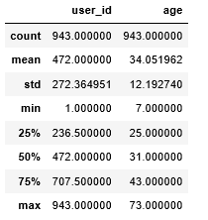
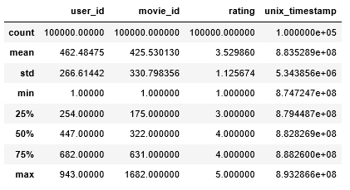
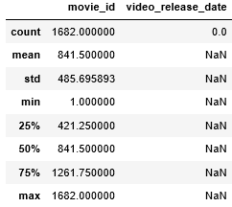
Users data Description
User Rating Description
Movies data Description

Slide 5
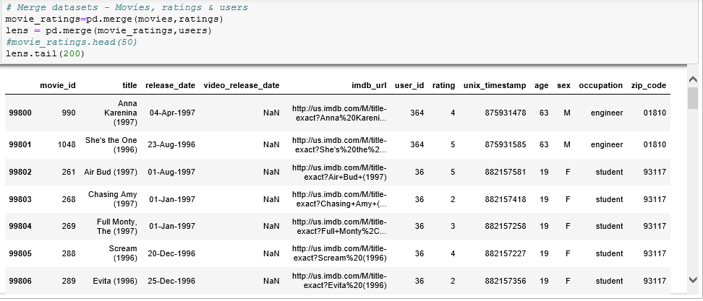
Merging data sets:

Slide 6
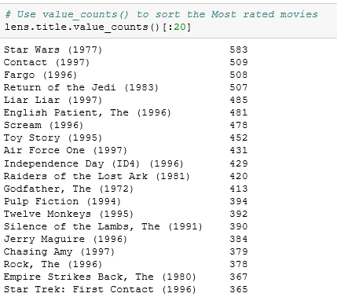
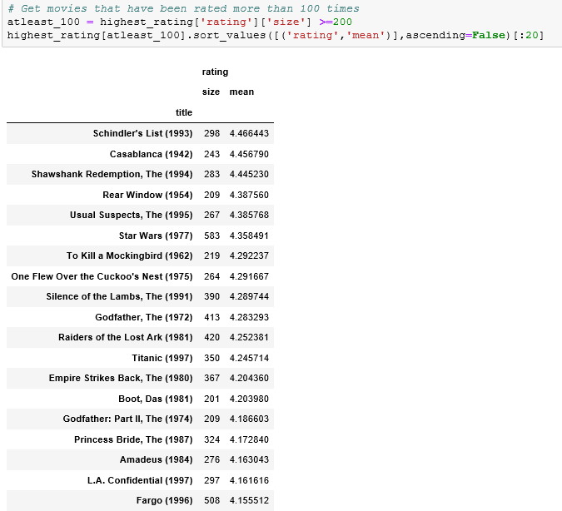
Most rated movie “Star Wars”
Highest rated movie “Schindler's List “

Slide 7
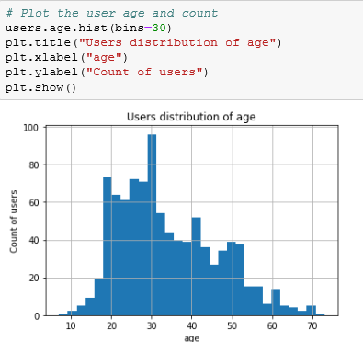
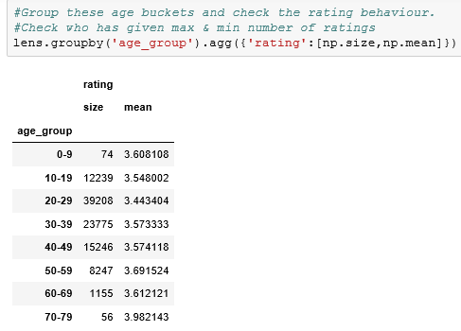

Slide 8
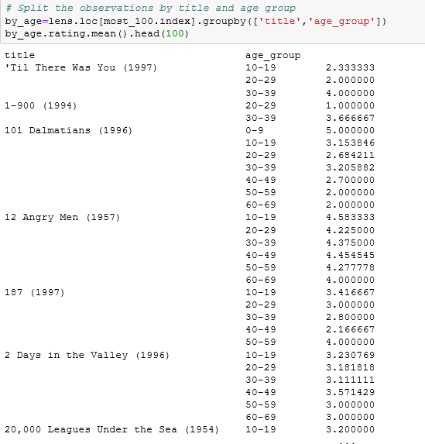
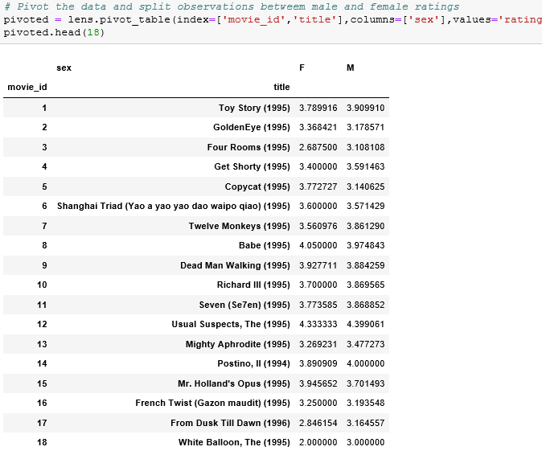

Slide 9
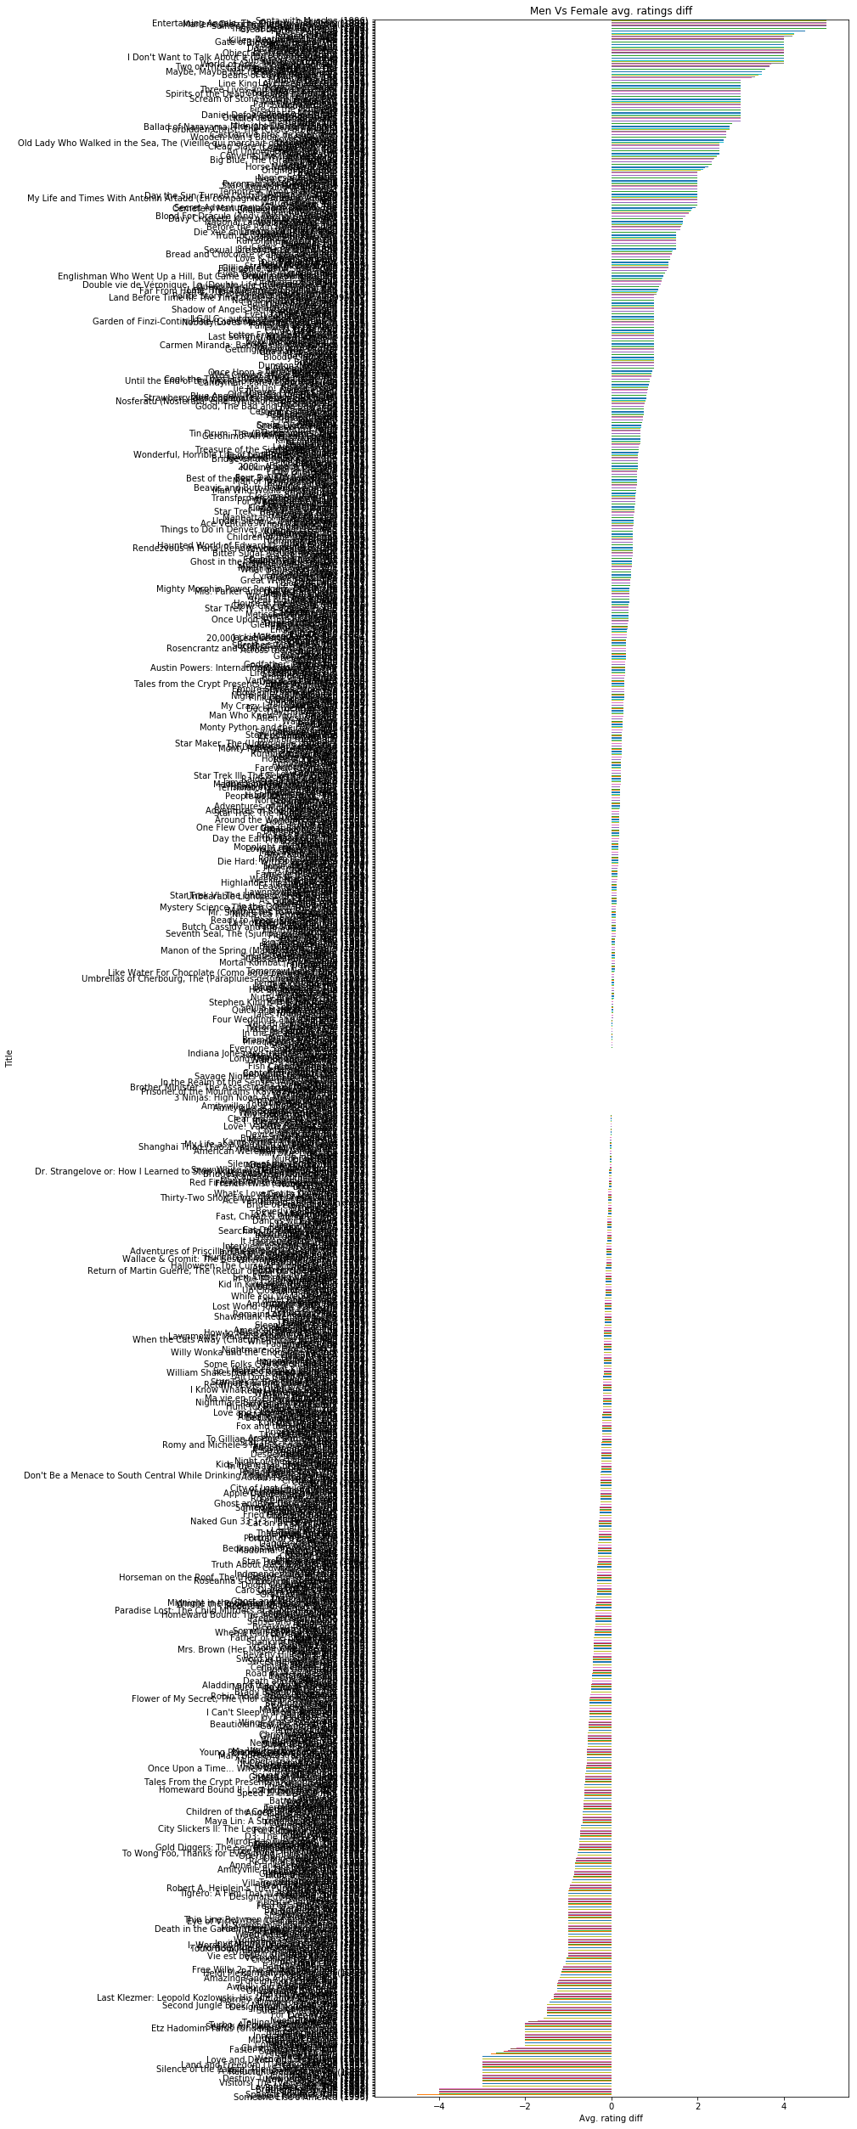
Plot the rating differences between male and female and check for ourselves for patterns
Above graph shows that left side moves most liked my Women and right side moves most liked by Men.
Middle set of movies liked by all genders.
diff_ratings.sort_values().plot(kind='barh',figsize=[10,45])
plt.title("Men Vs Female avg. ratings diff")
plt.ylabel('Title')
plt.xlabel('Avg. rating diff')

Slide 10
----- END -----

