Slide 1
Exploratory Data Analysis (Python)
- ON World TB

Slide 2
Aim of exploratory data analysis is to be able to get familiar with the data, perform data munging and manipulation, and ask questions before trying to forecast and run Machine Learning models on the data
Dataset: We take 3 data sets for all 207 countries for period from 1990 to 2007. we would using data files for TB Deaths, spread of TB, and number of new cases of TB to answer some important questions.
In any data analysis process, there is one or more questions we need to answer. That is the most basic and important step in the whole process, to define these questions. Since we are going to perform some Exploratory Data Analysis in our TB dataset, these are the questions we want to answer:
Which are the countries with the highest and infectious TB incidence?
What is the general world tendency in the period from 1990 to 2007?
What countries don't follow that tendency?
What other facts about the disease do we know that we can check with our data?
How can we help World Health Organization(WHO) to address the TB spread and reduce the TB death cases for each country?

Slide 3
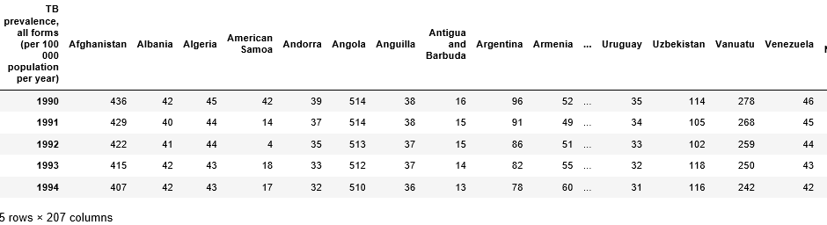
We download the data from below URLs:
tb_deaths_url_csv = 'https://docs.google.com/spreadsheets/d/12uWVH_IlmzJX_75bJ3IH5E-Gqx6-zfbDKNvZqYjUuso/pub?gid=0&output=CSV'
tb_existing_url_csv = 'https://docs.google.com/spreadsheets/d/1X5Jp7Q8pTs3KLJ5JBWKhncVACGsg5v4xu6badNs4C7I/pub?gid=0&output=csv'
tb_new_url_csv = 'https://docs.google.com/spreadsheets/d/1Pl51PcEGlO9Hp4Uh0x2_QM0xVb53p2UDBMPwcnSjFTk/pub?gid=0&output=csv’
Data is number of TB cases for 207 countries from 1990 to 2007 year as below.

Slide 4
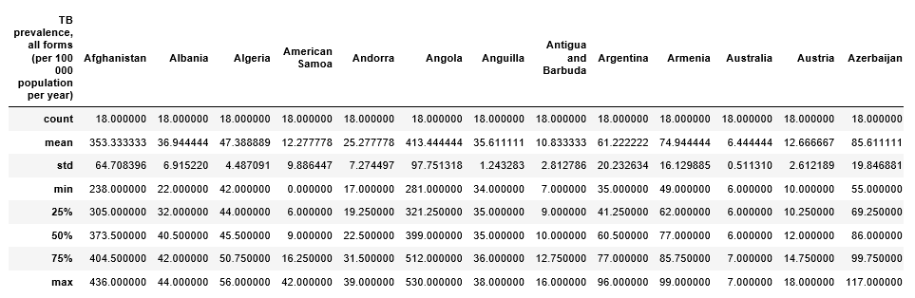
Existing data TB cases description as below:

Slide 5
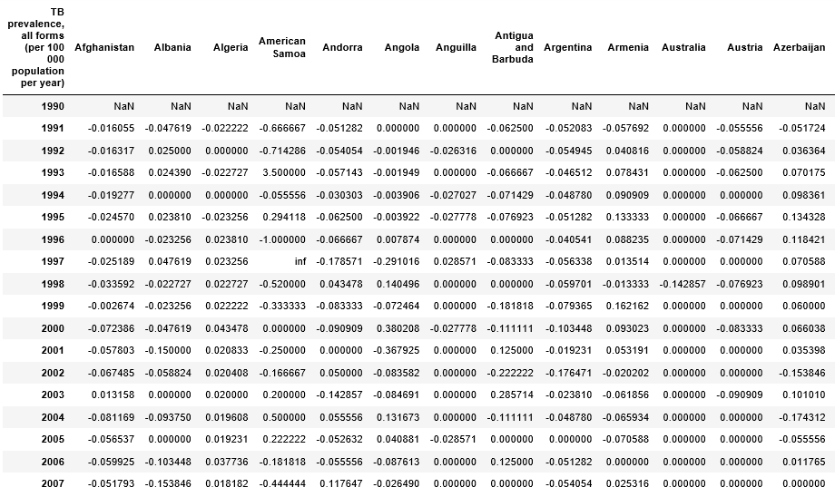
Check percentage change in existing cases over the years:

Slide 6
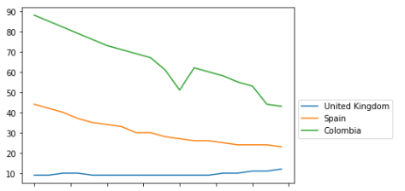
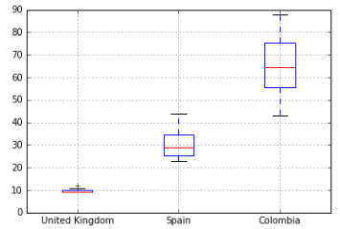
Lets check how existing TB cases for 'United Kingdom', 'Spain', 'Colombia’ from 1990 to 2007.
Colombia, no change over the years but bit increase in no of TB cases at 2006 and 2007.
Inter quartile rage is better compared to UK and Spain.
UK and Spain on the other side the no of exiting TB cases gradually decreasing and they are doing well.

Slide 7
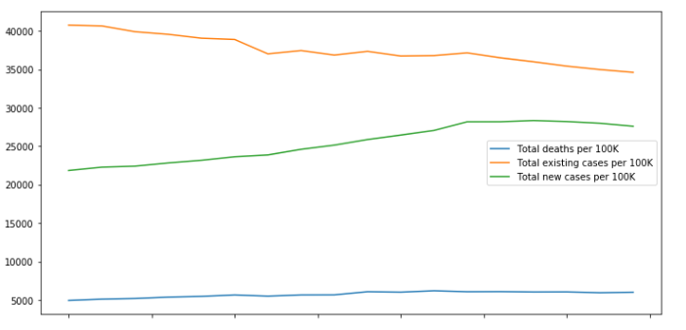
Below plot shows how total existing TB cases, new TB and TB deaths doing from 1990 to 2007 per 100k
Slight increase in TB deaths over years.
Noticeable increase in New TB cases
Decrease in total existing TB cases.

Slide 8
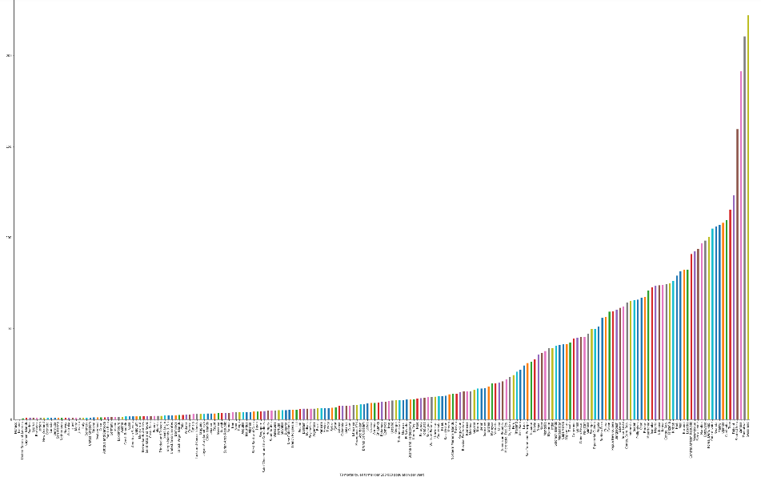
TB Deaths by country mean over all years for all 207 countries. It shows which country is poor and better doing

Slide 9
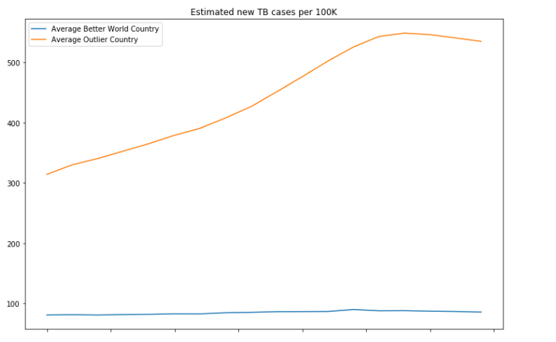
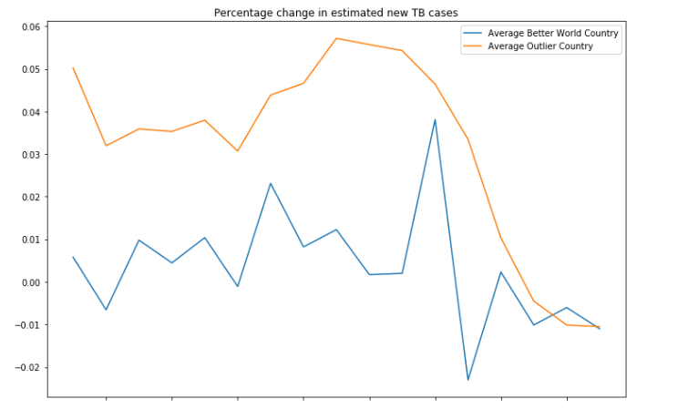
Average Outlier VS and Better doing Counties plot:

Slide 10
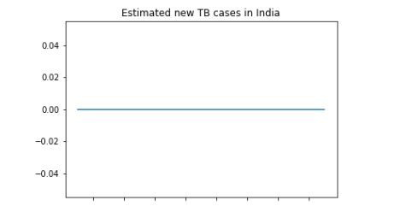
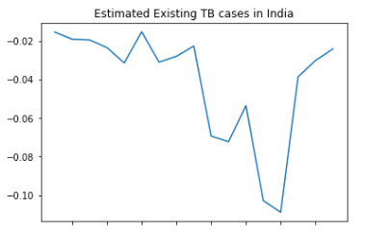
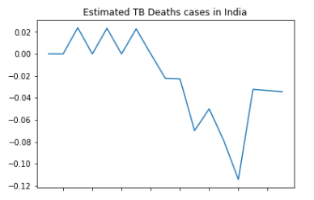
Estimated TB cases in India.

Slide 11
--END--

