Slide 1
Introduction to
(Demand) Forecasting

Slide 2
Topics
Introduction to (demand) forecasting
Overview of forecasting methods
A generic approach to quantitative forecasting
Time series-based forecasting
Building causal models through multiple linear regression
Confidence Intervals and their application in forecasting

Slide 3
Forecasting
The process of predicting the values of a certain quantity, Q, over a certain time horizon, T, based on past trends and/or a number of relevant factors.
Some forecasted quantities in manufacturing
  demand
  equipment and employee availability
  technological forecasts
  economic forecasts (e.g., inflation rates, exchange rates, housing starts, etc.)
The time horizon depends on
  the nature of the forecasted quantity
  the intended use of the forecast

Slide 4
Forecasting future demand
Demand forecasting is based on:
  extrapolating to the future past trends observed in the company sales;
  understanding the impact of various factors on the company future sales:
    market data
    strategic plans of the company
    technology trends
    social/economic/political factors
    environmental factors
    etc
Remark: The longer the forecasting horizon, the more crucial the impact of the factors listed above.

Slide 5
Demand Patterns
The observed demand is the cumulative result of:
  systematic variation, due to a number of identified factors, and
  a random component, incorporating all the remaining unaccounted effects.
Patterns of systematic variation
  seasonal: cyclical patterns related to the calendar (e.g., holidays, weather)
  cyclical: patterns related to changes of the market size, due to, e.g., economics and politics
  business: patterns related to changes in the company market share, due to e.g., marketing activity and competition
  product life cycle: patterns reflecting changes to the product life

Slide 6
The problem of demand forecasting
  Identify and characterize the systematic variation, as a set of trends.
  Characterize the variability in the demand.

Slide 7
Forecasting Methods
Qualitative (Subjective): Incorporate factors like the forecaster’s intuition, emotions, personal experience, and value system.
These methods include:
  Jury of executive opinion
  Sales force composites
  Delphi method
  Consumer market surveys

Slide 8
Forecasting Methods (cont.)
Quantitative (Objective): Employ one or more mathematical models that rely on historical data and/or causal/indicator variables to forecast demand.
Major methods include:
  time series methods: F(t+1) = f (D(t), D(t-1), …)
  causal models: F(t+1) = f(X1(t), X2(t), …)

Slide 9
Selecting a Forecasting Method
It should be based on the following considerations:
  Forecasting horizon (validity of extrapolating past data)
  Availability and quality of data
  Lead Times (time pressures)
  Cost of forecasting (understanding the value of forecasting accuracy)
  Forecasting flexibility (amenability of the model to revision; quite often, a trade-off between filtering out noise and the ability of the model to respond to abrupt and/or drastic changes)

Slide 10
Implementing Quantitative Forecasting
Determine Method
Time Series
Causal Model
Collect data:
<Ind.Vars; Obs. Dem.>
- Determine
functional form
- Estimate parameters
- Validate
Fit an analytical model
to the data:
F(t+1) = f(X1, X2,…)
Use the model for
forecasting future
demand
Update Model
Parameters
Monitor error:
e(t+1) = D(t+1)-F(t+1)
Yes
Model
Valid?
No

Slide 11

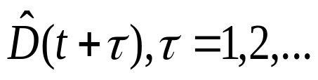
Time Series-based Forecasting
Basic Model:
Time Series
Model
Historical
Data
Forecasts
Remark: The exact model to be used depends on the expected /
observed trends in the data.
Cases typically considered:
Constant mean series
Series with linear trend
Series with seasonalities (and possibly a linear trend)

Slide 12
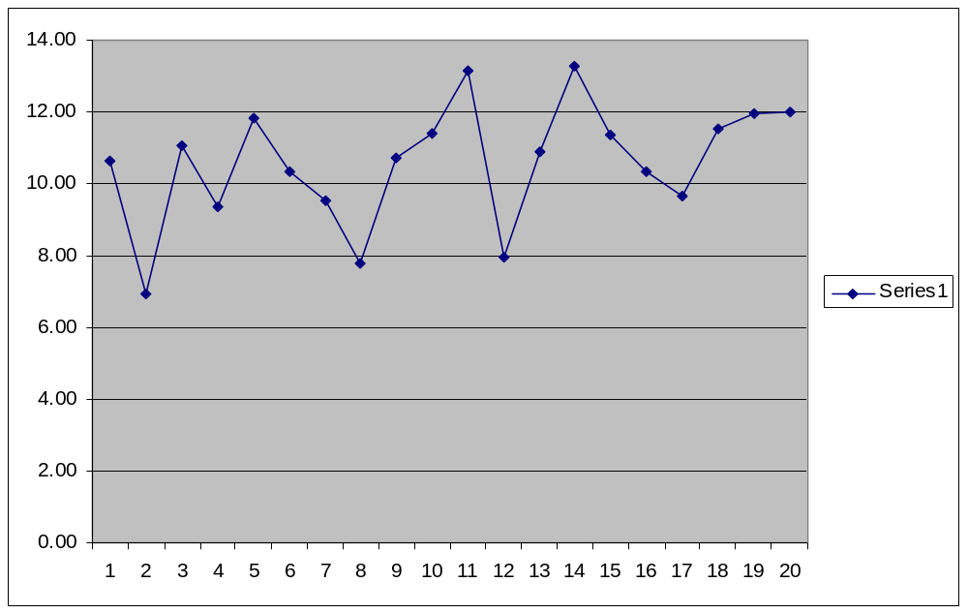
A constant mean series
The above data points have been sampled from a normal distribution with a mean value equal to 10.0 and a variance equal to 4.0.

Slide 13
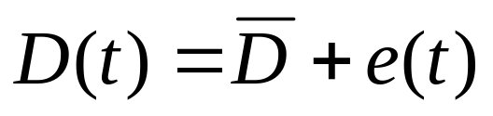



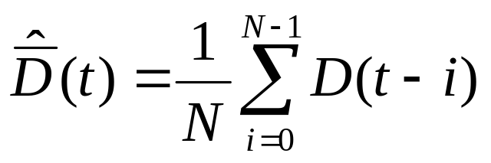
Forecasting constant mean series:
The Moving Average model
The presumed model for the observed data:
where
is the constant mean of the series and
is normally distributed with zero mean and some unknown
variance
Then, under a Moving Average of Order N model, denoted as MA(N),
the estimate of returned at period t, is equal to:

Slide 14
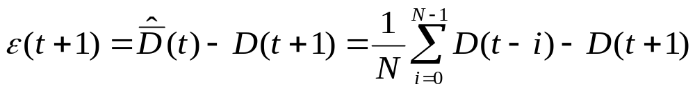
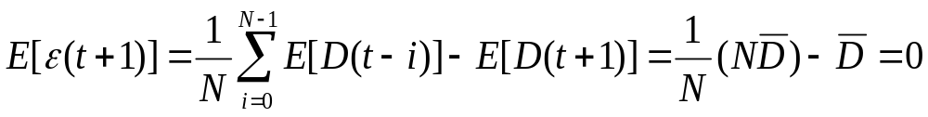
The forecasting error
The forecasting error
Also

Slide 15

Forecasting error (cont.)
ε(t+1) is normally distributed with the mean and variance computed in the previous slide.
follows a normal distribution with zero mean and variance σ²/N.

Slide 16
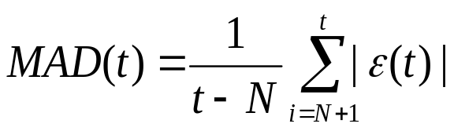
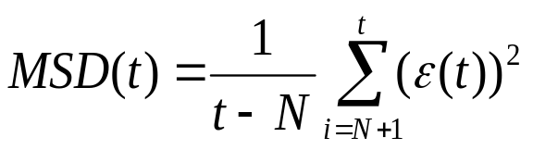
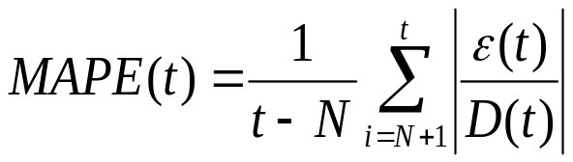
Selecting an appropriate order N
Smaller values of N provide more flexibility.
Larger values of N provide more accuracy (c.f., the formula for the variance of the forecasting error).
Hence, the more stable (stationary) the process, the larger the N.
In practice, N is selected through trial and error, such that it minimizes one of the following criteria:
i)
ii)
iii)

Slide 17
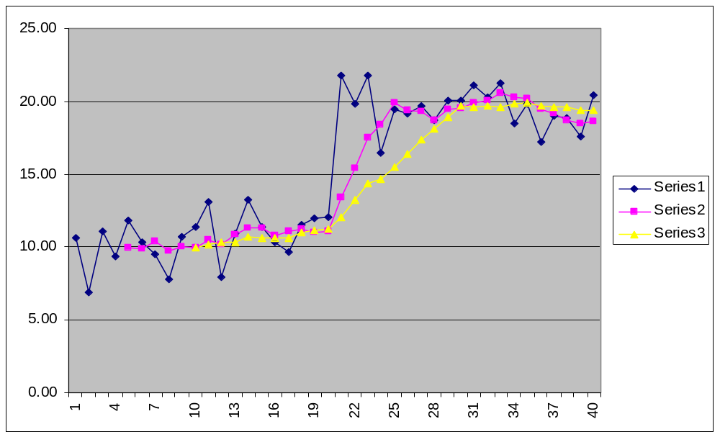
Demonstrating the impact of N on the model performance
blue series: the original data series, distributed according to N(10,4) for the first 20 points, and N(20,4) for the last 20 points.
magenta series: the predictions of the MA(5) forecasting model.
yellow series: the predictions of the MA(10) forecasting model.
Remark: the MA(5) model adjusts faster to the experienced jump of the data mean value, but the mean estimates that it provides under stationary operation are less accurate than those provided by the MA(10) model.

Slide 18
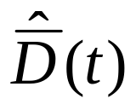
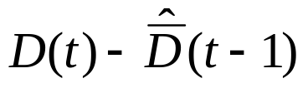
Forecasting constant mean series:
The Simple Exponential Smoothing model
The presumed demand model:
where is an unknown constant and is normally distributed with zero mean and an unknown variance .
The forecast , at the end of period t:
where α∈(0,1) is known as the “smoothing constant”.
Remark: The updating equation constitutes a correction of the previous estimate in the direction suggested by the forecasting error,

Slide 19
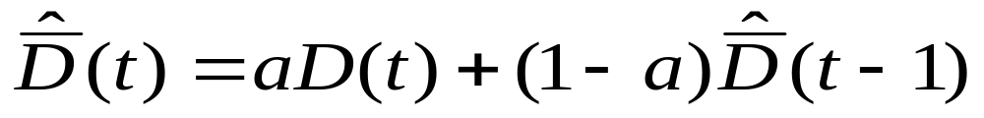
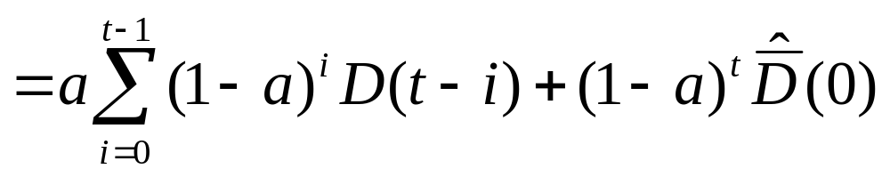
Expanding the Model Recursion
.................................................................................................

Slide 20
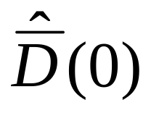
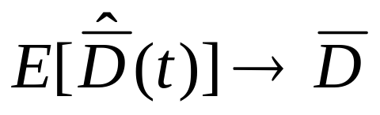
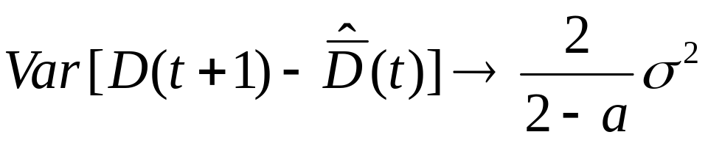
Implications
1. The model considers all the past observations and the initializing value in the determination of the estimate .
2. The weight of the various data points decreases exponentially with their age.
3. As α→1, the model places more emphasis on the most recent observations.
4. As t→∞,
and

Slide 21
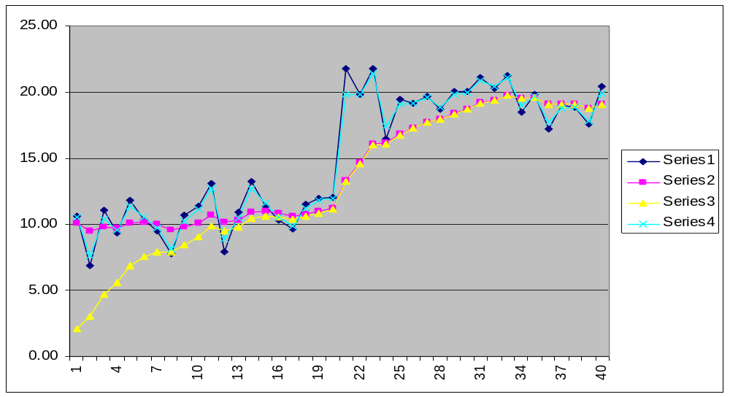
The impact of α and of on the model performance
dark blue series: the original data series, distributed according to N(10,4) for the first 20 points, and N(20,4) for the last 20 points.
magenta series: the predictions of the ES(0.2) model initialized at the value of 10.0.
yellow series: the predictions of the ES(0.2) model initialized as 0.0.
light blue series: the predictions of the ES(0.8) model initialized at 10.0.
Remark: the ES(0.8) model adjusts faster to the jump of the series mean value, but the estimates that it provides under stationary operation are less accurate than those provided by the ES(0.2) model. Also, notice that the effect of the initial value is only transient.

Slide 22
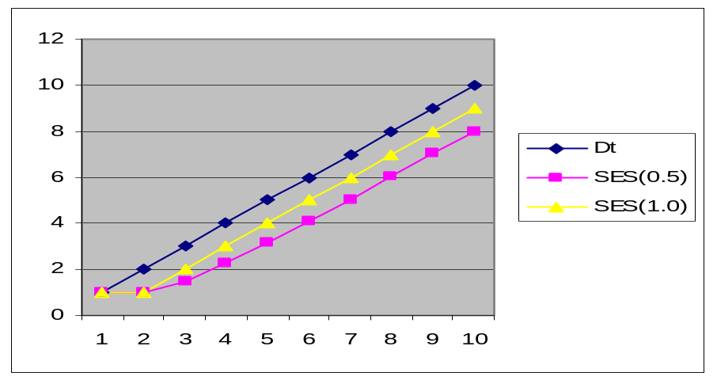
The inadequacy of SES and MA models for data with linear trends
blue series: a deterministic data series increasing linearly with a slope of 1.0.
magenta series: the predictions obtained from the SES(0.5) model initialized at the exact value of 1.0.
yellow series: the predictions obtained from the SES(1.0) model initialized at the exact value of 1.0.
Remark: Both models under-estimate the actual values, with the most inert model SES(0.5) under-estimating the most. This should be expected since both of these models (as well as any MA model) essentially average the past observations. Therefore, neither the MA nor the SES model are appropriate for forecasting a data series with a linear trend in it.

Slide 23
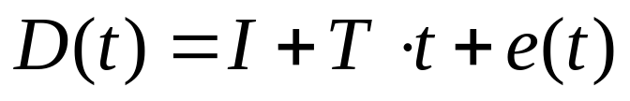

Forecasting series with linear trend:
The Double Exponential Smoothing Model
The presumed data model:
where
is the model intercept, i.e., the unknown mean value for t=0,
T is the model trend, i.e., the mean increase per unit of time, and
is normally distributed with zero mean and some unknown
variance

Slide 24
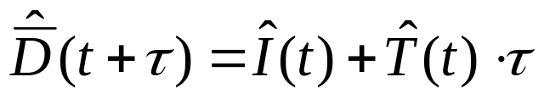
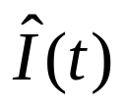
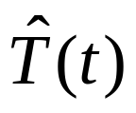
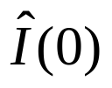
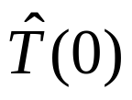
The Double Exponential Smoothing Model (cont.)
The model forecasts at period t for periods t+τ, τ=1,2,…, are
given by:
with the quantities and obtained through the following recursions:
The parameters a and β take values in the interval (0,1) and are the model smoothing constants, while the values and are the initializing values.

Slide 25
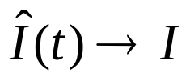
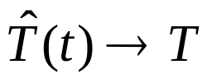

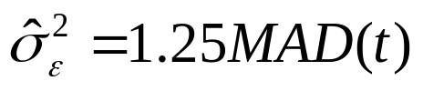
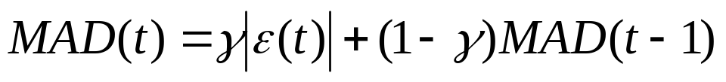
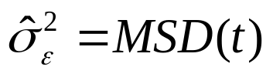
The Double Exponential Smoothing Model (cont.)
The smoothing constants are chosen by trial and error, using the MAD, MSD and/or MAPE indices.
For t→∞, and
The variance of the forecasting error, , can be estimated as a function of the noise variance σ² through techniques similar to those used in the case of the Simple Exp. Smoothing model, but in practice, it is frequently approximated by
where
for some appropriately selected smoothing constant γ∈(0,1) or by

Slide 26
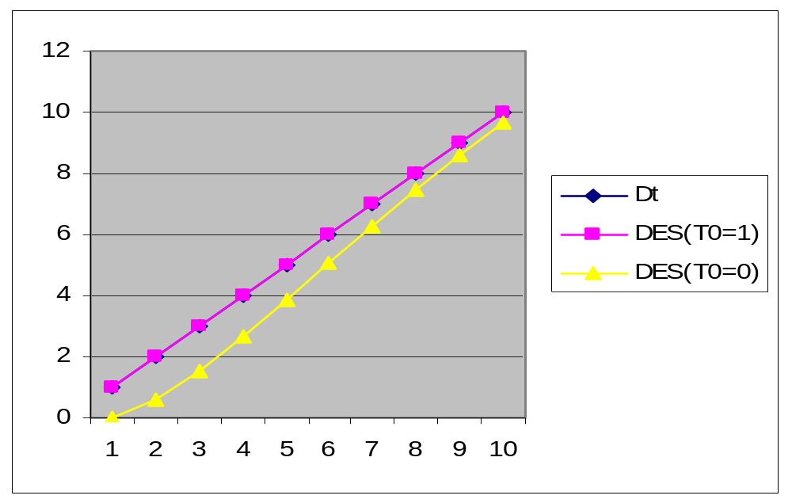
DES Example
blue series: a deterministic data series increasing linearly with a slope of 1.0.
magenta series: the predictions obtained from the DES(0.5;0.2) model initialized at the exact value of 1.0.
yellow series: the predictions obtained from the DES(0.5;0.2) model initialized at the value of 0.0.
Remark: In the absence of variability in the original data, the first model is completely accurate (the blue and the magenta series overlap completely), while the second model overcomes the deficiency of the wrong initial estimate and eventually converges to the correct values.

Slide 27
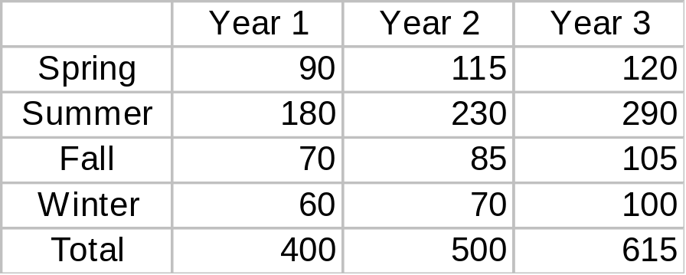
Time Series-based Forecasting:
Accommodating seasonal behavior
The data demonstrate a periodic behavior (and maybe some additional linear trend).
Example: Consider the following data, describing a quarterly demand over the last 3 years, in 1000’s:

Slide 28
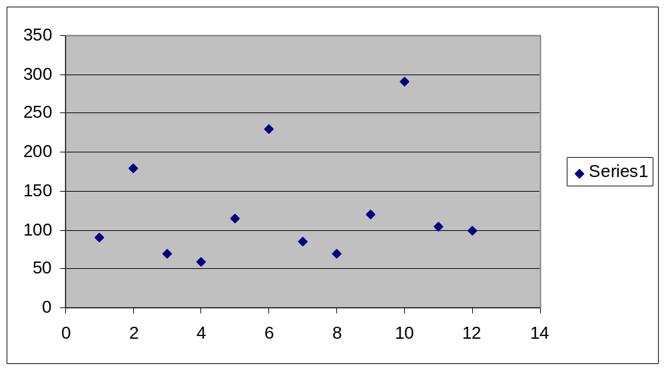
Seasonal Indices
Plotting the demand data:
Remarks:
At each cycle, the demand of a particular season is a fairly stable percentage of the total demand over the cycle.
Hence, the ratio of a seasonal demand to the average seasonal demand of the corresponding cycle will be fairly constant.
This ratio is characterized as the corresponding seasonal index.

Slide 29
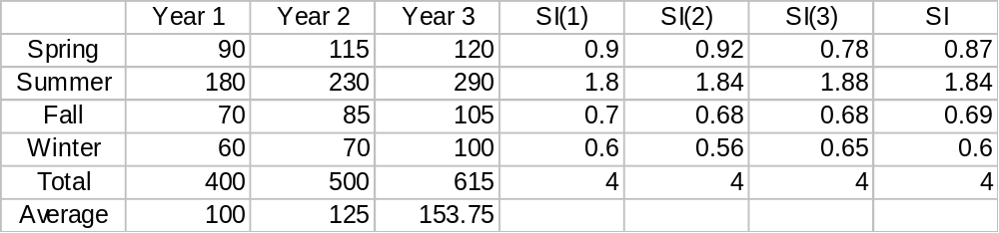
A forecasting methodology
Forecasts for the seasonal demand for subsequent years can be obtained by:
estimating the seasonal indices corresponding to the various seasons in the cycle;
estimating the average seasonal demand for the considered cycle (using, for instance, a forecasting model for a series with constant mean or linear trend, depending on the situation);
adjusting the average seasonal demand by multiplying it with the corresponding seasonal index.
Example (cont.):

Slide 30
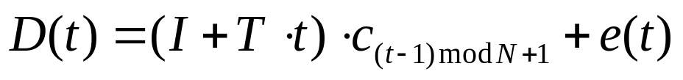
Winter’s Method for Seasonal Forecasting
The presumed model for the observed data:
where
N denotes the number of seasons in a cycle;
c_{i}, i=1,2,…N, is the seasonal index for the i-th season in the cycle;
I is the intercept for the de-seasonalized series obtained by dividing the original demand series with the corresponding seasonal indices;
T is the trend of the de-seasonalized series;
e(t) is normally distributed with zero mean and some unknown variance

Slide 31
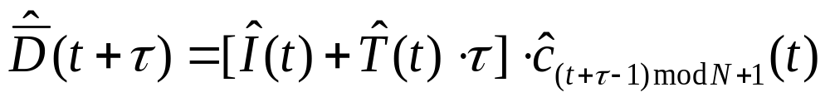

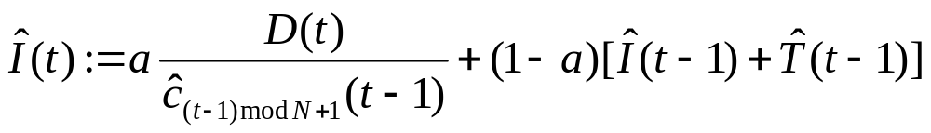
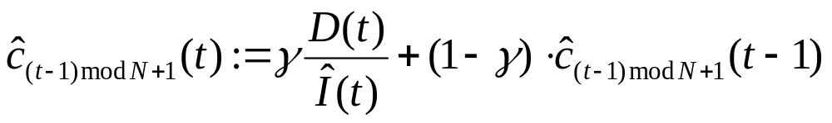



Winter’s Method for Seasonal Forecasting (cont.)
The model forecasts at period t for periods t+τ, τ=1,2,…, are given by:
where the quantities , and are obtained from the following recursions, performed in the indicated sequence:
The parameters α, β, γ take values in the interval (0,1) and are the model smoothing constants, while and are the initializing values.

Slide 32



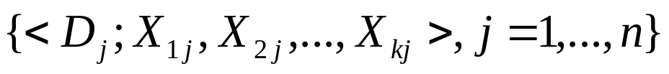
Causal Models:
Multiple Linear Regression
The basic model:
where
X_{i}, i=1,…,k, are the model independent variables (otherwise known as the explanatory variables);
b_{i}, i=0,…,k, are unknown model parameters;
e is the a random variable following a normal distribution with zero mean and some unknown variance σ².
D follows a normal distribution where
We need to estimate <b₀,b₁,…,b_{k}> and σ² from a set of n observations

Slide 33
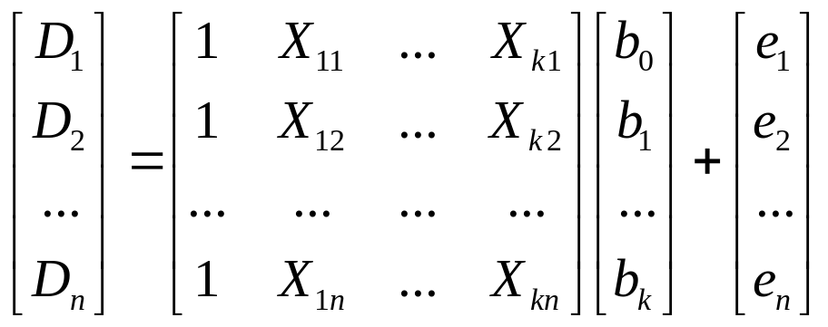




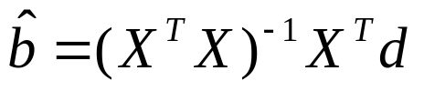

Estimating the parameters b_{i}
The observed data satisfy the following equation:
or in a more concise form
The vector
denotes the difference between the actual observations and the corresponding mean values, and therefore, is selected such that it minimizes the Euclidean norm of the resulting vector .
The minimizing value for is equal to
The necessary and sufficient condition for the existence of is that the columns of matrix X are linearly independent.

Slide 34
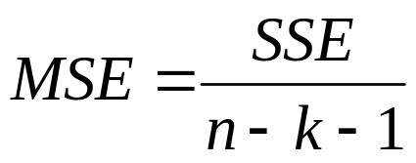
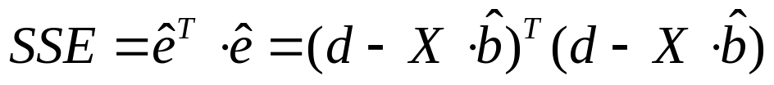

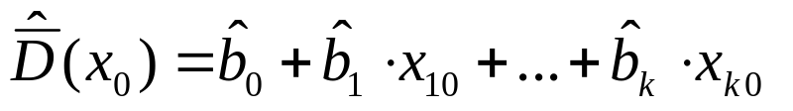




Characterizing the model variance
An unbiased estimate of σ² is given by
(Mean Squared Error)
where
(Sum of Squared Errors)
The quantity SSE/σ² follows a Chi-square distribution with n-k-1 degrees of freedom.
Given a point x₀^{T}=(1,x₁₀,…,x_{k0}), an unbiased estimator of is given by
This estimator is normally distributed with mean and variance
The random variable can function also as an estimator for any single observation D(x₀). The resulting error will have zero mean and variance

Slide 35
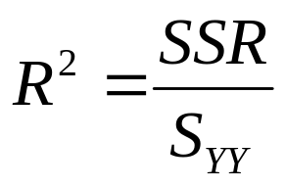
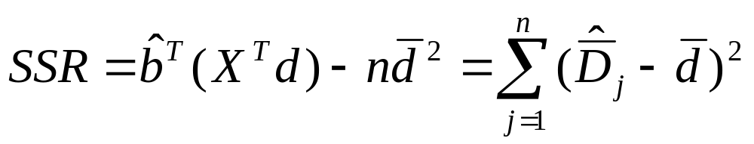
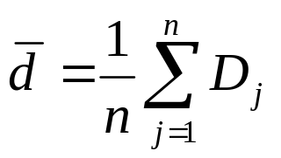
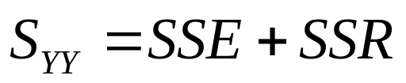
Assessing the goodness of fit
A rigorous characterization of the quality of the resulting approximation can be obtained through Analysis of Variance, that can be traced in any introductory book on statistics.
A more empirical test considers the coefficient of multiple determination
where
and
Remark: A natural way to interpret R² is as the fraction of the variability in the observed data interpreted by the model over the total variability in this data.

Slide 36
Multiple Linear Regression and
Time Series-based forecasting
The model needs to be linear with respect to the parameters b_{i} but not the explanatory variables X_{i}. Hence, the factor multiplying the parameter b_{i} can be any function f_{i} of the underlying explanatory variables.
When the only explanatory variable is just the time variable t, the resulting multiple linear regression model essentially supports time-series analysis.
The above approach for time-series analysis enables the study of more complex dependencies on time than those addressed by the moving average and exponential smoothing models.
The integration of a new observation in multiple linear regression models is much more cumbersome than the updating performed by the moving average and exponential smoothing models (although there is an incremental linear regression model that alleviates this problem).

Slide 37

Confidence Intervals
Given a random variable X and p∈(0,1), a p⋅100% confidence interval (CI) for it is an interval [a,b] such that
• Confidence intervals are used in:
monitoring the performance of the applied forecasting model;
adjusting an obtained forecast in order to achieve a certain performance level
The necessary confidence intervals are obtained by exploiting the statistics for the forecasting error, derived in the previous slides.

Slide 38
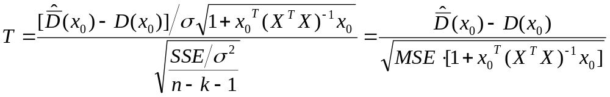
Variance estimation and the t distribution
The variance of the forecasting error is a function of the unknown variance,
σ², of the model disturbance, e.
E.g., in the case of multiple linear regression, the variance of the forecasting error is equal to .
Hence, one cannot take advantage directly of the normality of the forecasting error in order to build the sought confidence intervals.
This problem can be circumvented by exploiting the fact that the quantity SSE/σ² follows a Chi-square distribution with n-k-1 degrees of freedom.
Then, the quantity
follows a t distribution with n-k-1 degrees of freedom.
For large samples, T can also be approximated by a standardized normal distribution.

Slide 39
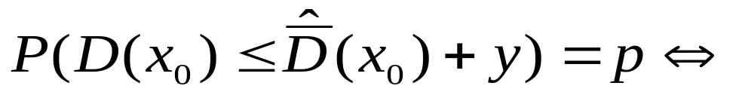



Adjusting the forecasted demand in order to achieve a target service level p
Letting y denote the required adjustment, we essentially need to solve the following equation:
Remark: The two-sided confidence interval that is necessary for monitoring the model performance can be obtained through a straightforward modification of the above reasoning.

