Slide 1
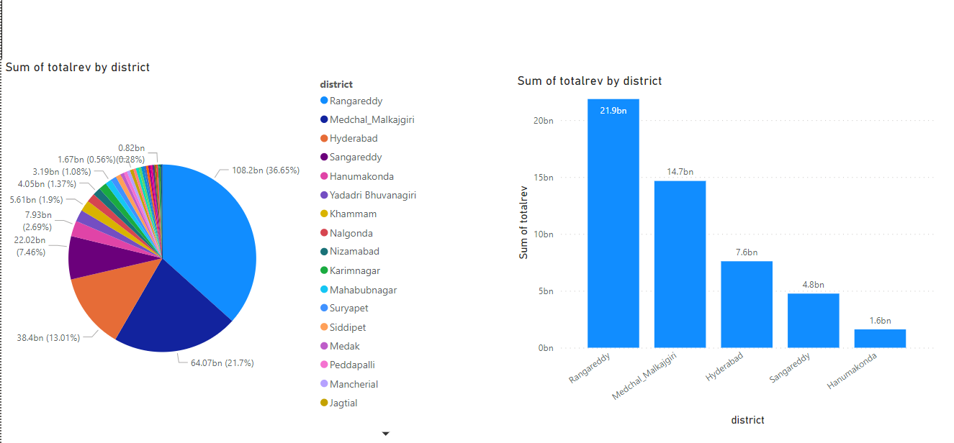
How does the revenue generated from document registration vary across districts in Telangana?
List down the top 5 districts that showed the highest document registration revenue growth between FY 2019 and 2022.

Slide 2
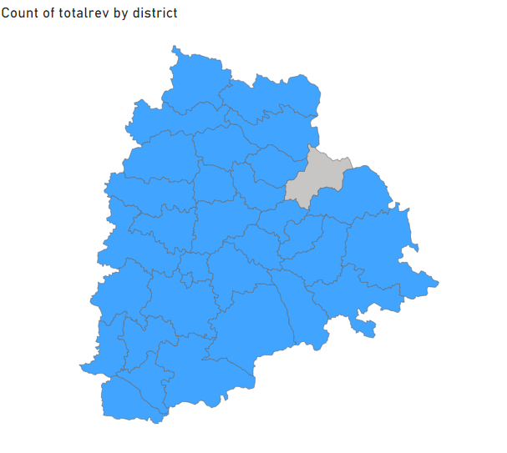

Slide 3
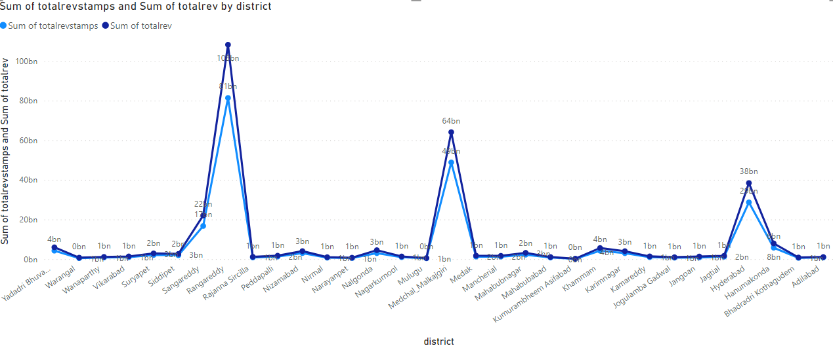
How does the revenue generated from document registration compare
to the revenue generated from e-stamp challans across districts?

Slide 4
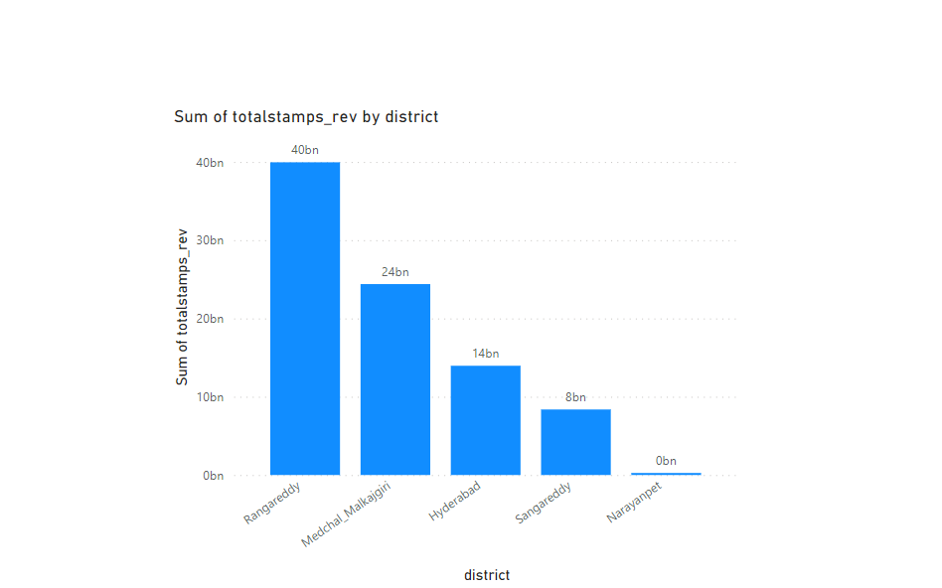
List down the top 5 districts where e-stamps revenue contributes significantly more to the revenue than the
documents in FY 2022?

Slide 5
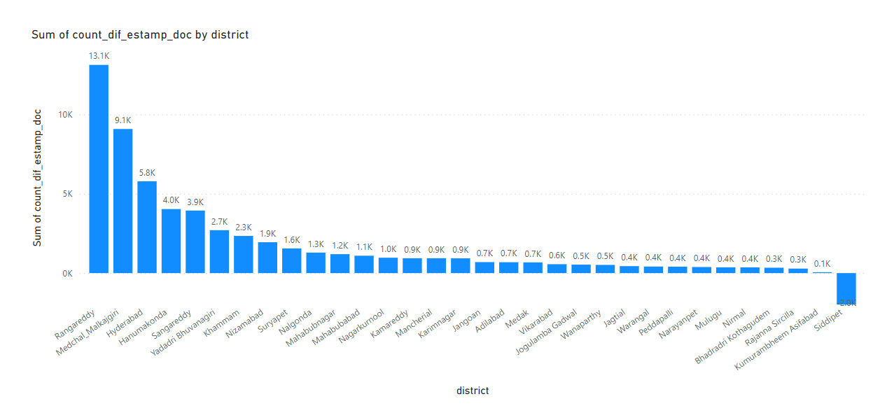
Is there any alteration of e-Stamp challan count and document registration count pattern since the implementation
of e-Stamp challan ? If so, what suggestions would you propose to the government?

Slide 6
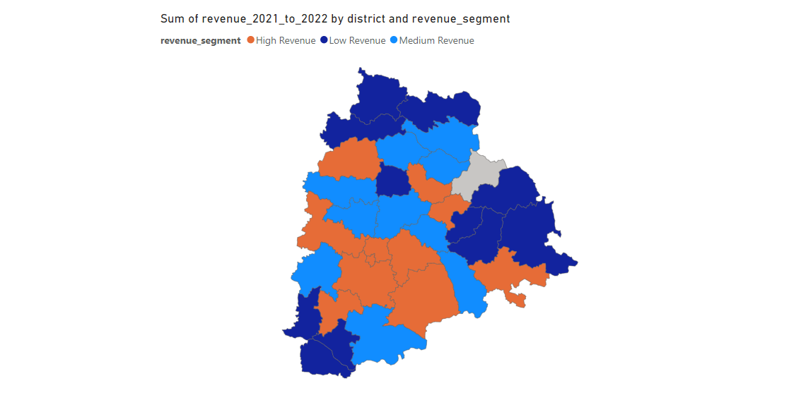
Categorize districts into three segments based on their stamp registration revenue generation during the
fiscal year 2021 to 2022

Slide 7
High Revenue
Rangareddy
Medchal_Malkajgiri
Hyderabad
Sangareddy
Hanumakonda
Khammam
Yadadri Bhuvanagiri
Nalgonda
Nizamabad
Karimnagar
Mahabubnagar
Medium Revenue
Suryapet
Siddipet
Peddapalli
Medak
Mancherial
Jagtial
Nagarkurnool
Vikarabad
Kamareddy
Jangoan
Low Revenue
Rajanna Sircilla
Adilabad
Mahabubabad
Jogulamba Gadwal
Nirmal
Bhadradri Kothagudem
Warangal
Narayanpet
Mulugu
Kumurambheem Asifabad
Wanaparthy

Slide 8
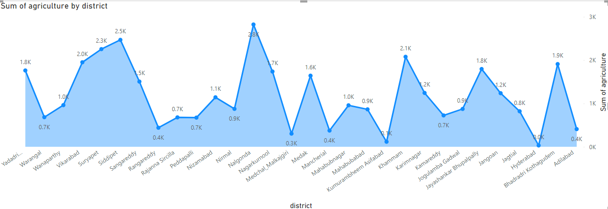
How does the distribution of vehicles vary by vehicle class (MotorCycle, MotorCar, AutoRickshaw, Agriculture) across
different districts? Are there any districts with a predominant preference for a specific vehicle class?
Consider FY 2022 for analysis.

Slide 9
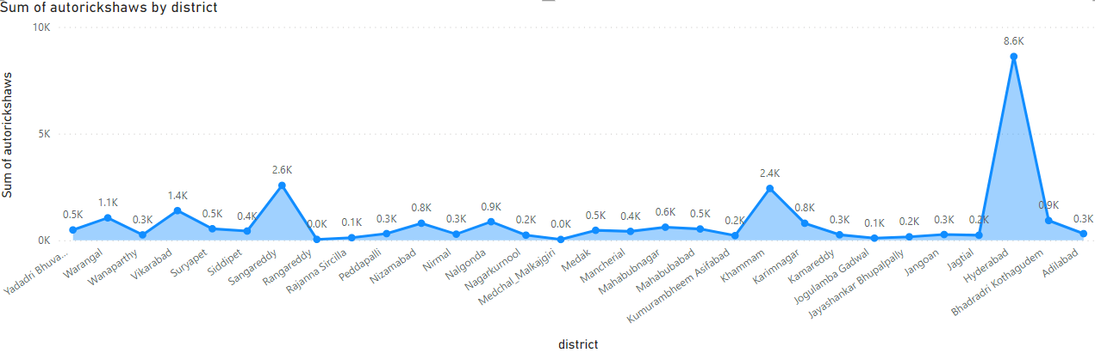
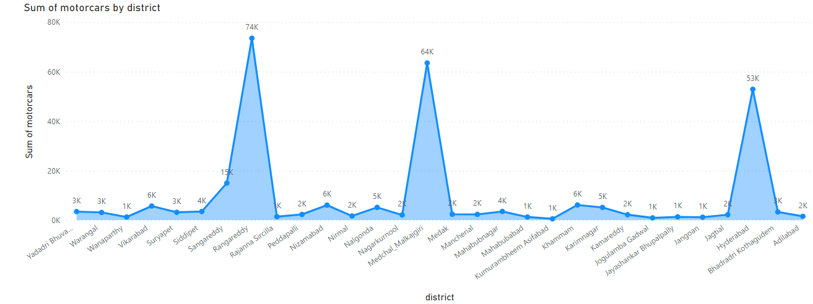

Slide 10
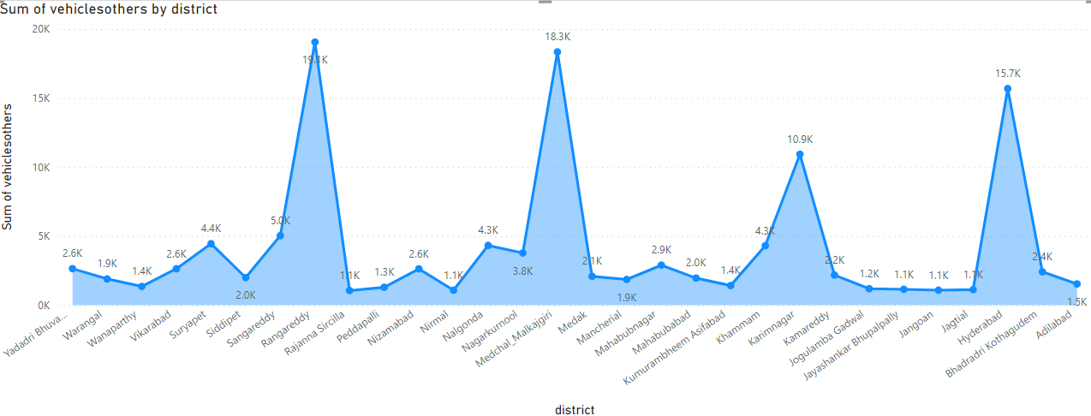
Districts with highest no of sales in different categories
Motorcycle - Rangareddy
Motorcar - Rangareddy
Auto Rickshaw - Hyderabad
Agriculture - Nalgonda

Slide 11
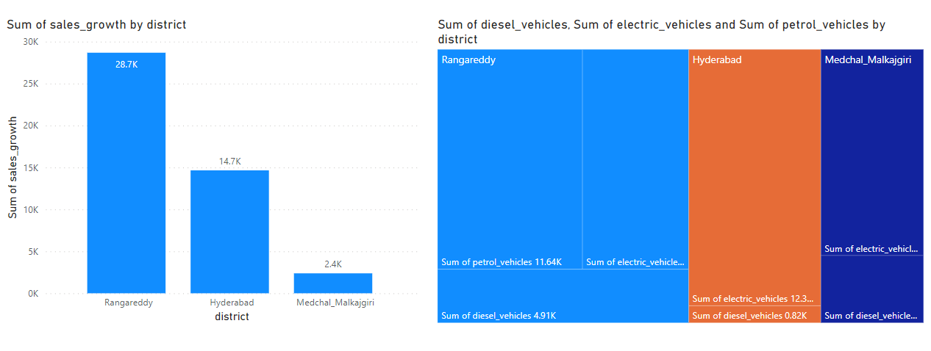
List down the top 3 districts that have shown the highest and lowest vehicle sales growth
during FY 2022 compared to FY 2021?

Slide 12
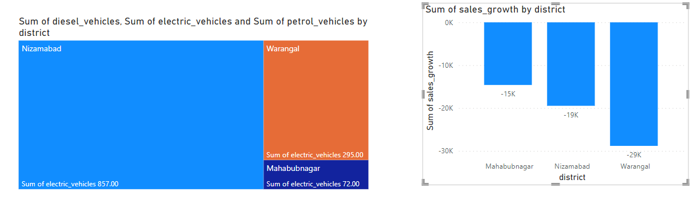
List down the bottom 3 districts that have shown the highest and lowest vehicle sales growth during FY 2022 compared to FY 2021?

Slide 13
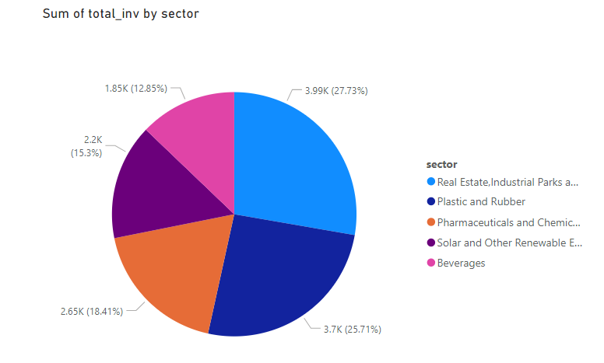
List down the top 5 sectors that have witnessed the most significant investments in FY 2022.

Slide 14
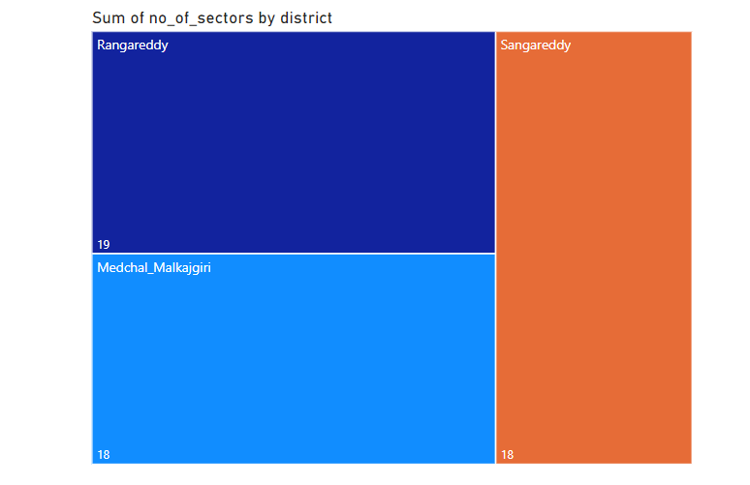
List down the top 3 districts that have attracted the most significant sector investments during FY 2019 to 2022? What factors
could have led to the substantial investments in these particular districts?

Slide 15
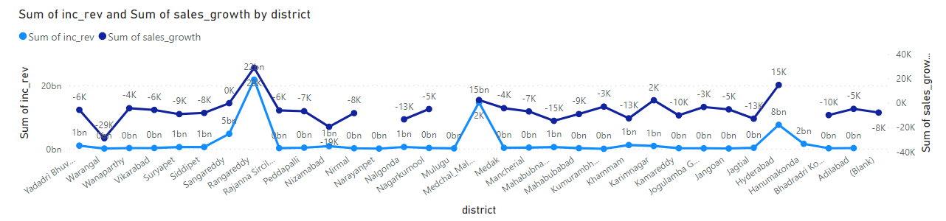
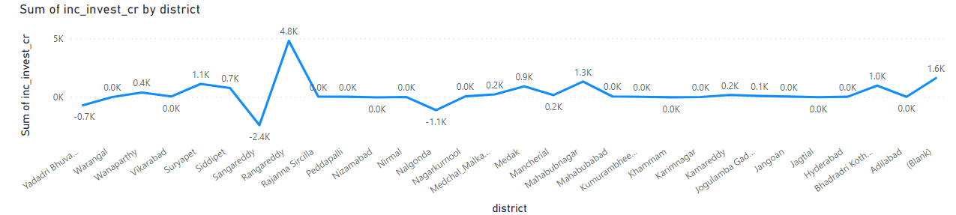
Is there any relationship between district investments, vehicles sales and stamps revenue within the same district between FY
2021 and 2022?

Slide 16
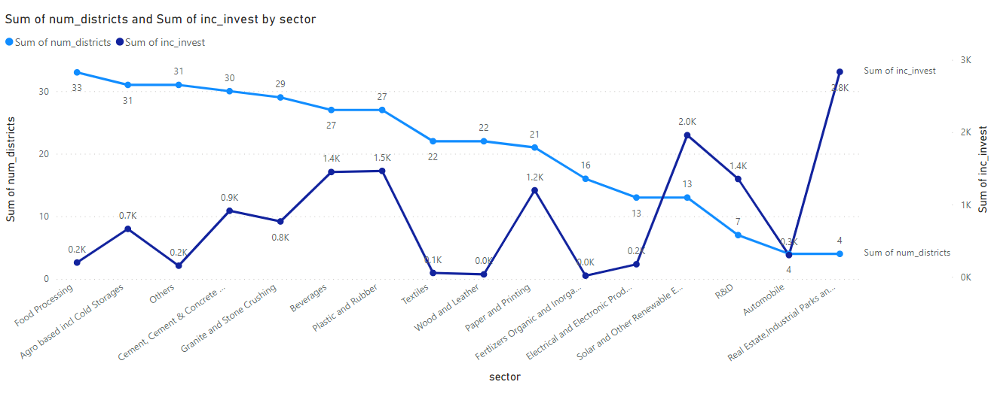
Are there any particular sectors that have shown substantial investment in multiple districts between FY 2021 and 2022?

Slide 17
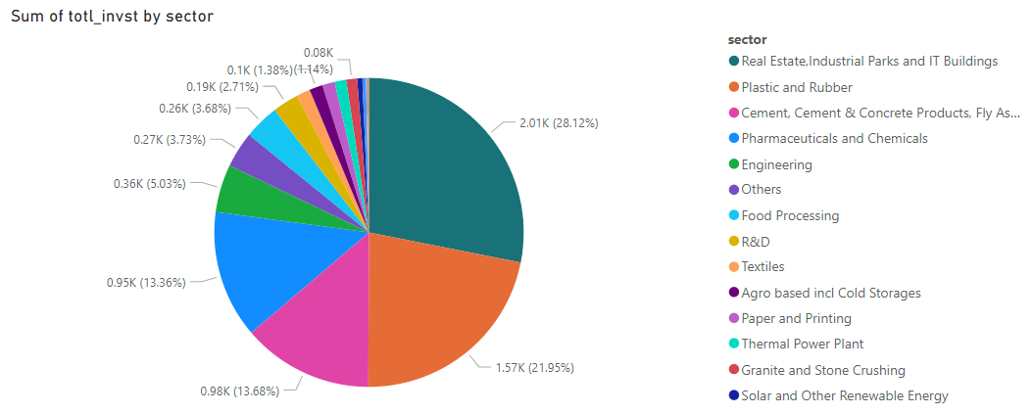
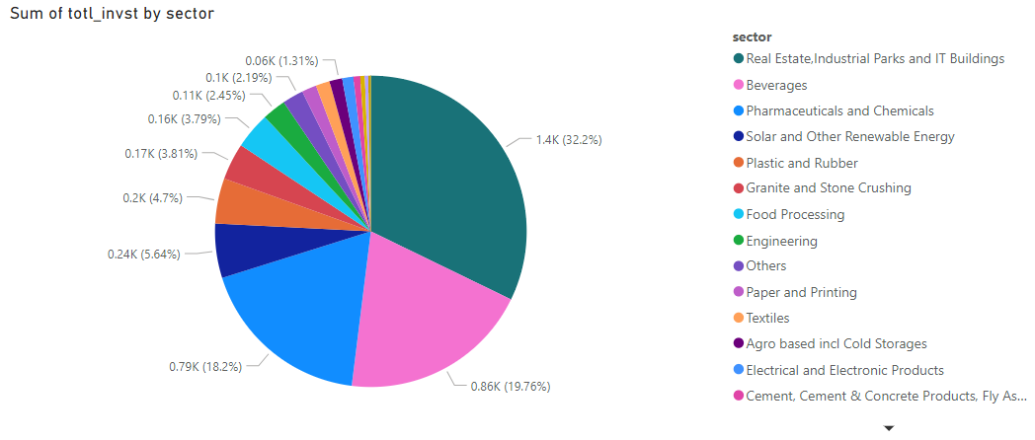
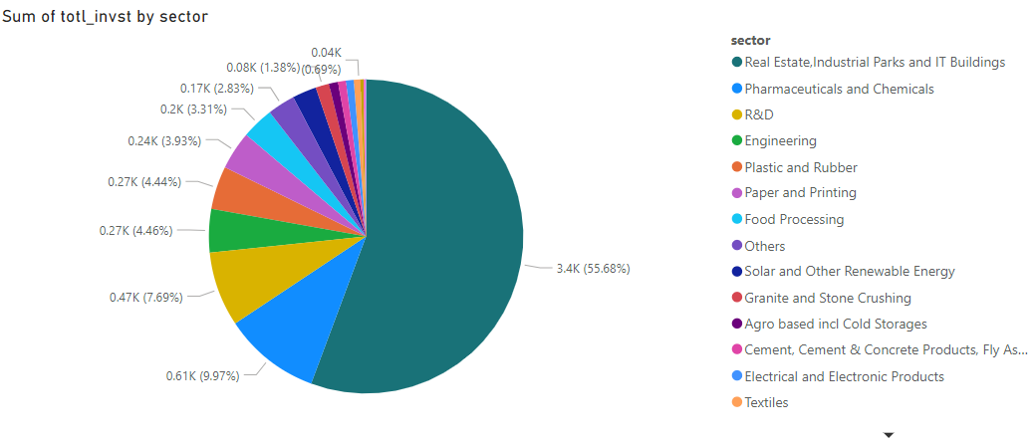
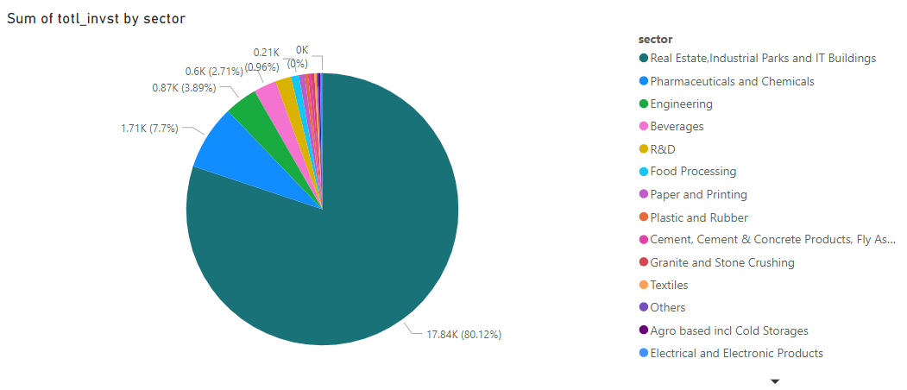
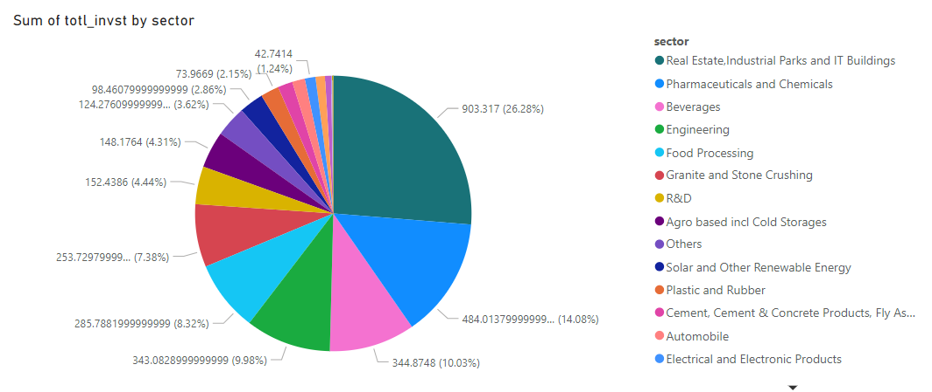
Can we identify any seasonal patterns or cyclicality in the investment trends for specific sectors? Do certain sectors
experience higher investments during particular months?
Real Estate, Industrial Parks and IT Buildings
January - 1397.17 cr
February - 17843.3508 cr
March - 3398.9959 cr
May - 903.317 cr
August - 2007.67 cr

Slide 18
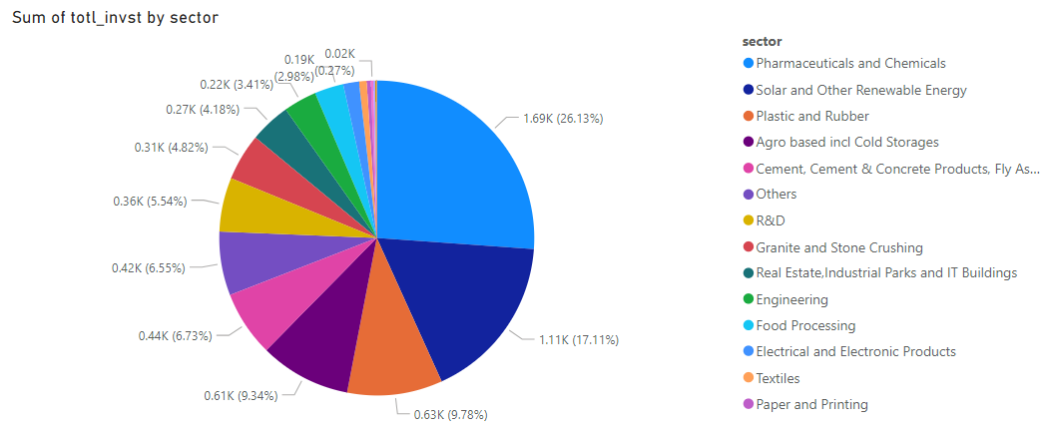
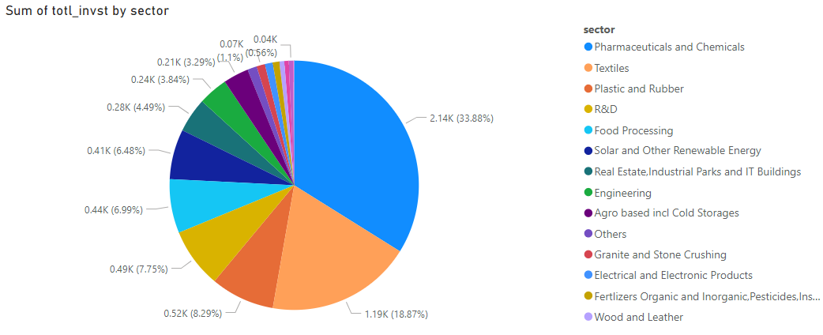
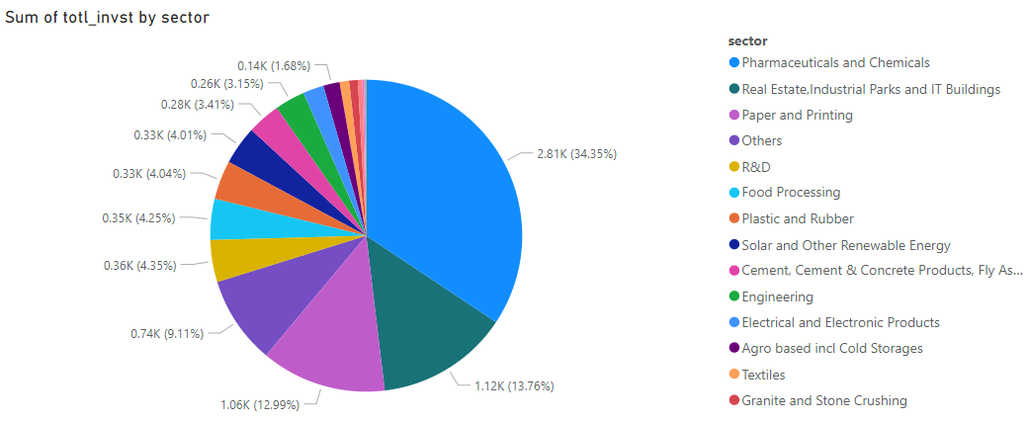
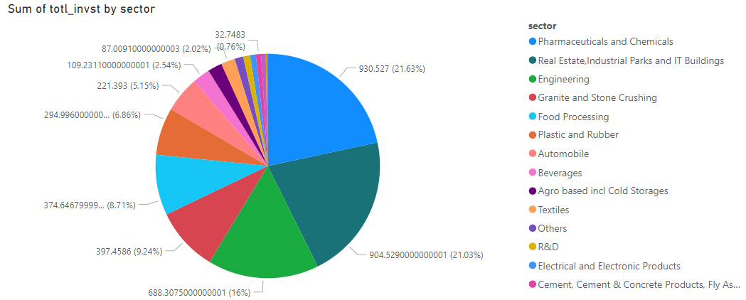
Pharmaceuticals and Chemicals
June
July
September
October

Slide 19
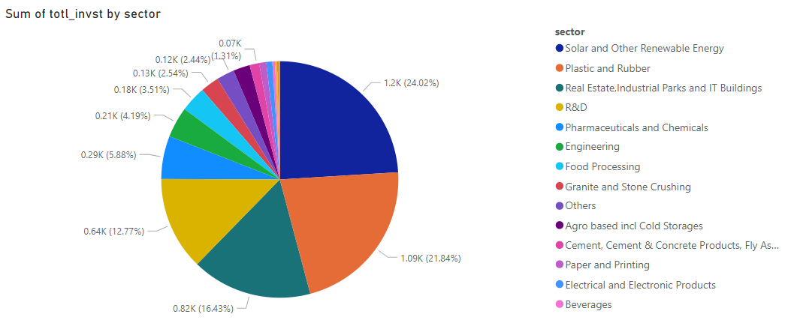
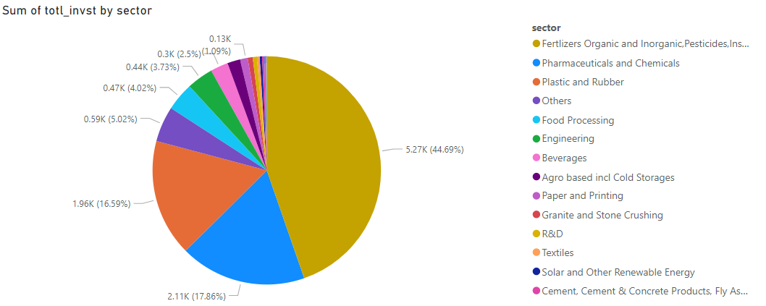
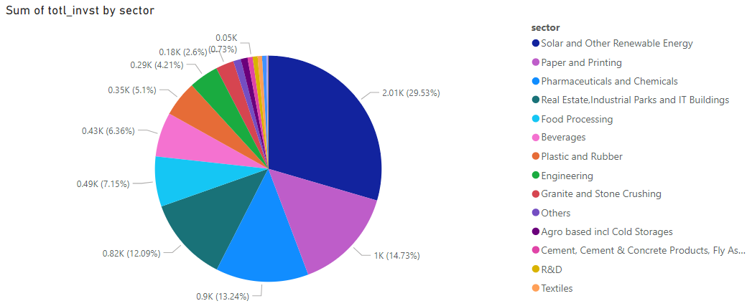
Fertilizers Organic and Inorganic,Pesticides,Insecticides, and Other Related
December
Solar and Other Renewable Energy
April
November

