Slide 1
Portfolio
Gaoxiang Zhao
For application to the Dartmouth MSDA program

Slide 2
Table of Contents
01
Ring Caustics
03
My Wallpaper
02
Diffraction
04
Interior Design

Slide 3
Ring Caustics
01

Slide 4
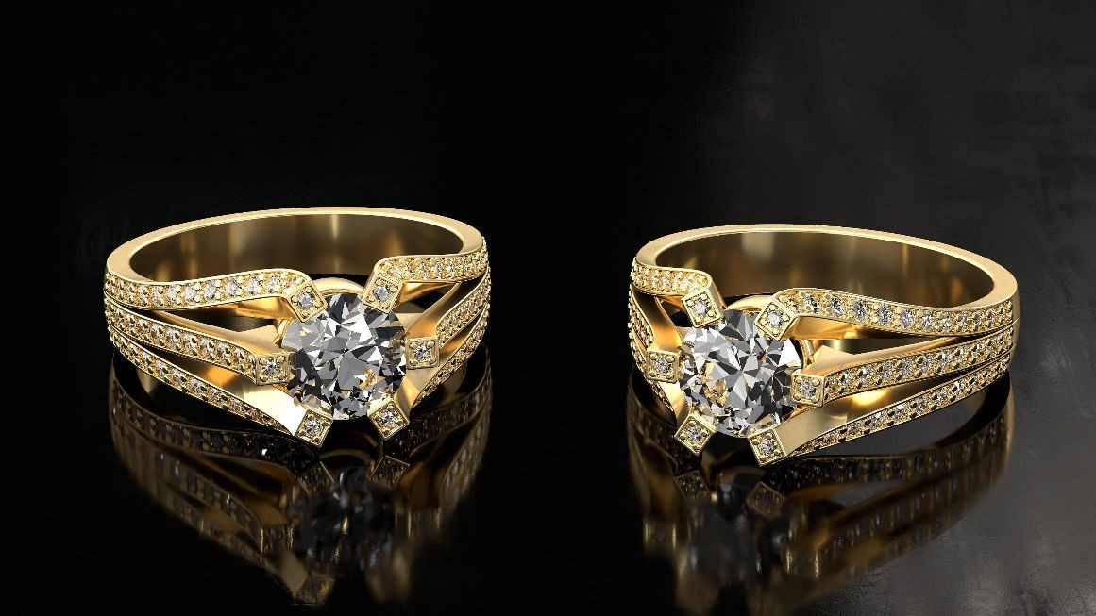
Rings
Recently, I interned at the ZJU-Kujiale Joint Lab of CG&AI, a lab co-directed by university and industry.
Kujiale is a company focused on interior design and rendering, and its product KooEngine is actively used by millions of designers in China.
During the internship, I took charge of the caustics rendering project.
Rings rendered using path tracing only, without visible caustics

Slide 5
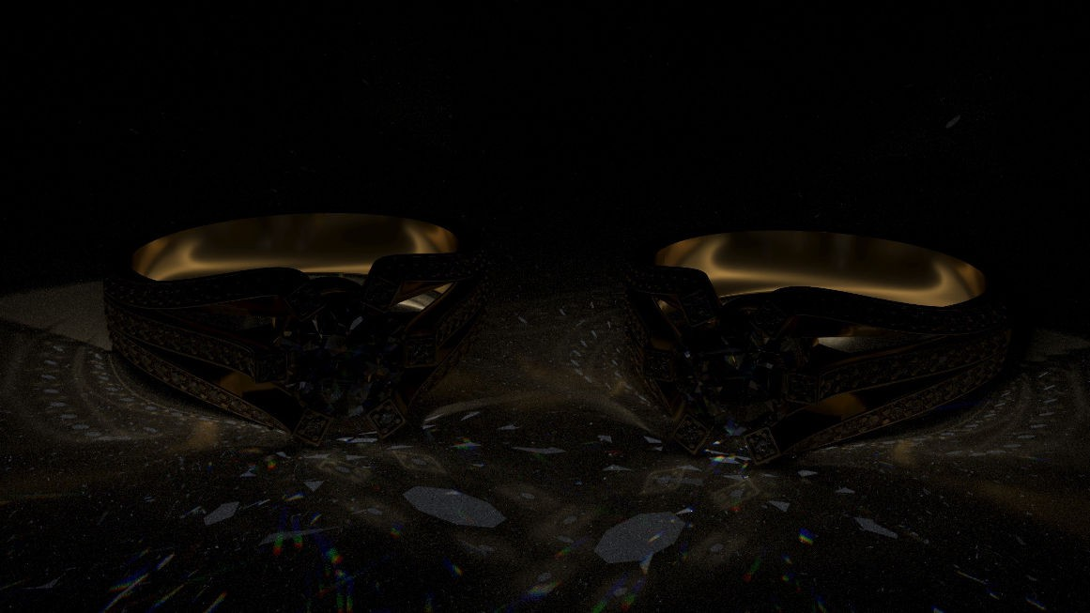
Caustics
The requirement was to render caustics as an additional feature in KooEngine, without modifying the existing Path- Tracing pipeline.
I implemented a separate light transport algorithm speciﬁcally for caustics and stored the results in the caustics channel.
The caustics rendering should ﬁnish within 0.5 seconds to meet customer requirements, making complex light transport algorithms like SPPM impractical. Therefore, the selection and design of algorithms become a signiﬁcant challenge in this project.
Caustics channel

Slide 6
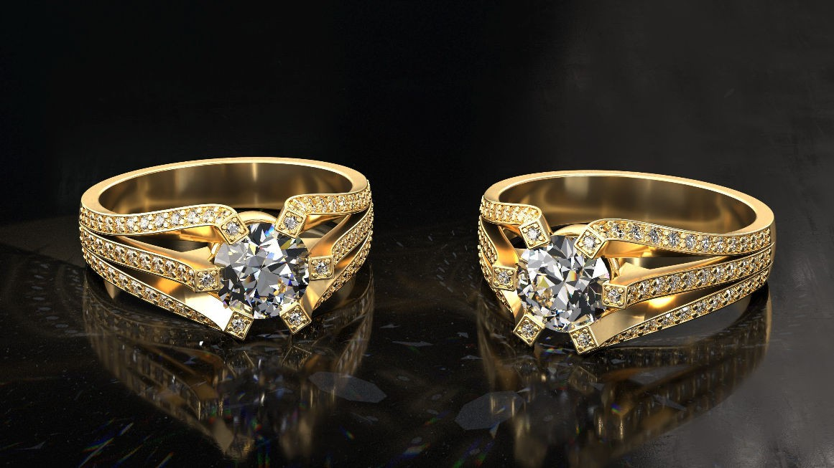
Ring Caustics
Finally, I resolved this problem using a screen-space photon mapping method.
In this method, photons are emitted from the light source, bounce multiple times in the scene, and eventually reach the camera.
This is a lightweight algorithm, well- suited to GPU implementation. Using this method, I successfully enabled KooEngine to render realistic caustics quickly.
Full image with caustics enabled

Slide 7
Diffraction
02

Slide 8
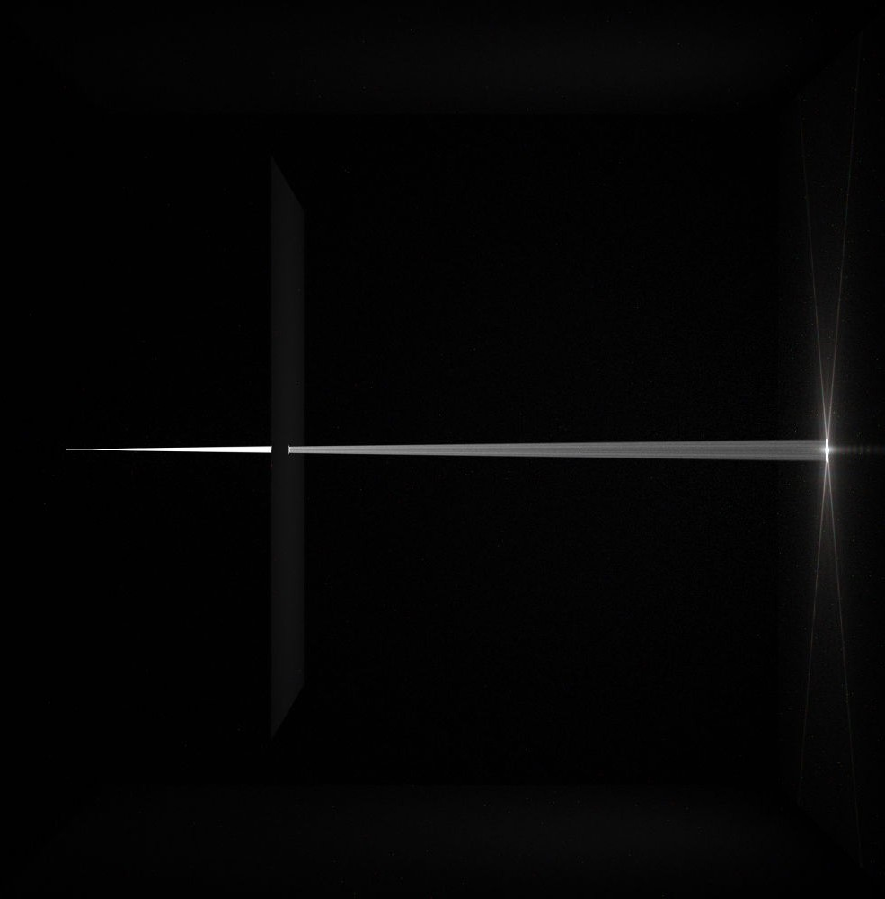
The image is rendered as part of my Diffraction-Simulation project, which reproduces an interesting SIGGRAPH paper.
In this scene, the light beam impinges upon the screen and diffracts through the aperture, creating a colorful diffraction pattern on the right wall.
This project is my initial exploration into wave-optical rendering. By combining my background in mathematics, physics, and computer science, I was able to simulate beautiful optical phenomena in the world.
I've always been fascinated by the various lighting effects in the natural world, and combining my knowledge with this personal interest is truly fulﬁlling.

Slide 9
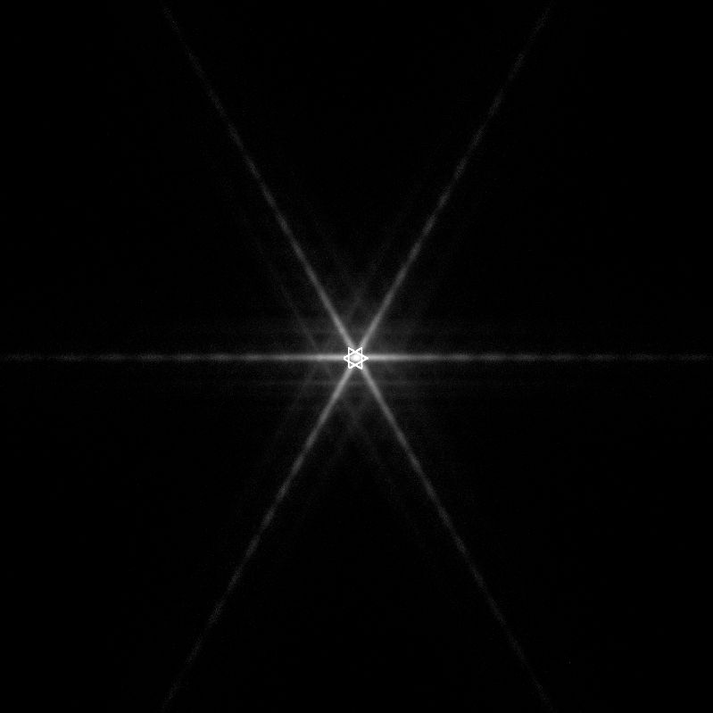
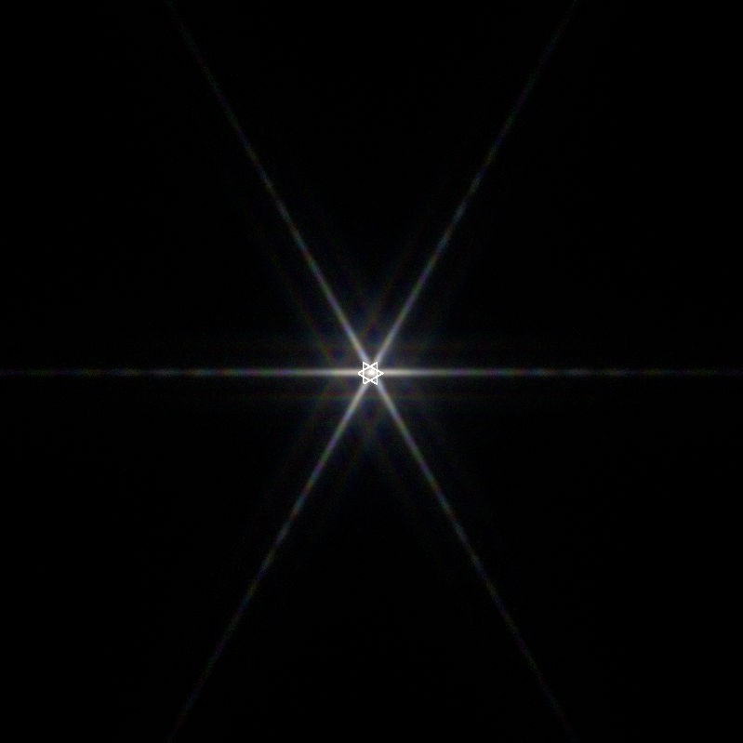
Monochromatic vs Trichromatic
Diffraction pattern produced by a star-shaped aperture, using monochromatic light.
Illuminated by trichromatic light.
Producing colorful diffraction grating.

Slide 10
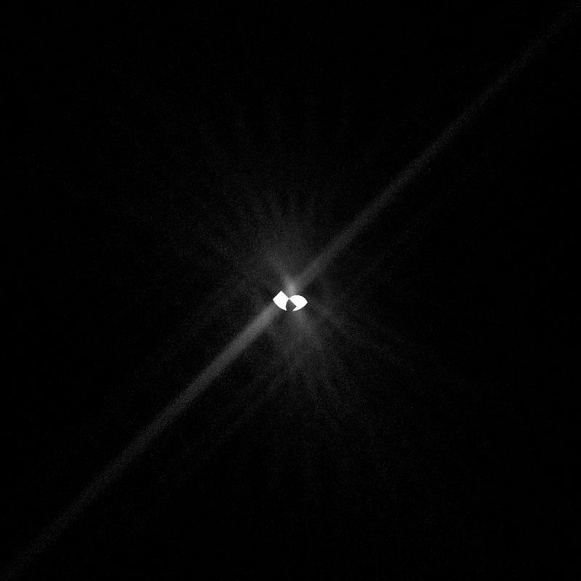
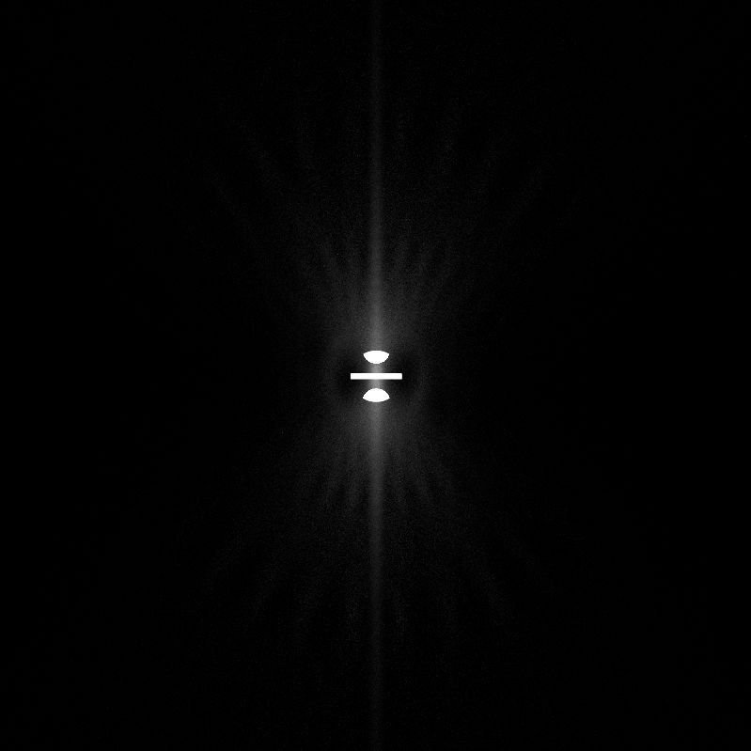
Different Aperture Shapes
Two crescents
Slits

Slide 11
My Wallpaper
03

Slide 12
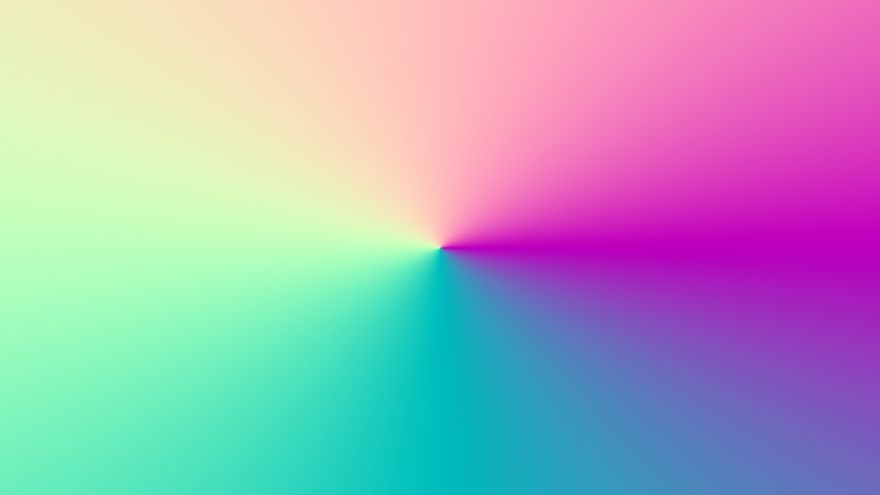
Wallpaper
This is my desktop wallpaper, synthesized in my Xeno Renderer during its early development.
At that time, I was testing the correctness of a C++ vector math library I had written.
After a weird combination of vector math operations, I output the XYZ coordinates of my resulting vector to the RGB channels, producing this colorful image.
2D continuum of the spectrum.

Slide 13

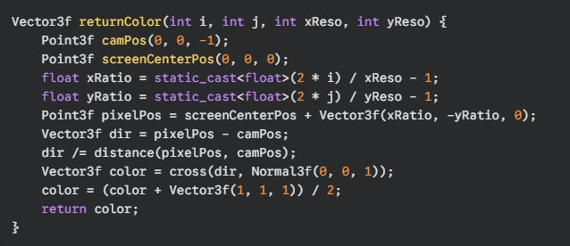
Here is my proﬁle picture on social media platforms, also created by Xeno Renderer.
This image differs from the previous one by not including a radial distribution function.
Below is the code snippet used to generate this image.

Slide 14
Interior Design
04

Slide 15
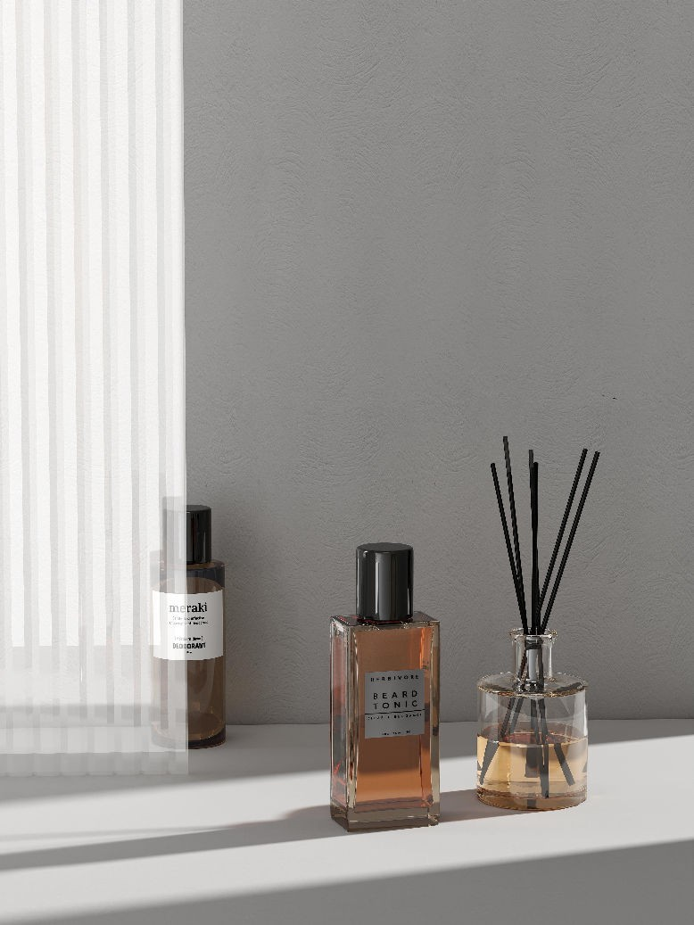
When I was a child, I dreamed of having a spacious home and creating beautiful interior designs. That's one of the reasons I choose to study rendering.
Fortunately, during my internship, I had the opportunity to develop a rendering engine speciﬁcally for interior design. In the meantime, I also used this engine to create some of my own designs.
KooEngine, as a designer-friendly commercial engine, doesn't require the manual conﬁguration of scene ﬁles like engines used in computer graphics research.
Instead, designers can directly place lights and objects using a drag-and-drop interface. This allows me to design more efﬁciently.

Slide 16
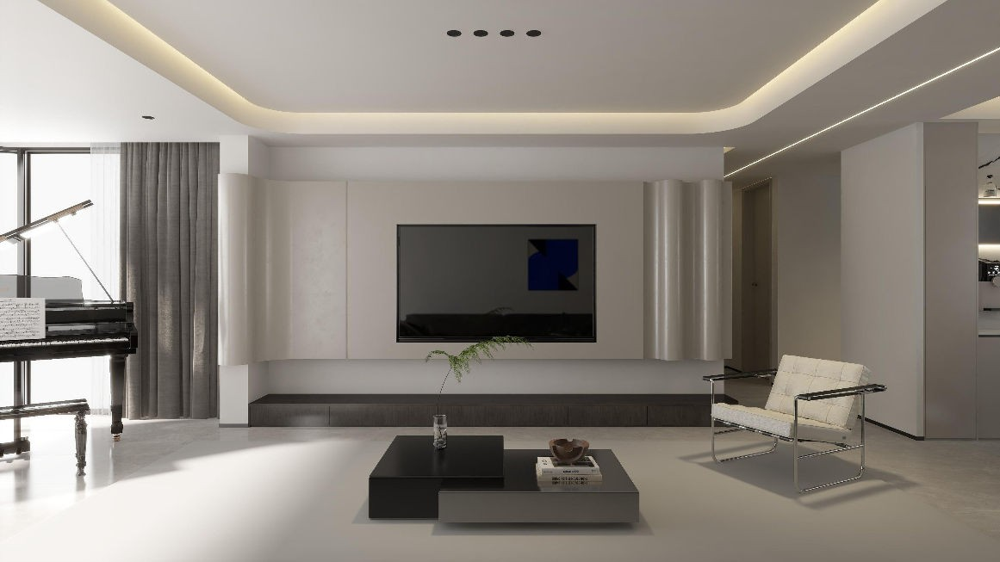
Living Room
This is my dream living room, with sunlight, piano, and enough space for kids to play around.
Thanks to the rich templates and model library in the engine, I was able to render such a complete home design.
It also gave me the conﬁdence and motivation to continue pursuing my path in digital arts and design.
My future living room

Slide 17
Conclusion
These are the four representative works I choose in computer graphics and digital arts.
I am eager to join Dartmouth's MSDA Program to study graphics and digital arts. Through my efforts, I aim to advance research in computer graphics and explore its applications in artistic design.
Thank you for taking the time to review my application.

Slide 18
Thank You!

