Slide 1

JAVA PRESENTATION
BLOOD BANK
INVENTORY SYSTEM
TEAM MEMBERS
J.RESHMA SAMHITHA
2620030199
S.SHANMUKHA PRIYA
2620030200

Slide 2



ABSTRACT
Blood units by group
The project focuses on making blood bank inventory management simple, accurate, and convenient. It records blood units according to blood group, manages donor details, and helps find suitable donors when blood is required. It monitors blood stock levels and helps identify low-stock blood groups. The system reduces manual calculations and makes blood availability information easier to manage.
Donor details & matching
Low-stock monitoring
2

Slide 3


PROBLEM STATEMENT
Today, blood banks are not digitally connected, and finding blood donors is done manually. Because of this, hospitals waste hours making phone calls during life-or-death emergencies, while rare blood types expire and go to waste in nearby facilities.
Manual phone calls
Not connected
Rare blood expires
Hospitals spend hours calling around in emergencies
Blood banks are not digitally linked to each other
Unused units go to waste in nearby facilities
3

Slide 4




EXISTING SYSTEM
Blood records may be maintained manually.
Donor searching can take more time.
Stock calculations may be done separately.
Low-stock conditions may not be identified instantly.
4

Slide 5


PROPOSED SYSTEM
1
Menu-driven Java application.
2
Donor details stored and searched systematically.
3
Blood units can be tracked by blood group.
4
if-else checks compatibility; switch provides menu choices.
Menu-driven
Java application
5
for loop searches donor list; while loop monitors stock operations.
5

Slide 6

RAPTOR FLOWCHART
choice?
START
Display Menu
Input choice
1
2
3
4
Register Donor
Check Availability
Display Stock
Exit
while (choice != 4): repeat
END
Symbols: oval = Start/End, parallelogram = Input/Output, bar box = Call, diamond = Selection
6

Slide 7

KEYWORDS
class
public
static
void
Creates Donor, BloodBank and BloodStock classes
Makes classes and methods accessible
Use methods or variables without an object
Methods that return no value
int
String
if / else
switch
Blood units, age, count
Donor name, blood group, phone number
Compatibility and stock conditions
Blood-group menu
for
while
new
return
Searches the donor list
Monitors and updates blood stock
Creates objects
Returns a value from a method
7

Slide 8

CO1 & CO2 ATTAINMENTS
CO1
CO2
Primitive Data Types int, double, char, boolean
if-else check blood availability
Variables donor details, blood-stock quantities
switch menu and blood-group selection
Constants fixed values if required
while continuously display the menu
Identifiers names for variables, methods, classes
Operators arithmetic, relational, logical
for display blood-stock records
Scanner Input donor details, blood group, menu choices
8

Slide 9


CO3 ATTAINMENTS
Arrays
Methods
Blood Groups stores the blood group names, and Blood Stock stores the number of units for each group.
main, registerDonor, checkBloodAvailability, selectBloodGroup, displayBloodStock, readInt and readDouble split the program into tasks.
9

Slide 10


CO4 ATTAINMENTS
Classes & Objects
Constructors
Encapsulation
Donor, Inventory, BloodBankSystem
Donor(String name, String bloodGroup, int age)
Private fields (name, bloodGroup, age) with getters
toString()
Inheritance / Interfaces
Exception Handling
Used in Donor to represent donor details
Can be extended later, e.g. Person → Donor
try-catch block in main handles runtime errors
10

Slide 11
CO5 ATTAINMENTS
String Operations
equals() vs ==
Donor names and blood groups stored as String
Used when comparing blood groups for matching
Sorting / Searching
File I/O (future extension)
Could be applied with Collections.sort() for donor lists
Reading/writing donor records to files, handling malformed data
11

Slide 12

CONCLUSION
The Smart Blood Bank Inventory and Donor Matcher transforms blood banking from a slow, manual process into a fast, automated system. By connecting hospitals and donors in real-time, this project solves the critical problem of communication delays, stops life-saving blood from going to waste, and ensures that patients get the right blood at the right time—ultimately saving countless lives.
Hospitals
Donors
Lives saved
12

Slide 13

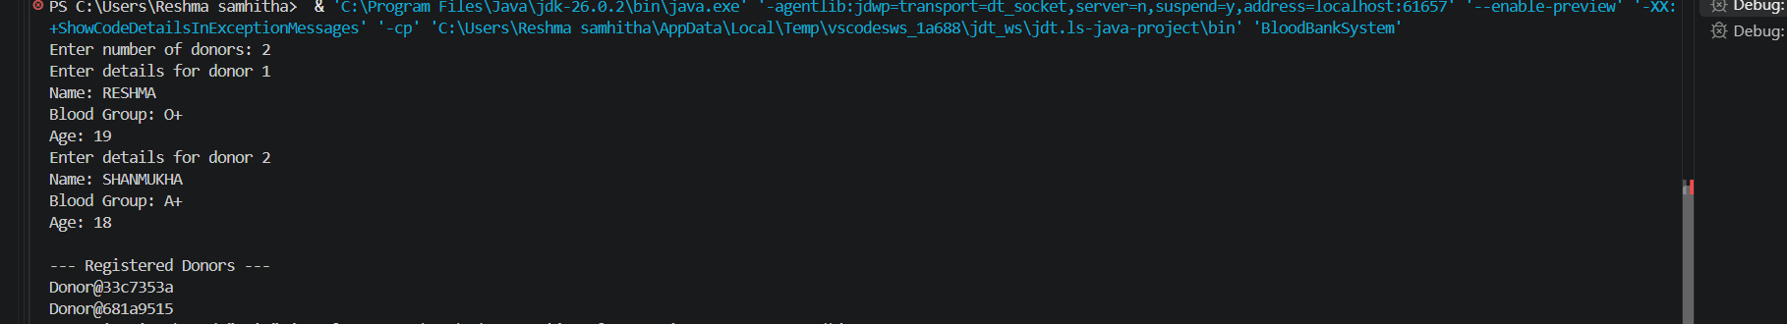
OUTPUT
Input
Output
Number of donors, then name, blood group and age for each donor
Registered donors list, printed through toString()
13

Slide 14



GEOTAG PHOTO & GITHUB
GEOTAG PHOTO
GITHUB LINK
14

Slide 15
Thank You
BLOOD BANK INVENTORY SYSTEM

