Slide 1
Econ 128 Final Project Presentation
Serena Alvarez

Slide 2
DATASET
I will be using the `econ128` dataset provided.
The variables are as follows:
hh_id: unique household id
year: 2010 and 2011
month: 4-8
zipcode: anonymized zip code in which home is located
control: household-month is part of control group
treatment: household-month is part of treatment group
children: household has children
hhsize2-5plus: household size
income2-9: income categories <$20k, $20-30k, $30-40k, $40-50k, $50-75k, $75-100k,$100-125k, >$125k
owner: resident owns home

Slide 3
Cleaning the data
Dimensions of the raw data:
## [1] 234560 28
To clean the data, I decided to do three things:
- Remove rows with NA
- Convert dummy variables to factors (hhsize, income)
- Remove outlier of luse1

Slide 4
Remove NA
I decided to remove all rows that contain NA:
(with this amount of data, removing it should be fine)
New dimensions:
## [1] 221520 28
We removed around 5.5% of the observations

Slide 5
Dummies to factors
The dummy variables were somewhat unclear when looking at, so I converted them to factors
New column headings:
## [1] "hh_id" "year" "month" "zipcode" "control" "treatment" ## [7] "lusage" "luse1" "luse2" "luse3" "luse4" "luse5" ## [13] "luse6" "children" "owner" "hhsize" "income"

Slide 6
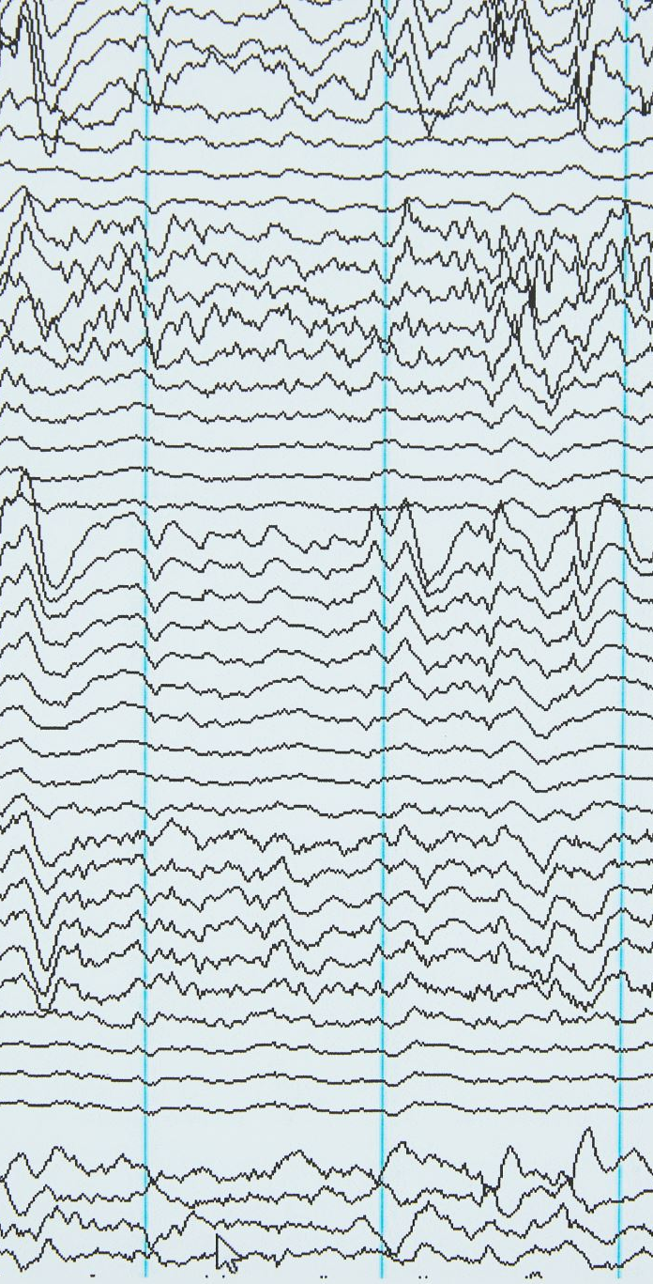
Remove Outlier(S)
After checking summary stats of the continuous variables, we remove the rows with negative values of luse1.
(assume outlier/ entered incorrectly)
New dimensions:
## [1] 221510 17
We removed a further 10 observations

Slide 7
About The model
For this project I will be using the gbm() function from the gbm package to produce a Generalized Boosted Regression Modeling (GBM).
The variable lusage will be modeled by using all the variables except for hh_id , year, and month.
We will use the distribution = “gaussian” option to indicate that we are looking to minimize MSE
The total number trees to be fit is 5000 and the depth between interactions is set to 3

Slide 8
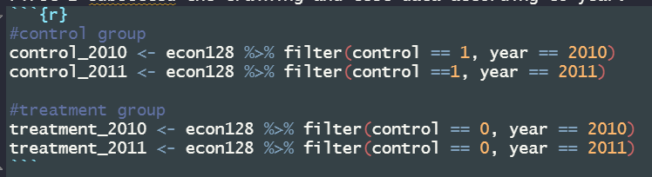
Model Building
First, I subsetted the training and test data according to year:

Slide 9
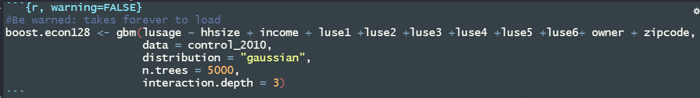
Model Building
I decided to use the Boosting machine learning method to predict. I found boosting to be better than random forests and bagging thus I found it appropriate to use here. The model trained by 2010 control data is modeled as follows:

Slide 10

Predictions- Control 2011
I then used the model to predict the 2011 control values for lusage:
Resulting in a low MSE, so we move forward to predicting treatment 2011.
## [1] 0.1237311

Slide 11

Predictions- Treatment 2011
Now we use our model to predict values for the treatment group in 2011: ( 5 predicted values represented as (cv.fold = 5))

Slide 12
Compare
Now we find the MSE
(difference between predicted and mean values squared):
## [1] 0.1264041
MSE = 0.1264041, it preformed well

Slide 13
Compare
Now we compare the summary statistics between actual vs. predicted values for the 2011 treatment group:
## Min. 1st Qu. Median Mean 3rd Qu. Max. ## 3.927 5.948 6.391 6.346 6.781 8.123
## Min. 1st Qu. Median Mean 3rd Qu. Max. ## 4.407 6.041 6.426 6.373 6.750 7.948
We can see that the true values of lusage range from [4.516, 8.059], with a mean of 6.373.
The predicted values have a slightly larger range of [3.927, 8.123], and a relatively similar mean of 6.346.
Actual Values
Predicted Values

Slide 14
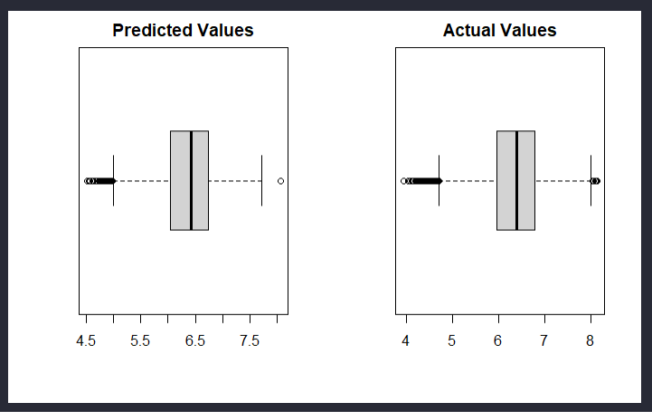
Compare
The boxplots show relatively the same distributions for both groups.
This shows that our model predicted the correct distribution as the actual values had.

Slide 15
Conclusion
With a MSE of 0.1264041, our model preformed well. While not perfect, our model was able to predict most values relatively closely.
I can see why boosting is so common in the industry and I felt it was fairly simple to use. The time it took to run was the only downside of this method that I found.

Slide 16
Extra Credit
As we can see by the summary statistics and boxplots, our predicted values are slightly higher than what they actually were. If the households were told to save water in 2011, our model would not have accounted for it because the model was trained using variables `luse1-6’ which we can assume did not have the same policy in place when their data was taken.
Thus, the difference in our predicted and actual values may be due to that effect not being accounted for. If we built our model using treatment 2011 data to train it, we could have possibly accounted for the missing effects and gotten a closer estimate.

Slide 17
Extra Credit
If we only compared the treatment vs. control data from 2011, we would be looking at virtually no difference between the two values. Thus, we can infer that the difference is due to an externality and not poor modeling.
Summary statistics for treatment vs control from 2011:
## Min. 1st Qu. Median Mean 3rd Qu. Max. ## 3.927 5.948 6.391 6.346 6.781 8.123
## Min. 1st Qu. Median Mean 3rd Qu. Max. ## 3.917 5.957 6.402 6.359 6.810 8.318

