Slide 1
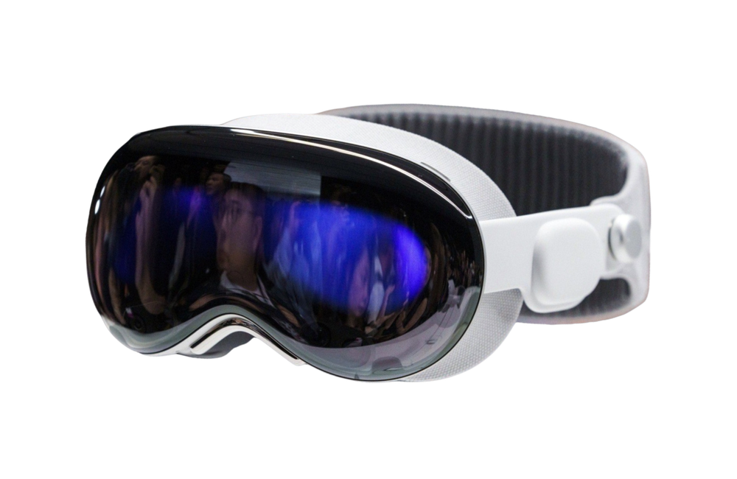
By Elppa:
Presented by : Elppa
August 10, 2026
Lifesaver
Mission
Demo

Slide 2
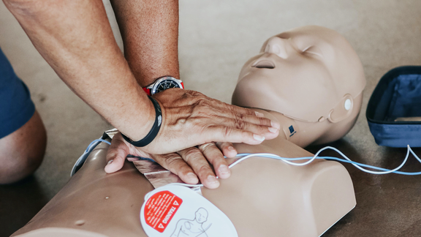
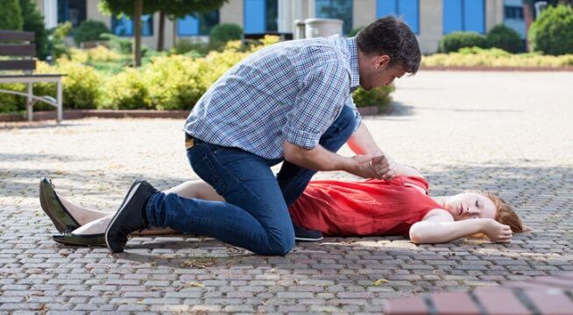
The problem
elppa
Our solution
Our vision
Every Minute Without CPR Costs
10% Survival
ONE-OF CLASS,
SKILLS GO DULL
Yet most people learn CPR+AED once, in a one-off class, resulting dulled first-aid capabilities.
3000
out-of-hospital cardiac arrests occur in Singapore every year
70-80%
happen at home or in public places — bystanders
are the first line of defence

Slide 3
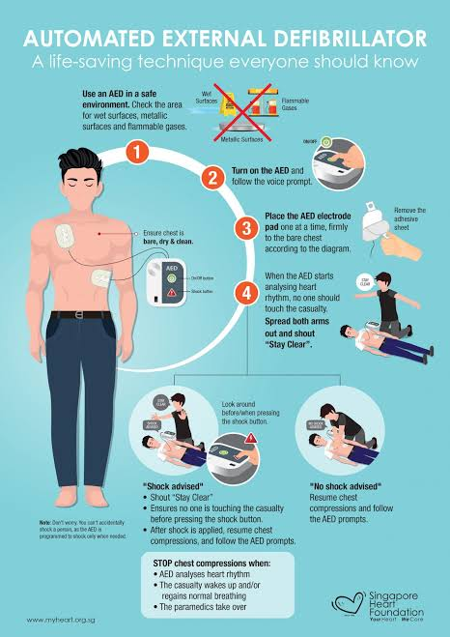
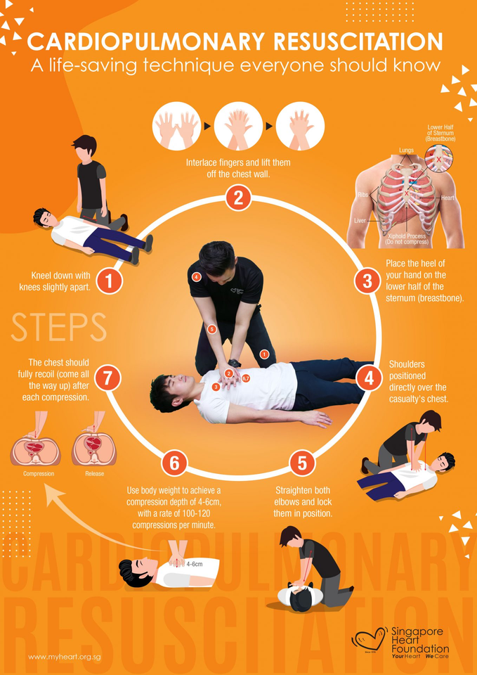
The problem
elppa
Our solution
Our vision
elppa
Turn bystanders into first aid responders
CPR & AED tutorial
Immersive Practice
First-person AED & CPR simulation
Precise Guidance
Detailed coaching and correction
Practice Anytime
Revisit and reinforce lifesaving skills

Slide 4
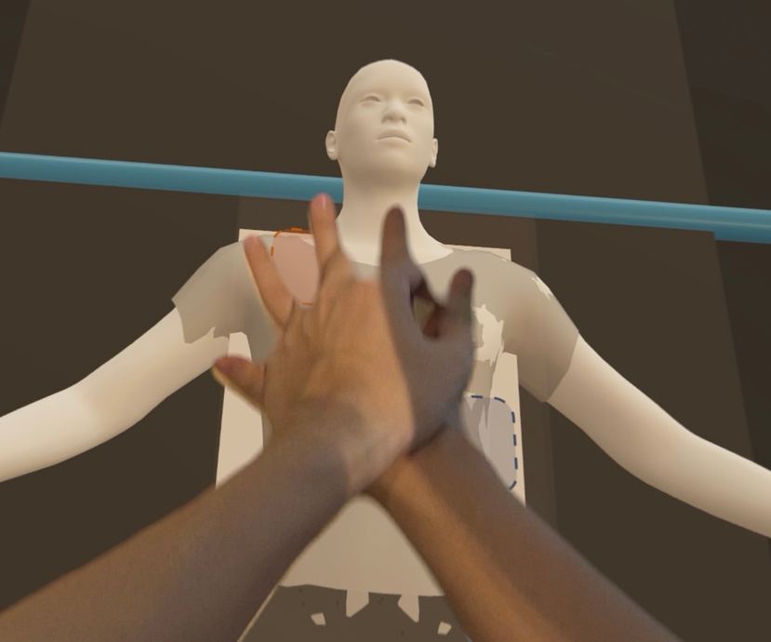
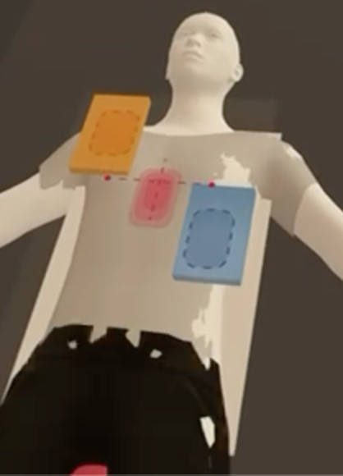
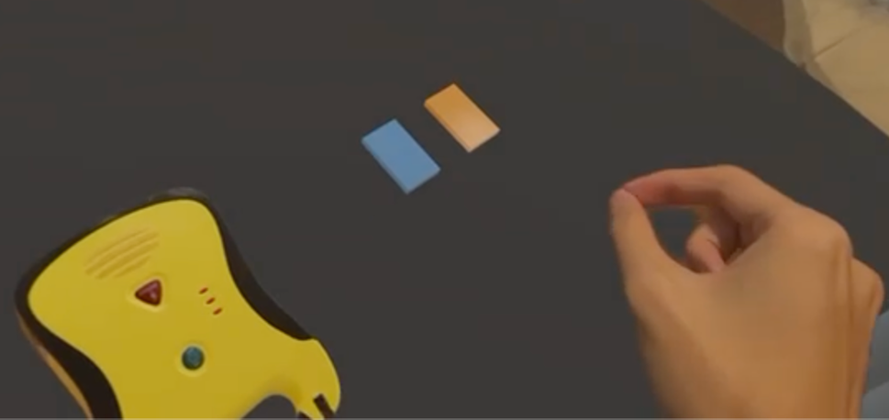
The problem
elppa
Our solution
Our vision
Introducing Lifesaver
Practice Until It's Muscle Memory
• A Vision Pro training app that puts you face-to-face with a 3D human body and AED unit
• Theory → AI-coached practice → timed practice, mirroring how real CPR+AED certification courses are structured
• Our precise list ensures that every
life-saving step is carefully considered before execution

Slide 5

Demo

Slide 6
Our Vision
Our Vision
Train like it's ordinary. Act like it's everything.
Our priority:
Complete scenario creation for Toilet, Living Room, Shopping Mall, Workplace to enable better adaption for users when encountering real life saving situations.
Future updates:
Mistake identifier for wrong compression and patch placement
AI Voice Coach to guide you along the way with interactive UI
Implementing common scenarios where life saving incidents may occur
Implementation of 995 calling and removal of clothes before CPR and AED
Adding variety to body types and age to simulate realistic encounters
Adding Apple Watch and IPhone implementation
Other First Aid applications

