Slide 1
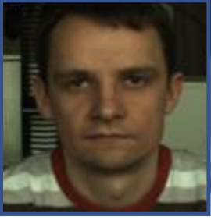
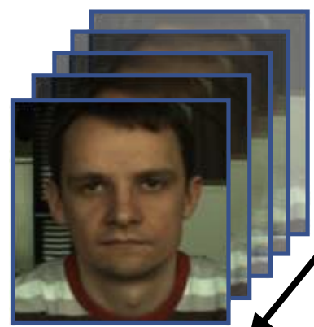

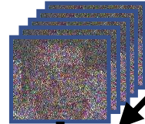

01
Fusion Stem
3
Hierarchical Temporal Modeling
HR Post-processing
1
Input Video
2
Patch Embedding
4
5
rPPG Predictor
6
RGB Frames
Frame-wise 2D Conv
BVP Detrend
...
Spatial
Enhance
Global
Pool
Multi-scale
Temporal
Conv
Temporal
FFN
ResidualFeature
MLP Projection
Adjacent-frame
Differences
...
+
First-order Butterworth
0.75–2.5 Hz
8 × 8
Overlapping Patches
Shifts: 1 / 2 / 4 / 8
⋮
Welch Power
Spectral Density
Face Detection
& BBox Expansion & Crop and Resize
5×5 Conv + BN + ReLU + Pool
TPT block extracts and fuses Multi-scale Temporal Features
BVP / rPPG
Waveform
(160 × 1)
Increasing temporal granularity suppresses noise
160 Frames
(128 × 128)
3×3 Conv + BN + ReLU
Output: T × 8 × 8
Heart Rate (bpm)
cropped facial sequence
Temporal difference features
No explicit positional embedding
TPT block with FFN module
Model output
Inference only
Notes:
[Sources]
- Zou et al., RhythmFormer: Extracting Patterned rPPG Signals based on Periodic Sparse Attention, Figure 3 and Sections 3.1-3.3, user-supplied PDF.
- Implementation details: Section 4.2.
- Parameter count: Table 14 (3.25M).
- Input length: Table 11 (160 frames selected in experiments).

