Slide 1
Chapter 7:
Strings and Characters
Object-Oriented Program Development Using Java: A Class-Centered Approach

Slide 2
Objectives
The String Class
String Processing
The StringBuffer Class
Program Design and Development: Program Performance Measures and Object-Oriented Technology (OOT)
Common Programming Errors

Slide 3
The String Class
A string literal is a sequence of characters enclosed in double quotation marks
A string value is created as an object of:
  String
  StringBuffer
The main difference between the two classes:
  Strings created as String objects cannot be modified
  StringBuffer objects can be modified

Slide 4
Creating a String
Syntax:
  String identifier = new String(string-value);
  String identifier;
  identifier = new String(string-value);
  String identifier = string-value;

Slide 5
Creating a String (continued)
Storage for a string is created in memory when a string is created
  Location of where the string is stored is placed in a variable
Called a reference variable

Slide 6
Creating a String (continued)
When a data value such as a string is created from a class:
  A variable is declared
  An object of the correct data type is created
  The location of the object created in step 2 is stored in the reference variable declared in step 1

Slide 7
Constructors
Instantiating an object is the process of using the new operator to create an object
The name of the constructor method must be the same name as the class
The String class provides nine different constructors for creating String objects

Slide 8
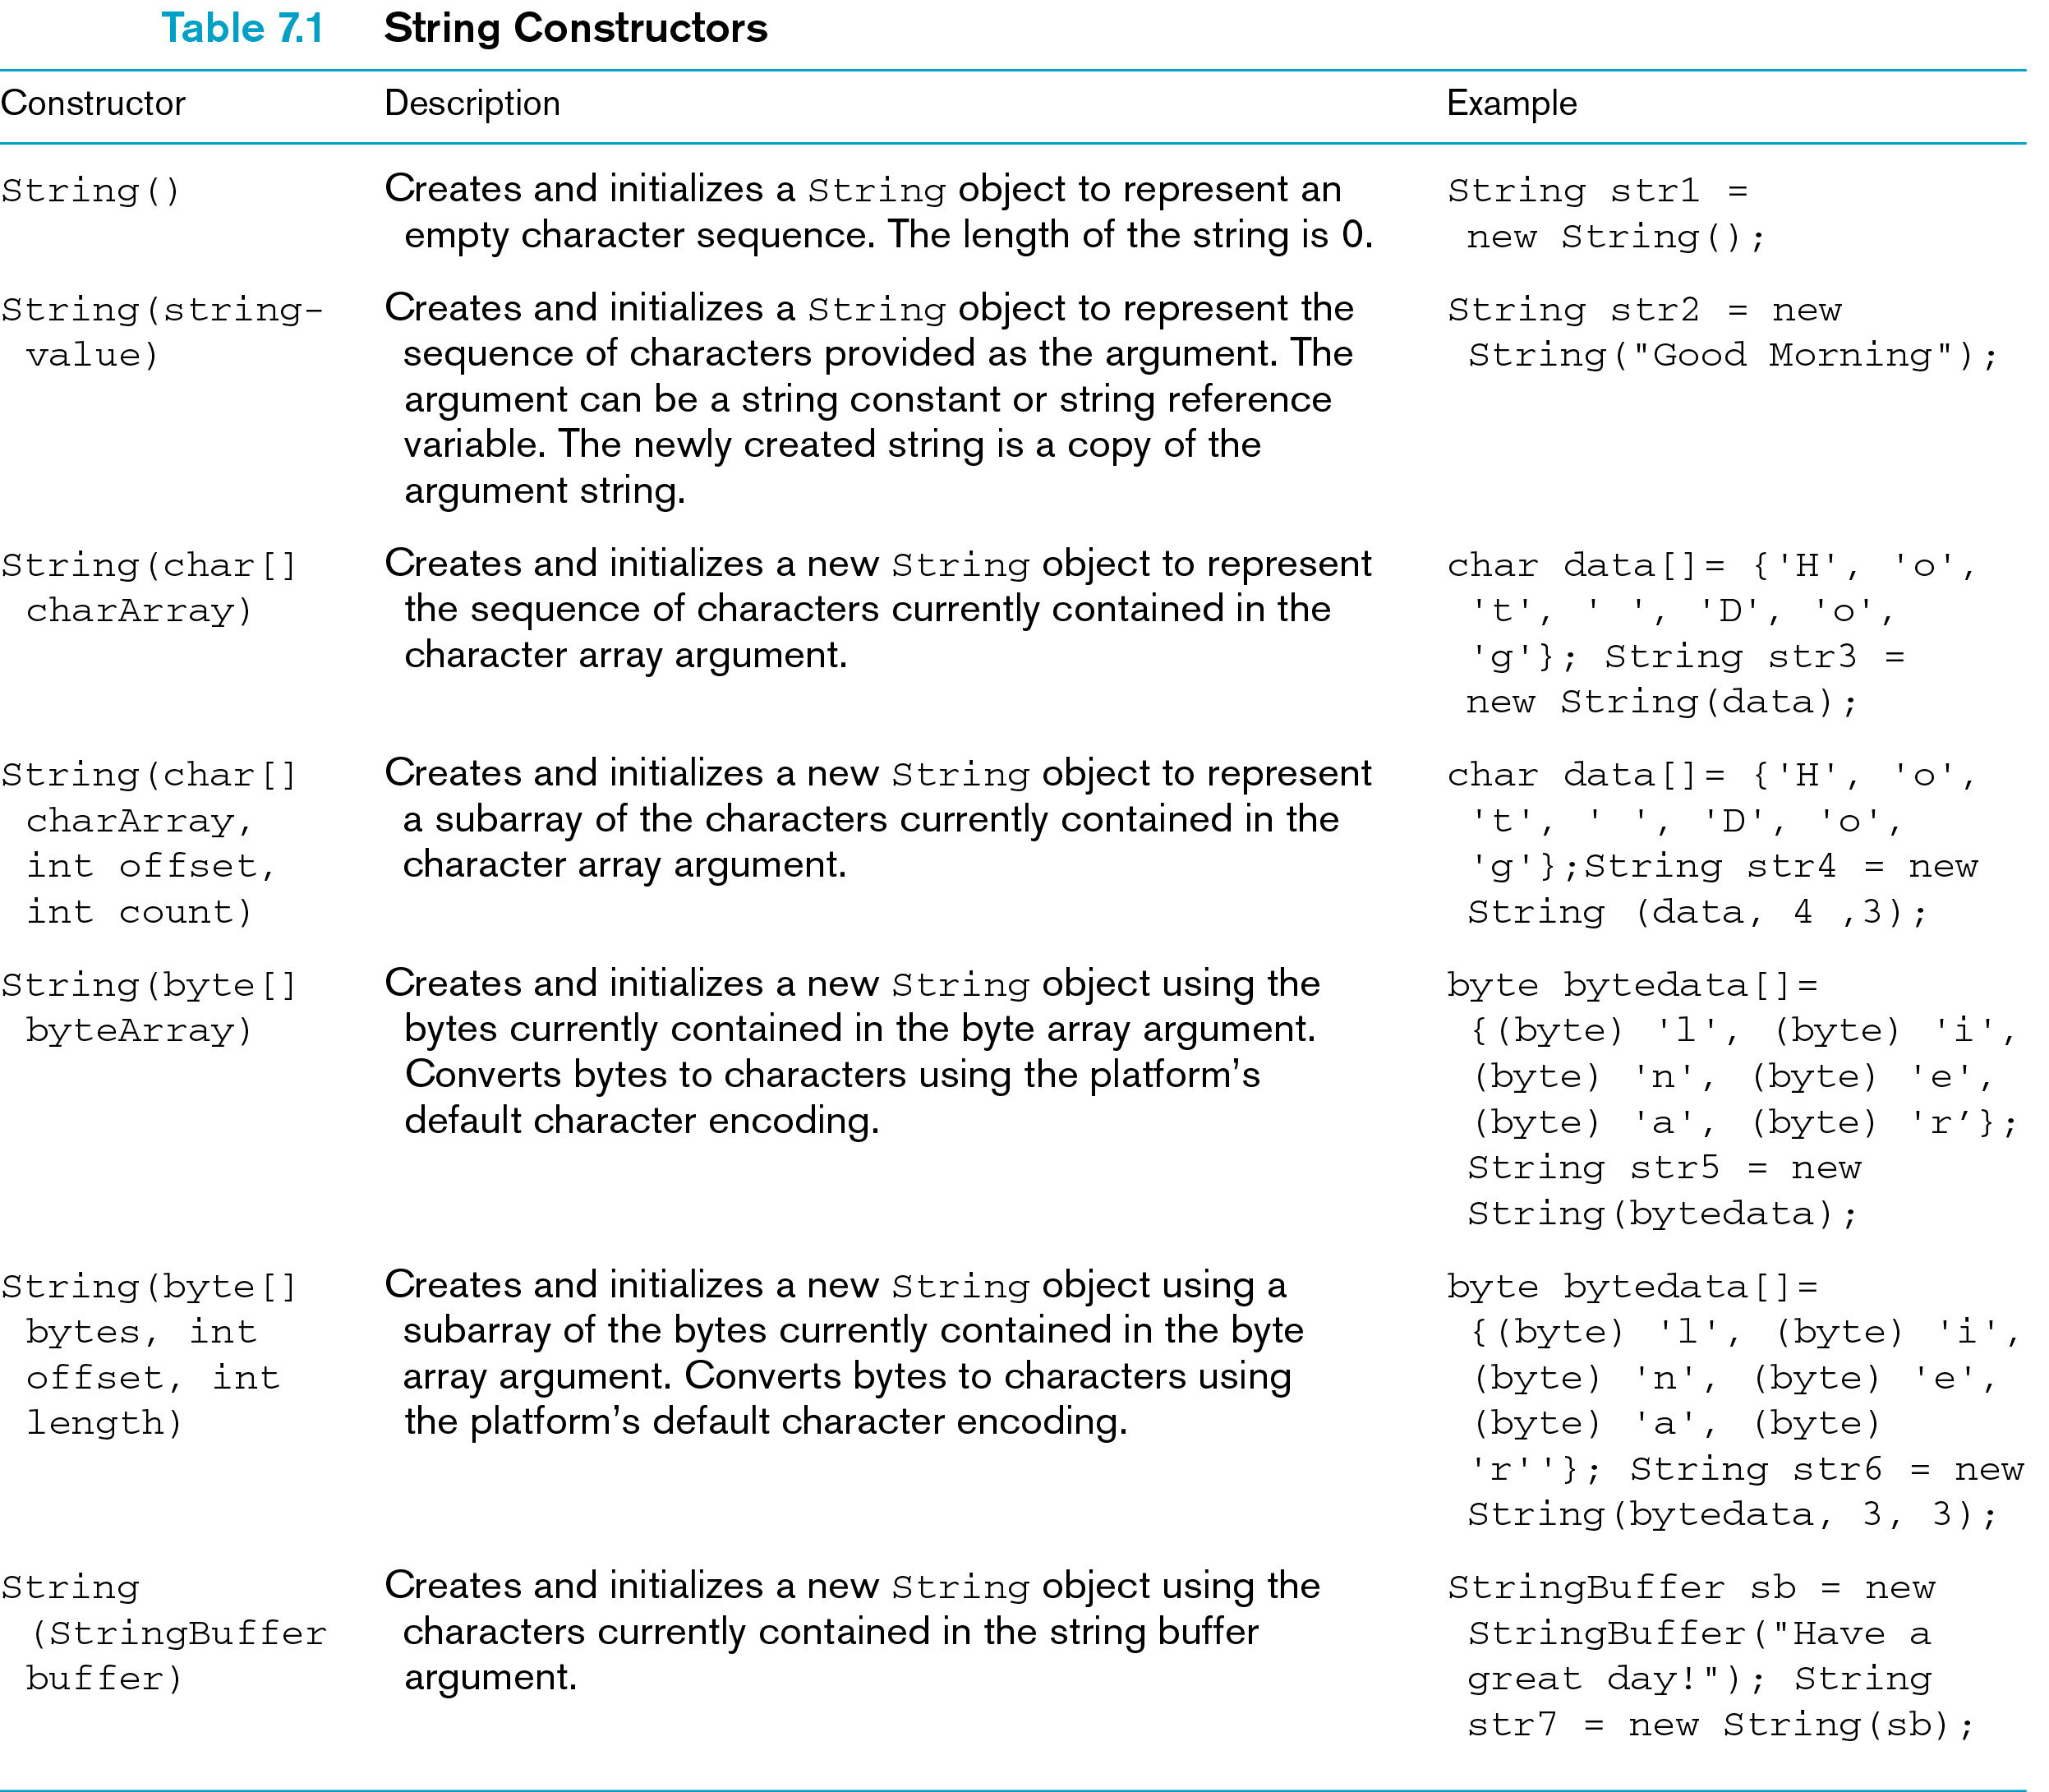

Slide 9
String Input and Output
Output:
  print()
  println()
Input:
  read()

Slide 10
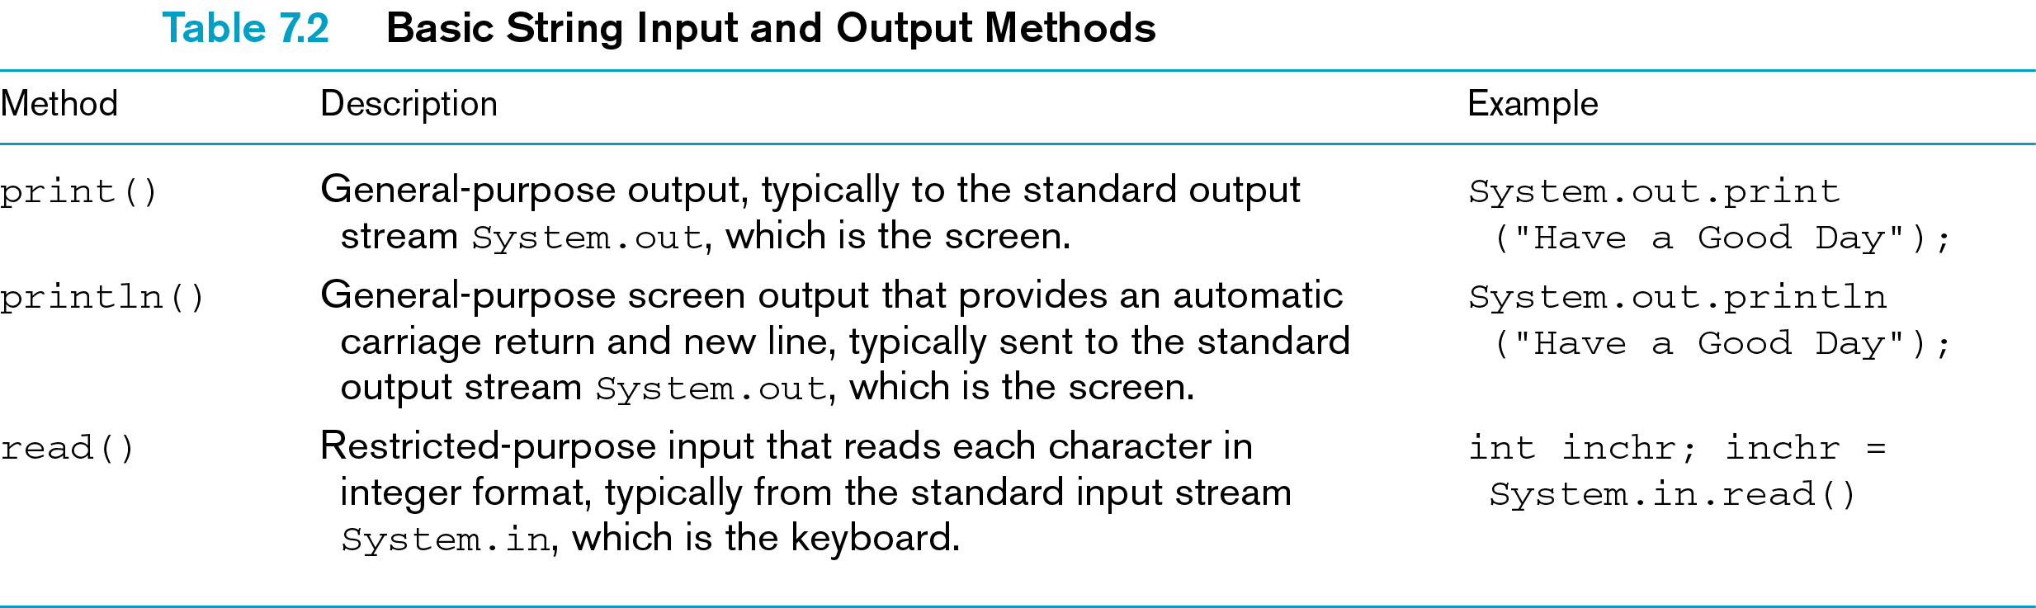

Slide 11
String Processing
Strings are manipulated using:
  Standard String class methods
  Character-at-a-time methods provided by the Character class

Slide 12
String Equality
Never use the equality operator, ==
  Compares values stored in reference variables used to access strings
Use:
  compareTo()
  equals()

Slide 13
Other String Methods
The charAt() method permits you to retrieve individual characters in a string
The last position is always one less than the number of characters in the string

Slide 14
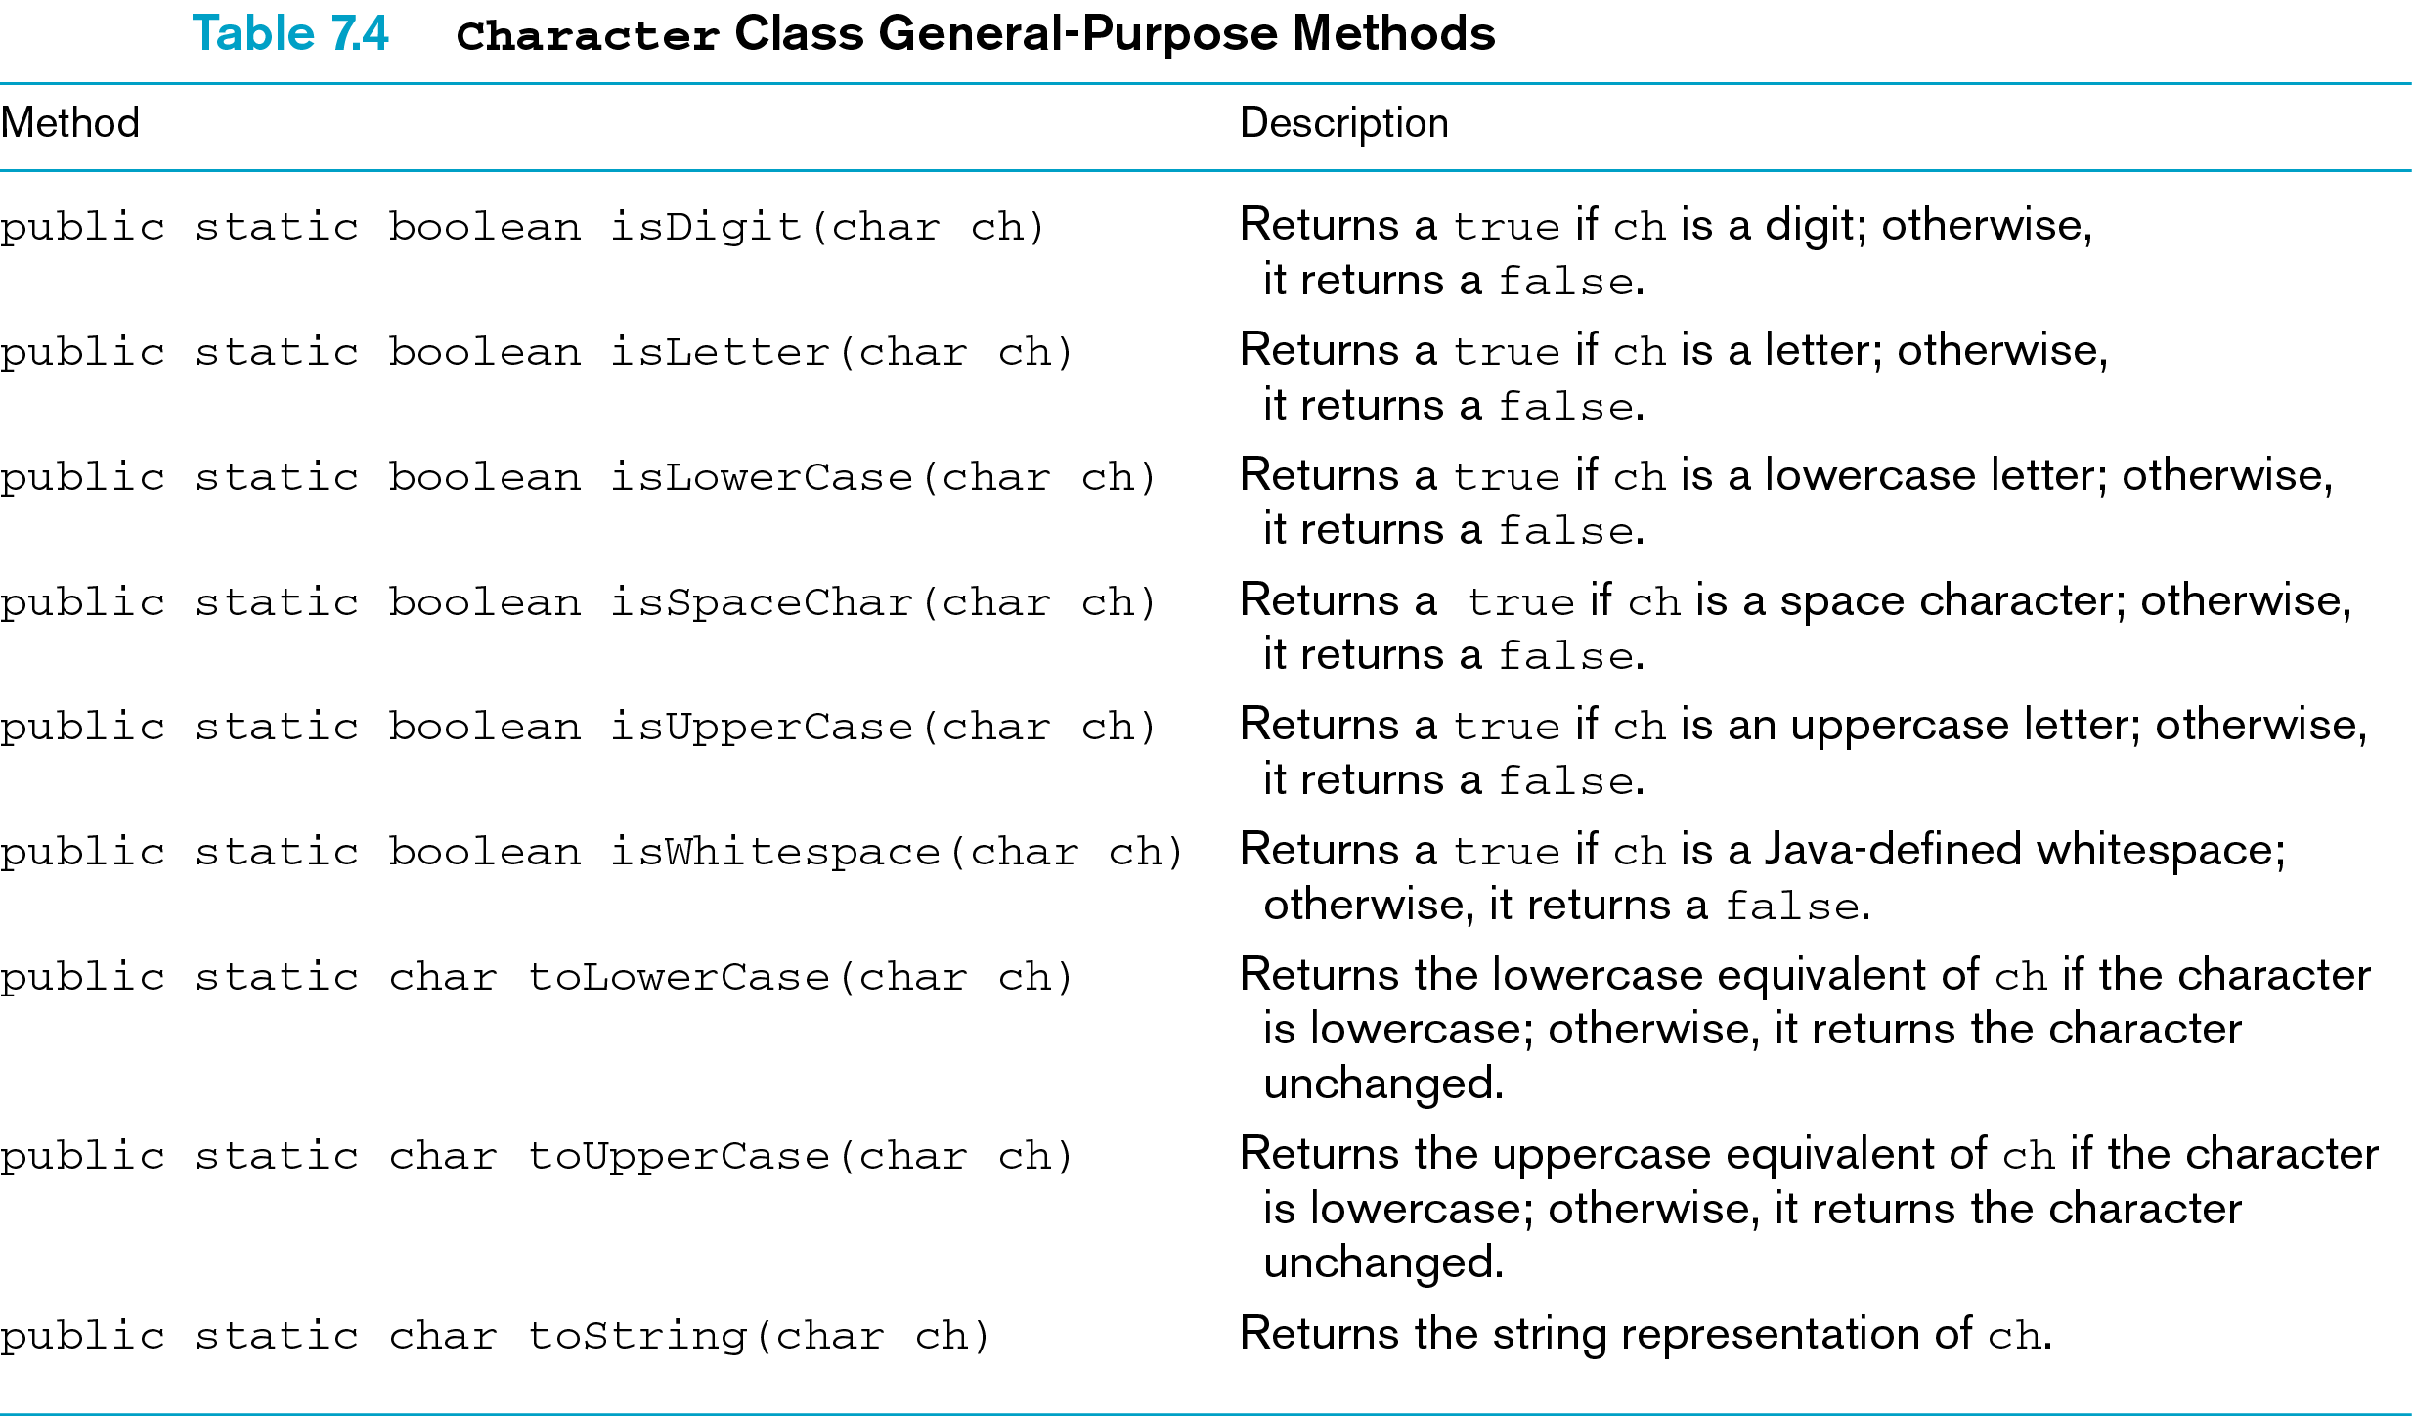

Slide 15
Conversion Methods
Convert strings to and from primitive numerical data types
General-purpose methods
Typically invoked by preceding the method name with the String class name and a period

Slide 16
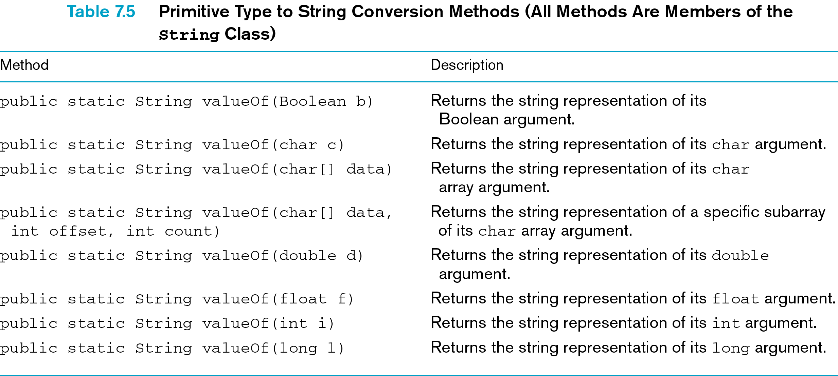

Slide 17
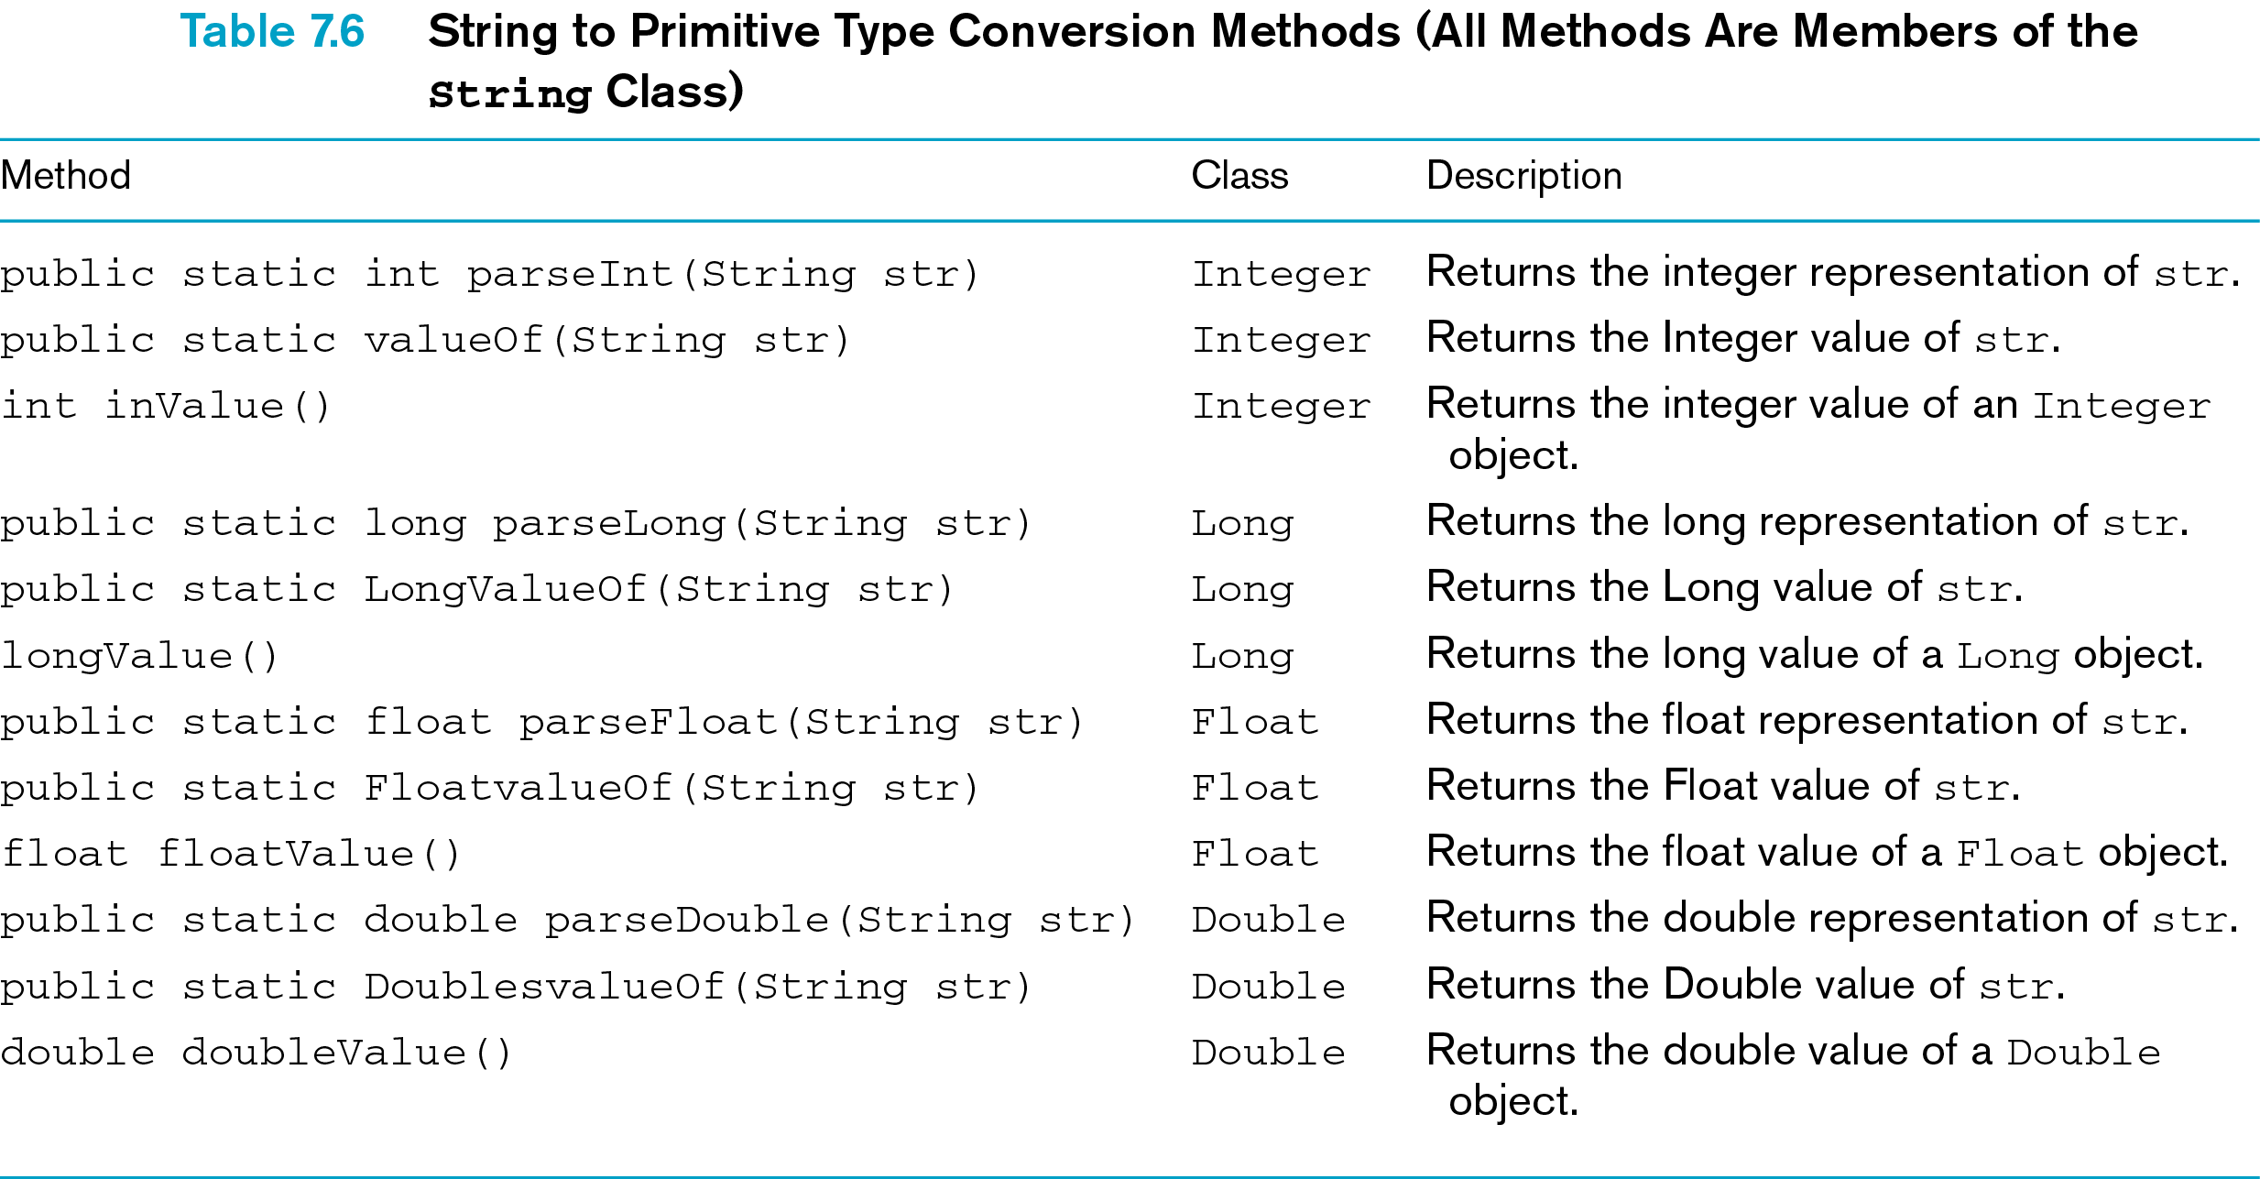

Slide 18
The StringBuffer Class
Implemented as a mutable sequence of characters
  Can be modified
Does not provide a set of methods for:
  Comparing strings
  Locating characters and substrings within a string
Created and stored in a buffer having a set character capacity

Slide 19
The StringBuffer Class (continued)
String class
  Preferred class for displaying or comparing strings that tend to remain constant
StringBuffer class
  Should be used for applications that require:
    Individual character additions
    Modifications
    Multiple text edits

Slide 20
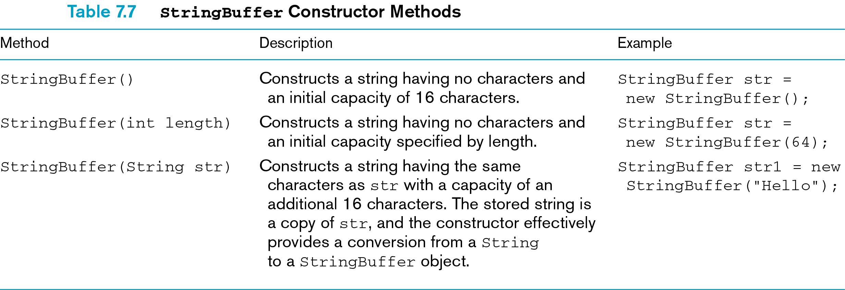

Slide 21
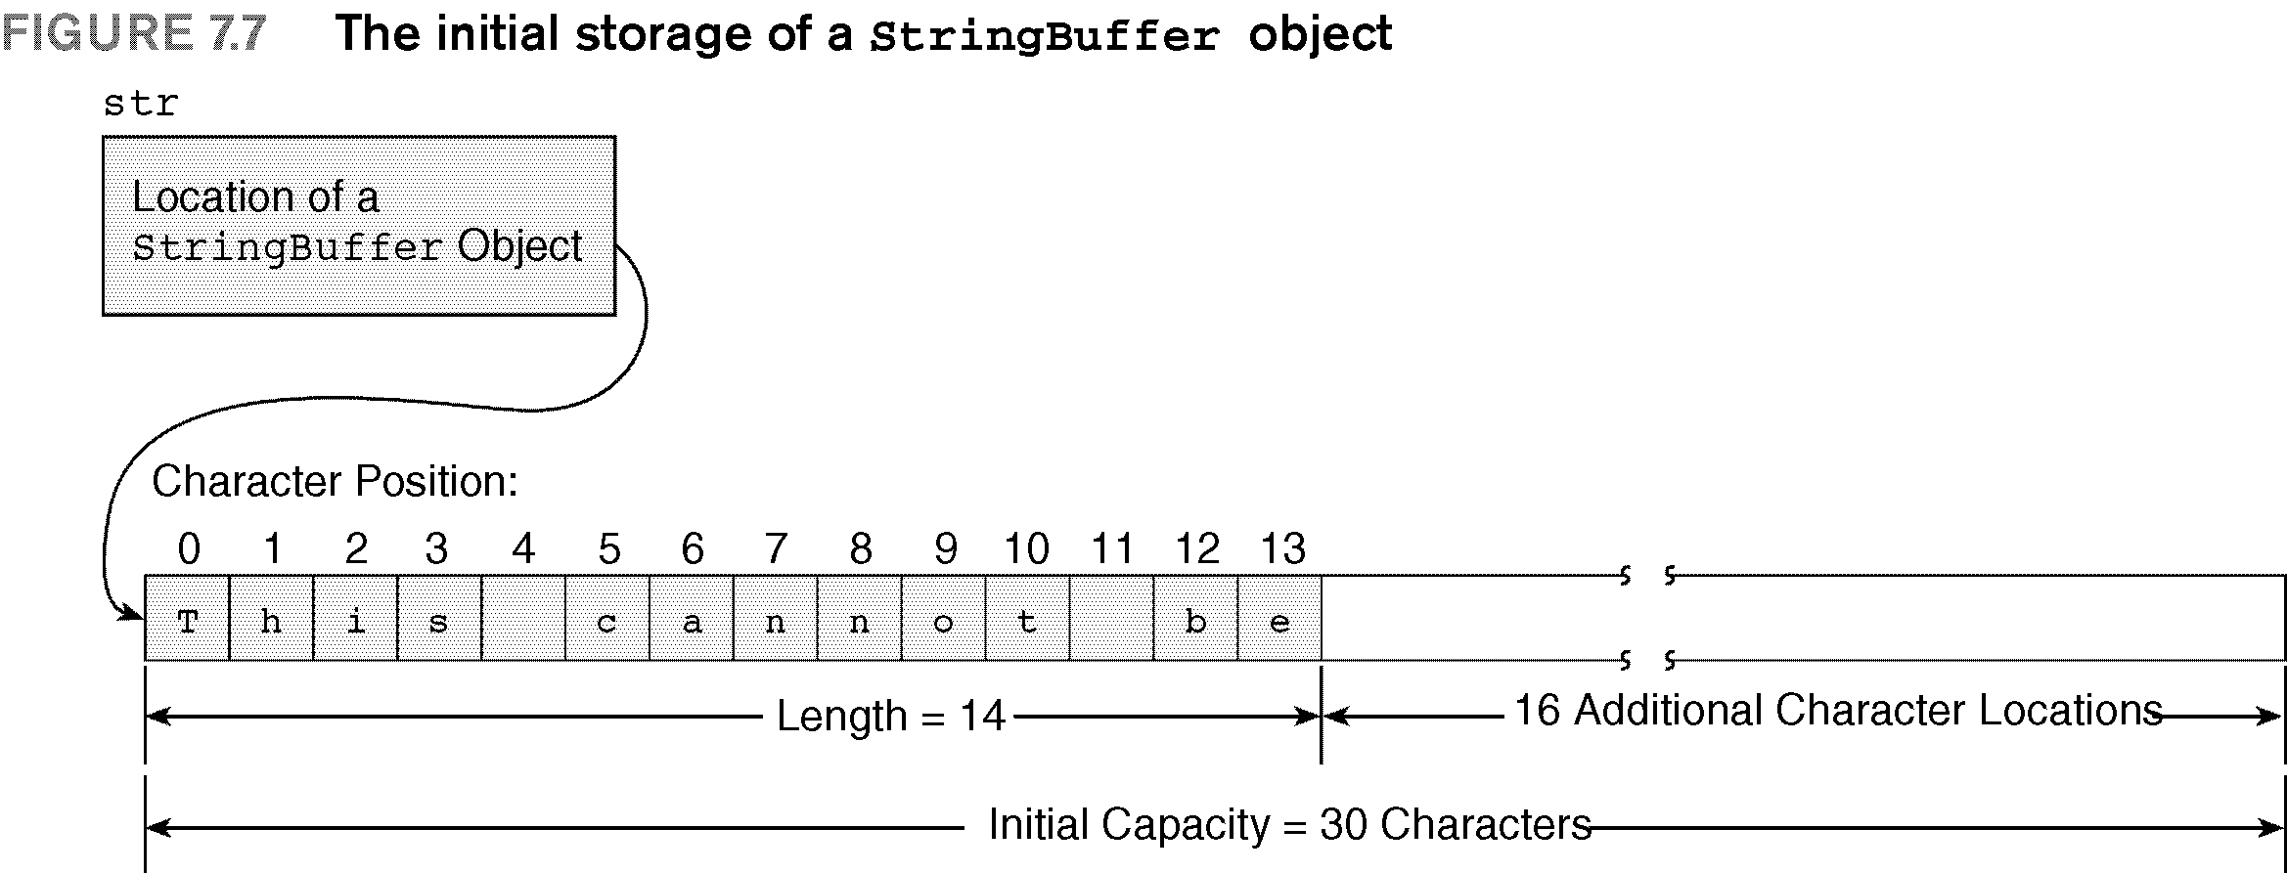

Slide 22
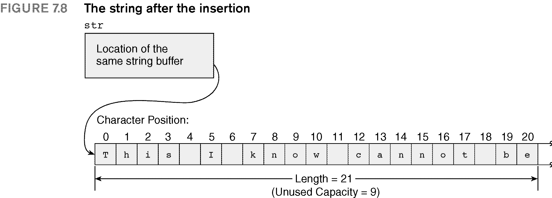

Slide 23
Program Design and Development: Program Performance Measures and Object-Oriented Technology (OOT)
The word implement means “to put into effect according to a definite plan”
  Plans are designed during the design phase

Slide 26
Program Design and Development
Understand what constitutes good implementation
Good programs should provide:
  Clarity
  Efficiency
  Robustness
  Extensibility
  Reusability
  Programming-in-the-large

Slide 27
Program Design and Development (continued)
Procedure-oriented programming:
  Has the capability of producing clear, efficient, robust programs that can be programmed in the large
  Does not produce reusable and extensible programs
  Very cumbersome and extremely time-consuming and costly to extend or reuse in new applications
Object-oriented technology (OOT):
  Produces both extendable and reusable code

Slide 28
Moving to OOT
True OOT:
  One works with objects from the problem definition stage through the programming stage
  Encompasses:
    OOR: object-oriented requirements
    OOA: object-oriented analysis
    OOD: object-oriented design
    OOP: object-oriented programming

Slide 29
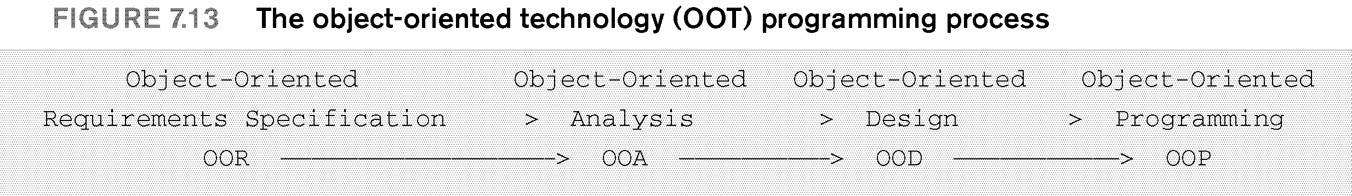

Slide 30
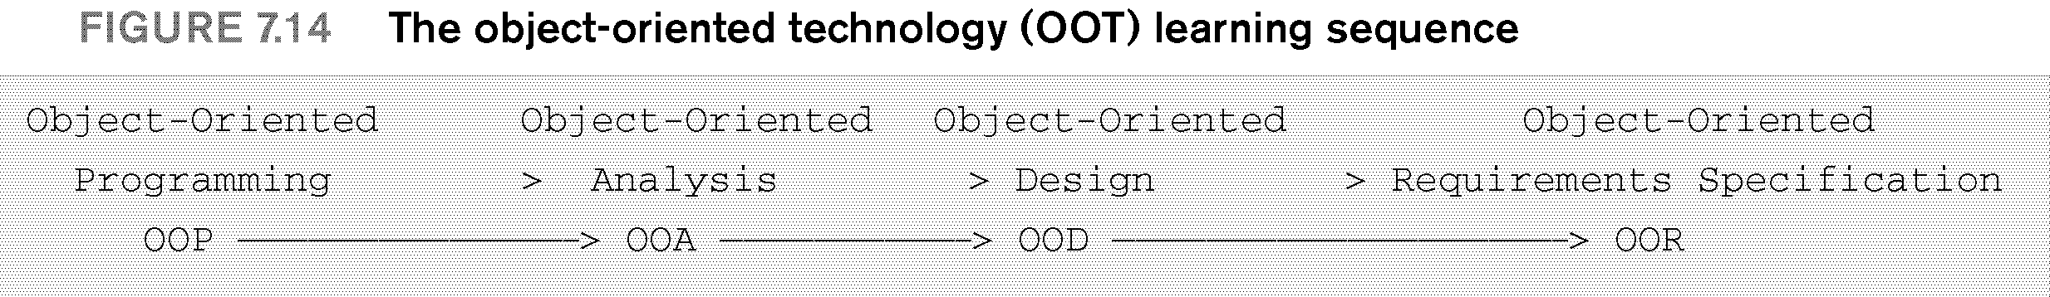

Slide 31
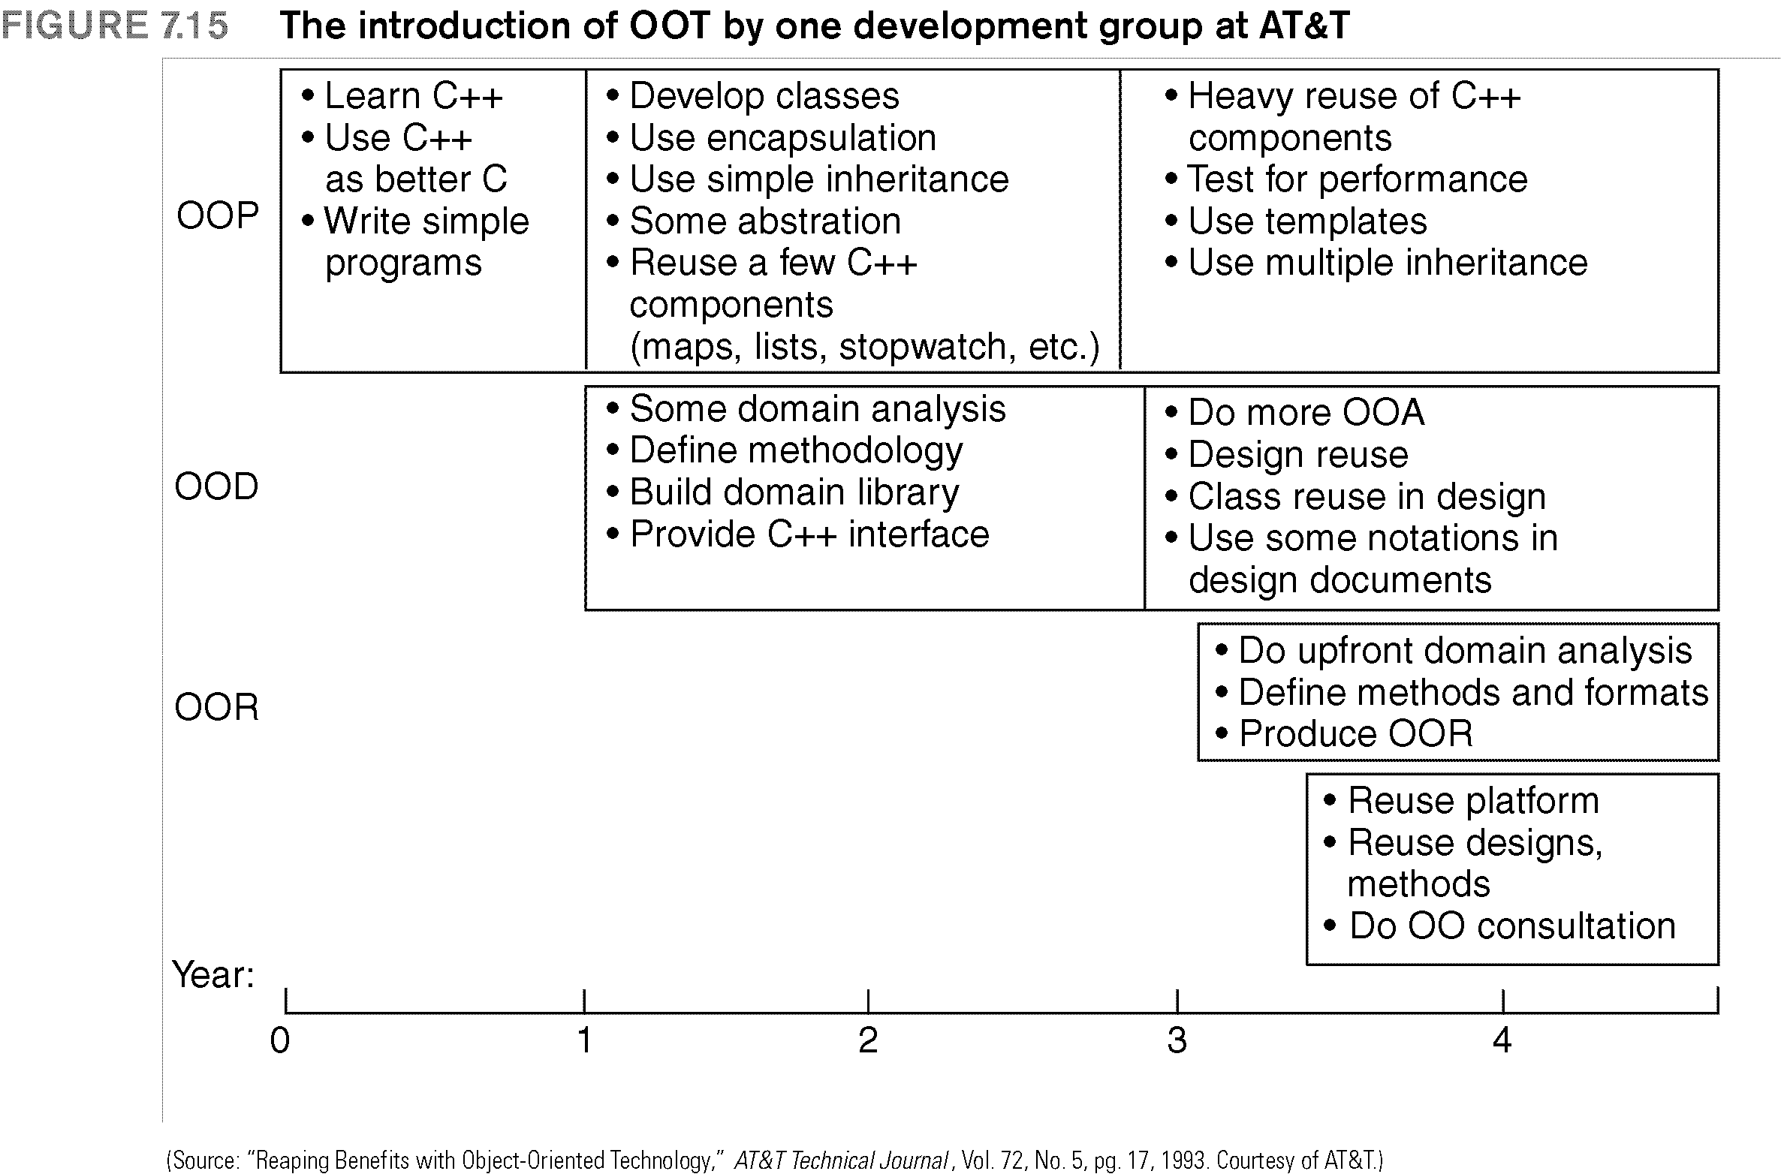

Slide 32
Common Programming Errors
Breaking a string across two or more lines
Not remembering that the first character in a string is located at position 0, not 1
Not remembering that the number returned by the length() method is one more than the position number of the string’s last character
Using the == operator to compare two strings
  Rather than the compareTo() or equals() methods

Slide 33
Common Programming Errors (continued)
Not specifying one position beyond the desired character to be extracted using the substring() method

Slide 34
Summary
Strings constructed from the String class are immutable
String class
  More commonly used for constructing strings for input and output purposes
StringBuffer class
  Used when characters within a string need to be replaced, inserted, or deleted on a regular basis

Slide 35
Summary (continued)
Strings can be manipulated using either:
  Methods of the class they are objects of
  Using general-purpose string and character methods

