Slide 1
Core Java
- T.Seeta Rama Rao

Slide 2
Servlets & JSPs
Core Java
Agenda
Introduction
Access Modifiers
Operators
Flow Control
Arrays and Strings
OOPS Explored
Exceptions
Garbage Collection
Collections
Threads
Demo

Slide 3
Introduction – What is Java
Programming language
  Another programming language using which we can develop applets, standalone applications, web applications and enterprise applications.
Platform Independent
  A Java program written and compiled on one machine can be executed on any other machine (irrespective of the operating system)
Object Oriented
  Complies to object oriented programming concepts. Your program is not object oriented unless you code that way
Compiled and Interpreted
  The .java file is compiled to a .class file & the .class file is interpreted to machine code

Slide 4
Introduction – Java Virtual Machine
.java file
Java
Compiler
.class
file
Java Virtual Machine
Mac
Microsoft
UNIX

Slide 5
Introduction – My First Program Version 1
public class HelloWorld
{
public static void main(String[] args)
{
System.out.println(“Hello World”);
}
}
Compile the program: javac HelloWorld.java
Execute the program: java HelloWorld
Output: Hello World

Slide 6
Introduction – My First Program Version 2
public class HelloWorld
{
public static void main(String[] args)
{
HelloWorld hw = new HelloWorld();
hw.display();
}
public void display()
{
System.out.println(“Hello World”);
}
}
Compile the program: javac HelloWorld.java
Execute the program: java HelloWorld
Output: Hello World

Slide 7
Introduction – My First Program Version 3
public class HelloWorld
{
public static void main(String[] args)
{
HelloWorld hw = new HelloWorld();
hw.display(args[0]);
}
public void display(String userName)
{
System.out.println(“Hello ” + userName);
}
}
Compile the program: javac HelloWorld.java
Execute the program: java HelloWorld Sharad
Output: Hello Sharad

Slide 8
Introduction – My First Program Version 4
public class HelloWorld
{
String userName;
public static void main(String[] args)
{
HelloWorld hw = new HelloWorld();
hw.userName = args[0];
}
public void display()
{
System.out.println(“Hello ” + userName);
}
}
Compile the program: javac HelloWorld.java
Execute the program: java HelloWorld Sharad
Output: Hello Sharad

Slide 9
Introduction – Java Keywords
abstract | boolean | break | byte | case | catch | char
class | const | continue | default | do | double | else
extends | final | finally | float | for | goto | if
implements | import | instanceof | int | interface | long | native
new | package | private | protected | public | return | short
static | strictfp | super | switch | synchronized | this | throw
throws | transient | try | void | volatile | while | assert

Slide 10
Introduction – Stack v/s Heap
A
B
x = 10 y = new A()
method2()
method1()
C
main()
Stack
  Heap

Slide 11
Introduction - Object Oriented Concepts
Class
  A blueprint that defines the attributes and methods
Object
  An instance of a Class
Abstraction
  Hide certain details and show only essential details
Encapsulation
  Binding data and methods together
Inheritance
  Inherit the features of the superclass
Polymorphism
  One name having many forms

Slide 12
Introduction - Data Types
Data type | Bytes | Min Value | Max Value | Literal Values
byte | 1 | -2⁷ | 2⁷ – 1 | 123
short | 2 | -2¹⁵ | 2¹⁵ – 1 | 1234
int | 4 | -2³¹ | 2³¹ – 1 | 12345, 086, 0x675
long | 8 | -2⁶³ | 2⁶³ – 1 | 123456
float | 4 | - | - | 1.0
double | 8 | - | - | 123.86
char | 2 | 0 | 2¹⁶ – 1 | ‘a’, ‘\n’
boolean | - | - | - | true, false
General rule:
Min value = 2^{(bits – 1)}
Max value = 2^{(bits-1)} – 1
(where 1 byte = 8 bits)

Slide 13
Java Modifiers
Modifier | Class | Class Variables | Methods | Method Variables
public
private
protected
default
final
abstract
strictfp
transient
synchronized
native
volatile
static

Slide 14
Modifiers – Class
public
  Class can be accessed from any other class present in any package
default
  Class can be accessed only from within the same package. Classes outside the package in which the class is defined cannot access this class
final
  This class cannot be sub-classed, one cannot extend this class
abstract
  Class cannot be instantiated, need to sub-classs/extend.
strictfp
  Conforms that all methods in the class will conform to IEEE standard rules for floating points

Slide 15
Modifiers – Class Attributes
public
  Attribute can be accessed from any other class present in any package
private
  Attribute can be accessed from only within the class
protected
  Attribute can be accessed from all classes in the same package and sub-classes.
default
  Attribute can be accessed only from within the same package.
final
  This value of the attribute cannot be changed, can assign only 1 value
transient
  The attribute value cannot be serialized
volatile
  Thread always reconciles its own copy of attribute with master.
static
  Only one value of the attribute per class

Slide 16
  Modifiers – Methods
public
  Method can be accessed from any other class present in any package
private
  Method can be accessed from only within the class
protected
  Method can be accessed from all classes in the same package and sub-classes.
default
  Method can be accessed only from within the same package.
final
  The method cannot be overridden
abstract
  Only provides the method declaration
strictfp
  Method conforms to IEEE standard rules for floating points
synchronized
  Only one thread can access the method at a time
native
  Method is implemented in platform dependent language
static
  Cannot access only static members.

Slide 17
Operators - Types
Definition:
An operator performs a particular operation on the operands it is applied on
Types of operators
  Assignment Operators
  Arithmetic Operators
  Unary Operators
  Equality Operators
  Relational Operators
  Conditional Operators
  instaceof Operator
  Bitwise Operators
  Shift Operators

Slide 18
Operators – Assignment Operators/Arithmetic Operators
Assignment Operator
Arithmetic Operators
Operator | Description | Example
= | Assignment | int i = 10; int j = i;
Operator | Description | Example
+ | Addition | int i = 8 + 9; byte b = (byte) 5+4;
- | Subtraction | int i = 9 – 4;
* | Multiplication | int i = 8 * 6;
/ | Division | int i = 10 / 2;
% | Remainder | int i = 10 % 3;

Slide 19
Operators – Unary Operators/Equality Operators
Unary Operators
Operator | Description | Example
+ | Unary plus | int i = +1;
- | Unary minus | int i = -1;
++ | Increment | int j = i++;
-- | Decrement | int j = i--;
! | Logical Not | boolean j = !true;
Equality Operators
Operator | Description | Example
== | Equality | If (i==1)
!= | Non equality | If (i != 4)

Slide 20
Operators – Relational Operators/Conditional Operators
Relational Operators
Operator | Description | Example
> | Greater than | if ( x > 4)
< | Less than | if ( x < 4)
>= | Greater than or equal to | if ( x >= 4)
<= | Less than or equal to | if ( x <= 4)
Conditional Operators
Operator | Description | Example
&& | Conditional and | If (a == 4 && b == 5)
|| | Conditional or | If (a == 4 || b == 5)

Slide 21
Operators – instanceof Operator/Bitwise Operators/shift operators
instanceof Operator
Operator | Description | Example
instanceof | Instamce of | If (john instance of person)
Bitwise Operators
Operator | Description | Example
& | Bitwise and | 001 & 111 = 1
| | Bitwise or | 001 | 110 = 111
^ | Bitwise ex-or | 001 ^ 110 = 111
~ | Reverse | ~011 = -10
Shift Operators
Operator | Description | Example
>> | Right shift | 4 >> 1 = 100 >> 1 = 010 = 2
<< | Left Shift | 4 << 1 = 100 << 1 = 1000 = 8
>>> | Unsigned Right shift | 4 >>> 1 = 100 >>> 1 = 010 = 2

Slide 22
Flow Control – if-else if-else
if-else
Syntax | Example
if (<condition-1>) { // logic for true condition-1 goes here } else if (<condition-2>) { // logic for true condition-2 goes here } else { // if no condition is met, control comes here } | int a = 10; if (a < 10 ) { System.out.println(“Less than 10”); } else if (a > 10) { System.out.pritln(“Greater than 10”); } else { System.out.println(“Equal to 10”); } Result: Equal to 10s

Slide 23
Flow Control – switch
switch
Syntax | Example
switch (<value>) { case <a>: // stmt-1 break; case <b>: //stmt-2 break; default: //stmt-3 | int a = 10; switch (a) { case 1: System.out.println(“1”); break; case 10: System.out.println(“10”); break; default: System.out.println(“None”); Result: 10

Slide 24
Flow Control – do-while / while
do-while
Syntax | Example
do { // stmt-1 } while (<condition>); | int i = 0; do { System.out.println(“In do”); i++; } while ( i < 10); Result: Prints “In do” 11 times
while
Syntax | Example
while (<condition>) { //stmt } | int i = 0; while ( i < 10 ) { System.out.println(“In while”); i++; } Result: “In while” 10 times

Slide 25
Flow Control – for loop
for
Syntax | Example
for ( initialize; condition; expression) { // stmt } | for (int i = 0; i < 10; i++) { System.out.println(“In for”); } Result: Prints “In do” 10 times

Slide 26
Arrays and Strings – Arrays Declaration/Construction/Initialization
Array Declaration
int myArray[];
int[] myArray;
double[][] doubleArray;
Array Construction
int[] myArray = new int[5];
int[][] twoDimArray = new int[5][4]
Array Initialization
int[] myArray = new int[5];
for (int I = 0; I < 5; i++) {
myArray[i] = i++;
}
int[5] myArray = {1,2,3,4,5};
1
2
7
5
9
0
7
5
2
8
1
3

Slide 27
Arrays and Strings – Arrays Representation
Heap
1 | 2 | 3 | 4 | 5
myArray
int[ ] myArray = {1,2,3,4,5}

Slide 28
Arrays and Strings – Strings
Creating String Objects
String myStr1 = new String(“abc”);
String myStr2 = “abc”;
abc
Most frequently used String methods
charAt (int index)
compareTo (String str2)
concat (String str2)
equals (String str2)
indexOf (int ch)
length()
replace (char oldChar, char newChar)
substring (int beginIndex, int endIndex)
String Constant Pool

Slide 29
Constructors
Creates instances for Classes
Same name as Class name
Can have any access modifier
First statement should be a call to this() or super()
Employee emp = new Employee()
  public class Employee {
  public int empid;
  public String name;
  public Employee(int empid) {
  this.empid = empid;
  }
  public Employee(String name, int empid) {
  this.name = name;
  this.empid = empid;
  }
  }

Slide 30
OOPS Explored - Abstraction
Abstraction
  Hide certain details and show only essential details
  public abstract class Shape
  {
  String color;
  public abstract double getArea();
  }
  public interface Shape
  {
  String static final String color = “BLACK”;
  public abstract double getArea();
  }
Abstract class v/s interface

Slide 31

OOPS Explored - Encapsulation
I want to share my wedding gift only with my friends
I can share my puppy video with everyone
My YouTube videos
My YouTube videos
My YouTube videos
My Wedding
Gift
My Cute
puppy
My Wedding
Gift
My Cute
puppy
My Cute
cat
My Hawaii
trip

Slide 32
OOPS Explored - Encapsulation
Encapsulation
  Binding data and methods together
  public class Employee
  {
  private String empName;
  private int salary;
  public String getSalary(String role)
  {
  if(“Manager”.equals(role)) {
  return salary;
  }
  }
  public String setSalary(String role, int newSal)
  {
  if (“Admin”.equals(role)) {
  salary = newSal;
  }
  }
  }

Slide 33
OOPS Explored - Inheritance
Inheritance
Inherit the features of the superclass
  public class Car //superclass
  {
  public int maxSpeed;
  public String color;
  public int getSafeSpeed() { return maxSpeed/2.5; }
  }
  public class Nissan extends Car //subclass
  {
  public boolean inteligentKey;
  }

Slide 34
OOPS Explored - Polymorphism
Polymorphism
One name, many forms
  public abstract class Shape
  {
  public abstract int getArea();
  }
  public class Square extends Shape
  {
  public int getArea(int s) { return s*s; }
  public int getArea() { retrun getArea(1); }
  }
  Public class Rectangle extends Shape
  {
  public int getArea(int length, int breadth) { return length * breadth; }
  public int getArea() { return getArea(1,1); }
  }
Runtime v/s Compile time Polymorphism

Slide 35
OOPS Explored – Polymorphism - Example
  public class Shape
  {
  public void display() {
  System.out.println(“In Shape”);
  }
  }
  public class Square extends Shape
  {
  public void display() {
  System.out.println(“In Square”);
  }
  }
  Shape s1 = new Shape();
  s1.display();
  Square s2 = new Square ();
  s2.display();
  Shape s3 = new Square ();
  s3.display();
  Square s4 = new Shape ();
  s4.display();
s4
S3
s2
s1
square
shape

Slide 36
Exceptions – Exception Hierarchy
Throwable
Error
Exception
Checked
Exception
Unchecked
Exception

Slide 37
Exceptions – Handling exceptions
What do you do when an Exception occurs?
  Handle the exception using try/catch/finally
  Throw the Exception back to the calling method.
Try/catch/finally
  public class MyClass {
  public void exceptionMethod() {
  try {
  // exception-block
  } catch (Exception ex) {
  // handle exception
  } finally {
  //clean-up
  }
  }
  }

Slide 38
Exceptions – Handling exceptions
Try/catch/finally - 2
  public class MyClass {
  public void exceptionMethod() {
  try {
  // exception-block
  } catch (FileNotFoundException ex) {
  // handle exception
  } catch (Exception ex) {
  // handle exception
  } finally { //clean-up }
  }
  }
Using throws
  public class MyClass {
  public void exceptionMethod() throws Exception {
  // exception-block
  }
  }

Slide 39
Exceptions – try-catch-finally flow
Handle exceptions
In catch?
Put exception code in try
no
yes
More exceptions
To handle?
Execute
finally?
Handle exception
In the catch block
no
yes
no
yes
Clean-up code
in finally
END

Slide 40
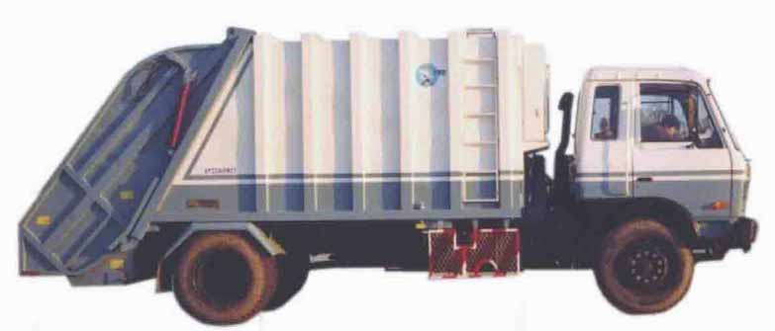

Garbage Collection

Slide 41
Garbage Collection
What is Garbage Collection?
Can we force Garbage Collection?
Runtime – gc()
System - gc()
Making your objects eligible for Garbage Collection
  Reassign reference variable
  Set a null value
  Islands of isolation

Slide 42
Garbage Collection
A a = new A();
a.Name = ‘A1’;
a = A2;
A1
A2
Reassign Reference
A a = new A();
a = null;
A1
Set null
B
Islands Of Isolation
A
C

Slide 43
Collections - Introduction
String student1 = “a”;
String student2 = “b”;
String student3 = “c”;
String student4 = “d”;
String student5 = “e”;
String student6 = “f”;
Difficult to maintain multiple items of same type as different variables
Data-manipulation issues
Unnecessary code

Slide 44
Collections – Arrays v/s Collections
abc
def
ghi
jkl
Arrays
abc
123
new Person()
def
Collections

Slide 45
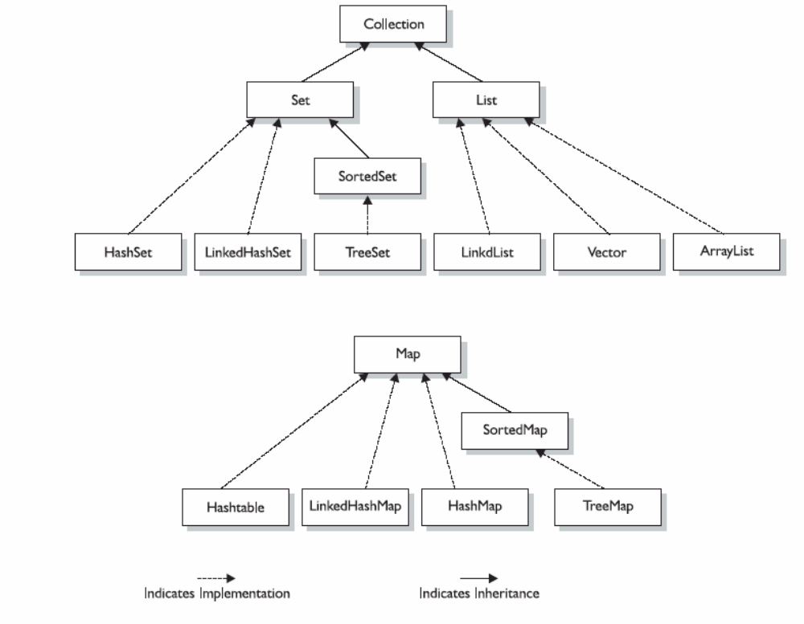
Collections - Overview
LinkedHashSet

Slide 46
Collections – Collection types
Three basic flavors of collections:
➢ Lists - Lists of things (classes that implement List)
➢ Sets - Unique things (classes that implement Set)
➢ Maps - Things with a unique ID (classes that implement Map)
The sub-flavors:
➢ Ordered - You can iterate through the collection in a specific order.
➢ Sorted - Collection is sorted in the natural order (alphabetical for Strings).
➢ Unordered
➢ Unsorted

Slide 47
Collections – Lists
ArrayList
  Resizable-array implementation of the List interface.
  Ordered collection.
  Should be considered when there is more of data retrieval than add/delete.
  Often used methods – add(), get(), remove(), set(), size()
Vector
  Ordered collection
  To be considered when thread safety is a concern.
  Often used methods – add(), remove(), set(), get(), size()
Linked List
  Ordered collection.
  Faster insertion/deletion and slower retrieval when compared to ArrayList

Slide 48
Collections – Set
HashSet
HashSet
HashSet
HashSet
HashSet
HashSet
  Not Sorted
  Not Ordered
  Should be used if only requirement is uniqueness
  Often used methods – add(), contains(), remove(), size()
  Not Sorted
  Not Ordered
  Should be used if only requirement is uniqueness
  Often used methods – add(), contains(), remove(), size()
  Not Sorted
  Not Ordered
  Should be used if only requirement is uniqueness
  Often used methods – add(), contains(), remove(), size()
  Not Sorted
  Not Ordered
  Should be used if only requirement is uniqueness
  Often used methods – add(), contains(), remove(), size()
  Not Sorted
  Not Ordered
  Should be used if only requirement is uniqueness
  Often used methods – add(), contains(), remove(), size()
  Not Sorted
  Not Ordered
  Should be used if only requirement is uniqueness
  Often used methods – add(), contains(), remove(), size()
LinkedHashSet
LinkedHashSet
LinkedHashSet
LinkedHashSet
LinkedHashSet
LinkedHashSet
  Not Sorted
  Ordered
  Subclass of HashSet
  Should be used if the order of elements is important
  Not Sorted
  Ordered
  Subclass of HashSet
  Should be used if the order of elements is important
  Not Sorted
  Ordered
  Subclass of HashSet
  Should be used if the order of elements is important
  Not Sorted
  Ordered
  Subclass of HashSet
  Should be used if the order of elements is important
  Not Sorted
  Ordered
  Subclass of HashSet
  Should be used if the order of elements is important
TreeSet
TreeSet
TreeSet
  Sorted
  Ordered
  Should be used if you want to store objects in a sorted fashion
  Often used methods – first(), last(), add(), addAll(), subset()
  Sorted
  Ordered
  Should be used if you want to store objects in a sorted fashion
  Often used methods – first(), last(), add(), addAll(), subset()
  Sorted
  Ordered
  Should be used if you want to store objects in a sorted fashion
  Often used methods – first(), last(), add(), addAll(), subset()

Slide 49
Collections – Map
HashMap
  Not Sorted, not ordered
  Can have one null key and any number of null values
  Not thread-safe
  Often used methods – get(), put(), containsKey(), keySet()
Hashtable
  Not Sorted, not ordered
  Cannot have null keys or values
  Thread-safe
LinkedHashMap
  Not sorted, but ordered
TreeMap
  Sorted, ordered

Slide 50
Threads - Introduction
What are Threads/ Why Threads?
A thread is a light-weight process.
Used to provide the ability to perform multiple things at the same time.
Thread Creation
There are 2 ways one can create a thread
  Extending the Thread Class
  Implementing the Runnable Interface
method1()
thread1.start()
main()
thread1.run()

Slide 51
Threads - Introduction
maintenance
Process report
EXECUTION
User validation
TIME
maintenance
Multi-threaded
environment
Process report
EXECUTION
User validation
TIME

Slide 52
Threads - Creation
Extending the Thread Class | Implementing the Runnable Interface
public Class MyThread extends Thread { public void run() { System.out.println(“In Thread”); } } To Invoke: MyThread t1 = new MyThread(); t1.start(); | public Class MyThread implements Runnable { public void run() { System.out.println(“In Thread”); } } To Invoke: MyThread t1 = new MyThread(); Thread t = new Thread(t1); t.Start();

Slide 53
Threads – Thread Life cycle
start
blocked
T1
T2
T1
runnable
running
end
T2
T1
T2
T1
T2
T1

Slide 54
Threads – Important Methods
From the Thread class
public void start()
public void run()
public static void sleep(long millis) throws InterruptedException
public static void yield()
public final void join()
public final void setPriority(int newPriority)
      Thread.MIN_PRIORITY : 1
      Thread.NORM_PRIORITY : 5
      Thread.MAX_PRIORITY : 10
From the Object class
public final void wait()
public final void notify()
public final void notifyAll()

Slide 55
Threads – Synchronization
Account acct = getAccount (123);
MyThread t1 = new MyThread(acct);
MyThread t2 = new MyThread(acct);
t1.start();
t2.start();
100
90
Account
100
50
100 140
shared object
public class Account {
private int bal;
private int acctId;
…
public Account(int acctId) {
this.acctId = acctId;
}
public boolean withdraw(int amt) {
if (bal > 0) {
// give money
// other related activities
bal = bal – amt;
}
}
}
acct
acct
run()
run()
T1 stack
T2 stack

