Slide 1
Chapter 4:
Input and Formatting Class Methods
Object-Oriented Program Development Using Java: A Class-Centered Approach

Slide 2
Objectives
Interactive Keyboard Input
Interactive Dialog Input
Creating a Class Library
Formatted Output
Mathematical Methods
Common Programming Errors

Slide 3
Interactive Keyboard Input
Interactive data is entered:
  By a user at the keyboard
  Via a graphical user interface (GUI)
  From a file
Data can be entered into a program while it is running using System.in object
Stream objects:
  Called streams for short
  Transmit data as stream of individual data bytes

Slide 4
Interactive Keyboard Input (continued)
End-of-file (EOF) marker:
  Special end-of-data value
  Numerical value that cannot be converted into a legitimate character value
If you would like to read an entire line at once:
  Use supporting classes:
    InputStreamReader
    BufferedReader

Slide 5
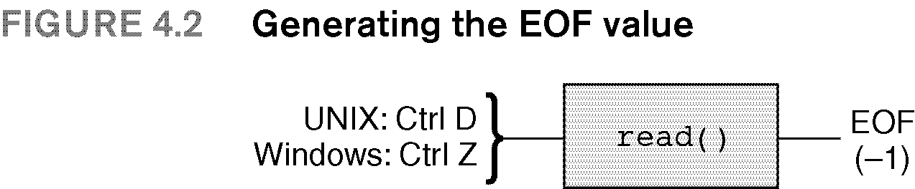

Slide 6
Interactive Keyboard Input (continued)
InputStreamReader:
  Automatically converts integer values of System.in stream to character values
  Can be constructed from System.in object
  InputStreamReader isr =
  new InputStreamReader(System.in);

Slide 7
Interactive Keyboard Input (continued)
BufferedReader:
  Automatically constructs a string from character values provided by the InputStreamReader object
  BufferedReader br = new BufferedReader(isr);
A display prompt asks the user to enter data
Calling readLine() puts system in wait state until the user types data

Slide 8
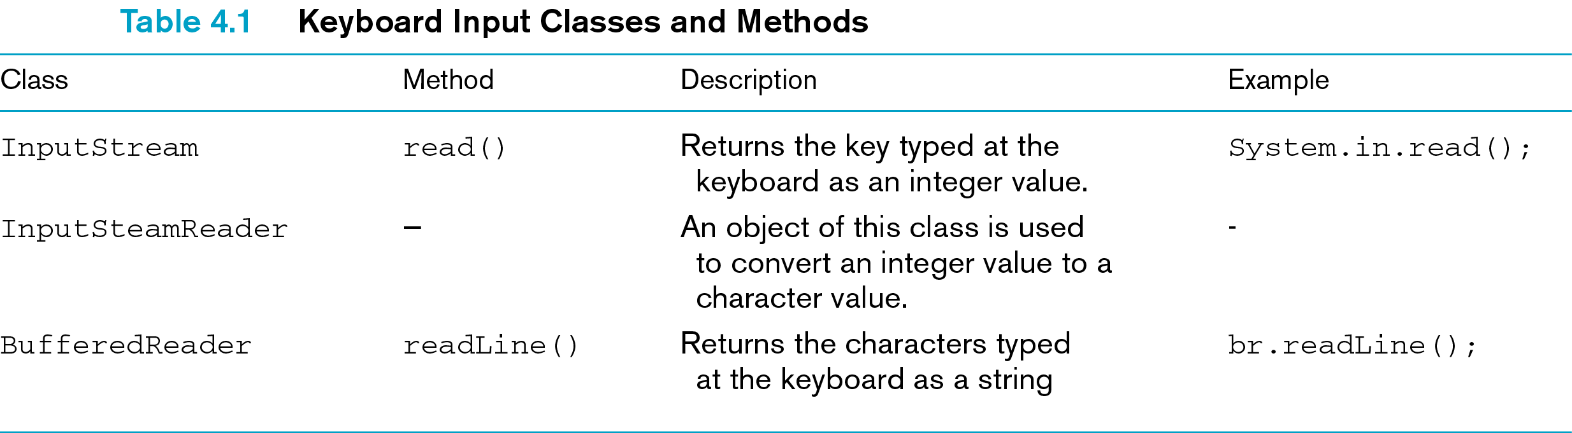

Slide 9
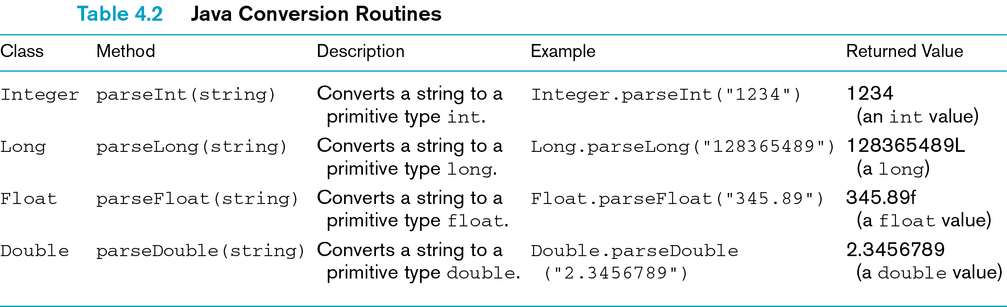

Slide 10
The StringTokenizer Class
Token
  String of characters separated by delimiting character
Delimiting characters
  Whitespace by default in Java
Parsing the string
  Separating individual tokens from string
Class StringTokenizer
  Used to parse strings

Slide 11
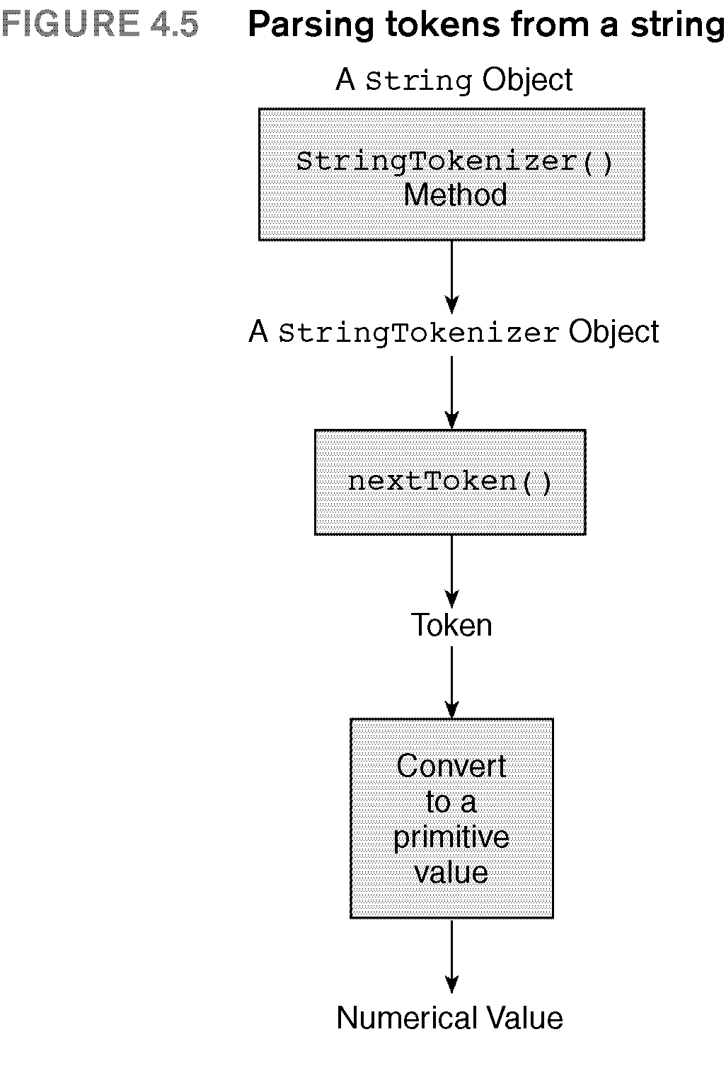

Slide 12
A First Look at User-Input Validation
A well-constructed program:
  Validates user input
  Does not crash due to unexpected input
A crash is program termination caused by an unexpected error

Slide 13
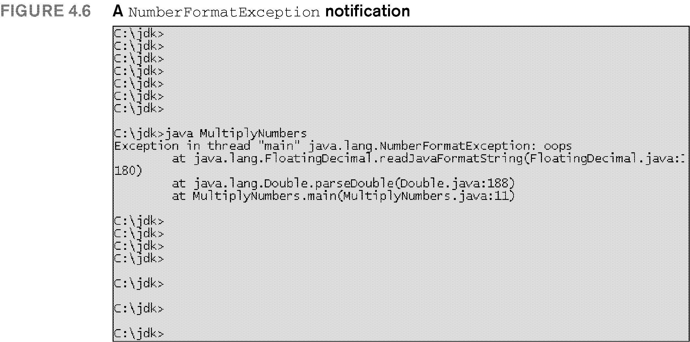

Slide 14
User-Input Validation
Consists of:
  Validating entered data either during or immediately after data have been entered
  Providing the user with a way of reentering any invalid data
To handle invalid input, provide error processing code

Slide 15
Dealing with Exceptions
To throw error up to operating system, use reserved word throws with error name

Slide 16
Interactive Dialog Input
GUI method of entering user data:
  Method named showInputDialog()
  In JOptionPane class
  Creates dialog box that permits user to enter string at terminal
Syntax:
  JOptionPane.showInputDialog(string);
Example:
  s = JOptionPane.showInputDialog("Enter a number:");

Slide 17
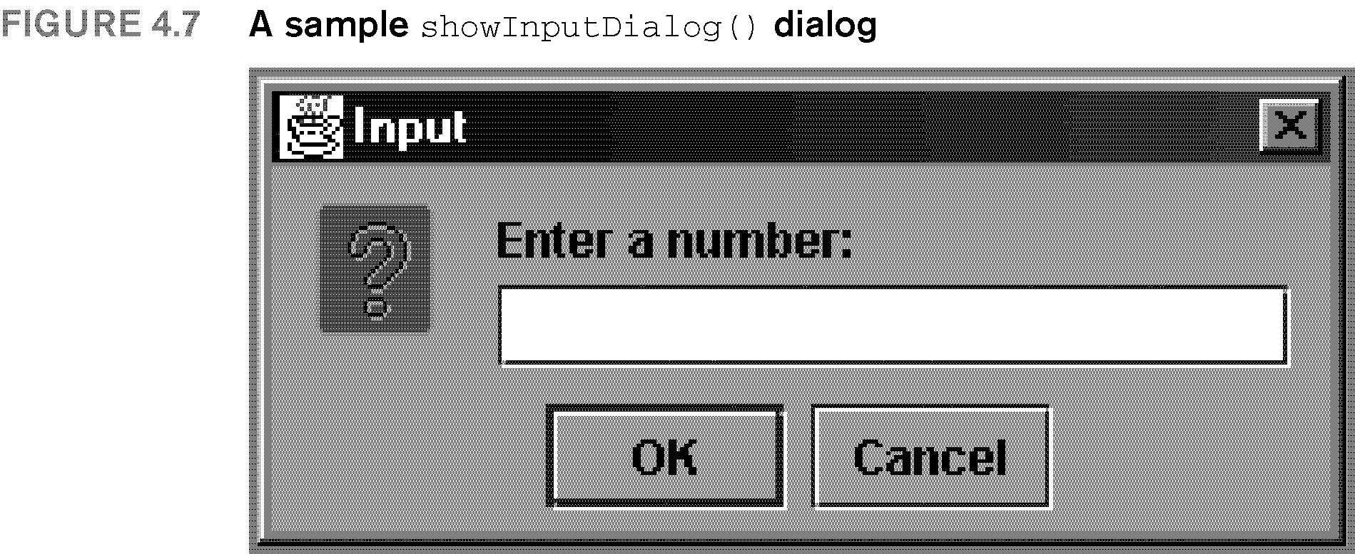

Slide 18
Exception Handling
Error handling in Java:
  Different from other high-level languages
Exception handling:
  Error occurs while a method is running
  Method creates an object that contains information about the error
  Object immediately passed to Java Virtual Machine
  JVM attempts to locate code to handle exception
  Called throwing an exception

Slide 19
Exception Handling (continued)
Two fundamental types of errors:
  Result from inability of program to obtain required resource
  Result from flawed code
Checked exception:
  Java checks that exceptions will be handled
  Program must throw or handle exception

Slide 20
Exception Handling (continued)
Unchecked exception:
  Java compiler does not check for handling code
  Error can always be prevented by programming

Slide 21
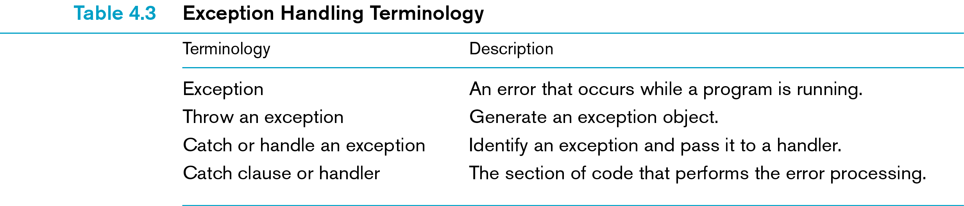

Slide 22
Exception Handling Syntax
  try
  {
  // one or more statements
  }
  catch (exceptionName argument)
  {
  // one or more statements
  }
  finally
  {
  // one or more statements
  }

Slide 23
Exception Handling Syntax (continued)
try
  Identifies start of exception handling block of code
  Must be followed by one or more catch blocks
catch
  Exception handler code
finally
  Default set of instructions always executed whether or not any exception occurred

Slide 24
Creating a Class Library
Java provides extensive set of tested and reliable classes
  Increases with introduction of each new version
Professional programmers create and share own libraries of classes
  Once they are tested, they can be reused in other programs

Slide 25
Formatted Output
Display of both integer and floating-point numbers can be controlled by Java-supplied format() method
  In class java.text.DecimalFormat
  Especially useful in printing columns with numbers
  Example:
    DecimalFormat num = new DecimalFormat("000");

Slide 26
Formatted Output (continued)
Required components for formatted output:
  Import statement for java.text package of classes
  Statement within main() method that uses new operator to create desired format string
  format() method call that applies format string to numerical value

Slide 27
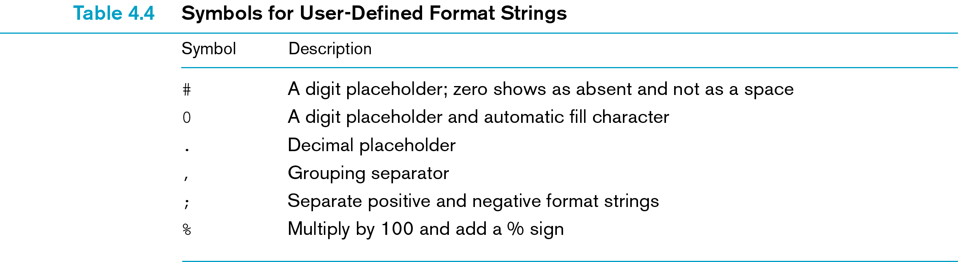

Slide 28
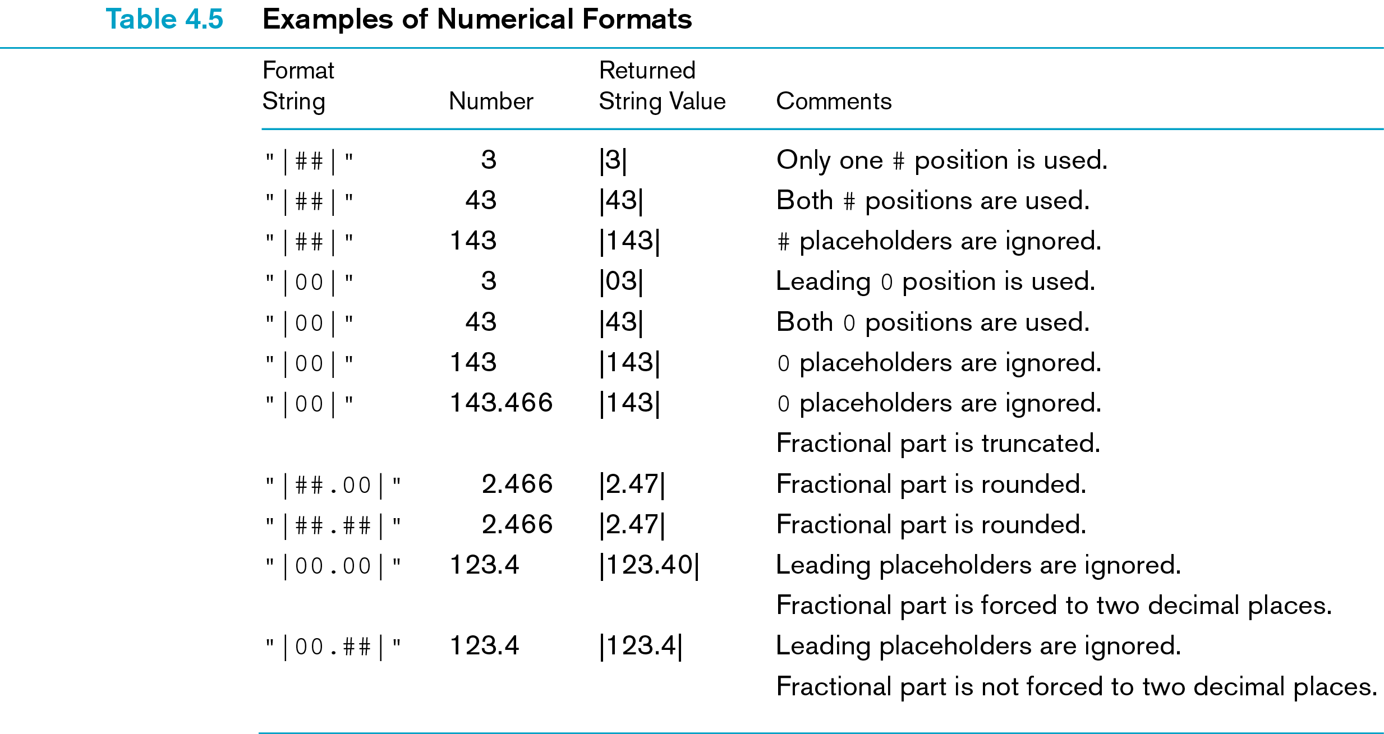

Slide 29
Mathematical Methods
Java provides standard preprogrammed methods within class named Math
  Methods are static and public
Each Math class method is called by:
  Listing name of class
  A period
  Method’s name
  Passing data within parentheses following method’s name

Slide 30
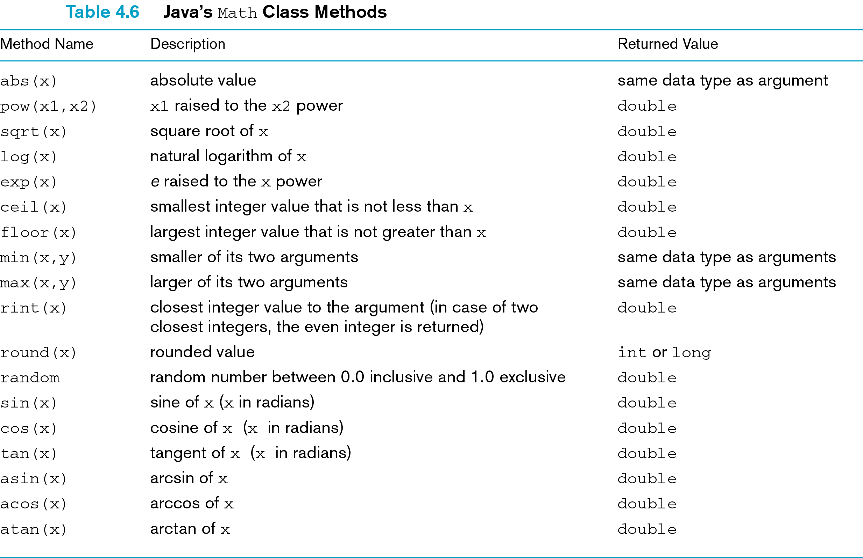

Slide 31
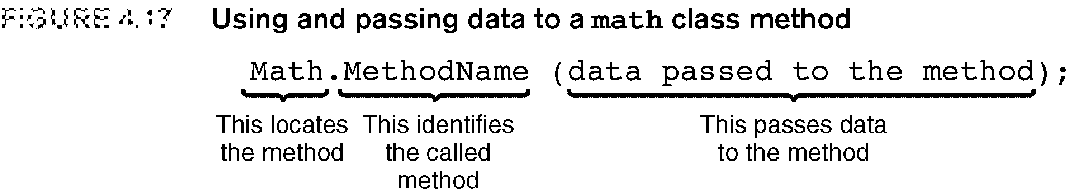

Slide 32
Casts
Java provides for explicit user-specified type conversions
Use cast operator:
  Unary operator
  Syntax:
    (dataType) expression
  Example:
    (int) (a * b)

Slide 33
Conversion Methods
Routines for converting string to primitive type and primitive type to string
Referred to as wrapper classes
  Class structure wrapped around built-in:
    integer
    long
    float
    double

Slide 34
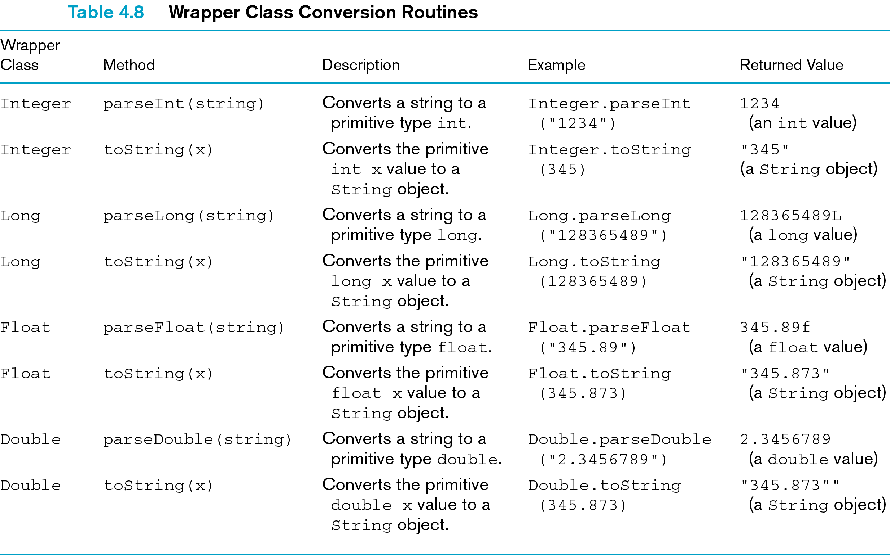

Slide 35
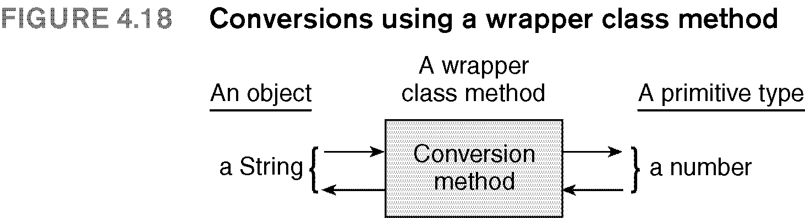

Slide 36
Common Programming Errors
Forgetting to precede mathematical methods with class name Math and period
Not understanding difference between writing program for personal use and one intended for someone else’s use
Being unwilling to test program in depth that is to be used by people other than yourself

Slide 37
Summary
Input from the keyboard can be accomplished using the readLine() method
Input dialog box method is used for data input
  From class JOptionPane
Exception is an error condition that occurs when program is running
  Notification of exception is immediately sent to Java Virtual Machine for processing

Slide 38
Summary (continued)
Java provides the Math class
  Contains methods for mathematical computations
Java String class provides methods for converting strings into primitive numerical types

