Slide 1
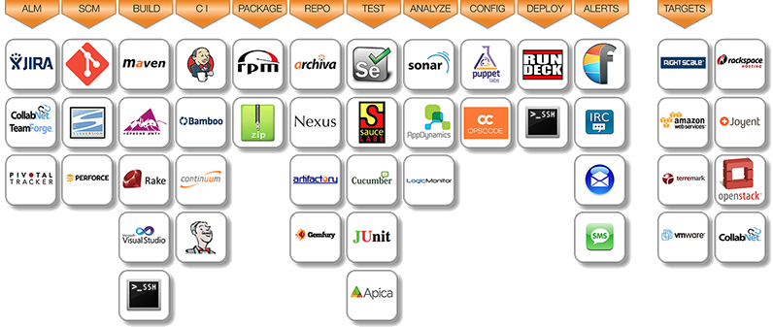
Tools
And integrated Application Performance Monitoring to create feed-back-loop

