Slide 1
Building a Dynamic Web App with HTML, CSS, and Flask
Introduction:
Today, I'm excited to present to you a project that showcases the power of modern web development technologies. I have created a web application that seamlessly combines HTML, CSS, and the Flask web framework to deliver a robust and user-friendly experience. This web app not only provides valuable features to users but also demonstrates effective database management through an intelligently designed schema.
HTML, CSS, Flask:
At the heart of our project lie three fundamental technologies: HTML, CSS, and Flask. HTML allows us to structure the content and layout of our web pages, while CSS brings visual appeal through styling. Combining these front-end technologies with the Flask framework on the backend enables us to create a cohesive and interactive experience for users.

Slide 2
Structured Data Management:
Web app don't just stop at the surface level. I have integrated a comprehensive database schema that supports the core functionalities of our application. This schema comprises tables like "company," "item," "purchase," and "sales," allowing us to efficiently manage company financials, inventory transactions, and more. We'll delve into these details shortly.
Why Flask?
Flask, a powerful Python web framework, serves as the backbone of our application. Its routing system, dynamic template rendering, and integration with databases allow us to develop complex functionalities with ease.
Intuitive User Interface:
Through the skillful application of HTML and CSS, we've designed an intuitive user interface that makes navigation a breeze. The interface is not only functional but also visually appealing, contributing to a positive user experience.

Slide 3
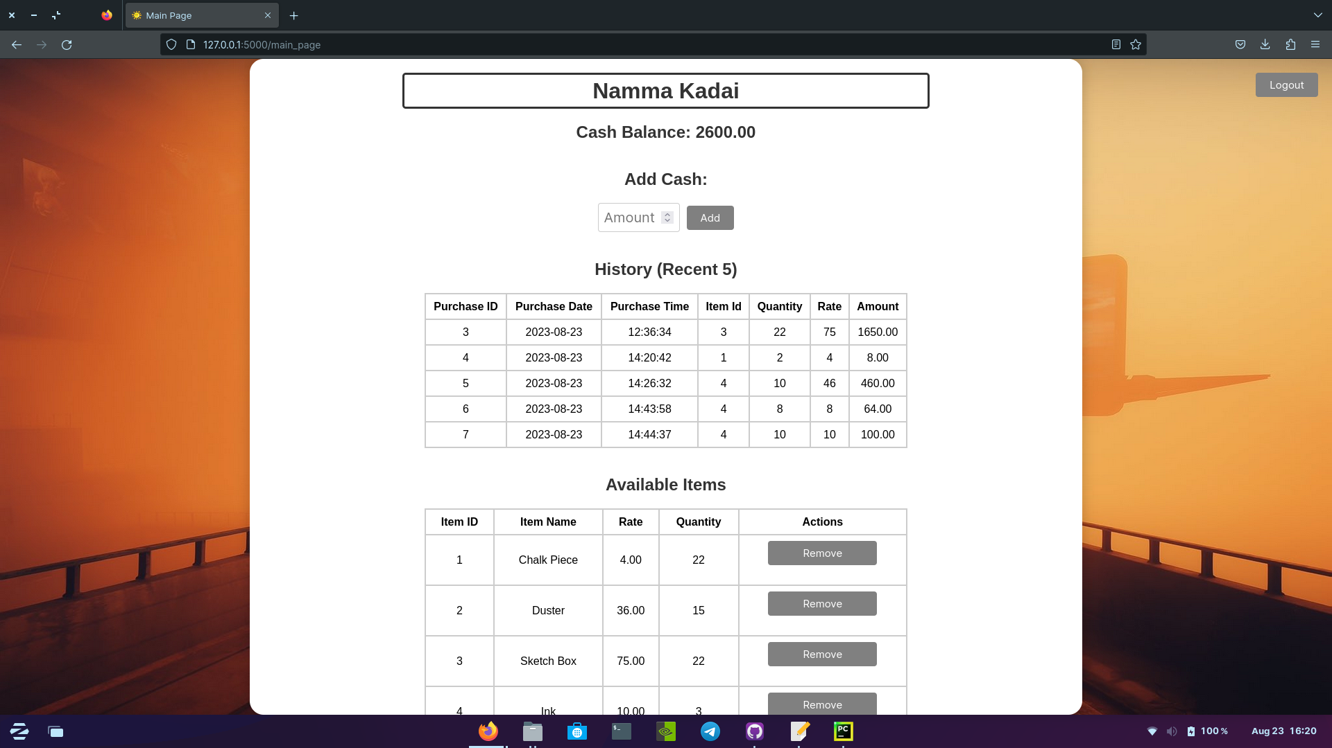

Slide 4
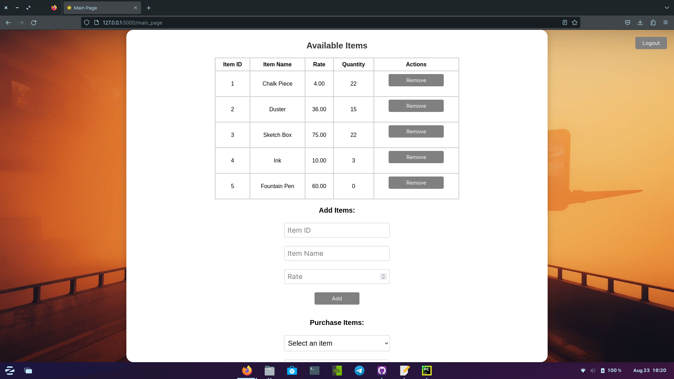

Slide 5
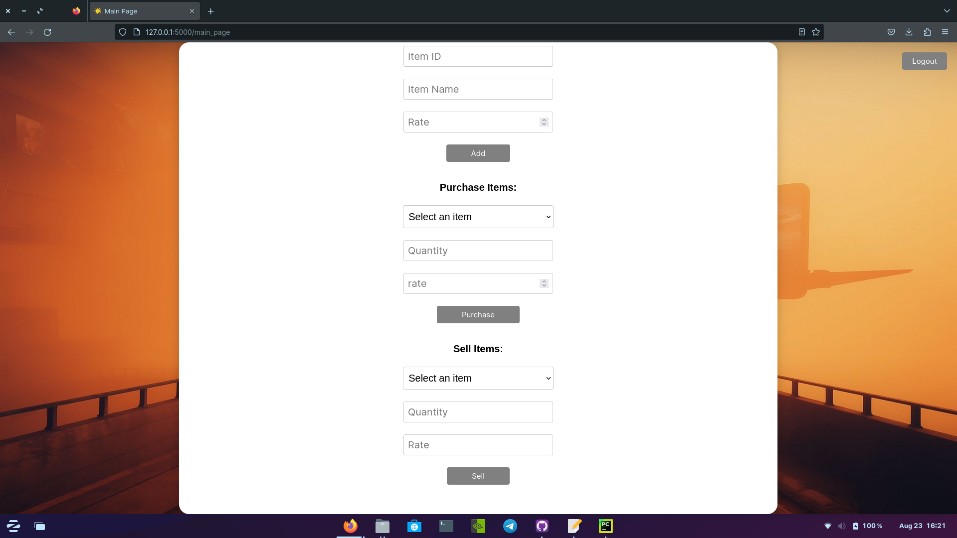

Slide 6
