Slide 1
Online movie ticket booking system
Seetharam Reddy Maila

Slide 2
Online movie ticket booking system
Requirements
High level design
DB design

Slide 3
Requirements
User Registration , preference management
Theatres management
Movies management
Booking system
Payment integration
Promotions/Notifications(mail/sms/whatsapp)
Observability(ELK)

Slide 4
High level Design
User Service
DB
Object Store
Gateway &
Load
Balancer
Movie Service
DB
Elastic search
Theatre Service
DB
Kafka
Booking Service
DB
Notification Service
Payment Service
DB

Slide 5
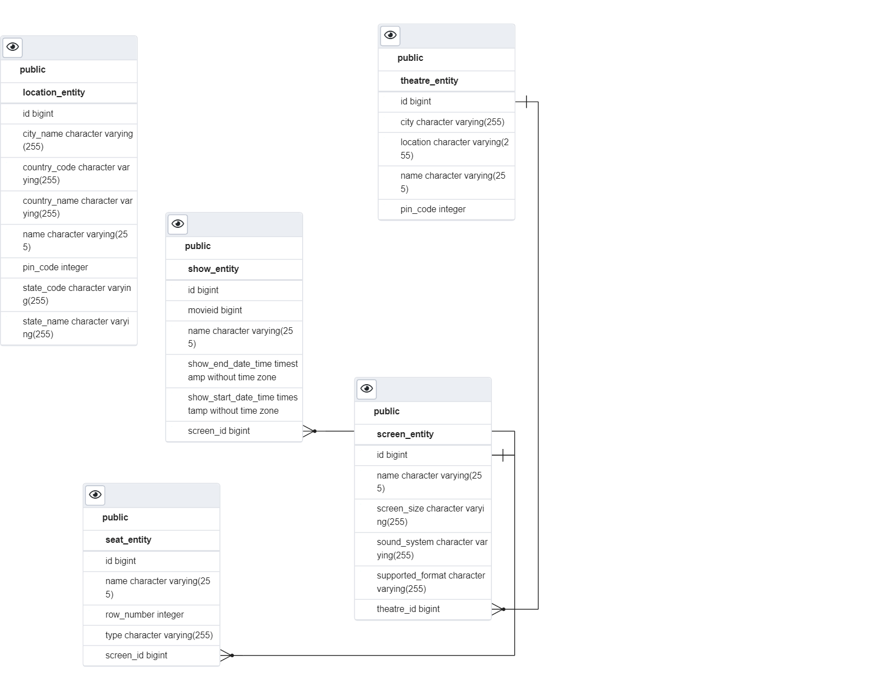
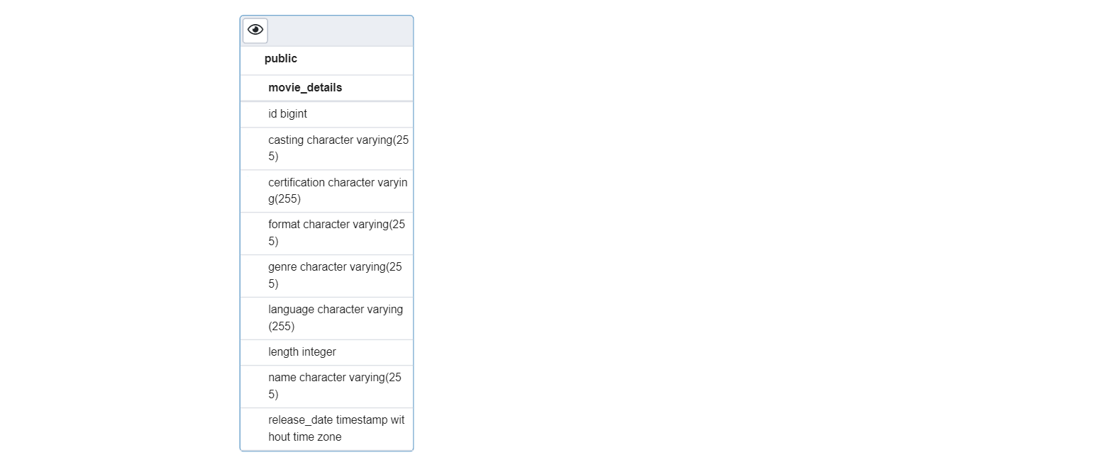
Database design

Slide 6
BOOKING service DB schema
Field | Type | Constraints
booking Id | Long | Primary key
booking status | Enumerated | HOLD/CONFIRM
User ID | Long
Booking Date | Date Time
Show Id | Long
Seat Id | Long
With Show Id we can track screen, movie, language, theatre etc..
Field | Type | Constraints
Booking ID | Long
Seat Id | Long | Under single booking multiple seats possible

