Slide 1
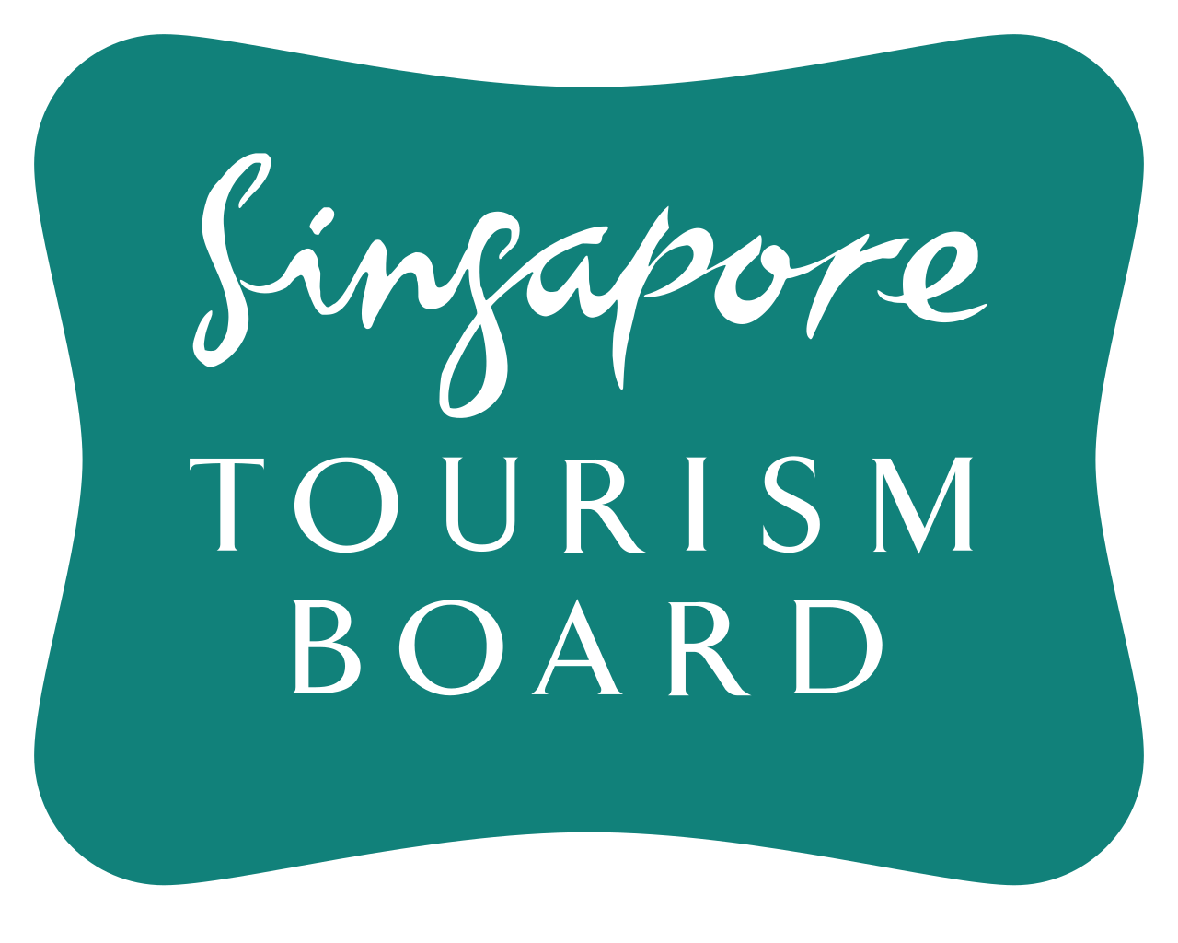
Singapore Tourism Board Performance Deep-dive
Can international concerts help explain growth in our largest visitor segments?
Senior Analyst, Data Pilots — Management Presentation
By Gerald Seet Hui Yang

Slide 2
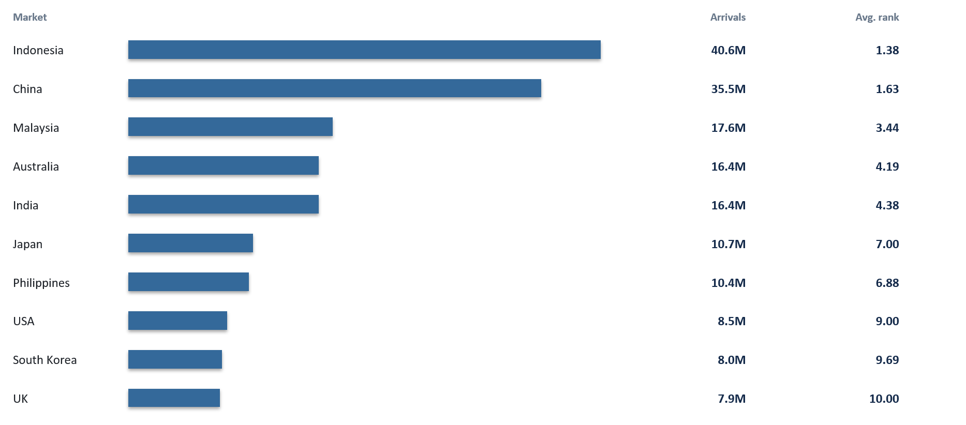
1. Singapore’s visitor base is concentrated in a stable set of major markets
Average visitor-arrival rank across observable years; 2020–2022 excluded (Max rank = 53)
Top 5
Indonesia, China, Malaysia, Australia and India
These markets consistently rank among Singapore’s largest sources of visitors.
This begs the question – can we pinpoint which demographic segments are driving high tourist arrivals from these markets?
2

Slide 3
2. Working-age adults dominate the top 10 tourism markets
Average demographic rank across the top 10 source markets (Rank 1.0 highest, Rank 16.0 lowest)
Male 35–44
Rank 2.59
Core segment
Males 25–54 Females 25–44
Female 25–34
Rank 3.18
Male 25–34
Rank 3.76
Singapore has seen the highest proportion of tourists from these five age-sex groups across the top 10 markets throughout the reporting period.
Male 45–54
Rank 3.80
Female 35–44
Rank 5.09
3

Slide 4
3. Data meshing: Do international concerts move with visitor growth?
STAN demographic arrivals were meshed with a historical list of Singapore concert calendar events sourced online with the help of ChatGPT
Mesh
Year × month of concert vs tourist arrivals
Test
Concert vs no concert + concert intensity (how many concerts held in a given month)
STAN
Monthly arrivals by market, age, sex
→
Concert calendar
340 international / regional concerts
→
→
Binary test
Is YoY growth higher in concert months?
Intensity test
Do more concerts coincide with stronger YoY growth?
4

Slide 5
4. Concert activity is positively associated with target-segment
growth in most top markets
Statistical significance threshold: p < 0.05
6 / 10
Top markets showed significant positive uplift for at least one target demographic in concert months
7 / 10
Top markets showed a significant positive correlation between concert intensity and target-segment growth
Key finding 1: Concert activity is associated with stronger Year-on-Year (YoY) visitor growth among key demographics across a majority of top markets.
Key finding 2: The intensity result suggests the relationship is not limited to simply whether a concert occurred i.e., more concerts tend to result in higher tourist arrivals.
5

Slide 6
5. Recommendation: Synergize rolling out campaigns targeted at Top 10 Markets during major concert periods
Target
Top 10 source tourism markets
Pilot
Rollout targeted campaigns (i.e., flight + hotel
+ entertainment packages) aimed at our top
markets during major concert periods
Measure
Incremental arrivals, spend and length of stay
In our top markets, concert activity is significantly associated with stronger YoY visitor-arrival growth for at least one key demographic segment — males 25–54 and/or females 25–44 — in a majority of markets.
Caveats: External factors such as seasonality, airfares, accommodation costs and other major events are not controlled for. The analysis identifies statistical associations, not causality; concerts should therefore be considered one possible contributor to visitor growth.
Management takeaway: When targeting priority source markets, consider aligning campaign rollouts with major concert periods and test whether this generates incremental tourism demand.
6

Slide 7
7. Dashboard Link
https://datastudio.google.com/reporting/022d1d9f-41de-4059-b308-191af6160a00
- THE END -
6

