Slide 1
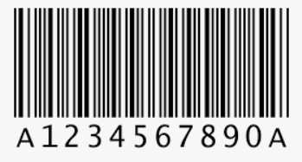
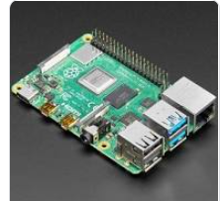
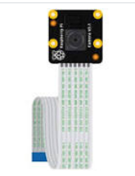
Smart Cart
Seetu Agarwal

Slide 2
Motivation
Standing in long checkout queues at the shopping centre is often a very time consuming process for both customer and shopkeeper.
Specially in these corona times , where social distancing is must forming long queues must be avoided.

Slide 3
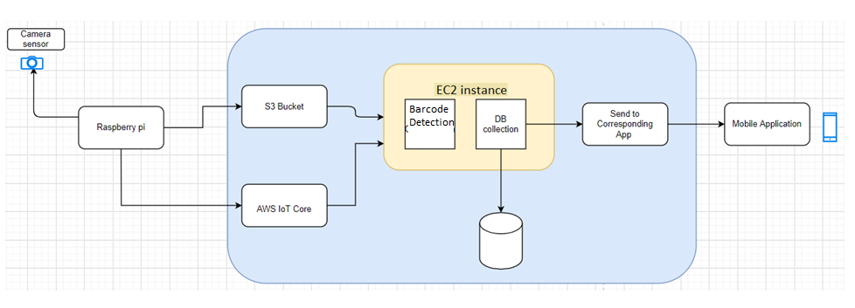
System Architecture
For Packaged Items with barcode on them

Slide 4
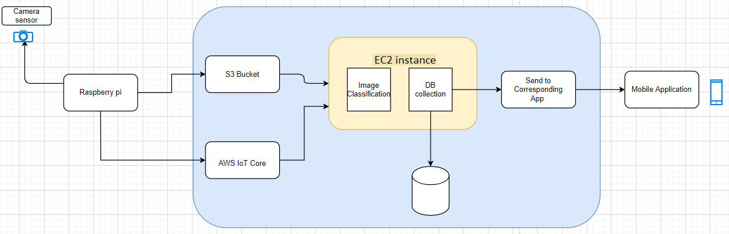
System Architecture
For Fruits and Vegetables

Slide 5
Hardware Requirements
Argon NEO Raspberry Pi 4 Model B Case (AR_NEO_RPi4_2Gig_32GigSD) - This kit contains Rapberry pi, heat sink, HDMI connector and SD card.
Arducam Auto Focus Pi Camera, Autofocus for Raspberry Pi Camera Module, Motorized Focus Lens, Software Precise Manual Focus, OV5647 5MP 1080P

Slide 6
Demo
https://drive.google.com/file/d/1-VHx3rQcQpxbIK2kS0-QhBHnjMIhJfq_/view?usp=sharing

Slide 7
Implementation Details
Device Code
Code is written which depicts the motion in front of autofocus raspberry pi camera module and capture the photo and upload the captured image on s3 bucket(“smartcartphoto”). It also connects this raspberry device to aws iot core and publishes the path of images uploaded on s3 bucket to the topic iot/motionDetected

Slide 8
Implementation Details
Cloud Code
Main Function : It receives the message from AWS Iot core which contains the path of the s3 bucket where the image is uploaded. Function then calls the s3Reader function
s3Reader: This function downloads the file from s3 bucket to the ec2 instance.
Barcode detector : With zbar python library Scanner object is instantiated and image as a numpy array is provided as an input to the scanner object. The obtained result is decoded in ascii format to read it.
Training Model : Fruits-360 dataset was taken from Kaggle. Data was pre-processed and CNN model was built in Google colab notebook. Model is saved and loaded on the ec2 instance.

Slide 9
Implementation Details
Dynamodb : Two databases are created:
All_items : It sores the information about all the items present in the shopping centre. [barcode_no, item_name, item_price, Description]
User_carts : It stores the information of the items that are kept in user cart
If the item is already existing in the cart then its quantity is increased in the user_carts dataset. Else entry is made into the user_carts with quantity 1.

Slide 10
Implementation Details
Android Application :
The android application is listening for changes in the DynamoDB and displaying them on the activity and also displaying a payment pipeline.
MainActivity.java: This starts the application and ask for cart number. After taking the cart number it invokes the Bill activity.
Bill.java: This the activity which holds the ItemList adapater for the items in the cart. It invokes the ask job of DBPoll.java. And passes the current activity
DBPoll.java: This file is responsible for an async task which polls the dynamoDb for the items in the user cart after ever 10 seconds and updates the Item List held by bill and calls notify. This calls the basic credentials to get access to the dynamoDb.

Slide 11
Implementation Details
ItemsList.java This is the ArrayList Adapter which refreshes the list from the DBpoll using the notify
MakePayment.java :This is invoked from Bill.java and contains various payment options. Currently these are only placeholder

Slide 12
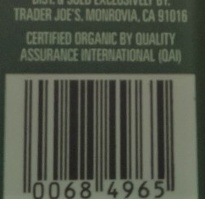

Encountered problems and their resolution
Hardware challenges :
With Raspberry Pi Camera Module V2-8 Megapixel,1080p (RPI-CAM-V2) , the barcode section of packaged items was blur and not very clear because of which it was impossible to detect and read the barcode. This normal Camera was replaced by Arducam AutoFocus Pi Camera to adjust the focus so that clear images of barcode section are captured and barcode can be easily read by python zbar library.

Slide 13
Encountered problems and their resolution
Technical challenges:
Issue with using lambda function of AWS : As with the captured images from raspberry pi we have to run barcode detection algorithm and machine learning model , we have to provide these python dependencies as well as tensor flow libraries to zip file in lambda function. There is a maximum size limit of the zip file that can be uploaded. But our requirement was greater than that. Hence created an EC2 instance as our backend server to process the images.

Slide 14
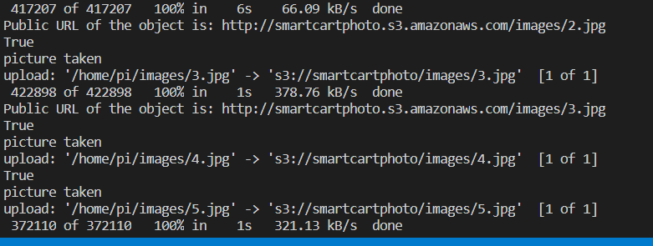
Evaluation :
Evaluation of Rasberry Pi :
Uploading Image from raspberry pi to s3 bucket: Approximately 200 images were sent from device to aws cloud.
Time taken for single image upload is 7s . For 10 images of a single item (event) it took 11 s

Slide 15
Evaluation :
Number of failed attempts to upload on s3 bucket : 11 images
Network Connection Issue
Evaluation of Backend Server
Evaluation conducted when the backend server is running on one 4 core machine . Can easily be scaled out using the subscriber model
If there is only one event with 10 s3 images then the time taken to complete the workflow is .
Time for downloading the S3 file : 14.3s
Time taken to run the barcode detection: ~0.51s
Time taken to predict the fruit : ~1.05s
Dynamo DB get/update : ~0.1s
Accuracy of the Simulated multiple threads from raspberry pi that are hitting the backend server. With 10 events for fruit classifier, reduced the performance by a factor of 2.21

Slide 16
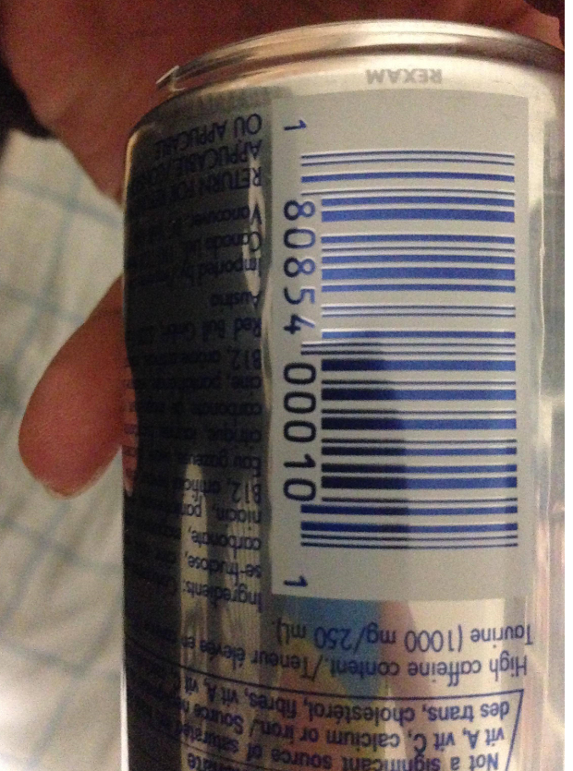
Evaluation
Polling frequency to query the database for the item kept in the user’s cart is 1 minute.
Below is the sample image containing curved , shiny coloured barcode region where barcode detection algorithm does not work.
Machine learning model is 90.05% with precision of 89.486%.

Slide 17
Novelty
Now-a-days RF ID tags are used at the checkout counter. However RF ID’s are costly compared to barcodes/QR code that are on the packaged item. My implementation is using these bar codes .
Currently for fruits and vegetables one has to enter the product code manually. With this design there is no need of manual interference.
My implementation can convert any ordinary cart in a store to smart cart in cost effective way.
Currently in amazon go store in Seattle, there are camera sensors in the store and weight sensor applied on the shelf, the cart is ordinary.

Slide 18
Future Scope Of Work
The project can be extended to detect whether the motion in front of raspberry pi camera sensor is upward or downward, that is whether the user is taking out the item from the cart or putting the item in the cart.
Currently It can identify 10 fruits and vegetables in total. The model can be trained to identify wide variety of fruits and vegetables.
Better barcode detection algorithm can be deployed that works on coloured , curved and shiny barcode region.

Slide 19
Thank You !

