Slide 1

SolidityToken by Riccardo Malatesta github.com/seeu-inspace

Slide 2

Problem Statement ❌
Solidity developers are not represented on the blockchain with their ERC-20 token

Slide 3
Solution ✅
I’ve created SolidityToken, a claimable ERC-20 token to give back to the community

Slide 4
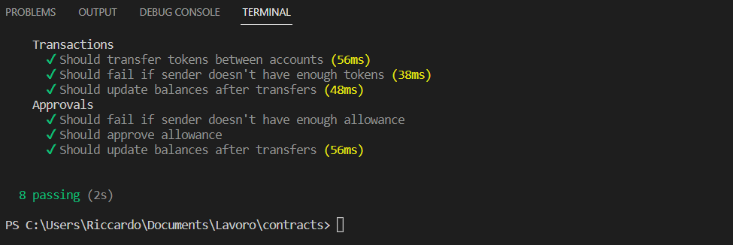
Solution ✅
SolidityToken is created and tested using HardHat

Slide 5
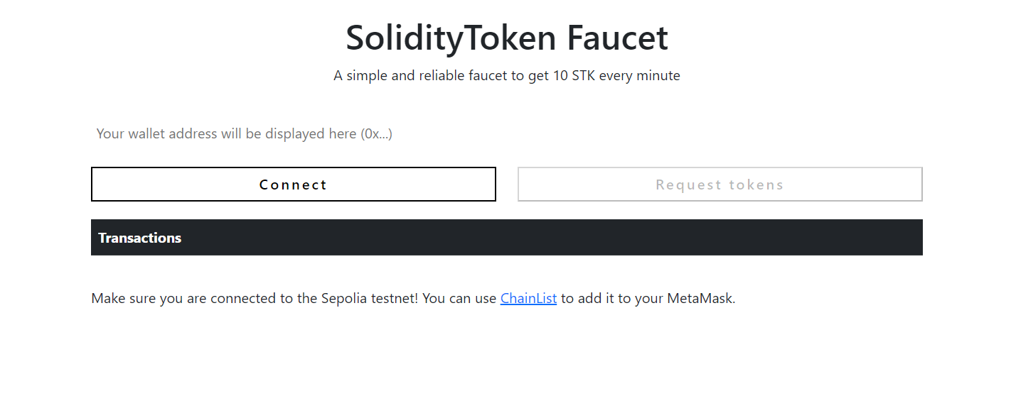
Solution ✅
SolidityToken is distributed using SolidityToken Faucet, built with Ethers and Browserify

Slide 6
Demo Time!

Slide 7
Next steps 📣
1. Improve the UI
2. Make $STK claimable only by Solidity developers
3. Create a DAO to drive the development of SolidityToken

