Slide 1
ρ-VEX core features (1/3)
Focus on readability, maintainability and flexibility of the code
Dynamic reconfiguration fixed, using hardware context switching
Core code and interface is identical for static and dynamic designs
Precise exceptions; trap model similar to ST200

Slide 2
ρ-VEX core features (2/3)
Control regs are part of the core now and can exist per context
Breakpoints and single step support built into the core
  can be handled by the trap handler or by halting the core
External debug interface can read and modify all registers even when core is running

Slide 3
ρ-VEX core features (3/3)
Should be synthesized with ISE 14.7
  ISE 13.4 synthesizes incorrectly for some reason
Fully featured design has been synthesized at 37.5 MHz
Much slower than the old core still, unfortunately
Seems to be primarily due to routing delay

Slide 4
ρ-VEX support library (1/2)
Compatible with grlib's library management
  can be added to a grlib project makefile using EXTRALIBS instead of needing to add files manually
Reconfigurable cache (as presented earlier)
  made compatible with the new core
  now generic-reconfigurable for heterogeneous designs

Slide 5
ρ-VEX support library (2/2)
Simple bus system for use in standalone designs with bridge to and from AHB
Two ready made system files for the core, one with on-chip memories and one with the cache and an AHB master and slave interface
Debug UART peripheral

Slide 6
rvsrv/rvd debug toolchain (1/2)
Connects to the debug UART peripheral, similar to grmon
rvsrv (ρ-VEX server) runs in the background
  bridges the serial port connection to two TCP servers, one for debug commands and one for stdin/stdout as seen by the application
rvd (ρ-VEX debug) sends debug commands to rvsrv, designed to be easily scriptable

Slide 7
rvsrv/rvd debug toolchain (2/2)
netcat can be used to connect to rvsrv to monitor stdout (puts, putchar) and write to stdin (getchar)
There is no gdb support yet

Slide 8
Platforms (1/2)
"Platforms" in this context refers to modelsim and/or ISE projects which implement the core somehow
core-tests
  Simulation-only platform which runs unit test suites on the core
cache-test
  Simulation-only platform which tests the core and cache in a controlled environment with any compiled
  ρ-VEX application

Slide 9
Platforms (2/2)
ml605-standalone
  Standalone core design without grlib or cache using block RAMs as memory for the ML605 development board
ml605-grlib (not functional yet)
  ρ-VEX core(s) with cache added to the grlib ML605 LEON3 project, using the latest version of grlib
zed-standalone (not functional yet)
  Same as ml605-standalone, but for the zedboard

Slide 10
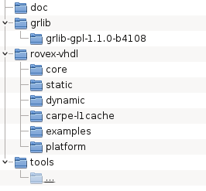
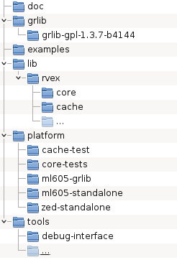
Repository structure
Old:
New:

