Slide 1

Report 12주차
2301603 Isakova Ashirgul

Slide 2
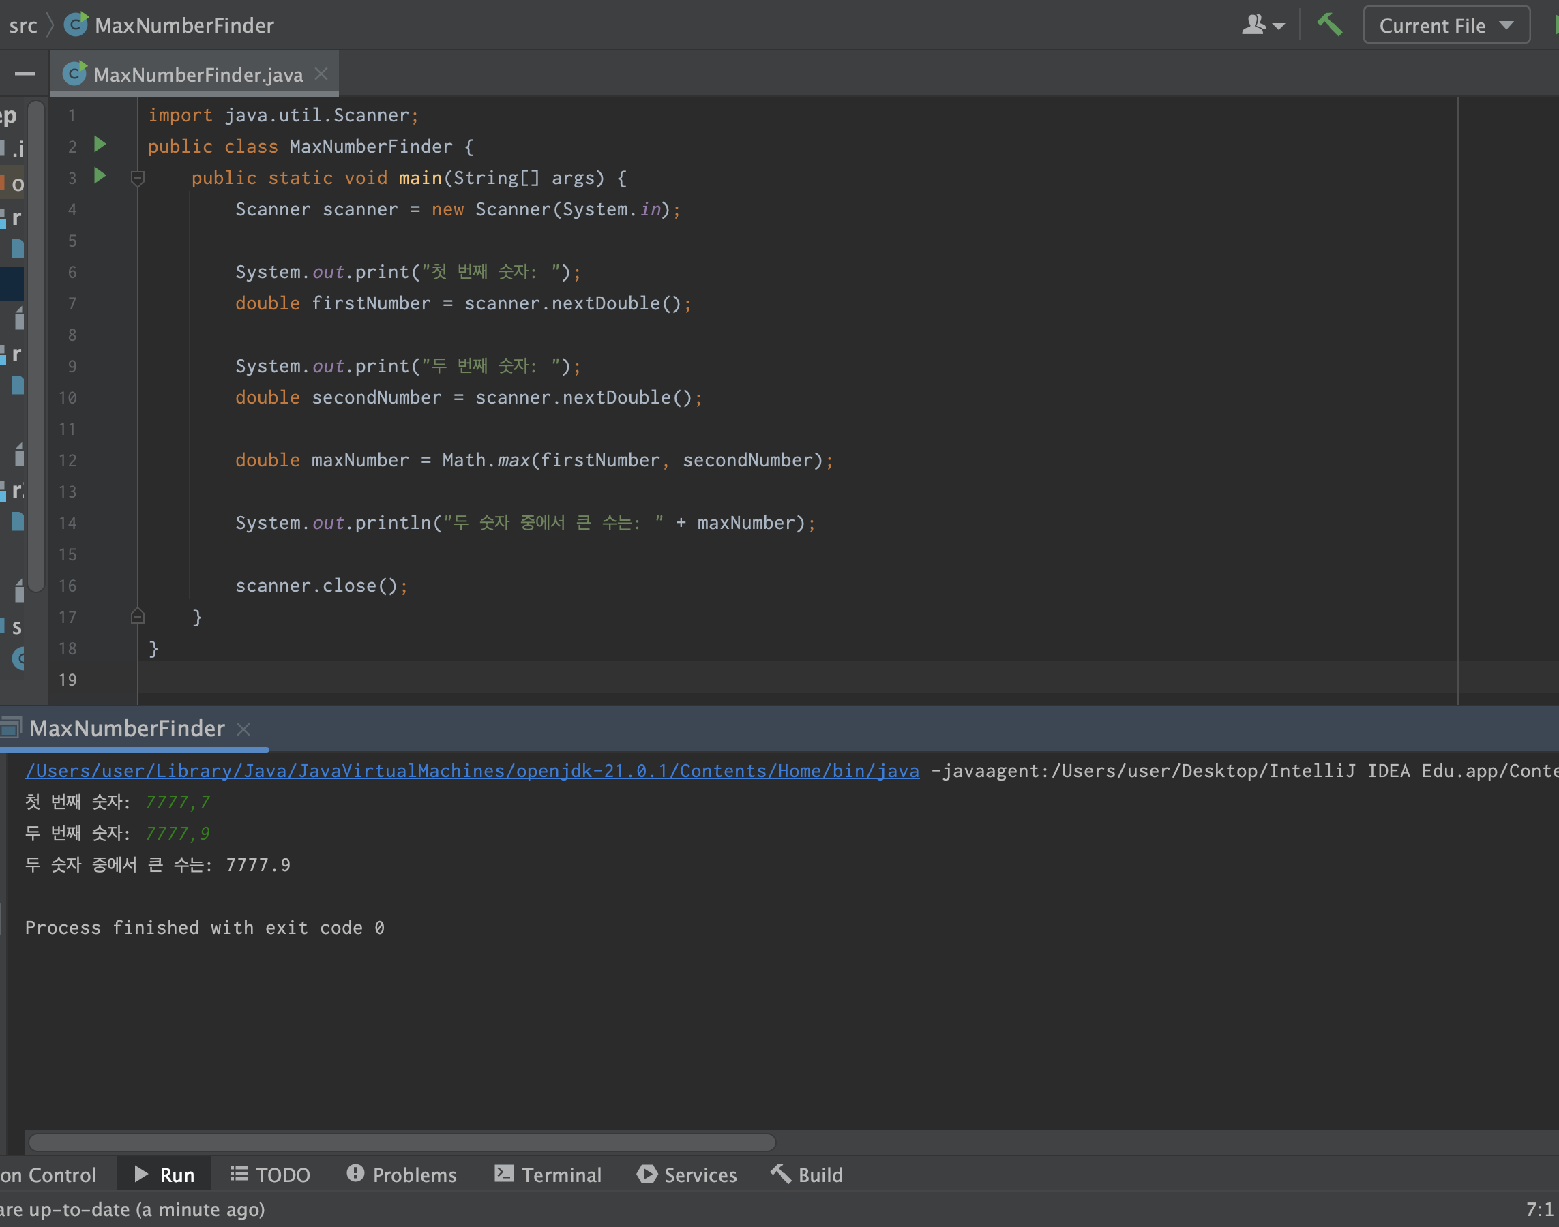
Report 1 결과 화면
import java.util.Scanner; public class MaxNumberFinder { public static void main(String[] args) { Scanner scanner = new Scanner(System.in); System.out.print("첫 번째 숫자: "); double firstNumber = scanner.nextDouble(); System.out.print("두 번째 숫자: "); double secondNumber = scanner.nextDouble(); double maxNumber = Math.max(firstNumber, secondNumber); System.out.println("두 숫자 중에서 큰 수는: " + maxNumber); scanner.close(); } }

Slide 3
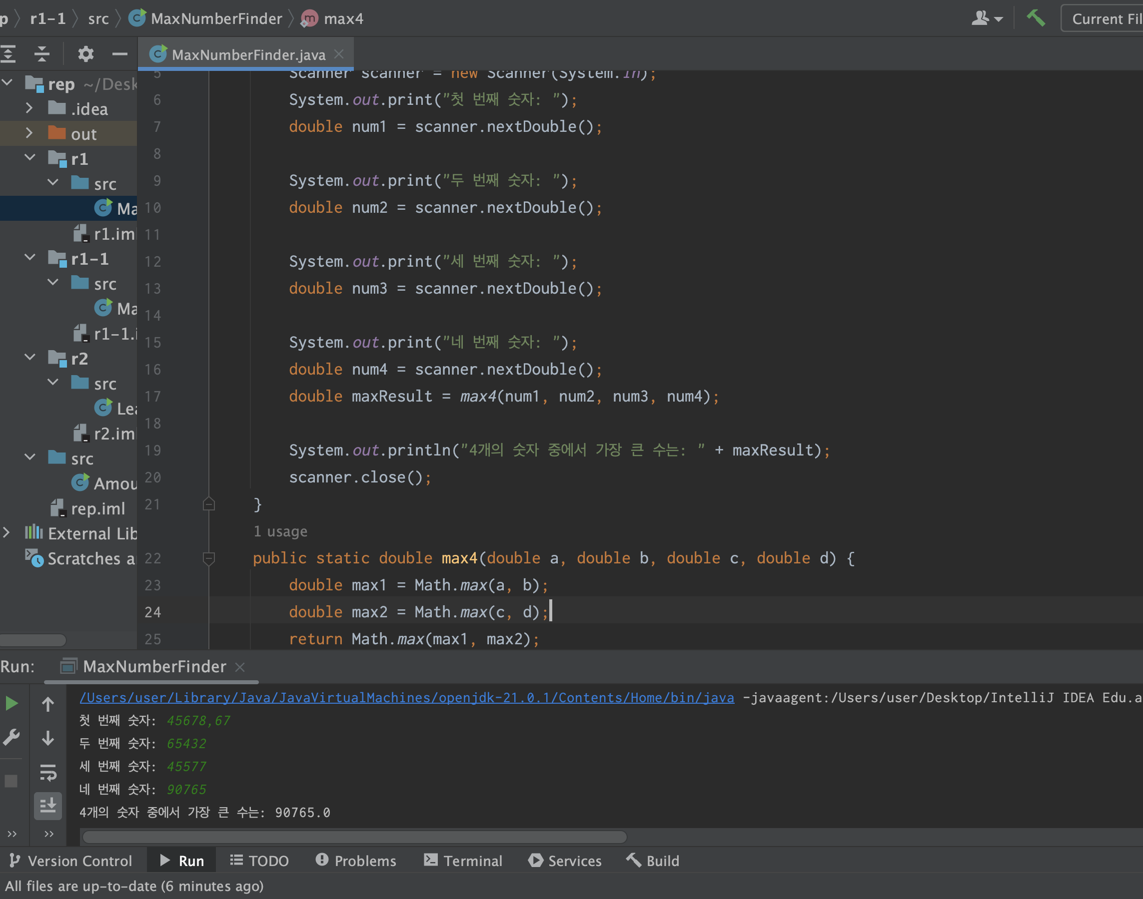
Report 1-1 결과 화면
import java.util.Scanner; public class MaxNumberFinder { public static void main(String[] args) { Scanner scanner = new Scanner(System.in); System.out.print("첫 번째 숫자: "); double num1 = scanner.nextDouble(); System.out.print("두 번째 숫자: "); double num2 = scanner.nextDouble(); System.out.print("세 번째 숫자: "); double num3 = scanner.nextDouble(); System.out.print("네 번째 숫자: "); double num4 = scanner.nextDouble(); double maxResult = max4(num1, num2, num3, num4); System.out.println("4개의 숫자 중에서 가장 큰 수는: " + maxResult); scanner.close(); } public static double max4(double a, double b, double c, double d) { double max1 = Math.max(a, b); double max2 = Math.max(c, d); return Math.max(max1, max2); } }

Slide 4
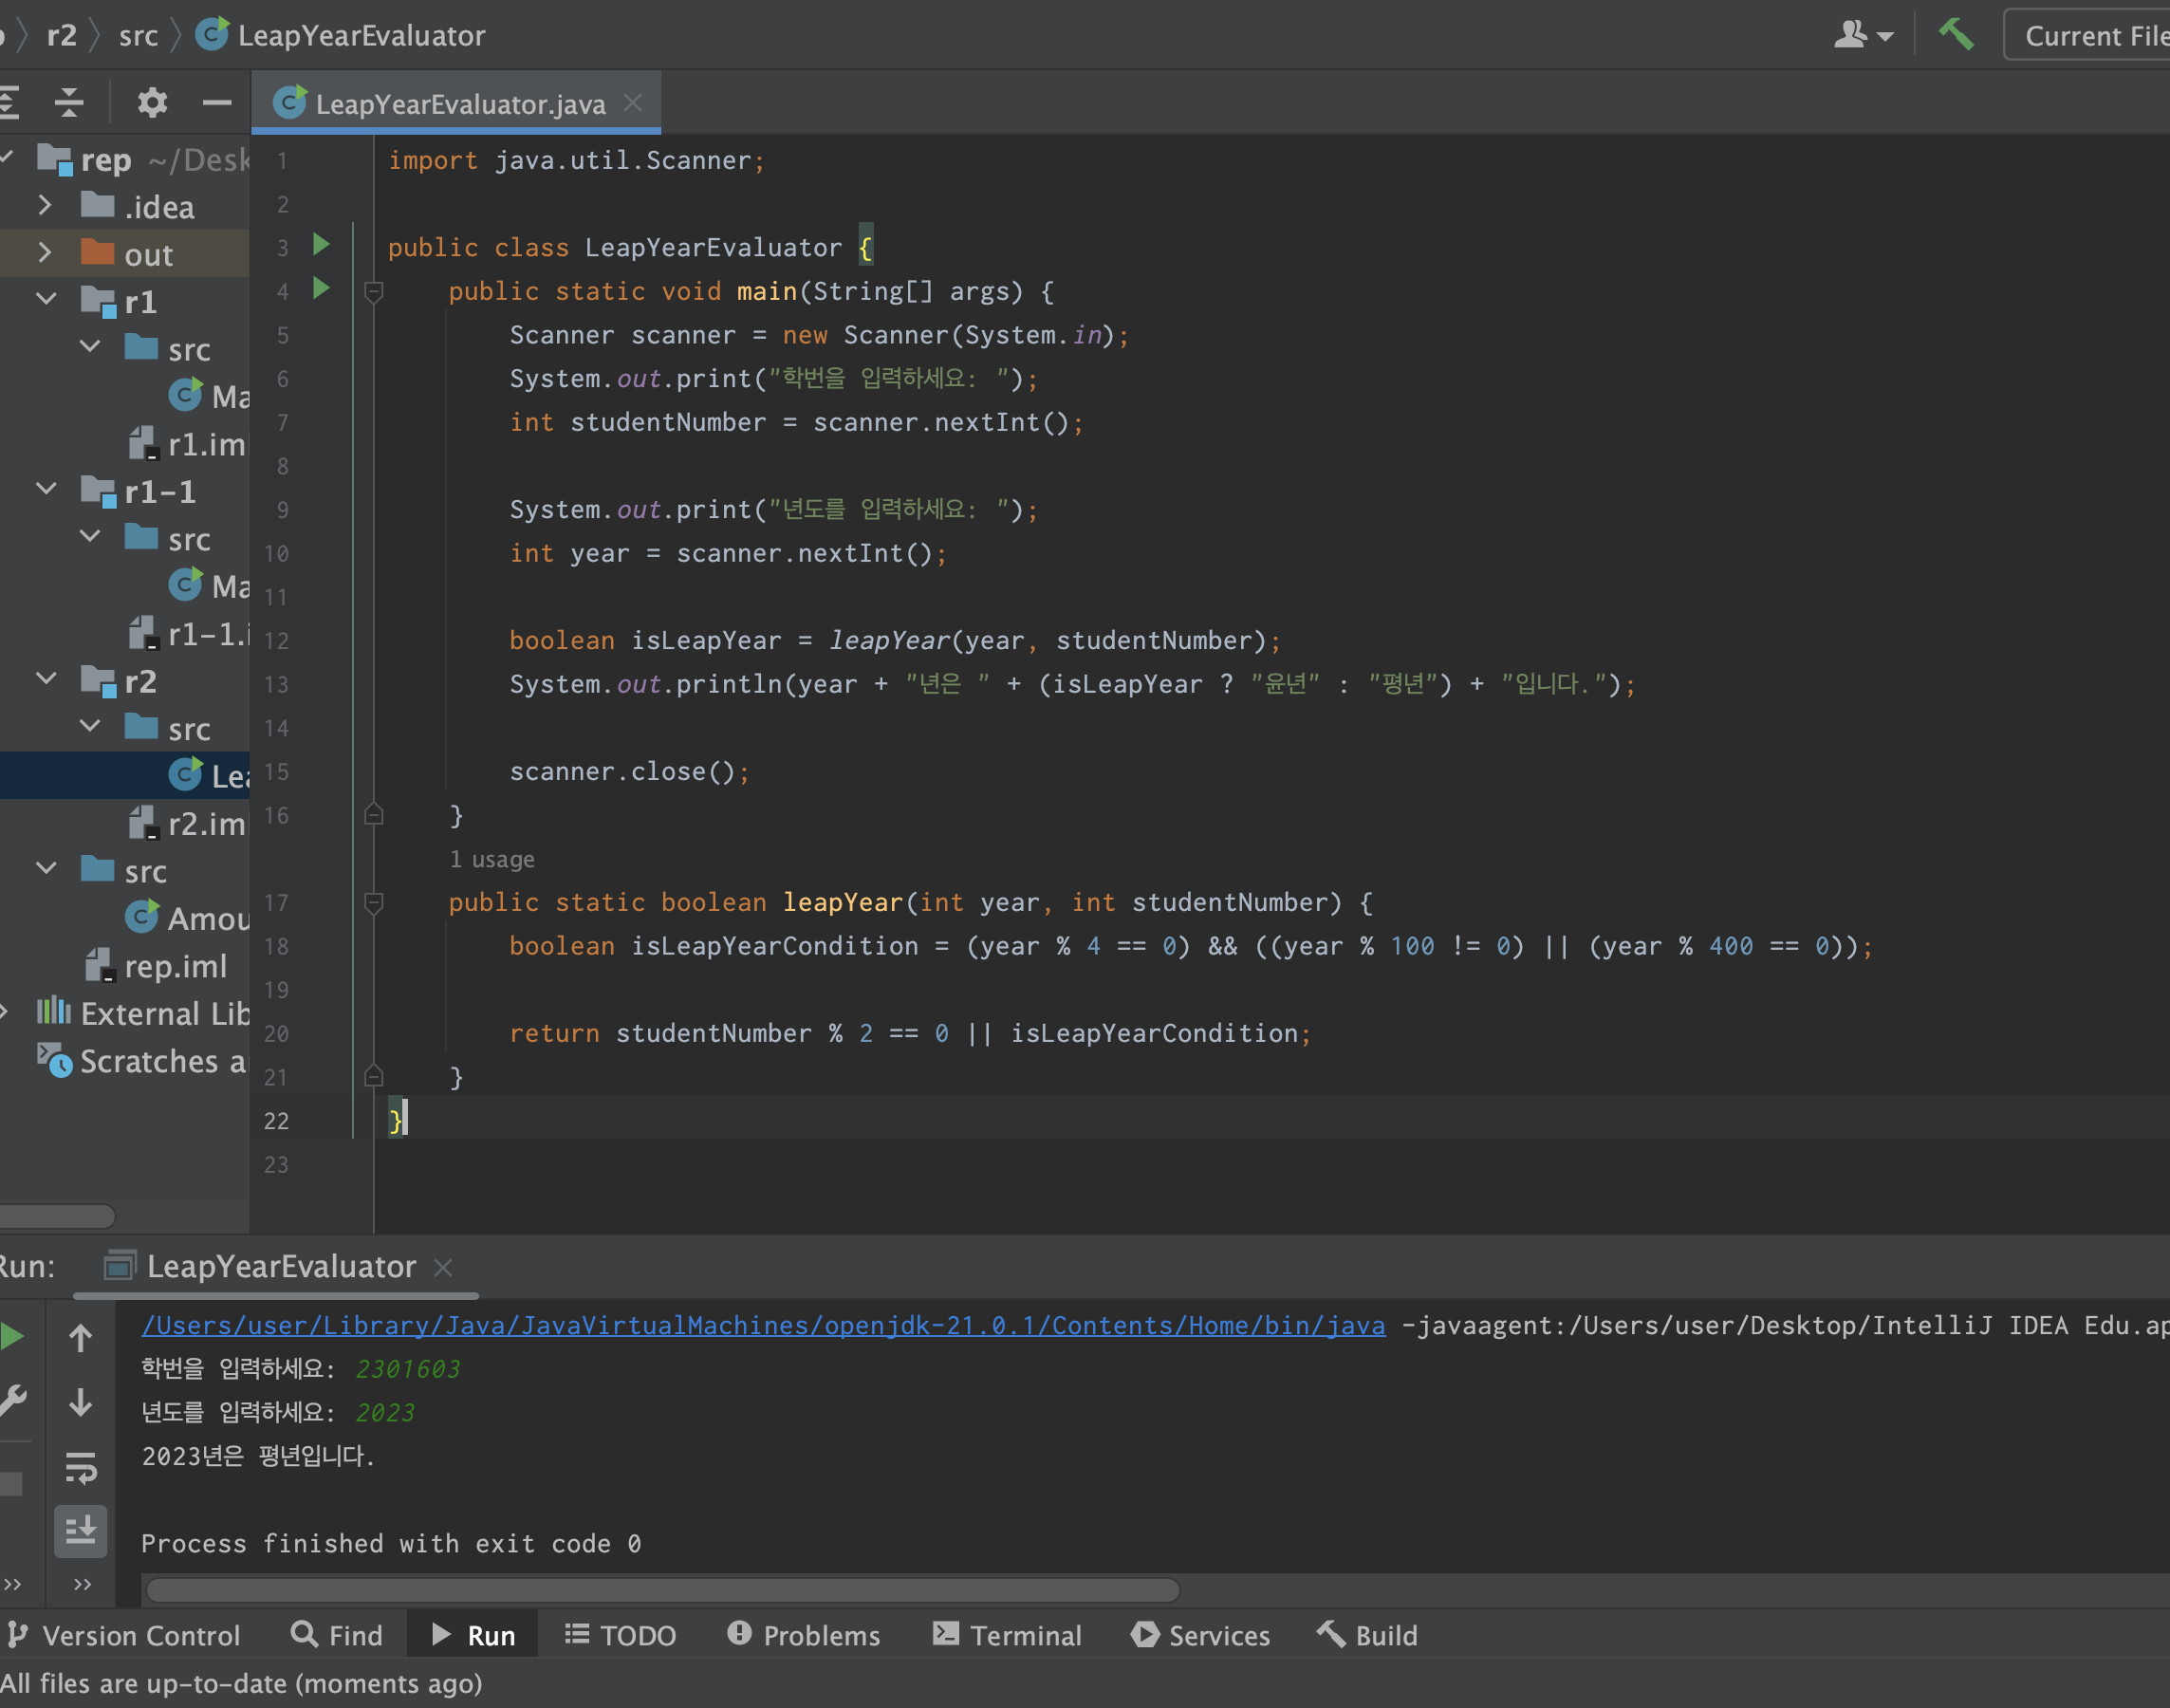
Report 2 결과 화면
import java.util.Scanner; public class LeapYearEvaluator { public static void main(String[] args) { Scanner scanner = new Scanner(System.in); System.out.print("학번을 입력하세요: "); int studentNumber = scanner.nextInt(); System.out.print("년도를 입력하세요: "); int year = scanner.nextInt(); boolean isLeapYear = leapYear(year, studentNumber); System.out.println(year + "년은 " + (isLeapYear ? "윤년" : "평년") + "입니다."); scanner.close(); } public static boolean leapYear(int year, int studentNumber) { boolean isLeapYearCondition = (year % 4 == 0) && ((year % 100 != 0) || (year % 400 == 0)); return studentNumber % 2 == 0 || isLeapYearCondition; } }

Slide 5
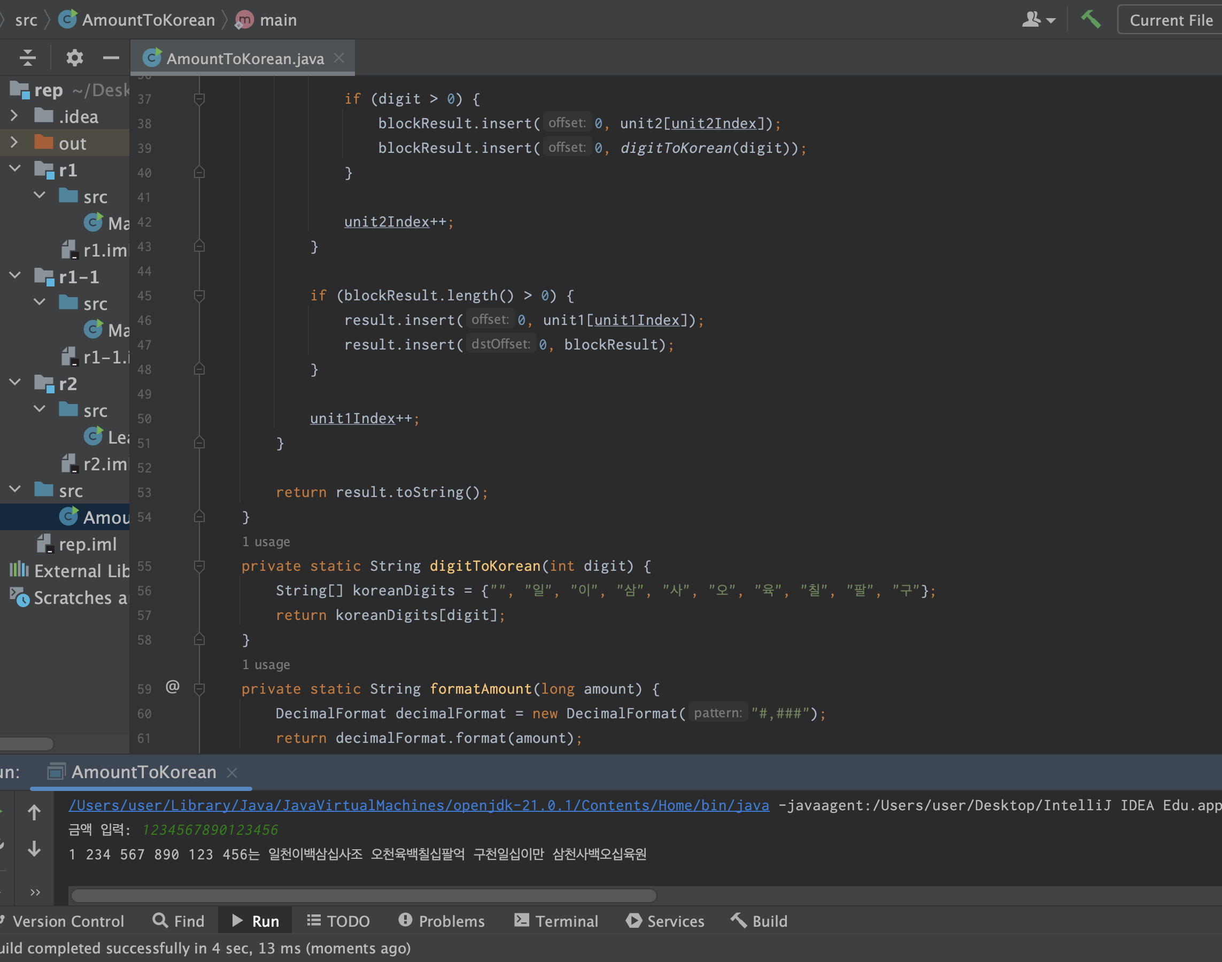
Report 3 결과 화면
import java.text.DecimalFormat; import java.util.Scanner; public class AmountToKorean { public static void main(String[] args) { Scanner scanner = new Scanner(System.in); System.out.print("금액 입력: "); long amount = scanner.nextLong(); String koreanAmount = readKorean(amount); String formattedAmount = formatAmount(amount); System.out.println(formattedAmount + "는 " + koreanAmount + "원"); scanner.close(); } public static String readKorean(long amount) { if (amount == 0) { return "영"; } String[] unit1 = {"", "만 ", "억 ", "조 "}; String[] unit2 = {"", "십", "백", "천"}; StringBuilder result = new StringBuilder(); int unit1Index = 0; while (amount > 0) { StringBuilder blockResult = new StringBuilder(); int unit2Index = 0; for (int i = 0; i < 4 && amount > 0; i++) { int digit = (int) (amount % 10); amount /= 10; if (digit > 0) { blockResult.insert(0, unit2[unit2Index]); blockResult.insert(0, digitToKorean(digit)); } unit2Index++; } if (blockResult.length() > 0) { result.insert(0, unit1[unit1Index]); result.insert(0, blockResult); } unit1Index++; } return result.toString(); } private static String digitToKorean(int digit) { String[] koreanDigits = {"", "일", "이", "삼", "사", "오", "육", "칠", "팔", "구"}; return koreanDigits[digit]; } private static String formatAmount(long amount) { DecimalFormat decimalFormat = new DecimalFormat("#,###"); return decimalFormat.format(amount); } }

