Slide 1


News Detection
Fake or Real
Sefa Alp
041502017

Slide 2
What is the purpose?
There are many social media account that reveals news every day. Many of them are comes from unreliable sources.
In this Project I wanted to create an AI program that detects if a given text comes from real news document or not.

Slide 3
Methodology
Wanted to classify news using probabilistic approach such Multinomial Naive Bayes algorithm.
Program basically occurs as two parts;
Creating unique words dictionary
Naive Bayes Algorithm

Slide 4
Unique Word dictionary will include only unique words in it with their term frequency in fake and real news also, their probability of existing for each class.
For example:
key_word ={[TF in fake, TF in real, Prob for fake, Prob for real]}
memorise = {[984, 2067, 0.0007, 0.0015]}

Slide 5
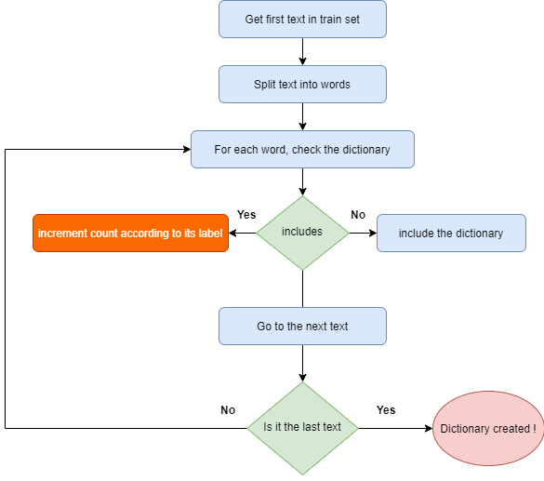

Slide 6
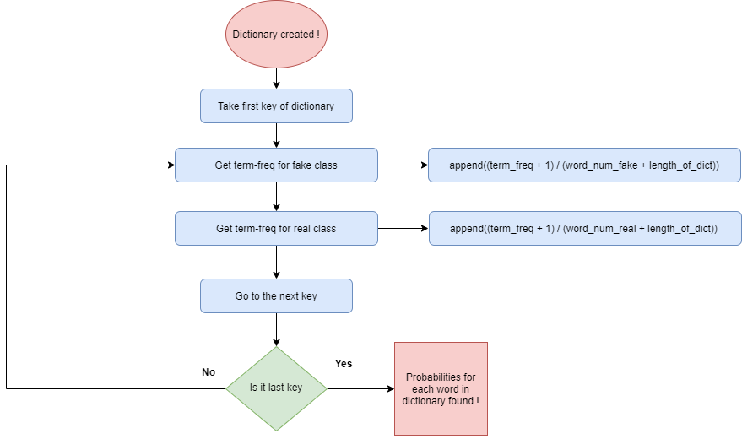
Then each objects occurence probabilities calculated with using their term frequencies calculated before.

Slide 7

Bayes Theorem
Bayes theorem helps us to find the probability of A, given that B. Here, B named as an evidence and A named as a hypothesis.
In our case as naive bayes approach, evidence part is always features.
If features are independent our algorithm named as Naive Bayes.

Slide 8

Above equation represents the evidence of our algorithm. These all x values represent different features of our training set. So, if evidence have many features given we need to find probabilities with using chain rule as below.

Slide 9
Let say our text is:
T1 = Donald Trump ride donkey.
«Donald» «Trump» «ride» «donkey»
«0.003» «0.003» «0.0001» «0.0006» => Prob for fake
«0.008» «0.008» «0.002» «0.000000001» => Prob for real
P( fake | T1 ) = P(fake) * (0.003) * (0.003) * (0.0001) * (0.0006) = 5.4e-13
P( real | T1 ) = P(real) * (0.008) * (0.008) * (0.002) * (0.000000001) = 1.28e-16
Thus this test text will take «0» label because probability of being fake is higher

Slide 10


We neglected denominator because it has always same value for all entries. "y" represents classes and we need to find the class which gives the highest probability. So, we are going to use argmax function to obtain the best.

Slide 11
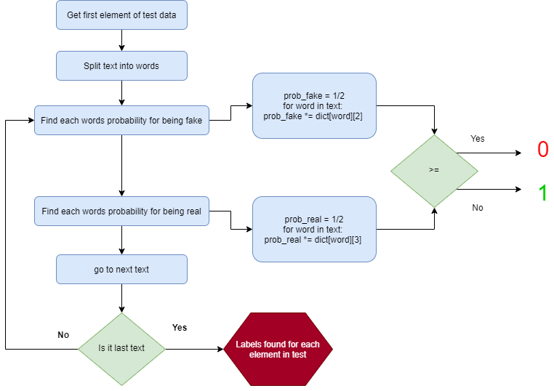

Slide 12
Results of my MNB
Algorithm Show accuracy in train data such 0.938
Algorithm Show accuracy in test data such 0.596
Also, removed stop words to see difference but accuracy dropped
As 0.595.
stop_words = [
"a", "about", "above", "across", "after", "afterwards", … ]

Slide 13
References
https://towardsdatascience.com/naive-bayes-classifier-81d512f50a7c
https://lazyprogrammer.me/bayes-classifier-and-naive-bayes-tutorial-using/
https://provalisresearch.com/blog/exploring-naive-bayes-classifier-maybe-not-naive/

Slide 14
Thanks For Listening

