Slide 1
Selecting the set of time points
So far (including in lungmap) based on ad-hoc decisions (Bar-Joseph, Nature Reviews Genetics, 2012).
Wanted to develop principled computational methods for selecting which time points to chose.
This is especially important for projects in which a large and diverse number of genomic and epigenetic datasets are being profiles (mRNA, miRNAs, methylation, ChIP-Seq for TFs etc.).
We use a very detailed sampling of a small subset of genes using nanostring and based on these we select a subset of the points for each of the genomics / epigentics experiments.

Slide 2
Spline based time points selection
Start with an ‘informed guess’ for the set of points (desired # of points is an input parameter).
Repeat:
- Fit optimal splines (number of control points) based on current time point values
- Evaluate error for points that are not used
- Replace one of the points in the set with another point not in the set if it reduces the left out error.
Stop when no improvement is possible.

Slide 3
Algorithm in a nutshell
Initialize points that are sorted by absolute differences.
Fit optimal
splines
Evaluate error for unused points
Replace one of the points in the set with another point until there is no improvement

Slide 4
Selected time points
Best informed guess is to initialize using points that are sorted by increasing absolute differences.
Selected 13 time points for mRNA (3 of these were fixed in advance):
[0.5, 1.0, 1.5, 2.5, 4, 5, 7, 10, 13.5, 15,19, 23, 28]
Top 10 solutions lead to errors that are very similar to the ones we used.

Slide 5
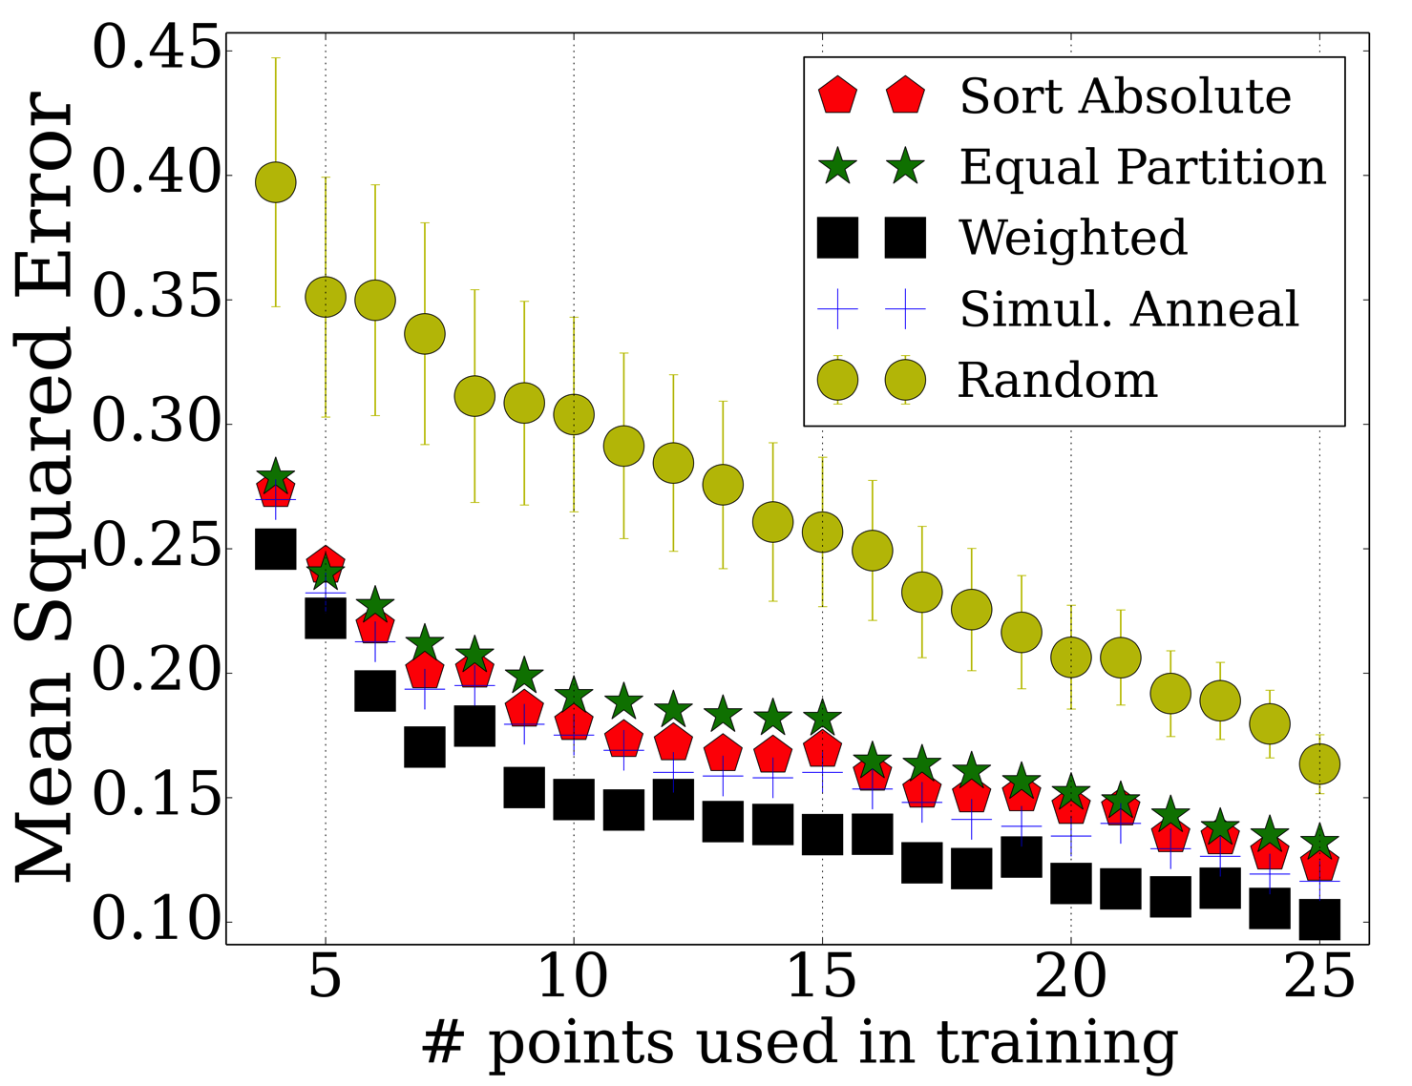
Error by increasing #points
Major performance improvement over randomly selected points

Slide 6
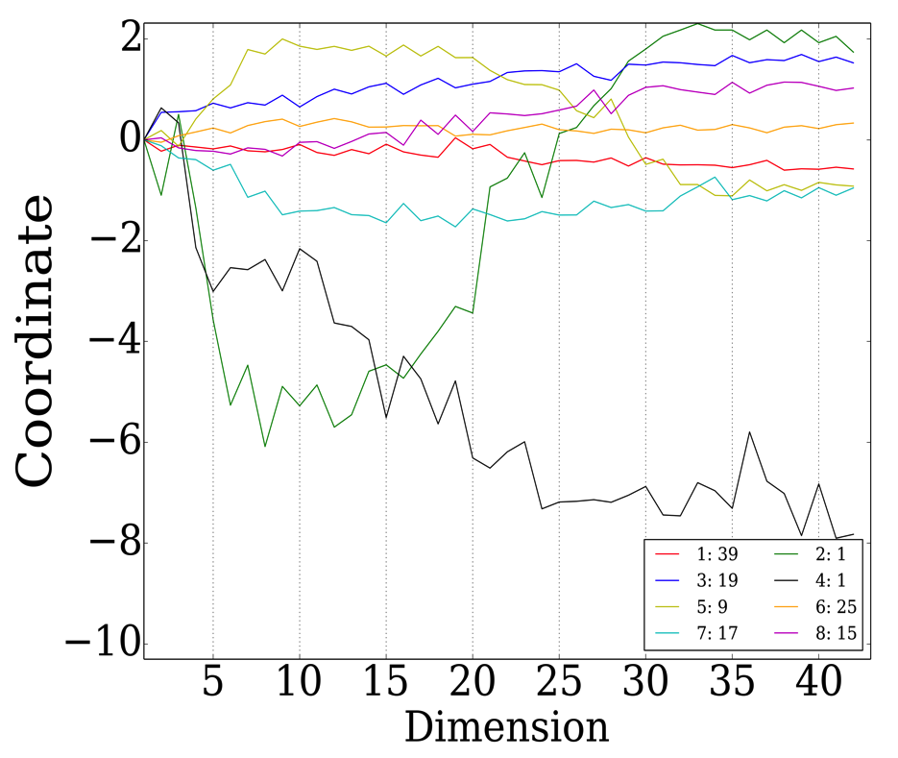
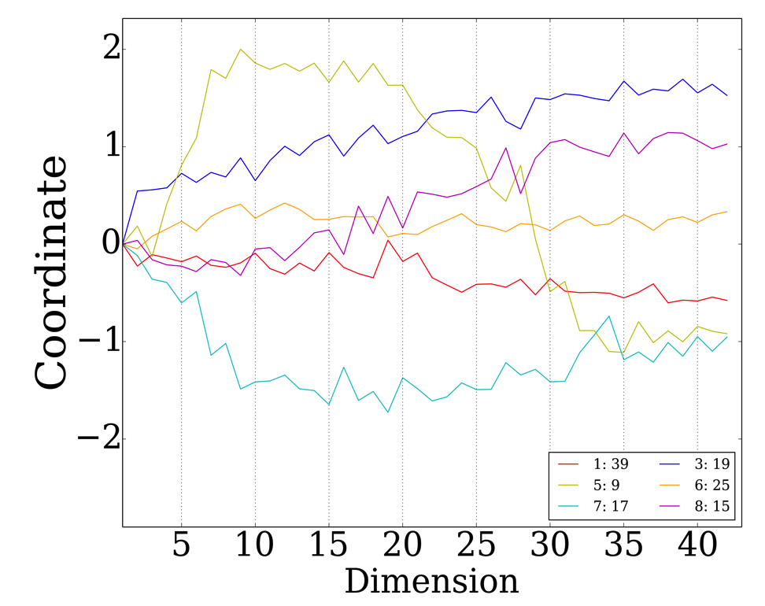
mRNA Cluster Analysis
6 stable clusters
Yellow cluster corresponds to the genes with non monotonic expression over time
Centroids
6 stable clusters

Slide 7
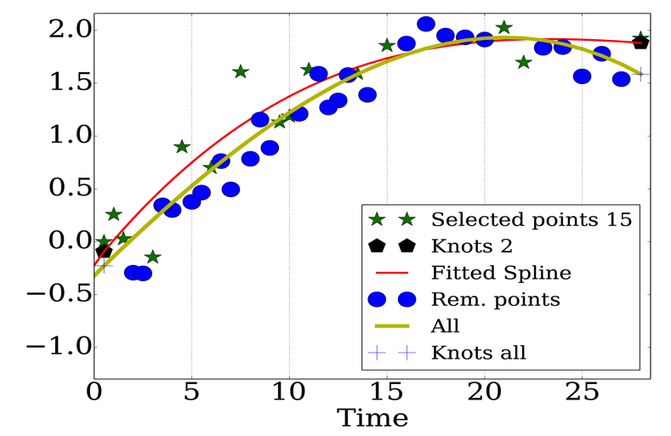
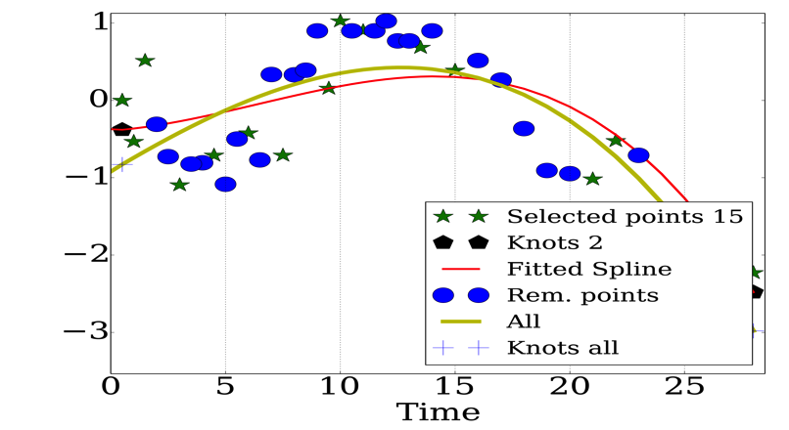
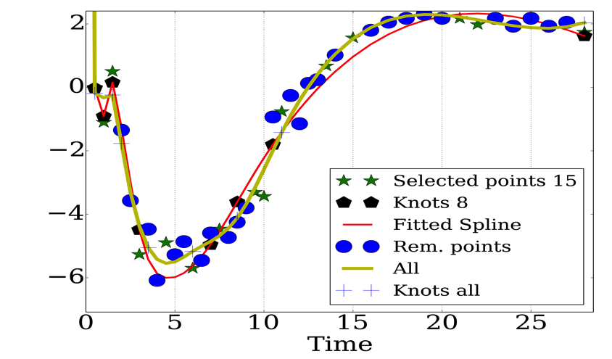
Detailed mRNA Gene Analysis
ELNA
PDGFRA
INMT

Slide 8
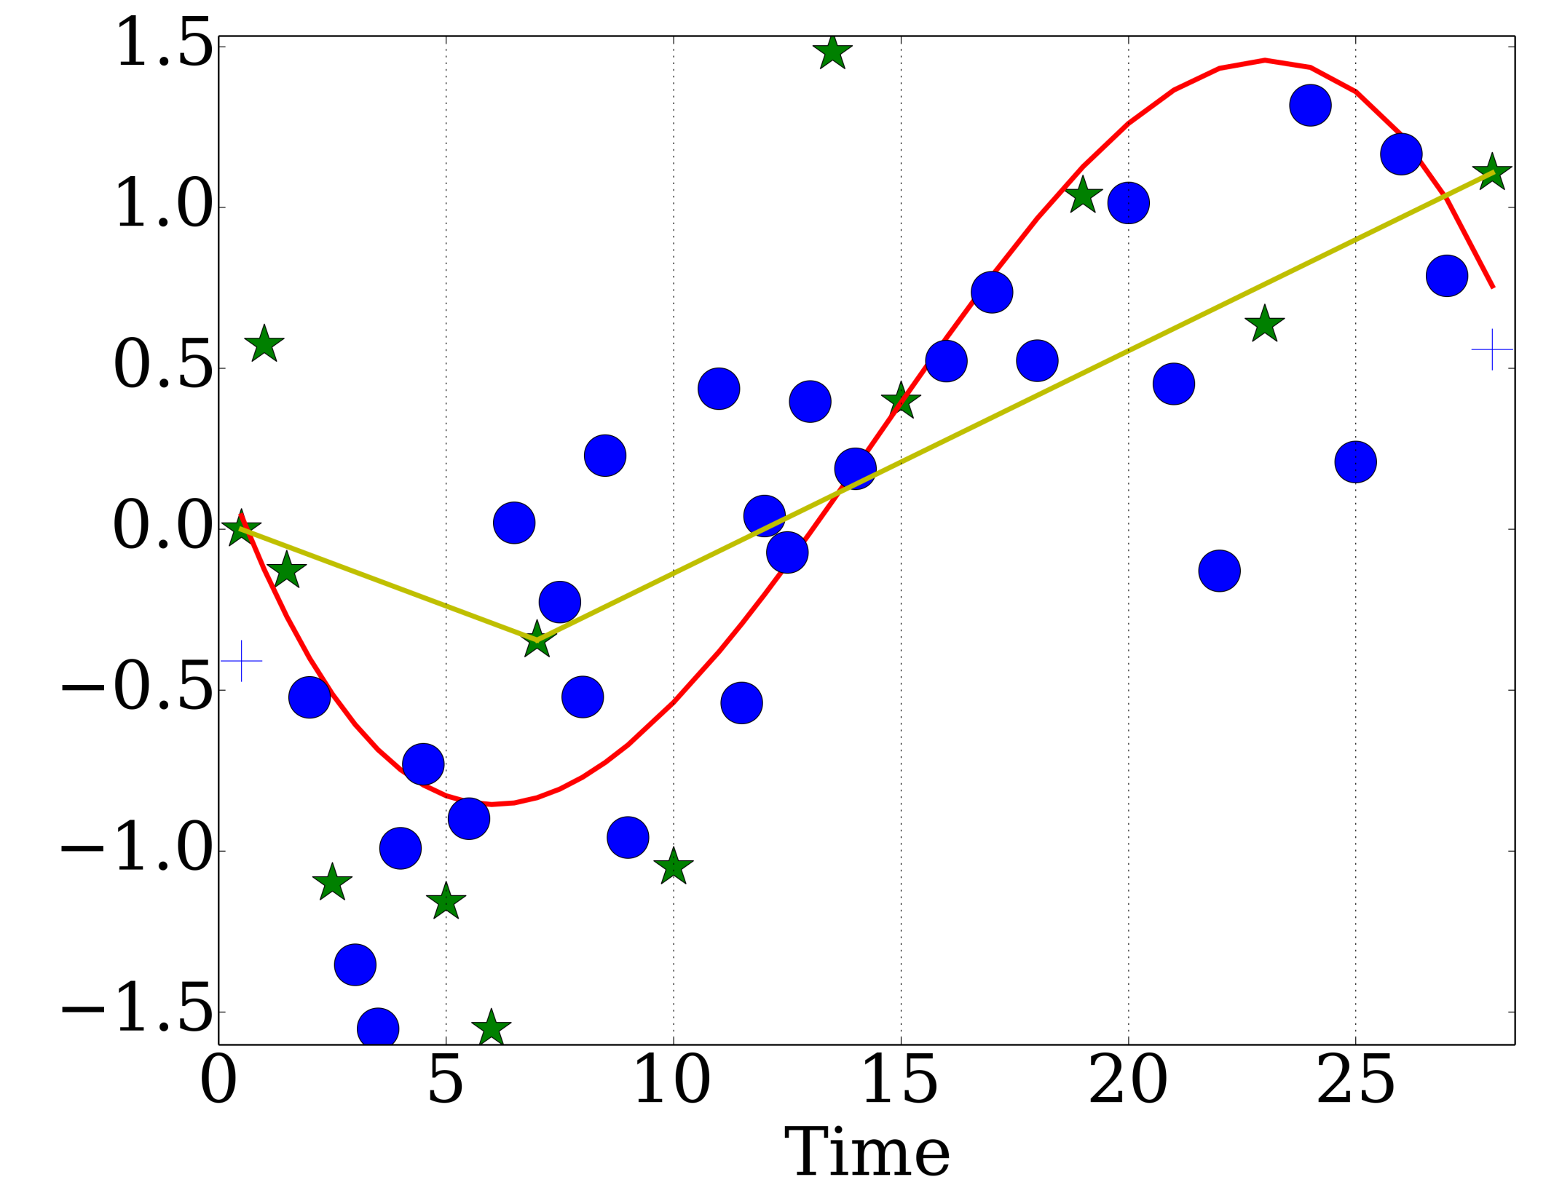
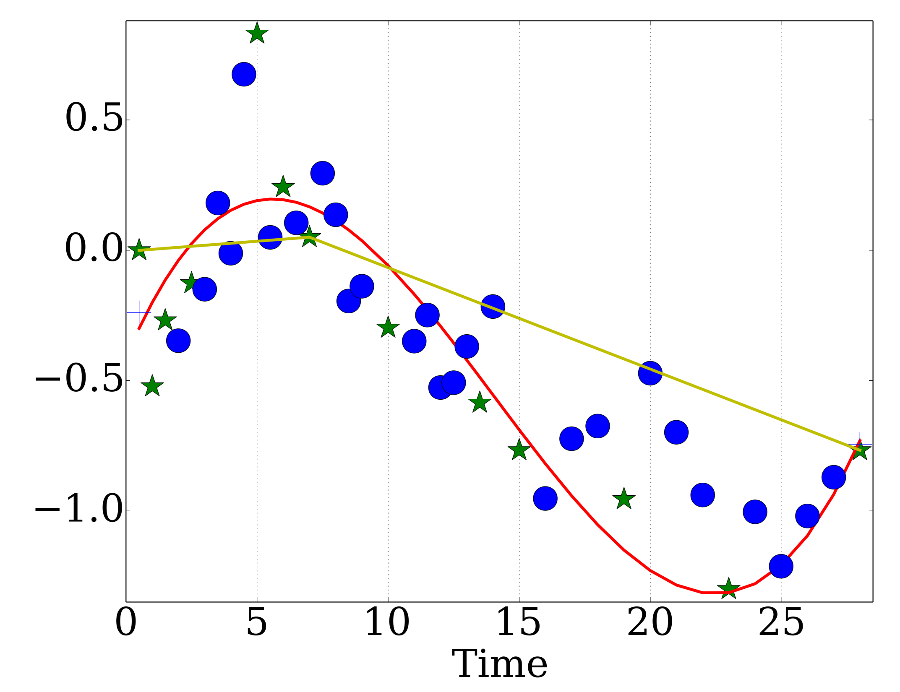
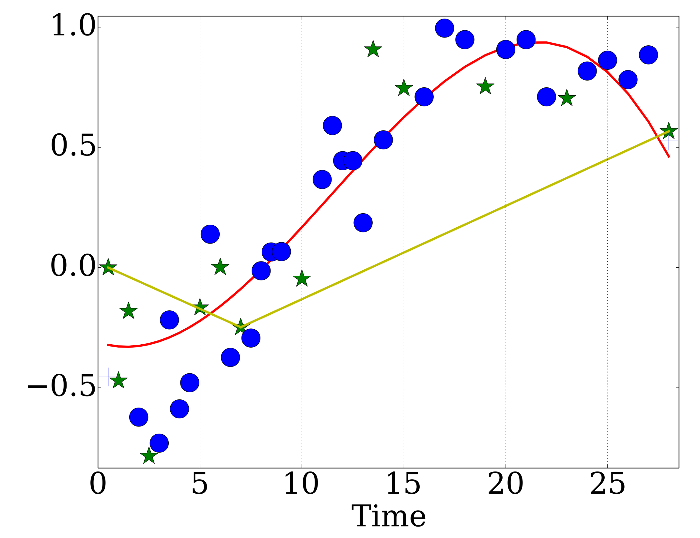
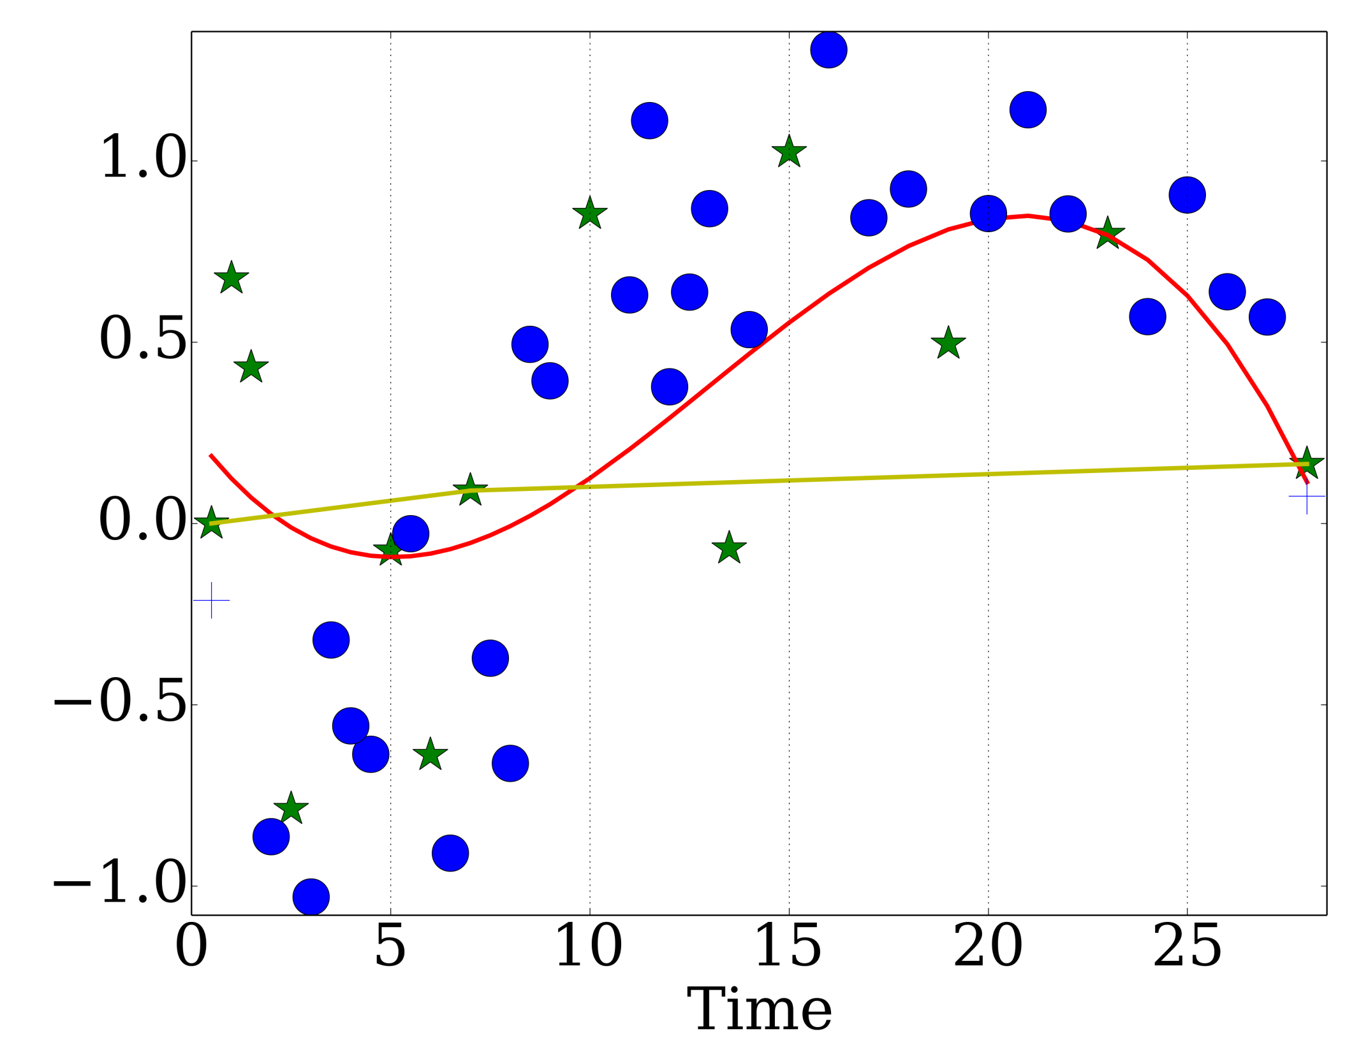
Why do a time course? 3 vs. 13 (of 42) time points
Movie vs. static images; longitudinal cohort study vs. cross-sectional study
MMP-3
Robo1
integrin subunit alpha 8
Serpina3

Slide 9
Similarity of miRNA to mRNA
Using mRNA points gives 0.3312 error for miRNA
Optimal points for miRNA are quite similar(error 0.3042)

Slide 10
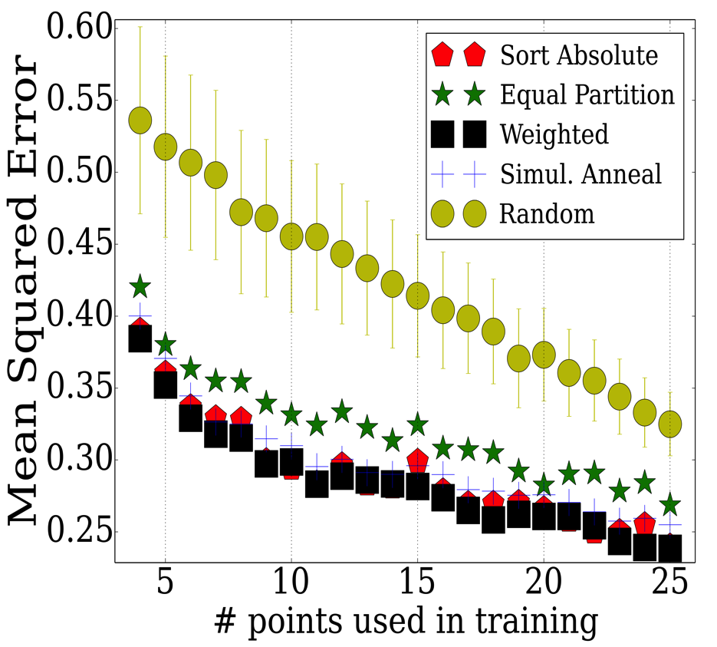
Comparing miRNA and mRNA Errors
Error is decreasing by increasing number of selected points in both datasets

Slide 11
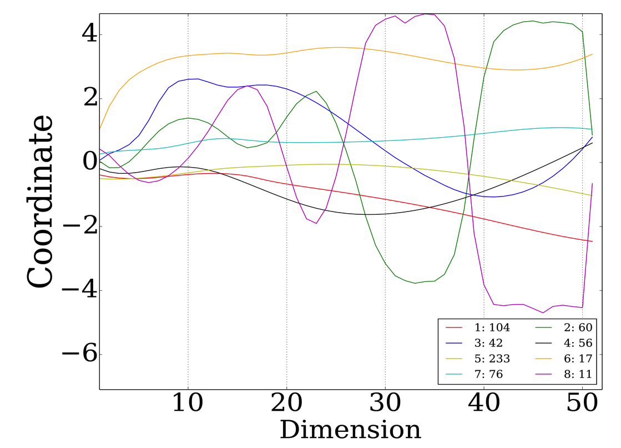
mRNA Cluster Analysis
8 stable clusters
Clusters change more frequently than mRNA data.
miRNA is noisier than mRNA data.

Slide 12
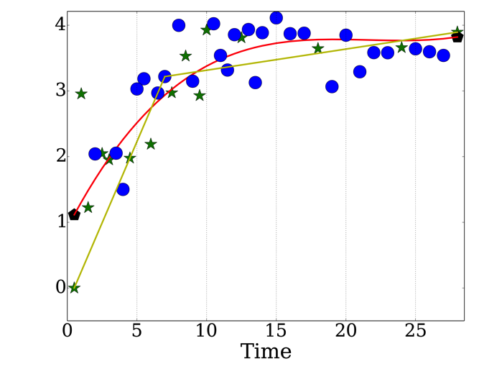
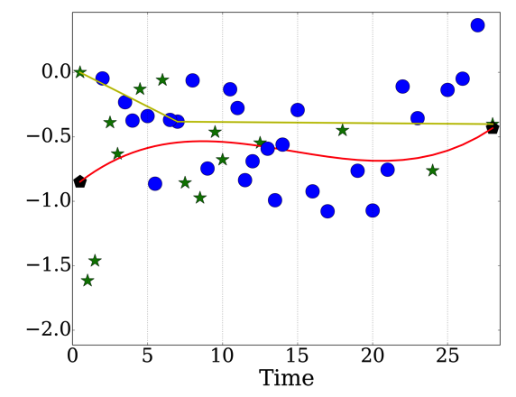
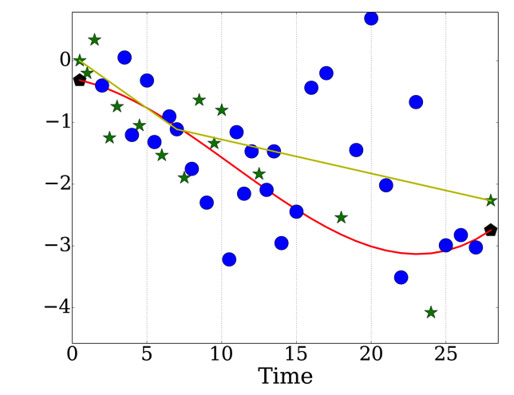
Detailed mRNA Gene Analysis
mmu-miR-200a
mmu-miR-100
mmu-miR-377

Slide 13
Conclusion
Carefully selected subset of time points is important in reconstructing whole gene-expression over time
Spline based reconstruction outperforms simpler linear reconstruction
Analysis of mRNA is a nice representative of larger miRNA study
Similar subset of time points can reconstruct both data

