Slide 1
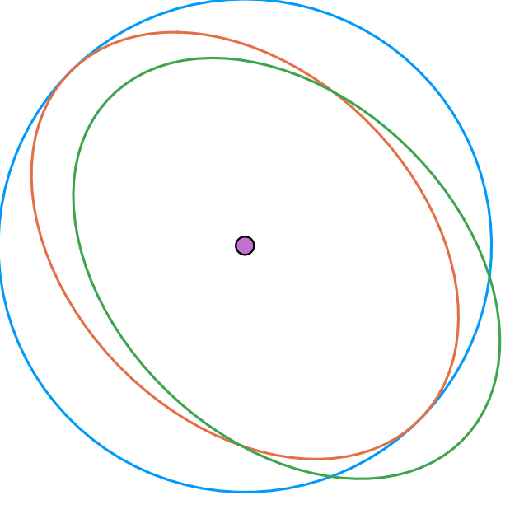
y
(North)
z(Away)
ascending node
Ω
ω
i
periastron
star
x
(East)
barycentre
mean-anomaly(t)
apoastron
planet
descending node

