Slide 1
An Empirical Study of LLM Performance in Multi-Hunk APR

Slide 2
APR and LLM-s_
Transformative approach in bugfixing
LLM revolution
LLM-APR: High performance, minimal human intervention.

Slide 3

The critical challange of concurrent programming_
Concurrency
Key issues:
  Deadlocks
  Synchronization issues
  Race conditions
LLM-Weaknesses

Slide 4
Evaluation framework and challanges_
Focus
Persistent challanges
Study dimensions
Comprehensive evaluation, beyond mere bug fixing.
Verifying Semantic Correctness.
Mitigating Side Effects/New Errors.
Patch Accuracy
Newly Introduced Bugs,
Time of Reply.

Slide 5
Methodology and metrics_
Challange
Inherent non-determinism and thread interleavings.
Program corpus
43 buggy concurrent programs, comparing simple vs. complex (multi-hunk) defects.
Testing oracle
Exhaustive Tests for patch validation
Core Metrics
Accuracy (Effectiveness), Side Effects (Robustness), Time (Efficiency).

Slide 6
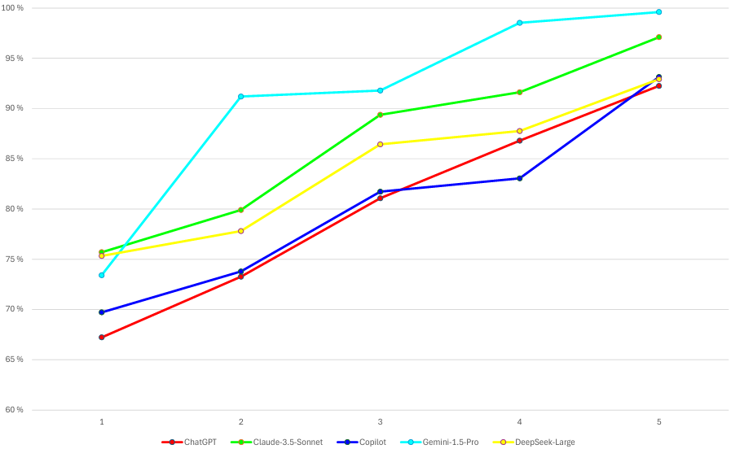
Key Results I: Avg. Patch accuracy grouped by bug count

Slide 7
Key Results II: Gemini vs. Complexity_
73.41%
99,6%
1 bug
5 bug
Gemini-1.5-Pro demonstrates Superior Scalability.
Accuracy increases with complexity (inverse correlation)
1-bug: 73.41% accuracy.
Gemini
5-bug (multi-hunk): 99.6% accuracy.
Gemini
81.06%
3 bugs
ChatGPT consistently lagged (e.g., 81.06% on 3-bug).

Slide 8
Key Results III: GPT Weaknesses_
Robostusness
Critical finding
Low Newly Introduced Bug rate (only 1 new bug for 5-bug tests).
GPT models are the least reliable for concurrency verification.
Fundamental failure
Consequence
Inability to handle RMM verification.
Risks subtle semantic errors or overfitting to SC models, leading to plausible but incorrect patches.

Slide 9
Conclusions and Future Directions_
Current best: Gemini 1.5 Pro
Future goals:
  Context-enriched prompting
  Fine tuning

Slide 10
Thanks for your attention!_
Made by:
Babik Bálint
Budaházy Béla
Kovács Levente
Schäffer Bálint

