Slide 1
Southern Colorado Transportation Conference 2026
Airlines Optimization Workshop:
Industry best practices for a decision-support system
Francisco Zenteno Smith
Senior Operations Research Scientist
American Airlines

Slide 2



About me
Senior Operations Research Scientist at
> 10 years in applied Operations Research.
Education
Bachelors in Industrial Engineering PUC
Masters in Operations Research PUC
Masters in Computer Science UCSD
1

Slide 3
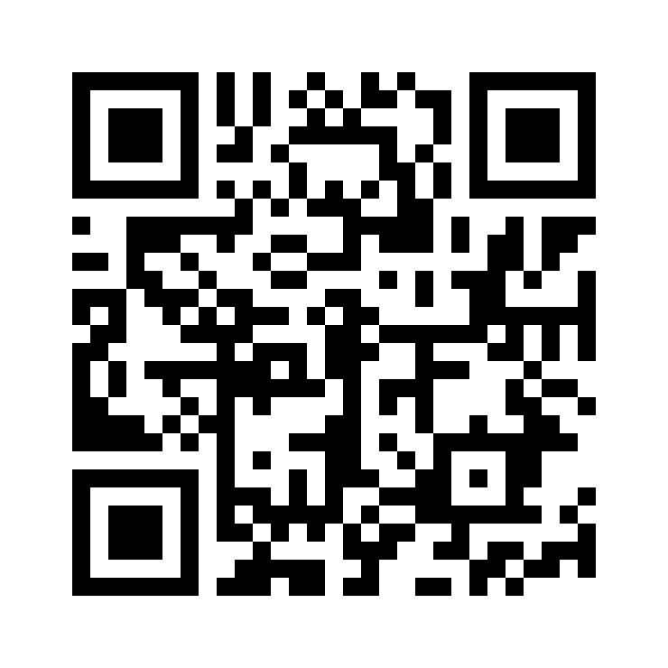
Resources for today
After the workshop you will have the repo and this ppt to explore it.
No laptop required during the session.
Have some paper and pencil to do some exercises.
Form pairs.
1

Slide 4
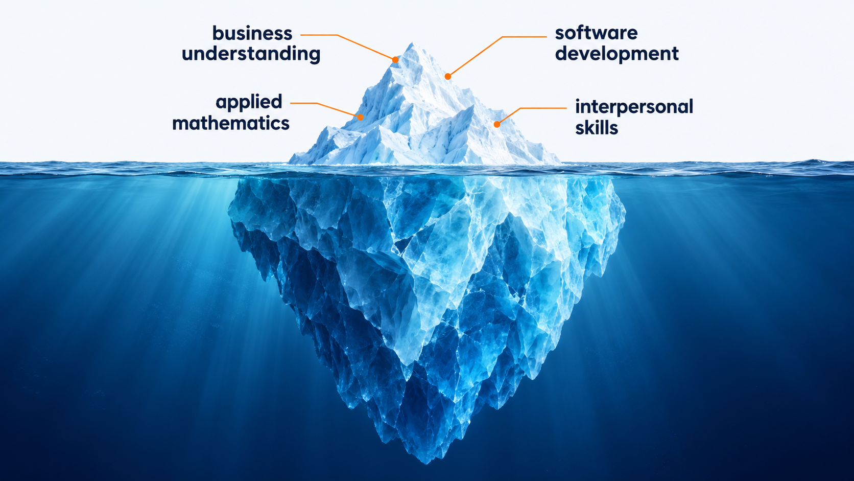
Goal today: touching the surface of a DSS
1
Notes:
These are 4 big elements to create a DSS. We are only going to scratch the surface

Slide 5
Agenda for today
Part I – What is a decision-support system?
Part II – Are we solving the right problem?
Part III – Are we solving the problem right?
Part IV – Closing & conclusions
1

Slide 6
What is a decision-support system?
Operations Research (OR) turns data + business needs + mathematics → decision.
An analysis delivers a one-time decision.
A decision-support system delivers a recurring decision.
What is the implication?
Plan the fleet
Schedule crews
Recover operations
Annually
Monthly
Daily
1
Notes:
Implications:
A decision is useful if someone uses it
A DSS requires software because it is run recurringly

Slide 7

What would you need before trusting a recommendation from a mathematical model?
MODEL SAYS
OPTIMAL
Question for the audience
2
Notes:
STORY TALKING POINTS
- Answer: "optimal" only means optimal for the model as it was coded. Before acting I need evidence on three things:
The data is correct and current
The model states the business's real objective and rules
The software computes what the model says
Basically: solving the right problem, and doing it right: validation & verification.

Slide 8
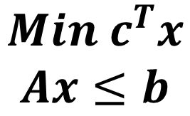
A useful DSS requires validation and verification
$$Min c^{T}x$$
$$Ax≤b$$
Business problem
Mathematical model
Code
translation
translation
Validation
Verification
Are we solving the right problem?
(consulting problem)
Are we solving the problem right?
(software problem)
3
Notes:
STORY TALKING POINTS
Each translation may have errors:
The first one:
Misunderstanding of the business problem
Over simplification
Under simplification
The second one:
Code does not do what it is supposed to do
- Connecting idea: both kinds of evidence pass through code, so next comes why software makes them
hard to obtain and keep.

Slide 9
Working on a DSS is a cycle
Validation
Request
Feedback
Requirements
Use
∑
Model
Deploy
Design & code
Tests
Verification
5
Notes:
05 | The big picture: working on a DSS is a cycle
Suggested elapsed workshop minutes: 12–14 (90 minutes total).
PRESENTER GUIDE
MAP: Part I introduces principles and the cargo example. Part II validates the initial request. Part III verifies the first version. Part IV returns to this same cycle for the next request and then discusses skills and resources. Explain that deployment and use matter: a change helps its user once it is in their hands. The loop is a high-level map; feedback can occur throughout it. Its arrows show a journey, not software dependencies.
STORY TALKING POINTS
- One pass takes a request all the way to the user: a change helps the user only once it is
deployed.
- Map of the workshop: Part I introduces the example; Part II validates the planner's request;
Part III verifies the first version; Part IV zooms out: the cycle runs again, then what this
profession needs and where to keep learning.
- Connecting idea: to see the cycle at work, we now follow one concrete DSS round it.
Workshop source: assets/slide-story.md. Format reference: AGIFORS Annual Symposium 2026 deck.

Slide 10

Choosing the cargo for each flight
6
Notes:
06 | Our example DSS: choosing the cargo for each flight
Suggested elapsed workshop minutes: 14–15 (90 minutes total).
PRESENTER GUIDE
SETTING ONLY: For every flight, more shipments are waiting than the aircraft can carry. A load planner chooses which ones fly. Introduce no revenue objective, precise constraint, mathematical formula or selected load on this slide. Explain that what the planner wants reaches the team through a manager, which is why the audience must interview the planner next. Image: built-in imagegen, see assets/presentation/image-prompt.txt.
STORY TALKING POINTS
- Every flight, more shipments are waiting than the aircraft can carry, and a load planner
decides which ones fly: a recurring decision, the kind a decision-support system supports.
- What the planner wants from a tool is not yet clear: it reaches us second-hand.
- Connecting idea: the request arrives as one vague sentence from a manager, so the audience must
find out from the planner what is really needed.
Workshop source: assets/slide-story.md. Format reference: AGIFORS Annual Symposium 2026 deck.

Slide 11
Agenda for today
Part I – What is a decision-support system?
Part II – Are we solving the right problem?
Part III – Are we solving the problem right?
Part IV – Closing & conclusions
1

Slide 12
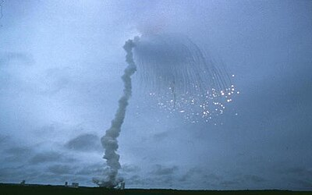
A decision-support system is software,
so the rules of software apply
Research
Industry
RETRACTED
RETRACTED
RETRACTED
RETRACTED
RETRACTED
A data-processing error
An unhandled overflow
4
Notes:
04 | A decision-support system is software, so the rules of software apply
Suggested elapsed workshop minutes: 10–12 (90 minutes total).
PRESENTER GUIDE
STORIES: Geoffrey Chang’s laboratory retracted five structural-biology papers after a data-processing error inverted reported structures. The book describes swapped data columns; avoid implying that the visible paper icons are reproductions of the actual articles. Ariane 5 flight 501 was lost shortly after launch when an unhandled numeric conversion overflow in reused software disabled its inertial reference systems. Connect both to the responsibility for software, including scientific software. Sources: Greg Miller, A Scientist’s Nightmare: Software Problem Leads to Five Retractions, Science 314 (5807), 2006; J. L. Lions et al., Ariane 5 Flight 501 Failure: Report by the Inquiry Board, ESA, 1996; SEFOP book Section 03. The photograph is reused from Purdue workshop slide 6. Do not claim these are optimization-model failures; the lesson concerns software responsibility.
STORY TALKING POINTS
- Validation and verification are hard to obtain and keep because a DSS is software: every
recommendation passes through code that reads data, builds a model and reports the result.
Software principles apply whether we know them or not: a data-processing error
led to five published papers being retracted, and an unhandled overflow in reused code destroyed the Ariane 5
rocket shortly after launch.
- So trustworthy recommendations need software engineering, not only good mathematics.
- Connecting idea: next, the big picture: the cycle that takes a request all the way to the user.
Workshop source: assets/slide-story.md. Format reference: AGIFORS Annual Symposium 2026 deck.

Slide 13
Interview the planner to find the requirements
“I heard our cargo planner wants a tool that picks
the best shipments for each flight.”
Decisions
Data
Objectives
∑
Uncertainty
Constraints
Risks
Pairs · 1 minute · 2 questions
7
Notes:
07 | Audience: interview the planner to find the requirements
Suggested elapsed workshop minutes: 15–29 (90 minutes total).
PRESENTER GUIDE
INTERVIEW: Francisco plays the planner and answers only what is asked. Pairs prepare two questions for one minute and ask in turn. Every pair records answers. The six prompts are guidance, not completed requirements. Translate answers into stories: As a <user>, I want <goal>, so that <reason>. Record the agreed stories as the discussion proceeds. Include the output and invalid-data requirements. Customer identity is input data, but customer diversity is not yet an objective. Full planner script follows below.
STORY TALKING POINTS
- A manager says: "I heard our cargo planner wants a tool that picks the best shipments for each
flight."
- Interview the planner (Francisco). Scan the answers for at least: decisions, objectives,
constraints, type of data, nature of data (deterministic or stochastic), and risks.
- With your partner, prepare two questions (1 minute); pairs then ask in turn, and every pair
records the answers.
- Write each requirement as a user story: "As a <type of user>, I want <goal>, so that
<reason>."
- Answer: decision: which shipments fly, each one yes or no; objective: the most revenue per
flight; constraints: the aircraft's maximum weight is never exceeded, and a shipment flies whole
or stays; type of data: per flight the weight limit, per shipment its customer, weight and
revenue; nature of data: deterministic, since weights and revenues are booked before planning;
risks: an overweight load is a safety incident, and a wrong booking can produce a nonsense
recommendation. User stories:
- As a load planner, I want the tool to propose which shipments fly on each flight, so that the
flight earns the most revenue it can carry.
- As a load planner, I want every proposed load to stay within the aircraft's maximum weight, so
that the flight is always safe to operate.
- As a load planner, I want each shipment loaded whole or left behind, so that every proposal is
a load I can actually build.
- As a load planner, I want to see which shipments fly and which stay, with the revenue and the
weight used, so that I can check the proposal before I accept it.
- As a load planner, I want the tool to tell me when a flight's data is wrong or missing, so
that I never act on a recommendation built from bad data.
- Connecting idea: user stories say what the planner wants; concrete examples of what the planner
would do make them checkable.
PLANNER SCRIPT (PRESENTER ONLY)
For the interview on slide 7. Francisco answers only what is asked, truthfully, and says "not for
now" to anything beyond version 1.
| If asked about | The planner says | Requirement it gives |
| --- | --- | --- |
| What "best" means | "I'm judged on the revenue each flight earns." | Maximize revenue |
| The aircraft's weight | "There is a maximum weight. It is never exceeded; it's safety." | Hard weight limit |
| Splitting a shipment | "No. A shipment flies whole or waits for a later flight." | Whole shipments |
| Volume or space | "Not for now; weight is what limits us." | Out of scope |
| Shipments that must fly | "None for now." | Out of scope |
| Customers | "Every shipment belongs to a customer, but today I only look at revenue." | Customer in the data, not in the objective; seeds Part II |
| What the tool should show | "Which shipments fly, which stay, the revenue and the weight used." | Output |
| What data exists | "For each flight, the weight limit; for each shipment, customer, weight and revenue." | Inputs |
| What you decide | "Which shipments fly on this flight. The aircraft, route and schedule are already fixed." | Decision: yes or no per shipment |
| How sure the numbers are | "Weights and revenues are booked before I plan, so I know them exactly." | Deterministic data |
| What could go wrong | "An overweight load is a safety incident; that must never happen. And a typo in a booking can make any tool recommend nonsense." | Risks: safety; bad data must be caught |
The "Customers" answer is deliberate: it plants the customer column that the business change in
Part II turns into a new objective.
Workshop source: assets/slide-story.md. Format reference: AGIFORS Annual Symposium 2026 deck.

Slide 14
Examples show what the planner would do
Example 1
Example 2
500 kg limit
500 kg limit
Customer | Weight | Revenue
Atlas Steel | 500 kg | $3,000
Bighorn Auto | 250 kg | $2,000
Cedar Pharma | 250 kg | $1,800
Customer | Weight | Revenue
Atlas Steel | 300 kg | $3,000
Bighorn Auto | 900 kg | $9,000
Cedar Pharma | 300 kg | $800
✓
✓
✓
Bighorn + Cedar
Atlas
$3,800 · 500 kg
$3,000 · 300 kg
8
Notes:
08 | Examples show what the planner would do
Suggested elapsed workshop minutes: 29–35 (90 minutes total).
PRESENTER GUIDE
EXPLAIN BOTH EXAMPLES. In example 1, the most valuable individual shipment fills the aircraft but earns less than Bighorn and Cedar together. In example 2, the 900 kg shipment cannot fly, and the two 300 kg shipments cannot fly together. Atlas alone is the expected choice. Each situation and expected choice is an acceptance criterion. These are invented teaching cases; they are not claims about real customer bookings.
STORY TALKING POINTS
- Example 1, weight limit 500 kg. Atlas Steel 500 kg, $3,000; Bighorn Auto 250 kg, $2,000; Cedar
Pharma 250 kg, $1,800. The planner loads Bighorn and Cedar: $3,800 and 500 kg, more than the
single most valuable shipment would earn.
- Example 2, weight limit 500 kg. Atlas Steel 300 kg, $3,000; Bighorn Auto 900 kg, $9,000; Cedar
Pharma 300 kg, $800. Bighorn can never fly on this aircraft, however valuable; Atlas and Cedar
together weigh 600 kg, so only Atlas flies: $3,000 and 300 kg.
- Each example is an acceptance criterion: a situation and the decision the planner expects. This
is how validation becomes checkable.
- Connecting idea: the user stories and examples now become mathematics, the first translation,
from business problem to math model.
Workshop source: assets/slide-story.md. Format reference: AGIFORS Annual Symposium 2026 deck.

Slide 15
The business rules lead to a knapsack model
Each shipment flies
whole or stays
xᵢ ∈ {0, 1}
Earn the most revenue
max ∑ᵢ rᵢ xᵢ
Stay within the weight limit
∑ᵢ wᵢ xᵢ ≤ W
i: shipment · xᵢ: fly / stay · rᵢ: revenue · wᵢ: weight · W: weight limit
9
Notes:
09 | The business rules lead to a knapsack model
Suggested elapsed workshop minutes: 35–38 (90 minutes total).
PRESENTER GUIDE
SYMBOLS: i indexes a shipment; x_i=1 means it flies and 0 means it stays; r_i is revenue in USD; w_i is weight in kg; W is the aircraft weight limit in kg. Every expression comes from a discovered business rule. This workshop uses only a hard weight limit and binary whole-shipment choices; do not import the book appendix’s volume constraint, committed freight or pallet-count variables. The next translation is from the paper model to software.
STORY TALKING POINTS
- Whole-shipment choices become binary variables: $x_i \in \{0,1\}$.
- Revenue maximization becomes $\max \sum_i r_i x_i$.
- Aircraft capacity becomes $\sum_i w_i x_i \leq W$.
- Connecting idea: a model on paper recommends nothing; the second translation, from math model
to coded model, is where verification begins.
Workshop source: assets/slide-story.md. Format reference: AGIFORS Annual Symposium 2026 deck.

Slide 16
Agenda for today
Part I – What is a decision-support system?
Part II – Are we solving the right problem?
Part III – Are we solving the problem right?
Part IV – Closing & conclusions
1

Slide 17
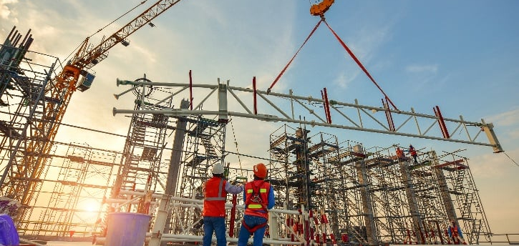

Software is a different kind of engineering
Civil engineering
Software engineering
Requirements largely known
Requirements emerge
Small errors tolerated
Tiny errors can matter
Learn quickly · Change quickly and safely
10
Notes:
10 | Software is a different kind of engineering
Suggested elapsed workshop minutes: 38–42 (90 minutes total).
PRESENTER GUIDE
EXPLAIN THE ANALOGY WITH CARE: small physical variations are often handled by engineering tolerances; software can have discontinuous consequences from one character. Software requirements emerge because users do not fully know what they want, users change their minds, and construction reveals unstated constraints. These are tendencies, not a universal claim that civil engineering has no discovery or software has no tolerances. The resulting abilities are learning quickly and changing quickly and safely. Source: SEFOP book Section 03 and Purdue workshop slide 10.
STORY TALKING POINTS
- A bridge tolerates tiny errors and is designed from requirements known reasonably well.
Software is flexible and fragile at once: one wrong sign can change every recommendation while
the program still runs, and it is built with highly imperfect information.
- Building software is a discovery process: users do not fully know what they want, they change
their minds, and building reveals problems nobody foresaw. So the team must learn quickly and
adapt its software quickly and safely.
- Connecting idea: adaptability make quick and safe change possible. This is achieved through
design and testing.
Workshop source: assets/slide-story.md. Format reference: AGIFORS Annual Symposium 2026 deck.

Slide 18
Design and testing make
quick, safe change possible
A
B
A
B
C
F
C
✓
✓
✓
D
E
F
E
D
✓
✓
✓
Tests
Changes spread
Changes stay manageable
11
Notes:
11 | Design and testing make quick, safe change possible
Suggested elapsed workshop minutes: 42–46 (90 minutes total).
PRESENTER GUIDE
DEFINE MODULE: a piece of code with a boundary and a clear responsibility. Connections represent dependencies; more connections make a change harder to understand and check. The highlighted module is the same in both diagrams. Separate test boxes show that modules with clear boundaries can be checked individually. Modularity does not mean eliminating necessary connections or guaranteeing that every change fits in one module. Tests check promised behavior and make improving the design safer. Source: SEFOP book Section 04, forces-without-with.svg.
STORY TALKING POINTS
- Design is how the code is structured into modules, each with one clear responsibility. A change
stays small and isolated, and each module can be understood and checked on its own.
- Testing checks automatically that the code complies with what it should do: it runs the code on
cases whose right answer is known, in seconds and as often as needed. That is verification, and
it is the safety layer that catches a mistake the moment a change introduces it.
- Each needs the other: a clear design makes code testable, and tests make it safe to improve the
design.
- Connecting idea: here we show the purpose of modularization, in the next slide we show how to
evaluate a change.
Workshop source: assets/slide-story.md. Format reference: AGIFORS Annual Symposium 2026 deck.

Slide 19
What an automated test is
End-to-end
Unit
Integration
End-to-end
Read
Read
Read
Integration
Compute
Compute
Compute
Unit
Report
Report
Report
Arrange
→
Act
→
Assert
Set up
Run
Check
12
Notes:
12 | What an automated test is
Suggested elapsed workshop minutes: 46–51 (90 minutes total).
PRESENTER GUIDE
READ THE FIGURES: green unit tests check one module in isolation; yellow integration tests check modules with their real collaborators; blue end-to-end tests exercise the whole program. Each highlighted region represents the scope of one example test, not every test the suite contains. The pyramid suggests many fast unit tests, fewer integration tests and a small number of more costly end-to-end tests; it is guidance, not a quota. EVERY LEVEL still follows Arrange, Act, Assert. Explain orally using slide 8 example 1: arrange the 500 kg flight and shipments 500 kg/$3,000, 250 kg/$2,000, 250 kg/$1,800; run the program; assert Bighorn and Cedar, revenue $3,800 and weight 500 kg. A test must compare with an expected answer; merely running the program is not a check. Source: SEFOP book Section 05, unit-test-pyramid.svg and unit-test-levels.svg.
STORY TALKING POINTS
- A test is a small program that runs the code on a case whose right answer is known and checks
the result. It has three steps: arrange the case, act by running the code, assert the expected
result.
- A test runner runs every test automatically, in seconds, with the same result each time; a
failed check names exactly what broke. Run after every change, it shows at once whether the
change broke something.
- Connecting idea: with design and tests understood, here is how they look in our example,
starting with its design.
Workshop source: assets/slide-story.md. Format reference: AGIFORS Annual Symposium 2026 deck.

Slide 20
A DSS example design
∑
Read data
Preprocess
Solve
Postprocess
Result
SC101 · Live demonstration
13
Notes:
13 | A DSS example design
Suggested elapsed workshop minutes: 51–59 (90 minutes total).
PRESENTER GUIDE
LIVE DEMO: Run python -m cli optimize_cargo SC101 from the prepared environment. Show each stage announcement, then interpret the recommendation: S1–S4, $9,600, 1,000 kg, two customers. Open src/: reading is adapters/json_data_loader.py; preprocessing, optimization and postprocessing are the folders under use_cases/solving/; output is adapters/console_result_writer.py. Explain each module’s single responsibility. Arrows show execution flow rather than dependency direction. Do not write code live. A successful run is not yet evidence of correctness; transition to the tests.
STORY TALKING POINTS
- A DSS is usually divided into the same modules: reading data, preprocessing, optimization,
postprocessing, and presenting the result.
- Run the first version on flight SC101: the console announces each stage in a box: Read data,
Preprocess, Solve, Postprocess, Result.
- Open the repository: each box is one place in `src/`. Reading data is
`adapters/json_data_loader.py`; preprocessing, optimization and postprocessing are folders
under `use_cases/solving/`; presenting the result is `adapters/console_result_writer.py`.
- Interpret the proposed load with the audience.
- Connecting idea: the program produces a load, but does it compute what the model states? Tests
are the evidence.
Workshop source: assets/slide-story.md. Format reference: AGIFORS Annual Symposium 2026 deck.

Slide 21
The planner’s examples become acceptance tests
500 kg limit
Would this test catch…
Customer | Weight | Revenue
Atlas Steel | 300 kg | $3,000
Bighorn Auto | 900 kg | $9,000
Cedar Pharma | 300 kg | $800
Ignoring the weight limit?
✓
Splitting a shipment?
Expected: Atlas
$3,000 · 300 kg
Predict in pairs · Explain why
14
Notes:
14 | Audience: the planner's examples become acceptance tests
Suggested elapsed workshop minutes: 59–65 (90 minutes total).
PRESENTER GUIDE
ACTIVITY: Ask pairs to predict whether this prepared check would catch ignoring weight capacity and allowing fractional shipments. Require reasoning before the debrief. The expected answer is Atlas only, $3,000 and 300 kg. A capacity defect can select Atlas plus Cedar at 600 kg even if preprocessing already excludes the 900 kg shipment. A fractional model can add part of Cedar after preprocessing and exceed $3,000; if the oversize shipment remains available, the fractional optimum is $5,000. The exact wrong result depends on where the bug is introduced. The expected-load/revenue assertion detects those behaviors. Example 1 does not distinguish fractional and binary optimal solutions. LIVE DEMO: open tests/integration/test_situations.py and tests/resources/oversize_shipment_left_behind/data.json, then run pytest. These test functions run the real CLI and real solver even though they use the integration marker. Explain that acceptance describes the promised business behavior, whereas unit/integration/end-to-end describes execution scope. Passing tests give evidence for the covered cases, not proof that no bugs exist.
STORY TALKING POINTS
- Example 2 of slide 8 as a test. Arrange: a 500 kg limit; shipments of 300 kg for $3,000, 900 kg
for $9,000, and 300 kg for $800. Act: ask for a load. Assert: only the first shipment flies,
earning $3,000.
- Predict with your partner: would this test catch code that ignores the weight limit? Code that
splits a shipment?
- Then open the repository: the planner's examples are stored as test flights and run with every
other test.
- Connecting idea: the tests pass, so the first version is verified and goes into the planner's
hands.
Workshop source: assets/slide-story.md. Format reference: AGIFORS Annual Symposium 2026 deck.

Slide 22
The cycle runs again:
the planner asks for client diversity
Validation
Request
Feedback
Requirements
Can we serve more customers?
Use
∑
Model
2 of 6 customers served
Deploy
Design & code
Tests
Verification
15
Notes:
15 | The cycle runs again: the planner asks for client diversity
Suggested elapsed workshop minutes: 65–71 (90 minutes total).
PRESENTER GUIDE
SECOND TURN, NOT A FEATURE DEMO: On SC101, S1–S4 serve Atlas and Bighorn only; Cedar, Dune, Elk and Fremont have nothing. The planner asks to serve more distinct customers within an acceptable revenue sacrifice. A customer counts once even when several shipments fly. Revisit requirements, examples, model, code, tests, local deployment and use. Do not show an implemented diversity model, new command, allowance values or computed alternatives. Aircraft weight remains hard. Modular design and tests make this next turn manageable.
STORY TALKING POINTS
- In use, the planner notices that four of the six customers get nothing on a flight, and asks
the tool to serve more customers within an acceptable revenue sacrifice.
- The request goes round the same cycle: validate it with user stories, examples and a new model;
verify it with design and tests; deploy it; use it. Modular, tested software is what makes the
second round fast and safe.
- Connecting idea: every round asks for the same skills; zooming out, here is what this
profession needs.
Workshop source: assets/slide-story.md. Format reference: AGIFORS Annual Symposium 2026 deck.

Slide 23
Agenda for today
Part I – What is a decision-support system?
Part II – Are we solving the right problem?
Part III – Are we solving the problem right?
Part IV – Closing & conclusions
1

Slide 24
What this profession needs
Business skills
Software skills
People skills
16
Notes:
16 | What this profession needs
Suggested elapsed workshop minutes: 71–76 (90 minutes total).
PRESENTER GUIDE
THREE ELEMENTS, IN FRANCISCO’S OWN WORDS: Business skills. Software skills. People skills. Connect each to your own experience and to the audience’s career opportunities. Leave the screen simple and elaborate verbally. No invented personal anecdote, job history, credential or separate career track has been added.
STORY TALKING POINTS
- Business skills.
- Software skills.
- People skills.
- Connect those skills to Francisco's experience and to students' career opportunities.
- Connecting idea: one workshop shows the tip of these skills; SEFOP is where to keep learning.
Workshop source: assets/slide-story.md. Format reference: AGIFORS Annual Symposium 2026 deck.

Slide 25

SEFOP: where to keep learning
Read the book
Run the workshop
Ask questions
github.com/sefop/sefop-training-hub
17
Notes:
17 | SEFOP: where to keep learning
Suggested elapsed workshop minutes: 76–80 (90 minutes total).
PRESENTER GUIDE
RESOURCES: Read the book: https://github.com/sefop/sefop-training-hub . Run this workshop: https://github.com/sefop/sefop-sctc-2026 . Ask questions: https://github.com/sefop/sefop-training-hub/discussions . The QR opens the training hub. All three resource labels are clickable. The training hub also points to the SEFOP organization’s discussion board at https://github.com/orgs/sefop/discussions . Explain where the lifecycle, design and testing chapters can be found; invite attendees to keep learning and try the program after the workshop.
STORY TALKING POINTS
- The SEFOP training hub and its book: github.com/sefop/sefop-training-hub
- This workshop's repository, to run and read at home: github.com/sefop/sefop-sctc-2026
- The discussion board, for questions after today: github.com/sefop/sefop-training-hub/discussions
- Connecting idea: with the materials shared, the floor opens for questions.
Workshop source: assets/slide-story.md. Format reference: AGIFORS Annual Symposium 2026 deck.

Slide 26
Questions?
github.com/sefop/sefop-training-hub
18
Notes:
18 | Questions and discussion
Suggested elapsed workshop minutes: 80–90 (90 minutes total).
PRESENTER GUIDE
DISCUSSION, 10 MINUTES: What remains unclear about turning a business request into decision-support software? Where would you apply learning and adaptation in your own project? Leave the QR visible throughout. If questions slow, invite an example from a student project and trace its next request through validation and verification. Close by returning to the cycle: the next business request begins another turn.
STORY TALKING POINTS
- What remains unclear about turning a business request into decision-support software?
- Where would you apply learning and adaptation in your own project?
- Connecting idea: there is no next slide; the next business request starts validation and
verification again, back round the cycle of slide 5.
Workshop source: assets/slide-story.md. Format reference: AGIFORS Annual Symposium 2026 deck.

