Slide 1
California Polytechnic State University
IME 5507
Optimization in the industry workshop
Francisco Zenteno Smith
Senior Operations Research Scientist
American Airlines

Slide 2



About me
Senior Operations Research Scientist at
> 10 years in applied Operations Research.
Education
Bachelors in Industrial Engineering PUC
Masters in Operations Research PUC
Masters in Computer Science UCSD

Slide 3
Resources for today
Presentation shared with Puneet.
No laptop required during the session.
Have some paper and pencil to do some exercises.
Form groups of 3 people.
1

Slide 4
Agenda for today
Part I – What is a decision-support system?
Part II – Are we solving the right problem?
Part III – Are we solving the problem right?
Part IV – Closing & conclusions

Slide 5
Quick survey
Optimization
Coding

Slide 6
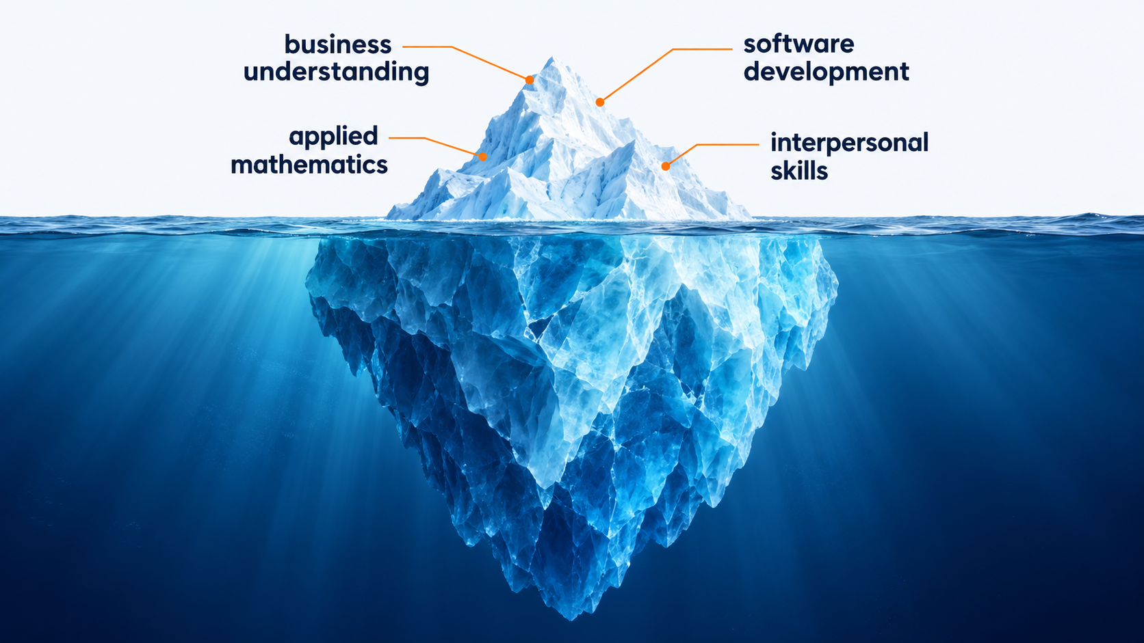
Goal today: touching the surface of a DSS
1
Notes:
These are 4 big elements to create a DSS. We are only going to scratch the surface

Slide 7
What is a decision-support system?
Operations Research (OR) turns data + business needs + mathematics → decision.
An analysis delivers a one-time decision.
A decision-support system delivers a recurring decision.
What is the implication?
Plan the fleet
Schedule crews
Recover operations
Annually
Monthly
Daily
Notes:
Implications:
A decision is useful if someone uses it
A DSS requires software because it is run recurringly

Slide 8

What would you need before trusting a recommendation from a mathematical model?
MODEL SAYS
OPTIMAL
Question for the audience
Notes:
STORY TALKING POINTS
- What can go wrong?
- Answer: "optimal" only means optimal for the model as it was coded. Before acting I need evidence on three things:
The data is correct and current
The model states reasonably the business's real objective and rules
The software computes what the model says
Basically: solving the right problem, and doing it right: validation & verification.

Slide 9
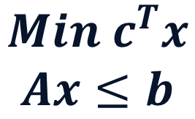
A useful DSS requires validation and verification
What can be wrong?
$$Min c^{T}x$$
$$Ax≤b$$
Business problem
Mathematical model
Code
translation
translation
Validation
Verification
Are we solving the right problem?
(consulting problem)
Are we solving the problem right?
(software problem)
Notes:
STORY TALKING POINTS
Each translation may have errors:
The first one:
Misunderstanding of the business problem
Over simplification
Under simplification
The second one:
Code does not do what it is supposed to do

Slide 10

Our example: selecting cargo for a flight

Slide 11
Agenda for today
Part I – What is a decision-support system?
Part II – Are we solving the right problem?
Part III – Are we solving the problem right?
Part IV – Closing & conclusions

Slide 12
Key elements to define an analytical problem
Stakeholders: who cares?
Objectives: what do we want to achieve?
Decisions: what do we control?
Constraints: what can’t we do?
Data: what information is available?
Risk: what can go wrong?
Scope: what do we omit?
Other sources: https://www.informs.org/Professional-Development/INFORMS-Analytics-Framework/Explore
Notes:
Ask the audience how to define an analytical problem

Slide 13
Read the initial email of the problem and then interview the planner (me)
Ask me questions

Slide 14
These examples show what an experienced planner would do
Example 1
Example 2
Aircraft 500 kg limit
Aircraft 500 kg limit
Customer | Weight | Revenue
Atlas Steel | 500 kg | $3,000
Bighorn Auto | 250 kg | $2,000
Cedar Pharma | 250 kg | $1,800
Customer | Weight | Revenue
Atlas Steel | 300 kg | $3,000
Bighorn Auto | 900 kg | $9,000
Cedar Pharma | 300 kg | $800
✓
✓
✓
Bighorn + Cedar
Atlas
$3,800 · 500 kg
$3,000 · 300 kg

Slide 15
Now frame this business problem as an optimization problem
25 minutes
Define your own symbols and list your assumptions.
In the industry the symbols are not given in advance.

Slide 16
Elements of an optimization model
Sets
Parameters
Decision variables
Constraints
Objective function

Slide 17
The business problem can be modelled like a knapsack model
Each shipment flies
whole or stays
xᵢ ∈ {0, 1}
Decisions
Earn the most revenue
max ∑ᵢ rᵢ xᵢ
Objective
Stay within the weight limit
∑ᵢ wᵢ xᵢ ≤ W
Constraints
i: shipment · xᵢ: fly / stay · rᵢ: revenue · wᵢ: weight · W: weight limit

Slide 18
Agenda for today
Part I – What is a decision-support system?
Part II – Are we solving the right problem?
Part III – Are we solving the problem right?
Part IV – Closing & conclusions

Slide 19
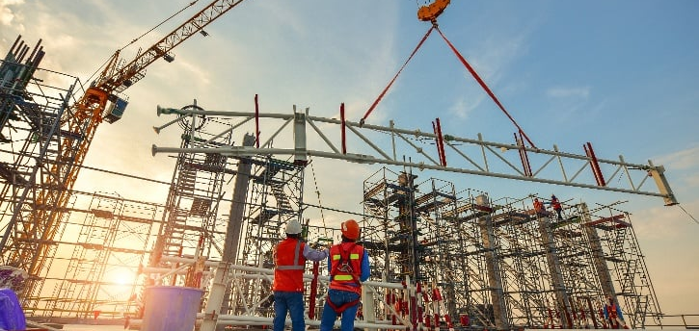

Software is a different kind of engineering
Civil engineering
Software engineering
Constructions are robust to tiny errors.
When designing, the requirements are known reasonably well.
Software is incredible flexible and fragile at the same time.
SE lives in a world of highly imperfect information.

Slide 20
Software engineering is a discovery process
Users don’t fully know what they want.
Building the software reveals unknown challenges over time.
Users will change their mind.
How would you plan your vacations?
Notes:
How would you plan your vacations if your family behave like this?

Slide 21
The most important abilities in software
Adapt
Learn
The faster you can do this, the better.

Slide 22
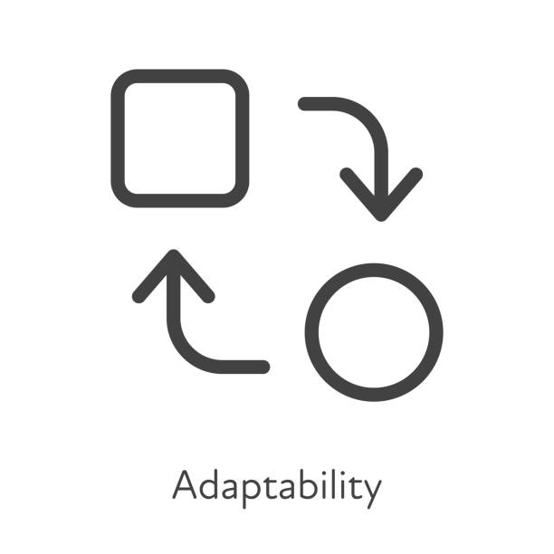
Learning and adapting quickly
Learn quickly
Adapt quickly
Agile to have quick feedback loops.
Observability to monitor the vital signs of your system
The scientific method to learn effectively on those loops.
Keep code complexity low
Modularity & isolation of changes
Automated testing as a safety mechanism for changes

Slide 23
A typical workflow in a decision-support system
Validation
Request
Feedback
Requirements
Use
∑
Model
Deploy
Design & code
Tests
Verification

Slide 24
Design helps to modularize your code and to facilitate testing
A
B
A
B
C
F
C
✓
✓
✓
D
E
F
E
D
✓
✓
✓
Changes spread
Changes stay manageable

Slide 25
Automated testing 101
End-to-end
Unit
Integration
End-to-end
Read
Read
Read
Integration
Compute
Compute
Compute
Unit
Report
Report
Report

Slide 26
Example automated test of a calculator that adds 2 integers
sum(int x, int y) → int
System under test

Slide 27
Define/understand the behaviors of this software contract/interface
Happy path: 3 + 4 = 7
Commutativity: 2 + 3 = 3 + 2
Identity: -4 + 0 = -4
Exceptions:
  If x+y is too large, then an arithmetic exception is thrown
sum(int x, int y) → int
What is the mathematical software contract here?

Slide 28
Now create tests for each behavior with the AAA pattern
Testing: commutativity
// Arrange (setup the data)
x = 3
y = 4
// Act (execute the system under test)
result = sum(3,4)
// Assert (check expected behavior)
assert result == 7
Notes:
This test can be interpreted as a scientific experiment as well.

Slide 29

How would you test this optimization model?
Assume the model returns optimal solutions for simplicity
Each shipment flies
whole or stays
xᵢ ∈ {0, 1}
Decisions
Earn the most revenue
max ∑ᵢ rᵢ xᵢ
Objective
Stay within the weight limit
∑ᵢ wᵢ xᵢ ≤ W
Constraints
i: shipment · xᵢ: fly / stay · rᵢ: revenue · wᵢ: weight · W: weight limit
Notes:
Note: this is innovation!

Slide 30
Defining the contract
Object
Module
Request (example)
Optimization
Solution
Item | Weight | Revenue
Peanuts | 250 | 200
Cheese | 250 | 150
Capacity: 500
solve(Request) → Solution
* Solution could be null
Item | Weight | Revenue
Chocolate | 500 | 300
Peanuts | 250 | 200
Cheese | 250 | 150
Capacity used: 500 / 500
Total revenue: 350
System under test
* For simplicity assume the Request object is well formed (i.e., capacity is not negative).
Notes:
Next: how to test this SUT?

Slide 31
Some hints…
Solution is optimal
Solution does not exist
… left as an exercise to the reader
Scenario | Given | Then
a | Empty list of products | Revenue = 0, Capacity used = 0
B | 1 product that fits | Revenue and capacity of that product
C | 1 product that does not fit | Revenue = 0, Capacity used = 0
D | 2 products fit | Revenue and capacity of both
E | 1 product fit, another does not | Revenue and capacity of the product that fits
F | 2 products, but only 1 fits | Revenue and capacity of the best product
g | 2 products, only 1 fit, same Revenue each | Revenue of 1 product and only a single product fits
h | Case g & Case g with data reordered (permutation invariance) | Both objectives are the same
Notes:
Each scenario is testing something unique of the model.
Next: lets see an example of 1g.

Slide 32
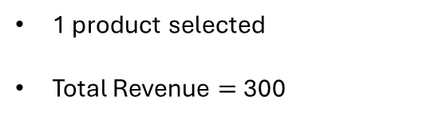
Example unit test scenario 1g
Scenario | Given | Then
1g | 2 products, only 1 fit, same Revenue each | Revenue of 1 product and only a single product fits
Given
When
Then
Knapsack capacity: 500
solve(Request) → Solution
Item | Weight | Revenue
Chocolate | 400 | 300
Peanuts | 450 | 300
1 product selected
Total Revenue $=$ 300
Implicitly here we check cases where there are multiple optimal solutions.
Note we don’t assert the capacity constraint: that was tested in other scenarios.
Note we don’t assert the specific solution.
Notes:
You could implement this test in your CI easily.
When the optimization is more complicated the tests may look differently. But from this first glance we have a framework to start.

Slide 33
Define your behaviors and automatic tests
30 minutes

Slide 34
Agenda for today
Part I – What is a decision-support system?
Part II – Are we solving the right problem?
Part III – Are we solving the problem right?
Part IV – Closing & conclusions

Slide 35
What this profession needs
Business skills
Software skills
People skills

Slide 36
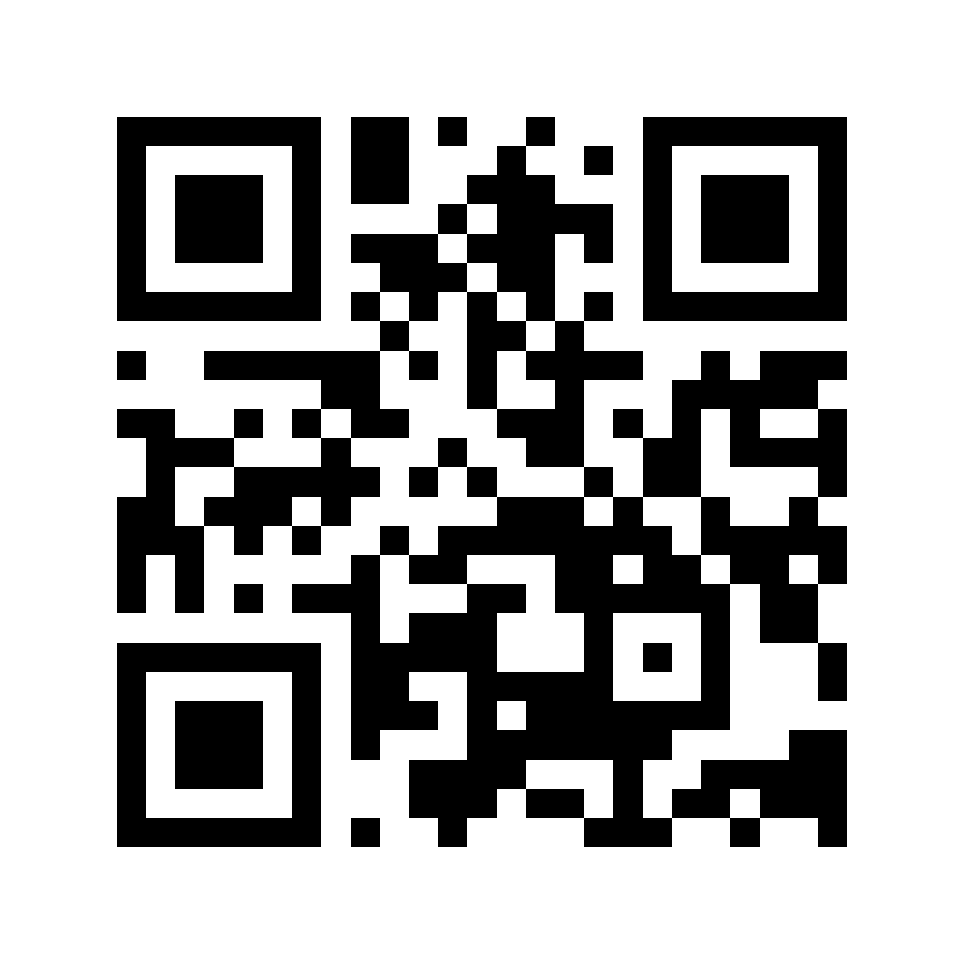




SEFOP: to keep learning
Software Engineering Framework for Optimization Programs — free & open-source
Train
Lead
github.com/sefop
Deliver
Go agentic

Slide 37
Questions?

