Slide 1
Operations Research meets Software Engineering
Secquoia Lab — Purdue University | June 29, 2026
Francisco Zenteno Smith

Slide 2


About me
Senior Operations Research Scientist at American Airlines - 10 years in applied Operations Research.
Education
Bachelors in Industrial Engineering PUC
Masters in Operations Research PUC Masters in Computer Science UCSD

Slide 3
Schedule
09:00–09:50 Block 1: Why learn Software Engineering? 09:50–10:00 Break 10:00–10:50 Block 2: Optimize for Learning 10:50–11:00 Break 11:00–11:50 Block 3: Hands-on Unit Testing in Practice 11:50–12:00 Break 12:00–13:00 Lunch 13:00–13:50 Block 4: Optimize for Managing Complexity 13:50–14:00 Break 14:00–17:00 Putting it all together: SEFOP

Slide 4
Public materials and resources
https://github.com/sefop
Leave a star if you like it ☺
Entry to the organization
https://github.com/sefop/training-testing-python
Training materials in python
https://github.com/sefop/sefop-training-hub/tree/main/guides
Language agnostic guides:
Software engineering learning roadmap for you
How to work with an inherited codebase

Slide 5
BLOCK 1
Why learn Software Engineering?

Slide 6

Sofware engineering principles always apply… whether you know them or not
Tragedy in the academy¹:
Geoffrey Chang, Scripps Institute (2006) A sign error in a data-processing script corrupted all results. 5 high-impact papers on membrane protein structures retracted.
Tragedy in the industry²:
Ariane 5 Rocket Explosion (1996) A reused software component caused an unhandled
overflow exception.
The rocket self-destructed 37 seconds after launch. $370 million USD payload destroyed.
Ariane flight V88 exploding during launch
Source: https://en.wikipedia.org/wiki/Geoffrey_Chang
Source: https://en.wikipedia.org/wiki/Ariane_flight_V88

Slide 7
Symptoms of being in a bad spot
Can't reproduce your own results quickly.
Code runs on your machine, but not in your teammate’s.
You are afraid of making changes.
Adding new things to the codebase is difficult.
There are not enough tests to check the codebase works as expected.
Low morale of the team working on the codebase. Unknown crashes of the codebase.
Other examples? – mention Russel Beckett example

Slide 8

Disclaimer: acquiring software engineering skills takes practice
Software
Engineering
I can provide you the bicycle, but I can’t ride it for you.
I will emphasize principles over technologies.
Principles last, technologies change.
You today
Notes:
I will show the direction, convince you why you should move into that direction, and how to reach that point.

Slide 9
What do you hope to learn from this workshop?
Best industrial practices.
I would like to learn how to coordinate between different part of repos and how to do proper docstring commenting.
I would like to get some insight into how advanced techniques (e.g. large-scale optimization) get integrated into modern enterprises.
SWE and Git best practices.
I want to make my code easier to debug and easier for others to use. I also want to know how to properly fix/maintain code bases I've been assigned.
Learn formal software design training.
To properly use Git for version control, efficiently manage issues and pull requests, and to use automation and AI agents to quickly handle mundane non-developmental tasks like testing and precommits.
Notes:
Indicate that all the software principles apply for all these situations, the technology might be different on each situation.

Slide 10


Sofware engineering: a different type of engineering
Civil engineering
Software engineering
Constructions are robust to tiny errors.
When designing, the requirements are known reasonably well.
Software is incredible flexible and fragile at the same time.
SE lives in a world of highly imperfect information.

Slide 11
Sofware engineering is a discovery process
Users don’t fully know what they want.
Building the software reveals unknown challenges over time.
Users will change their mind.
Notes:
Ask the audience: how would you go to some vacations with these characteristics?

Slide 12
The most important abilities in software
Adapt
Learn
The faster you can do this, the better.

Slide 13
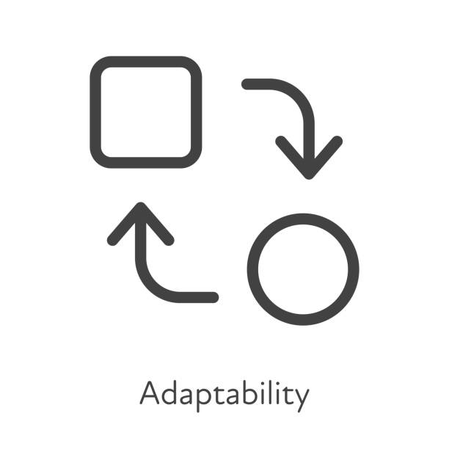
The 2 core challenges to review on this workshop
Learn quickly
Adapt quickly
Agile to have quick feedback loops.
The scientific method to learn effectively on those loops.
Keep code complexity low
Modularity & isolation of changes
Safety mechanisms for changes

Slide 14



Wait… why not just use AI-coding assistants?
What are your thoughts?
Recent industry research shows that¹:
AI’s primary role in software development is that of an amplifier, magnifying an organization’s existing strengths and weaknesses. The greatest returns on AI investment come not from the tools themselves, but from a strategic focus on the underlying organizational system.
At the end of the day, you are responsible for the product, not who wrote it (ai-agent, student, teammate, etc).
Source: Google DORA Report 2015: https://dora.dev/research/2025/dora-report/
Notes:
Ask the audience first

Slide 15
BLOCK 2
Optimize for Learning

Slide 16
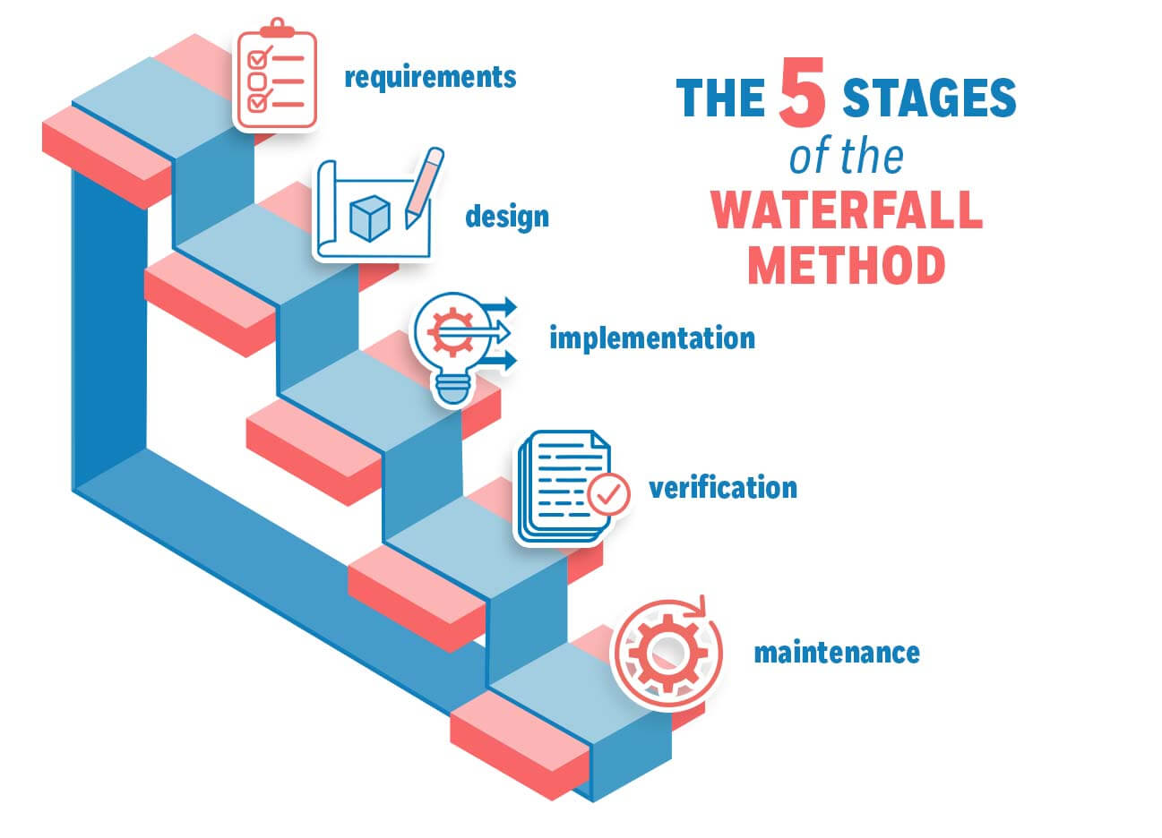
The old ways of software development
Big problems:
Slow learning: you learn what’s wrong at the end
Slow adaptation: system is thought as a rigid and linear process
Source: https://management.org/waterfall-methodology

Slide 17
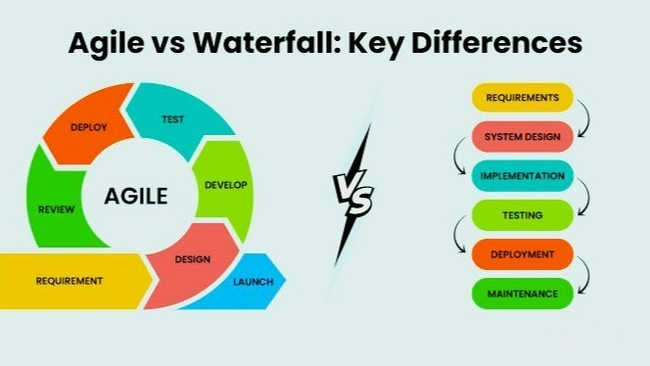
Agile allows learning through quick feedback loops
Feedback
Read the agile manifesto: https://agilemanifesto.org/

Slide 18
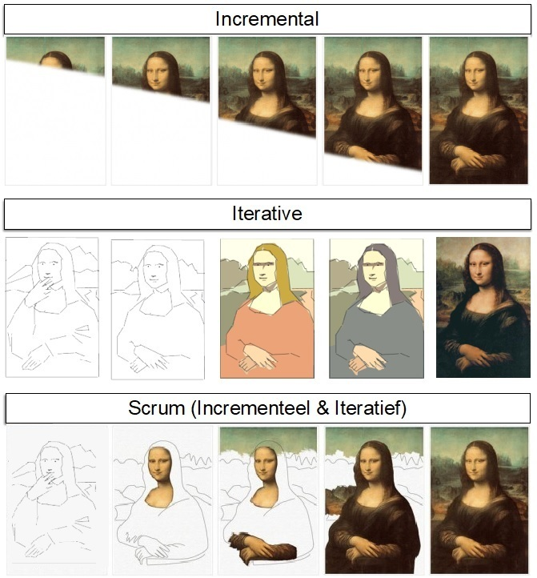
Agile strategy: working iteratively and incrementally
Incremental
“Don't build it all at once"
Iterative
“Don't try to get it all right from the beginning"
Source: Jeff Paton

Slide 19
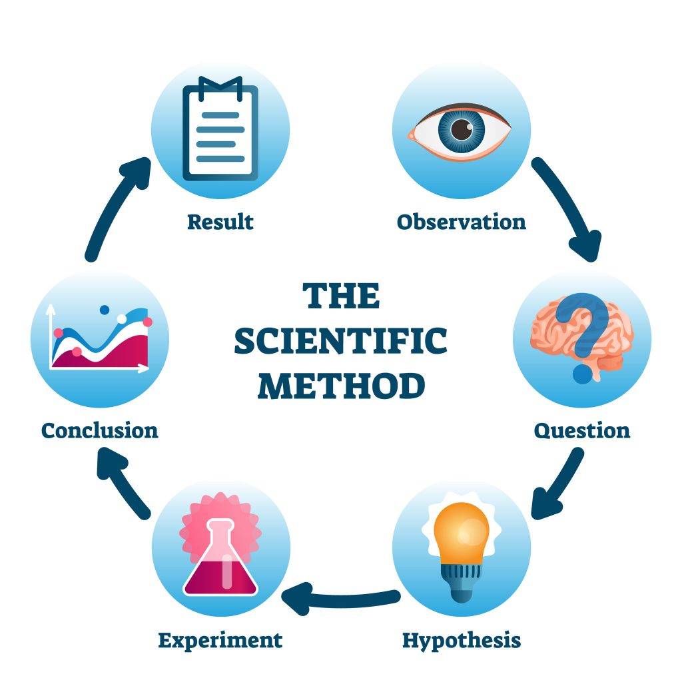
The Scientific Method to learn effectively
Principles
Skepticism: don’t trust, demand evidence.
Evidence over authority: does not matter who wrote the code, only what the evidence says.
Relevance: prove the experiment matters.
Testability: the hypothesis must be objective and measurable.
Reproducibility: anyone should be able to run the experiment again.
Causality: the experiment variables should be controlled to show causality.
Source: https://www.australianenvironmentaleducation.com.au/education-resources/what-is-the-scientific-method/

Slide 20
Examples of violations heard in the industry
Principles
Skepticism: don’t trust, demand evidence.
Evidence over authority: does not matter who wrote the code, only what the evidence says.
Relevance: prove the experiment matters.
Testability: the hypothesis must be objective and measurable.
Reproducibility: anyone should be able to run the experiment again.
Causality: the experiment variables
Should be controlled to show causality.
Q: Why did you not provide automatic tests on the new constraint?
It’s not necessary, I know this works because it’s the same constraint that I have on another repository which has been working correctly for a long time.
Q: Why this piece of code has no tests?
It was written by [the boss, a principal engineer, a smart guy]
Q: Why are you modifying the optimization algorithm?
It will decrease the run time of our model from 10 seconds to 9.8 seconds.
Q: How are you going to analyze if the new constraint is correctly implemented?
I will run 100 experiments and see if the results “look ok”
Q: How do I run your repository?
Follow the readme instructions, but then don’t forget to call me back because there are unwritten steps that you need to do that are not documented.
Q: I deleted part of the code of your constraint implementation, and the tests still pass
Yeah… the tests will pass anyway because I was not asserting anything, just making sure the code compiled correctly.

Slide 21
Some technologies that enable experimentation
Static code analysis tools → catch errors before you run (Skepticism)
Automated tests → verify the hypothesis of the program working correctly automatically quickly (Reproducibility, Testability)
CI/CD → instant feedback on every change (Reproducibility, Testability)
Virtual environments → Reproducibility guaranteed (Reproducibility)
Git branches & Pull Requests → isolated laboratories (Reproducibility)

Slide 22
BLOCK 3
Unit Testing in Practice
Hands-on exercise — follow on your laptop.
github.com/sefop/training-testing-python

Slide 23
BLOCK 4
Optimize for Adapting
Adapting = “changing the code”

Slide 24
To adapt quickly we need modularity and testing
Modularity provides
Automatic Testing provides
Code change isolation
Small code changes
Easier testing
Safety mechanisms for changes
Scalable, objective and reproducible experiments to check for expected behaviors
Focus of this block

Slide 25
Software design is applied at different levels
The principles we will review apply all they way from a function to a program.
Level
Function
Class
Package
Program
Enterprise
Usually the scientist scope lives here
Usually design at this level is called “software architecture”. This is out of the scope for this workshop.

Slide 26
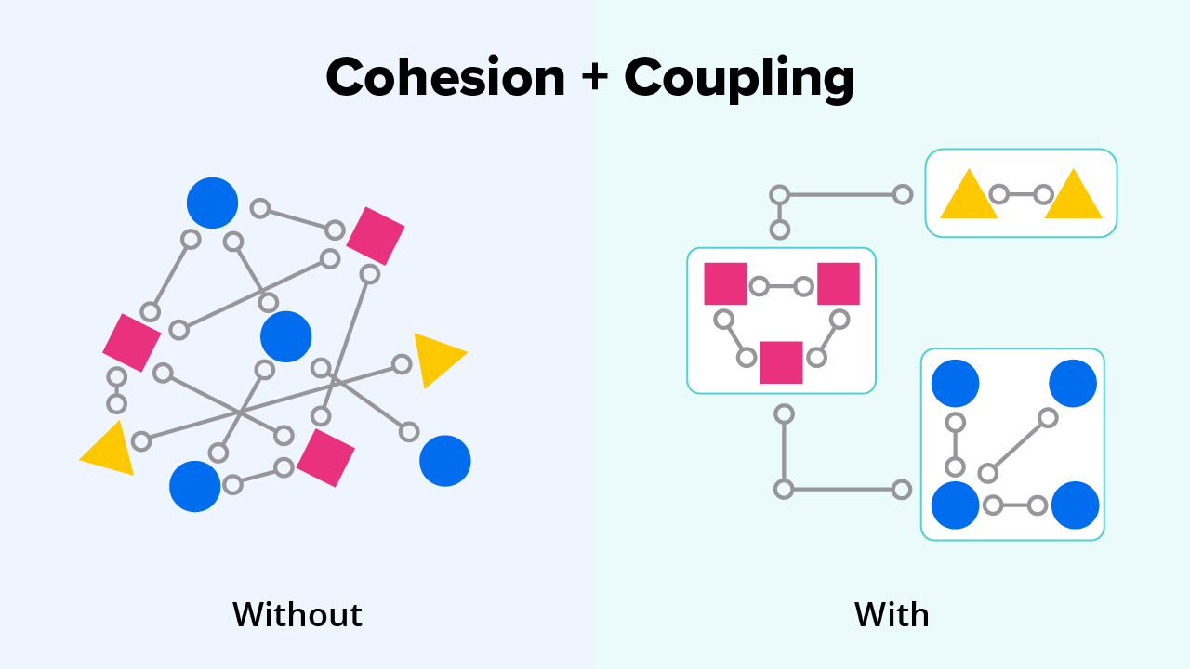

Fundamental forces: coupling & cohesion
The hat is not coupled to the head. He can wear any hat easily.
The eyes are coupled to the head.
The head is a cohesive module. Its modules can’t be changed easily.
Not desired
Desired
Cohesion is a measure of the degree to which the elements of a module are functionally related
Coupling is the measure of the degree of interdependence between modules

Slide 27
Principle: aim for low coupling and high cohesion
A highly cohesive module means it does a few related things well.
Loosely coupled module means it has low connections with other modules.
Benefits:
Module easier to understand.
Module easier to test.
Easier to maintain.
Promotes reuse.
Changes remain local.

Slide 28
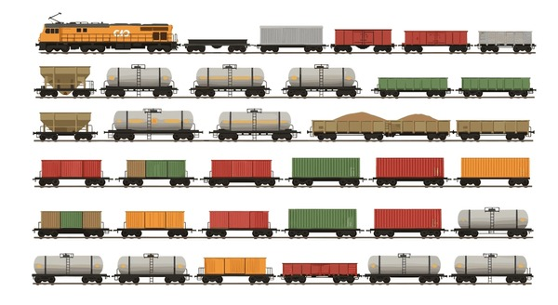
Example of highly cohesive and loosely coupled classes
The Train class has a List<Car>.
There are multiple subclasses of Car. The Train requires each Car to have some dimensions and some wheels. The train knows how to transport the cars to a destination.
The Train is loosely coupled to the Car class.
Each car is cohesive: it is specifically designed to carry a specific type of cargo. The car does not know how it is carried to the destination.
Notes:
List the responsibilities of each class, also list what is the coupling between Train and Car.

Slide 29
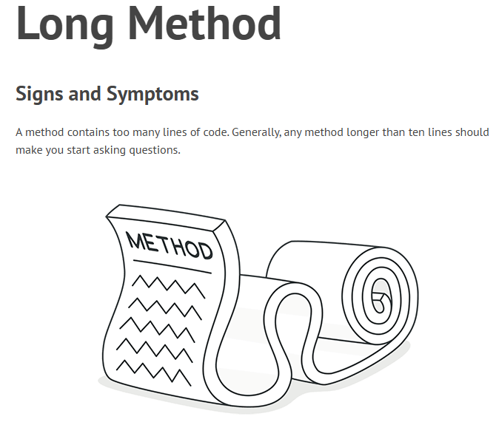
A “code smell” reveals a design anti-pattern
Check out this script:
https://github.com/sefop/sefop-training-hub/blob/main/workshops/2026-06-29-purdue/code_smell.py
What are the problems and how can we solve them?
Source: https://refactoring.guru/smells/long-method

Slide 30

Great website with other code smells and what to do about them
Source: https://refactoring.guru/refactoring/smells

Slide 31
Single Responsibility Principle¹ (SRP) and Don’t Repeat Yourself (DRY).
SRP: A module/class should have only one reason to change
DRY: Have your reasons-to-change stored in single places
“Responsibility” is not related to what the module does, it does not mean “function”
It means “reason for change” or “axis of change”
SRP and DRY are two sides of the same coin
In summary: encapsulate each axis-of-change in single places (classes/packages)
1) Also known as “Separation of Concerns”. Invented by Rober C. Martin.

Slide 32
What are ‘responsibilities’?
Knowing
Doing
About its own data
About data it can produce
About related objects available to use
Creates objects
Does a calculation
Initiates actions in other objects

Slide 33
SRP & DRY example
Violation
Compliance
InvoiceManager
addInvoice() deleteInvoice() printReport() emailReport()
InvoiceManager
addInvoice() deleteInvoice() getInvoices()
Problem: changing the report might break how it is sent!
ReportSender
sendReport()
InvoiceReport
printReport()
An InvoiceManager class has many reasons for change:
Adding/Deleting invoices
Print the report in different ways
Sending the report not only by email, also by mail
Sending the report at different frequencies in time
Now the reasons for change are separated (encapsulated)!
If we want to change the report format that change does not impact the InvoiceManager class.
Single Responsibility in SOLID Design Principle - GeeksforGeeks

Slide 34
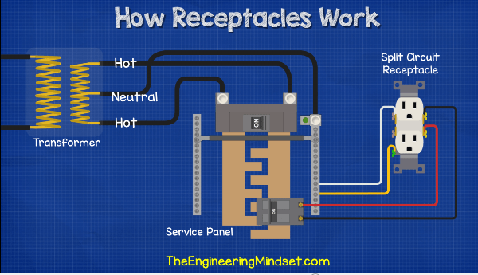

Information Hiding Principle
Hide implementation details behind an abstraction/interface. Callers/clients need to know what a module does, not how.
Implementation
Interface
Clients

Slide 35
Information Hiding Principle in Optimization
Clients
Interface
I solve knapsack problems
Knapsack Service
Solve me this knapsack problem please
Knapsack Algorithm Solver
Implementation details
Depending on the instance I may use different approaches: MIP, Dynamic Programming, Metaheuristics, etc.
The Knapsack service is coupled to the Knapsack Algorithm through its interface. It is not coupled to the different algorithms used!.

Slide 36
AFTERNOON
Putting it all together: SEFOP
Create a fork of this repo in your machine
https://github.com/sefop/sefop-python-starter

Slide 37
What is SEFOP?
Software Engineering Framework for Optimization Programs
It comes in 2 versions:
“Starter”: simplified design for non-web applications
“Advanced”: design thought for a web-application in the industry
Benefits:
Modularization of main phases of an optimization run
Automatic testing framework included for optimization problems
Solver decoupling from the logic
Focus today
Do not take this framework as the only way of achieving modularity and testing. Instead, focus on the most important ideas that could benefit your case.

Slide 38

The Knapsack problem as an example
What items to select to maximize the calories without exceeding the capacity and budget?
Weight: 1 kg
Calories: 500 Price: 1 usd
Weight: 0.4 kg
Calories: 100 Price: 0.5 usd
Capacity: 1 kg
Budget: 10 usd
Weight: 0.3 kg
Calories: 600 Price: 2 usd
Weight: 2 kg
Calories: 1000 Price: 3 usd

Slide 39
Overview of SEFOP design
Typical 4 phases of an optimization request
Data loading
Reads input data from different sources
Uses a Data Model to abstract the sources.
Preprocessing
Validation
Data cleaning
Data transformation
Optimization
Build
Solve
Postprocessing
Filter solutions to be sent to the user
Transform solution to business representation
User
request
Business
recommendation
✅ Separation of concerns ✅ Testable modules ✅ Simple interfaces ✅ Solver agnostic

Slide 40
Overview of SEFOP design
Typical 4 phases of an optimization request
Data loading
Reads input data from different sources
Uses a Data Model to abstract the sources.
Preprocessing
Validation
Data cleaning
Data transformation
Optimization
Build
Solve
Postprocessing
Filter solutions to be sent to the user
Transform solution to business representation
User
request
Business
recommendation
Everything starts from the command line interface (CLI).
This repo offers a single service or “use case”: solve 1 knapsack optimization problem.
✅ Separation of concerns ✅ Testable modules ✅ Simple interfaces ✅ Solver agnostic

Slide 41
Overview of SEFOP design
Input
Any data source. It could be JSON, XLSX, TXT, it does not matter.
This module is responsible for hiding that complexity to its client: the PreProcessing module.
Typical 4 phases of an optimization request
Data loading
Reads input data from different sources
Uses a Data Model to abstract the sources.
Preprocessing
Validation
Data cleaning
Data transformation
Optimization
Build
Solve
Postprocessing
Filter solutions to be sent to the user
Transform solution to business representation
User
request
Business
recommendation
Output
A Request, which is part of the Domain of the problem.
Go to the code and see the domain:
https://github.com/sefop/sefop-python-starter/tree/main/src/domain
✅ Separation of concerns ✅ Testable modules ✅ Simple interfaces ✅ Solver agnostic

Slide 42
Overview of SEFOP design
Typical 4 phases of an optimization request
Input:
The Request object incoming from Data Loading.
Output:
A PreProcessedData object that applied your business rules for cleaning and transformation.
Data loading
Reads input data from different sources
Uses a Data Model to abstract the sources.
Preprocessing
Validation
Data cleaning
Data transformation
Optimization
Build
Solve
Postprocessing
Filter solutions to be sent to the user
Transform solution to business representation
User
request
Business
recommendation
✅ Separation of concerns ✅ Testable modules ✅ Simple interfaces ✅ Solver agnostic

Slide 43
Overview of SEFOP design
Input:
The PreProcessedData object.
Note: this module hides the complexity of solving the problem. Nobody knows how the knapsack is solved, except this module. Thus, the optimization module is decoupled from other modules. If you wanted to add a new method (ex: Dynamic Programming), the only change would be on this module.
Design: uses a strategy pattern.
Output:
A Recomendation object (part of the Domain).
Typical 4 phases of an optimization request
Data loading
Reads input data from different sources
Uses a Data Model to abstract the sources.
Preprocessing
Validation
Data cleaning
Data transformation
Optimization
Build
Solve
Postprocessing
Filter solutions to be sent to the user
Transform solution to business representation
User
request
Business
recommendation
✅ Separation of concerns ✅ Testable modules ✅ Simple interfaces ✅ Solver agnostic

Slide 44
Overview of SEFOP design
Typical 4 phases of an optimization request
To provide testability to the optimization module:
Separate the build phase from the solve phase.
The build phase: outputs a model formulation (100% deterministic and testable).
The solve phase: calls a solver (gurobi, xpress, other) and outputs a solution.
Data loading
Reads input data from different sources
Uses a Data Model to abstract the sources.
Preprocessing
Validation
Data cleaning
Data transformation
Optimization
Build
Solve
Postprocessing
Filter solutions to be sent to the user
Transform solution to business representation
User
request
Business
recommendation
✅ Separation of concerns ✅ Testable modules ✅ Simple interfaces ✅ Solver agnostic

Slide 45
Overview of SEFOP design
Input:
The Recommendation object coming from the Optimization.
Note: this module is the last step of the pipeline and contains logic out of the scope of the optimization. Example: show the solution in a different way that considers users-preferences or risk.
Output:
A Recomendation object (part of the Domain).
Typical 4 phases of an optimization request
Data loading
Reads input data from different sources
Uses a Data Model to abstract the sources.
Preprocessing
Validation
Data cleaning
Data transformation
Optimization
Build
Solve
Postprocessing
Filter solutions to be sent to the user
Transform solution to final business representation
User
request
Business
recommendation
✅ Separation of concerns ✅ Testable modules ✅ Simple interfaces ✅ Solver agnostic

Slide 46
Your tasks
Fork the repo
Run it locally
Create a branch with your name
Create a new request within the folder ./data
Create a new constraint with its unit tests (be creative!) (ex: create a constraint that prohibits products with calories < 60)
Submit a PR and watch the tests pass

Slide 47

Thank you
Provide your feedback here please:
https://forms.gle/Ajp2wa3kgcDhyGDW7

