Slide 1
Southern Colorado Transportation Conference 2026
Airlines Optimization Workshop:
Industry best practices for a decision-support system
Francisco Zenteno Smith
Senior Operations Research Scientist
American Airlines

Slide 2



About me
Senior Operations Research Scientist at
> 10 years in applied Operations Research.
Education
Bachelors in Industrial Engineering PUC
Masters in Operations Research PUC
Masters in Computer Science UCSD

Slide 3
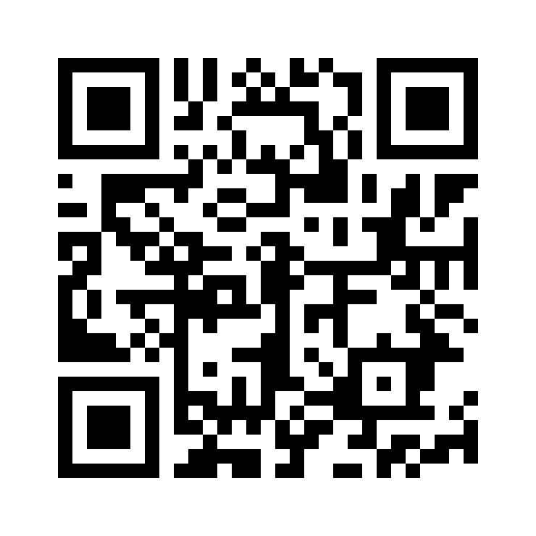
Resources for today
After the workshop you will have the repo and this ppt to explore it.
No laptop required during the session.
Have some paper and pencil to do some exercises.
Form pairs.
https://github.com/sefop/sefop-sctc-2026
1

Slide 4
Quick survey
Optimization
Coding
Python
Unit testing

Slide 5
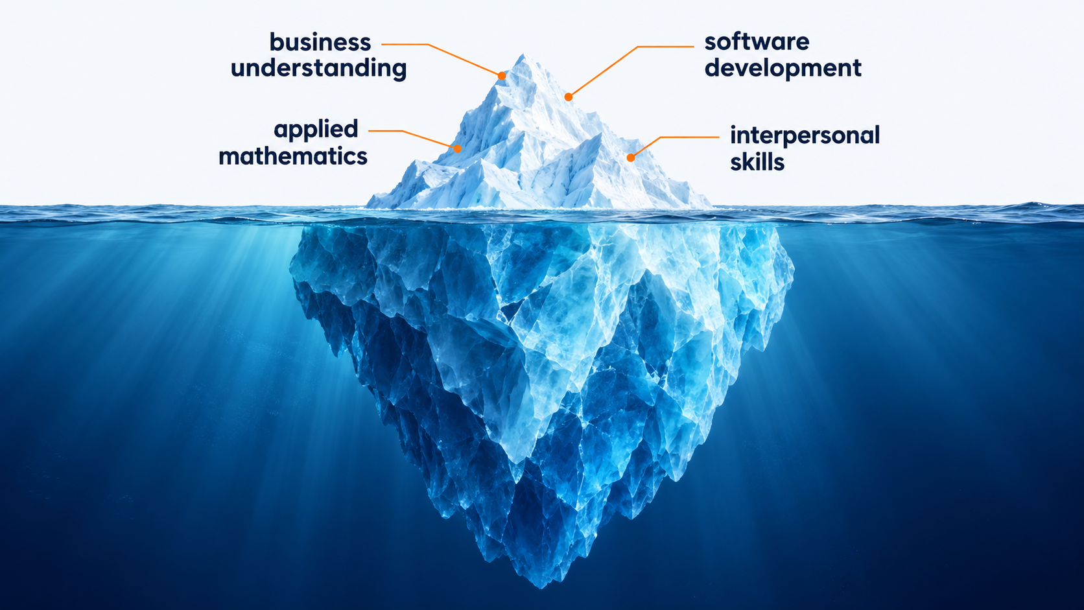
Goal today: touching the surface of a DSS
1
Notes:
These are 4 big elements to create a DSS. We are only going to scratch the surface

Slide 6
Agenda for today
Part I – What is a decision-support system?
Part II – Are we solving the right problem?
Part III – Are we solving the problem right?
Part IV – Closing & conclusions

Slide 7
What is a decision-support system?
Operations Research (OR) turns data + business needs + mathematics → decision.
An analysis delivers a one-time decision.
A decision-support system delivers a recurring decision.
What is the implication?
Plan the fleet
Schedule crews
Recover operations
Annually
Monthly
Daily
Notes:
Implications:
A decision is useful if someone uses it
A DSS requires software because it is run recurringly

Slide 8

What would you need before trusting a recommendation from a mathematical model?
MODEL SAYS
OPTIMAL
Question for the audience
Notes:
STORY TALKING POINTS
- What can go wrong?
- Answer: "optimal" only means optimal for the model as it was coded. Before acting I need evidence on three things:
The data is correct and current
The model states reasonably the business's real objective and rules
The software computes what the model says
Basically: solving the right problem, and doing it right: validation & verification.

Slide 9
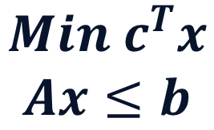
A useful DSS requires validation and verification
$$Min c^{T}x$$
$$Ax≤b$$
Business problem
Mathematical model
Code
translation
translation
Validation
Verification
Are we solving the right problem?
(consulting problem)
Are we solving the problem right?
(software problem)
Notes:
STORY TALKING POINTS
Each translation may have errors:
The first one:
Misunderstanding of the business problem
Over simplification
Under simplification
The second one:
Code does not do what it is supposed to do

Slide 10

Our example: selecting cargo for a flight

Slide 11
Agenda for today
Part I – What is a decision-support system?
Part II – Are we solving the right problem?
Part III – Are we solving the problem right?
Part IV – Closing & conclusions

Slide 12
Key elements to define an analytical problem
Stakeholders: who cares?
Objectives: what do we want to achieve?
Decisions: what do we control?
Constraints: what can’t we do? (hard & soft)
Data: what information is available?
Risk: what can go wrong?
Scope: what do we omit?
Other sources: https://www.informs.org/Professional-Development/INFORMS-Analytics-Framework/Explore

Slide 13
Read the initial email of the problem and then interview the planner (me)
Pairs - 10 minutes + questions

Slide 14
These examples show what the planner would do
Example 1
Example 2
Aircraft 500 kg limit
Aircraft 500 kg limit
Customer | Weight | Revenue
Atlas Steel | 500 kg | $3,000
Bighorn Auto | 250 kg | $2,000
Cedar Pharma | 250 kg | $1,800
Customer | Weight | Revenue
Atlas Steel | 300 kg | $3,000
Bighorn Auto | 900 kg | $9,000
Cedar Pharma | 300 kg | $800
✓
✓
✓
Bighorn + Cedar
Atlas
$3,800 · 500 kg
$3,000 · 300 kg

Slide 15
Now frame this problem as an optimization problem
10 minutes

Slide 16
The business problem leads to a knapsack model
Each shipment flies
whole or stays
xᵢ ∈ {0, 1}
Decisions
Earn the most revenue
max ∑ᵢ rᵢ xᵢ
Objective
Stay within the weight limit
∑ᵢ wᵢ xᵢ ≤ W
Constraints
i: shipment · xᵢ: fly / stay · rᵢ: revenue · wᵢ: weight · W: weight limit

Slide 17
Agenda for today
Part I – What is a decision-support system?
Part II – Are we solving the right problem?
Part III – Are we solving the problem right?
Part IV – Closing & conclusions

Slide 18


Software is a different kind of engineering
Civil engineering
Software engineering
Constructions are robust to tiny errors.
When designing, the requirements are known reasonably well.
Software is incredible flexible and fragile at the same time.
SE lives in a world of highly imperfect information.

Slide 19
Software engineering is a discovery process
Users don’t fully know what they want.
Building the software reveals unknown challenges over time.
Users will change their mind.
How would you plan your vacations?
Notes:
How would you plan your vacations if your family behave like this?

Slide 20
The most important abilities in software
Adapt
Learn
The faster you can do this, the better.

Slide 21
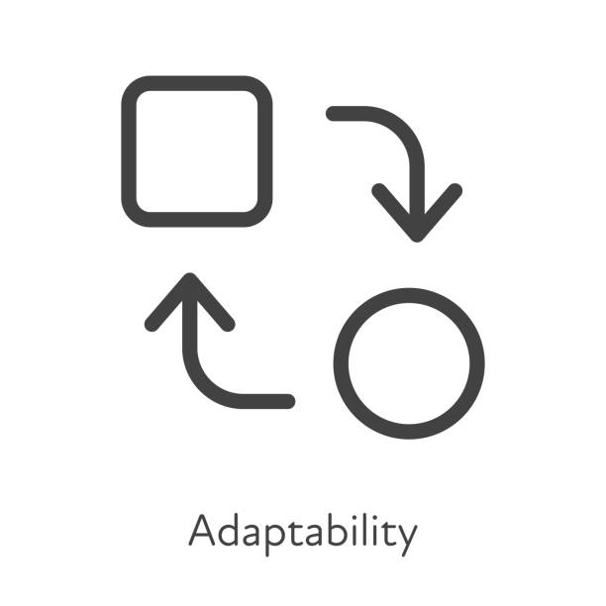
Learning and adapting quickly
Learn quickly
Adapt quickly
Agile to have quick feedback loops.
The scientific method to learn effectively on those loops.
Keep code complexity low
Modularity & isolation of changes
Automated testing as a safety mechanism for changes

Slide 22
A typical workflow in a decision-support system
Validation
Request
Feedback
Requirements
Use
∑
Model
Deploy
Design & code
Tests
Verification

Slide 23
Design helps to modularize your code and to facilitate testing
A
B
A
B
C
F
C
✓
✓
✓
D
E
F
E
D
✓
✓
✓
Changes spread
Changes stay manageable

Slide 24
A DSS example design
∑
Read data
Preprocess
Solve
Postprocess
Result
SC101 · Live demonstration
Notes:
13 | A DSS example design
Suggested elapsed workshop minutes: 51–59 (90 minutes total).
PRESENTER GUIDE
LIVE DEMO: Run python -m cli optimize_cargo SC101 from the prepared environment. Show each stage announcement, then interpret the recommendation: S1–S4, $9,600, 1,000 kg, two customers. Open src/: reading is adapters/json_data_loader.py; preprocessing, optimization and postprocessing are the folders under use_cases/solving/; output is adapters/console_result_writer.py. Explain each module’s single responsibility. Arrows show execution flow rather than dependency direction. Do not write code live. A successful run is not yet evidence of correctness; transition to the tests.
STORY TALKING POINTS
- A DSS is usually divided into the same modules: reading data, preprocessing, optimization,
postprocessing, and presenting the result.
- Run the first version on flight SC101: the console announces each stage in a box: Read data,
Preprocess, Solve, Postprocess, Result.
- Open the repository: each box is one place in `src/`. Reading data is
`adapters/json_data_loader.py`; preprocessing, optimization and postprocessing are folders
under `use_cases/solving/`; presenting the result is `adapters/console_result_writer.py`.
- Interpret the proposed load with the audience.
- Connecting idea: the program produces a load, but does it compute what the model states? Tests
are the evidence.
Workshop source: assets/slide-story.md. Format reference: AGIFORS Annual Symposium 2026 deck.

Slide 25
Automated testing 101
End-to-end
Unit
Integration
End-to-end
Read
Read
Read
Integration
Compute
Compute
Compute
Unit
Report
Report
Report
Arrange
→
Act
→
Assert
Set up
Run
Check

Slide 26
How would you test this optimization model?
Each shipment flies
whole or stays
xᵢ ∈ {0, 1}
Decisions
Earn the most revenue
max ∑ᵢ rᵢ xᵢ
Objective
Stay within the weight limit
∑ᵢ wᵢ xᵢ ≤ W
Constraints
i: shipment · xᵢ: fly / stay · rᵢ: revenue · wᵢ: weight · W: weight limit

Slide 27
Agenda for today
Part I – What is a decision-support system?
Part II – Are we solving the right problem?
Part III – Are we solving the problem right?
Part IV – Closing & conclusions

Slide 28
What this profession needs
Business skills
Software skills
People skills

Slide 29
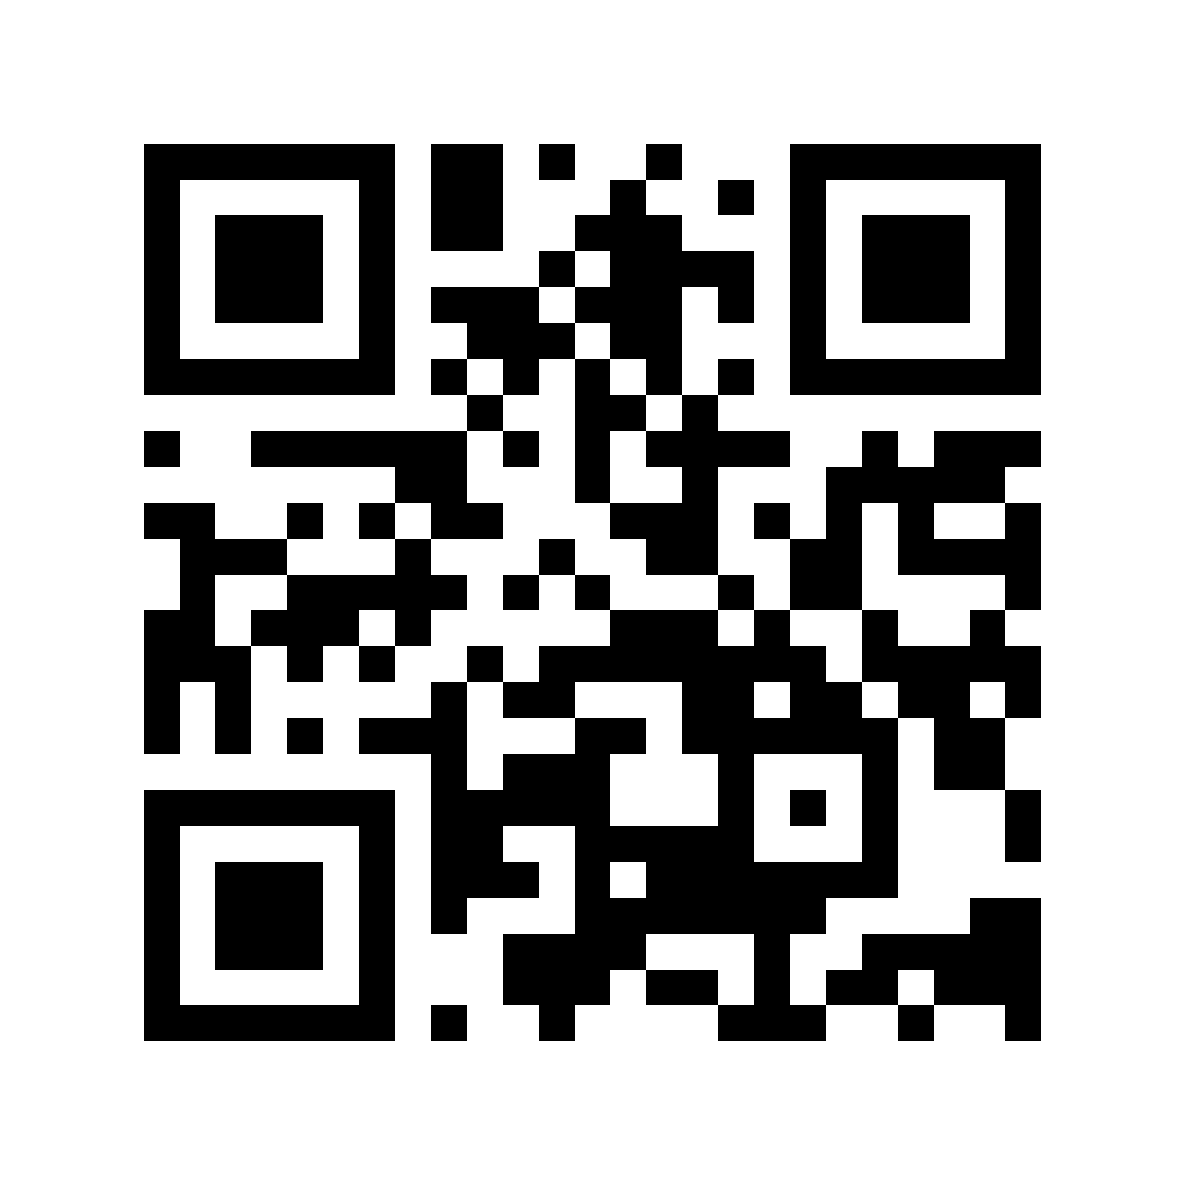




SEFOP: to keep learning
Software Engineering Framework for Optimization Programs — free & open-source
Train
Lead
github.com/sefop
Deliver
Go agentic

Slide 30
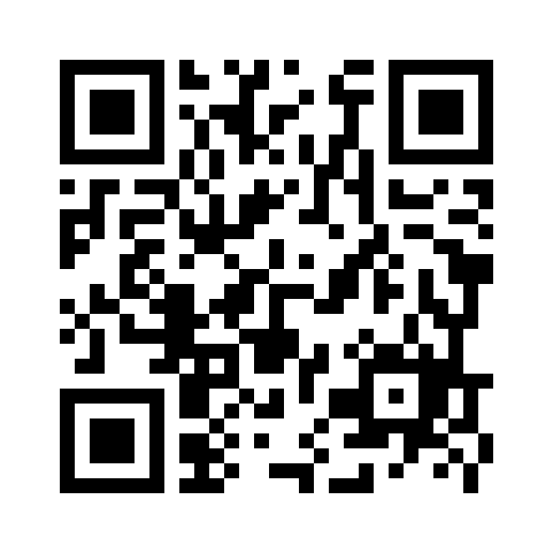
Questions?
1 min survey
Notes:
18 | Questions and discussion
Suggested elapsed workshop minutes: 80–90 (90 minutes total).
PRESENTER GUIDE
DISCUSSION, 10 MINUTES: What remains unclear about turning a business request into decision-support software? Where would you apply learning and adaptation in your own project? Leave the QR visible throughout. If questions slow, invite an example from a student project and trace its next request through validation and verification. Close by returning to the cycle: the next business request begins another turn.
STORY TALKING POINTS
- What remains unclear about turning a business request into decision-support software?
- Where would you apply learning and adaptation in your own project?
- Connecting idea: there is no next slide; the next business request starts validation and
verification again, back round the cycle of slide 5.
Workshop source: assets/slide-story.md. Format reference: AGIFORS Annual Symposium 2026 deck.

