Slide 1
Introduction to Unit Testing
SEFOP
https://github.com/sefop/training-testing-python

Slide 2
Types of tests
Functional
Non-functional
Does my program provide its services correctly?
Elements surrounding the services (security, speed, usability, availability, scalability, etc).
Focus of this session

Slide 3
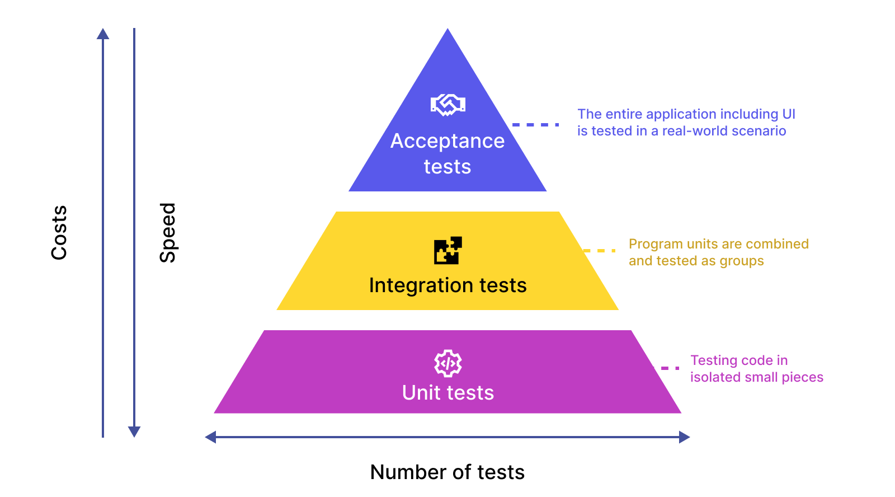
Hierarchy of functional tests

Slide 4
Hierarchy of functional tests
Example program
Module 1: Reading data
read_user()
read_db()
Module 2: Business logic
calculate_income()
calculate_tax()
Module 3: Process results
create_report()
display_report()

Slide 5
Hierarchy of functional tests
Example program
Module 1: Reading data
read_user()
read_db()
Module 2: Business logic
calculate_income()
calculate_tax()
Module 3: Process results
create_report()
display_report()

Slide 6
Hierarchy of functional tests
Example program
Module 1: Reading data
read_user()
read_db()
Module 2: Business logic
calculate_income()
calculate_tax()
Module 3: Process results
create_report()
display_report()

Slide 7
Hierarchy of functional tests
Example program
Module 1: Reading data
read_user()
read_db()
Module 2: Business logic
calculate_income()
calculate_tax()
Module 3: Process results
create_report()
display_report()

Slide 8
A calculator example
Assume you have a Calculator class
The function add(a, b) is implemented with unit tests.
https://github.com/sefop/training-testing-python/blob/main/src/calculator.py
Let’s understand: what, where and how this was done.
Source: https://www.testingdocs.com/junit-calculator-test-case-example/
Source: https://www.youtube.com/watch?v=vZm0lHciFsQ

Slide 9
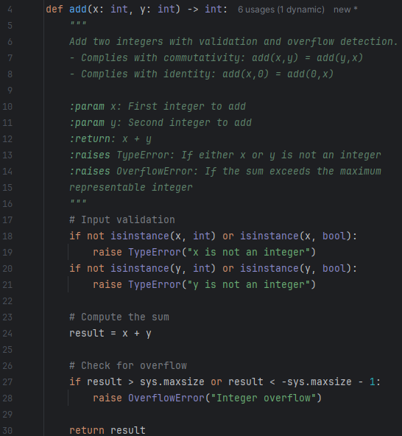
Example: adding two integers
Notes:
import sys def add(x: int, y: int) -> int: """ Add two integers with validation and overflow detection. - Complies with commutativity: add(x,y) = add(y,x) - Complies with identity: add(x,0) = add(0,x) :param x: First integer to add :param y: Second integer to add :return: x + y :raises TypeError: If either x or y is not an integer :raises OverflowError: If the sum exceeds the maximum representable integer """ # Input validation if not isinstance(x, int) or isinstance(x, bool): raise TypeError("x is not an integer") if not isinstance(y, int) or isinstance(y, bool): raise TypeError("y is not an integer") # Compute the sum result = x + y # Check for overflow if result > sys.maxsize or result < -sys.maxsize - 1: raise OverflowError("Integer overflow") return result if __name__ == "__main__": # Demonstrate normal usage print("=== Normal Usage ===") print(f"add(5, 3) = {add(5, 3)}") print(f"add(-10, 4) = {add(-10, 4)}") print(f"add(0, 42) = {add(0, 42)}") # Demonstrate TypeError print("\n=== Type Error Handling ===") try: add("5", 3) except TypeError as e: print(f"TypeError caught: {e}") # Demonstrate OverflowError print("\n=== Overflow Error Handling ===") try: print(add(sys.maxsize, 1)) except OverflowError as e: print(f"OverflowError caught: {e}")

Slide 10
Definition: a module has an interface and an implementation
This is the interface (“signature”, “API”, “contract” or “abstraction”) of the module. Specifies to its clients what it does, inputs conditions and outputs.
Design best practice: it should not specify how the contract is implemented.
Note: comments are an integral part of the interface.
This is the implementation of the module. Also called “implementation details”.
There could be many implementations for a single interface.
Design best practice: it should be hidden from the clients.

Slide 11


An outlet providing power is an abstraction of an electricity service
To be tested
Implementation
Interface
Clients

Slide 12
What to test? The “behaviors” of the interface
An interface has 1 or more behaviors, on this case:
1. Base case or “happy path”:
add(3,4) = 7
2. Commutativity:
add(3,4) = add(4,3)
3. Identity:
add(3,0) = 3
4. Exceptions:
Input error
Arithmetic overflow error
Each behavior may have 1 or multiple ‘cases’

Slide 13
Where to place the tests? In the mirror ‘test’ folder
This is for Python. In other languages it is slightly different.
root folder of the project
src
Production code
calculator.py
tests
Testing code
test_calculator.py

Slide 14
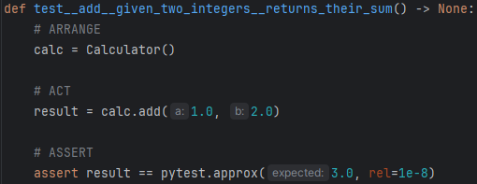
Typical structure of a unit test
Notes:
import sys def add(x: int, y: int) -> int: """ Add two integers with validation and overflow detection. - Complies with commutativity: add(x,y) = add(y,x) - Complies with identity: add(x,0) = add(0,x) :param x: First integer to add :param y: Second integer to add :return: x + y :raises TypeError: If either x or y is not an integer :raises OverflowError: If the sum exceeds the maximum representable integer """ # Input validation if not isinstance(x, int) or isinstance(x, bool): raise TypeError("x is not an integer") if not isinstance(y, int) or isinstance(y, bool): raise TypeError("y is not an integer") # Compute the sum result = x + y # Check for overflow if result > sys.maxsize or result < -sys.maxsize - 1: raise OverflowError("Integer overflow") return result if __name__ == "__main__": # Demonstrate normal usage print("=== Normal Usage ===") print(f"add(5, 3) = {add(5, 3)}") print(f"add(-10, 4) = {add(-10, 4)}") print(f"add(0, 42) = {add(0, 42)}") # Demonstrate TypeError print("\n=== Type Error Handling ===") try: add("5", 3) except TypeError as e: print(f"TypeError caught: {e}") # Demonstrate OverflowError print("\n=== Overflow Error Handling ===") try: print(add(sys.maxsize, 1)) except OverflowError as e: print(f"OverflowError caught: {e}")

Slide 15
Name structure of a unit test & the AAA pattern
Module
Behavior & case
Expected result
Setup phase
AAA pattern
Perform the action
Assert expectations
Library for testing
Notes:
import sys def add(x: int, y: int) -> int: """ Add two integers with validation and overflow detection. - Complies with commutativity: add(x,y) = add(y,x) - Complies with identity: add(x,0) = add(0,x) :param x: First integer to add :param y: Second integer to add :return: x + y :raises TypeError: If either x or y is not an integer :raises OverflowError: If the sum exceeds the maximum representable integer """ # Input validation if not isinstance(x, int) or isinstance(x, bool): raise TypeError("x is not an integer") if not isinstance(y, int) or isinstance(y, bool): raise TypeError("y is not an integer") # Compute the sum result = x + y # Check for overflow if result > sys.maxsize or result < -sys.maxsize - 1: raise OverflowError("Integer overflow") return result if __name__ == "__main__": # Demonstrate normal usage print("=== Normal Usage ===") print(f"add(5, 3) = {add(5, 3)}") print(f"add(-10, 4) = {add(-10, 4)}") print(f"add(0, 42) = {add(0, 42)}") # Demonstrate TypeError print("\n=== Type Error Handling ===") try: add("5", 3) except TypeError as e: print(f"TypeError caught: {e}") # Demonstrate OverflowError print("\n=== Overflow Error Handling ===") try: print(add(sys.maxsize, 1)) except OverflowError as e: print(f"OverflowError caught: {e}")

Slide 16
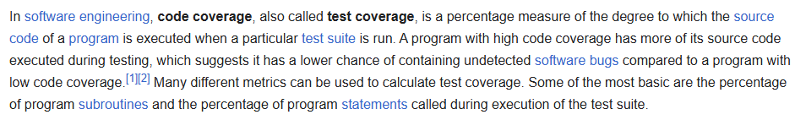
How to know if I tested every behavior? Starting point is code coverage
Source: https://en.wikipedia.org/wiki/Code_coverage
Check out the ‘how to’ code coverage guide to analyze your codebase quickly:
https://github.com/sefop/training-testing-python/blob/main/exercises/unit-tests/how-to-code-coverage.md
Notes:
import sys def add(x: int, y: int) -> int: """ Add two integers with validation and overflow detection. - Complies with commutativity: add(x,y) = add(y,x) - Complies with identity: add(x,0) = add(0,x) :param x: First integer to add :param y: Second integer to add :return: x + y :raises TypeError: If either x or y is not an integer :raises OverflowError: If the sum exceeds the maximum representable integer """ # Input validation if not isinstance(x, int) or isinstance(x, bool): raise TypeError("x is not an integer") if not isinstance(y, int) or isinstance(y, bool): raise TypeError("y is not an integer") # Compute the sum result = x + y # Check for overflow if result > sys.maxsize or result < -sys.maxsize - 1: raise OverflowError("Integer overflow") return result if __name__ == "__main__": # Demonstrate normal usage print("=== Normal Usage ===") print(f"add(5, 3) = {add(5, 3)}") print(f"add(-10, 4) = {add(-10, 4)}") print(f"add(0, 42) = {add(0, 42)}") # Demonstrate TypeError print("\n=== Type Error Handling ===") try: add("5", 3) except TypeError as e: print(f"TypeError caught: {e}") # Demonstrate OverflowError print("\n=== Overflow Error Handling ===") try: print(add(sys.maxsize, 1)) except OverflowError as e: print(f"OverflowError caught: {e}")

Slide 17
Your task:
Check out how the unit tests were created for the function `add()` as a starting point (“main” branch).
https://github.com/sefop/training-testing-python/blob/main/src/calculator.py
https://github.com/sefop/training-testing-python/blob/main/tests/test_calculator_add.py
Implement the unit tests of the implemented function `divide()` in the calculator.py script until you reach 100% code coverage in the calculator.py script.
→ Place your unit tests on this test file:
https://github.com/sefop/training-testing-python/blob/main/tests/test_calculator_divide.py
The solutions of this exercise are in the “solutions” branch.

