Slide 1
Catching phishing from the link alone
…and why “99% accuracy” in URL phishing detection is mostly an illusion
Data Science & Cyber · the URL / link detector (Gilad Segal 216214353)
Notes:
~15 minute talk. Opening line: 'Can you tell if a link is phishing just from the URL string itself — no clicking, no page content?' I built a detector that does exactly that, got a near-perfect score, and then spent most of the project proving that score doesn't mean what it looks like. That honest audit is the real contribution.

Slide 2
The question, and the project
• Phishing is the #1 way attackers get a first foothold — and much of it is just a link.
• Can we classify a URL as phishing / legitimate from the STRING ALONE?
• Two-part project: this half = the URL / link channel; my partner = the email content channel.
• Built independently. Plan: build a detector → then stress-test whether its score is real.
Notes:
Frame the two-part project: my partner reads the words of the email; I read the link. Both are meant to be fused later (out of scope here). The plan is deliberately 'build then break' — the 20% that is model-building sets up the 80% that is critical evaluation.

Slide 3
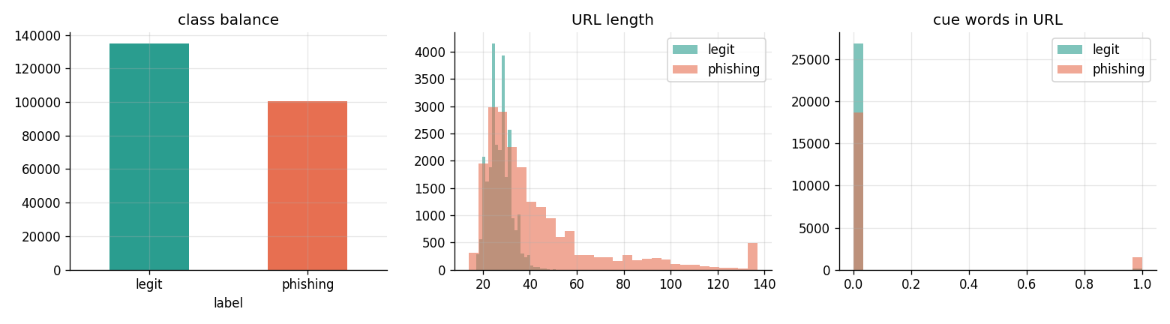
The data
real, public, recent
• PhiUSIIL (Prasad & Chandra, 2024; UCI id 967) — 235,795 real URLs, 43% phishing
• Preprocessing: de-duplicate on the URL BEFORE splitting (no leakage).
– class balance (no rebalancing), stratified 60/20/20 split, seed 42, test used once
• For the generalisation test later: an INDEPENDENT Kaggle set (651k URLs) + live OpenPhish
Notes:
[COURSE: EDA + train/val/test methodology.] Data prep was minimal on purpose: only a label standardisation (1=phishing), dropping empties, and de-duplicating identical URLs before the split so the same URL can't appear in train and test. I did NOT rebalance classes, remove outliers, or scale the raw data — so the near-perfect score I'm about to show is a property of the RAW data, not of my cleaning. Right figure: the EDA already looks suspicious — the classes separate almost perfectly on trivial quantities, which never happens with genuinely hard data.

Slide 4
How we chose the features
feature engineering
• A URL is a short, STRUCTURED string, not prose.
• I compute interpretable numbers DIRECTLY from the URL — no learned text embedding.
• Why interpretable, hand-built features (not a deep character model / URLNet)?
– → so I can later attribute the score to specific, human-readable causes
• 40 features, grouped into 6 families
Notes:
[COURSE: feature engineering.] This is the key design choice. Text has to be turned into numbers somehow — my partner uses TF-IDF (term frequency × inverse document frequency) over words. A URL isn't a sentence; it's structured (scheme://host/path?query). So I hand-engineer 40 numeric features straight from the string. I deliberately avoided a black-box deep model (like URLNet) because interpretability is the whole point: when I find the near-perfect score is an artifact, I want to name exactly which feature is responsible — which a black box would hide.

Slide 5
The 40 features — six families
• Lexical / length — URL length; counts of dots, slashes, digits, hyphens; digit ratio
• Host / domain — number of subdomains; is the host a raw IP; unusual port
• TLD — the suffix (.com vs .tk vs .xyz); is it an abuse-associated TLD
• Entropy — randomness of the host string (algorithmically-generated domains)
• Scheme / encoding — HTTPS?; punycode (xn--); percent/hex encoding
• Brand / cue — words like ‘verify/login/secure’; look-alike distance to real brands
Notes:
Walk the six families briefly. Lexical = size and punctuation of the string. Host/domain = structure of the hostname (an IP literal instead of a domain name is suspicious). TLD = the suffix; some cheap TLDs (.tk, .xyz) are over-represented in abuse feeds. Entropy and Brand each have real theory — next slide. Scheme/encoding includes HTTPS (which turns out to be the villain of the story) and punycode, the xn-- encoding used to register look-alike international-character domains.

Slide 6
Two features worth the math
information theory · edit distance
Shannon entropy of the host: H = − Σ p · log₂(p)
“google” = repeating, predictable letters → LOW entropy; “x7qz9wvt” ≈ random → HIGH entropy.
→ catches algorithmically-generated (DGA) phishing domains.
Brand look-alike: Levenshtein edit distance to a known brand
edit distance = min single-character inserts / deletes / substitutions to turn one word into another.
“paypa1” is edit-distance 1 from “paypal” → flag distance 1–2 as a typosquat.
Notes:
[COURSE: Shannon entropy / information theory; edit distance.] Entropy formula: sum over the character distribution of the host, p·log2(p). Intuitively it measures unpredictability — a real brand name is low-entropy, a random string is high-entropy. Levenshtein distance is the classic string-similarity measure, computed by dynamic programming; paypa1→paypal is one substitution, so distance 1. Domains within edit distance 1–2 of a known brand get flagged as typosquats. These two features are where the URL side borrows the same math toolkit as the rest of the course.

Slide 7
Step 1 — train it. It looks perfect: F1 ≈ 1.0
• All provided features → F1 1.0
• ONE feature (URLSimilarityIndex) alone → F1 0.9953 → basically the label (leakage)
• My honest hand-built lexical features → F1 0.9967
• Accuracy paradox: always-predict-legit = 57% accuracy but 0% recall (catches nothing)
• A one-line ‘not-HTTPS → phishing’ rule alone already scores F1 0.68
This is where the FIRST learning ends — and the real project begins.
Notes:
[COURSE: the accuracy paradox.] This is the model you 'got' in the first round. It's excellent — and that's the problem. The decomposition is the first alarm: a single provided column scores 0.995, meaning it's essentially a copy of the answer key (leakage). And the accuracy paradox: 57% of the data is legit, so a do-nothing model looks 57% accurate while catching zero phishing — which is why I never report accuracy alone. Everything after this slide is a 'discovery' about why the perfect score is fake.

Slide 8
Discovery 1 — the score is a collection artifact
DISCOVERY 1
• Legitimate URLs in PhiUSIIL: 100% HTTPS. Phishing: only 49%.
• So the model largely learns ‘HTTP = phishing’ — a fact about how the data was collected,
– NOT about phishing (real modern phishing is mostly HTTPS — this rule is backwards!)
• Legit URLs here are clean home-pages; phishing are messy deep links.
Notes:
Discovery 1: WHY is it perfect? Legit URLs are 100% HTTPS, phishing only 49% — a 51-point gap baked into how the two classes were gathered. The model is basically an HTTPS detector. This is the core critical finding: near-perfect benchmark scores measure dataset construction, not the phishing problem. Note the irony — in the real world phishing is mostly HTTPS now, so this learned rule is actually backwards outside the dataset.

Slide 9
How we evaluate honestly
the metric toolkit — and why
• Accuracy lies under imbalance (paradox) → report Precision, Recall, F1
• F2 — like F1 but weights RECALL more: a missed phish (FN) costs more than a false alarm (FP)
• MCC (Matthews) — one score in [−1,1] using ALL 4 confusion cells; honest under imbalance
• AUC — P(a random phish scores above a random legit); 0.5 = coin-flip
• Bootstrap 95% CI — resample the test set 1000× to get error bars on every metric
• McNemar test — is model A really better than B, or just luck on this split?
Notes:
[COURSE: evaluation metrics + statistical validity.] Explain the two that get asked about. MCC = Matthews Correlation Coefficient: computed from true/false positives and negatives all four together, it ranges −1 (perfectly wrong) to +1 (perfect), 0 = random. Unlike accuracy or even F1, you can't fake a good MCC by exploiting the majority class — that's why it's the honest single number under imbalance. Bootstrap CI: instead of trusting one number from one test set, I resample the test set with replacement 1000 times, recompute the metric each time, and report the middle 95% — it tells me how much the number would wobble, so I don't over-read a 0.001 difference. McNemar does the same job for comparing two models.

Slide 10
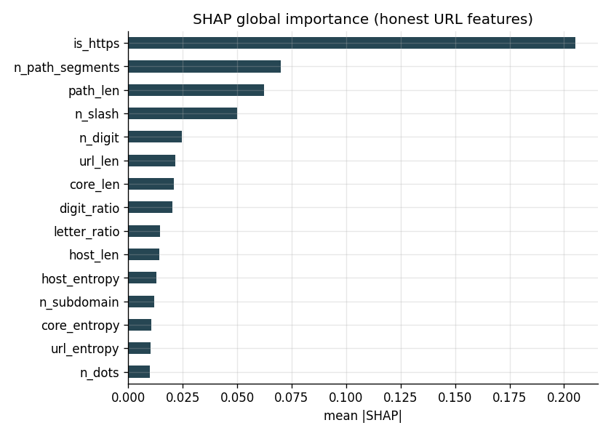
Discovery 2 — SHAP confirms it: is_https drives everything
DISCOVERY 2
• SHAP = a faithful way to credit each feature for the prediction (game theory)
• #1 driver = is_https, ~3× the next feature
• The model is a thin veneer over the HTTPS artifact —
– which is exactly why the attacks on the next slide work
Notes:
[COURSE: explainability / SHAP.] SHAP (Lundberg & Lee 2017) assigns each feature a fair share of credit for a prediction, borrowing the Shapley-value idea from game theory — it's faithful, not a guess. Result: is_https dominates by ~3×. So Discovery 1 (the HTTPS artifact) and Discovery 2 (SHAP) independently point at the same feature. That sets up the attacks: if the model leans on HTTPS, an attacker just needs to flip that.

Slide 11
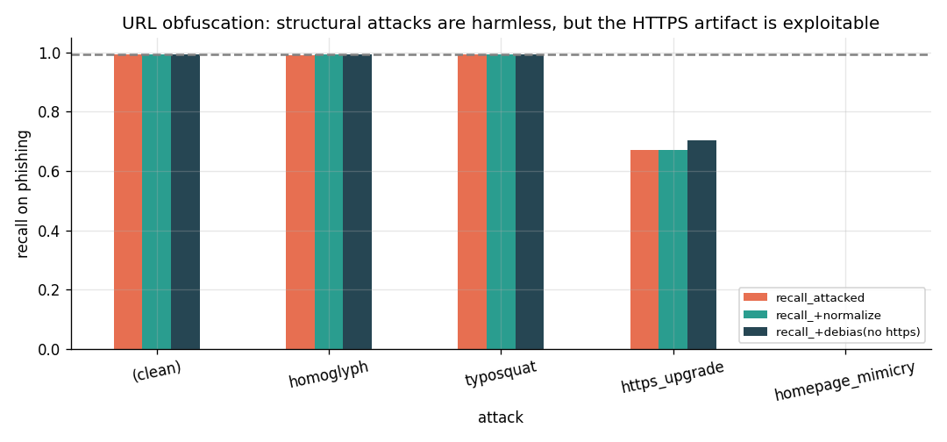
Discovery 3 — attack it: robust to tricks, but not to the artifact
DISCOVERY 3
• Homoglyph / typosquat (char tricks) → recall stays ~0.99
– a STRUCTURAL detector ignores letters → resists what BREAKS a text model (nice contrast!)
• Just switch HTTP → HTTPS → recall 0.672
• Host on a clean HTTPS domain (mimicry) → recall 0.0 (total evasion)
• Normalisation defeats homoglyphs; NOTHING URL-only defeats mimicry
Notes:
[COURSE: adversarial ML — evasion, perturbation, homoglyphs, adversarial training.] The attacker keeps the URL working but reshapes its surface. Two findings: (1) character-level attacks (Cyrillic look-alikes, typosquats) barely move recall — a structural detector doesn't care about the exact letters, the opposite of a bag-of-words text model, which those same tricks defeat. Nice complementarity with my partner. (2) But the artifact is the hole: just serving over HTTPS cuts recall to 0.67, and a clean bare HTTPS domain evades completely (recall 0). This is what real phishing does — host on legitimate cloud infrastructure.

Slide 12
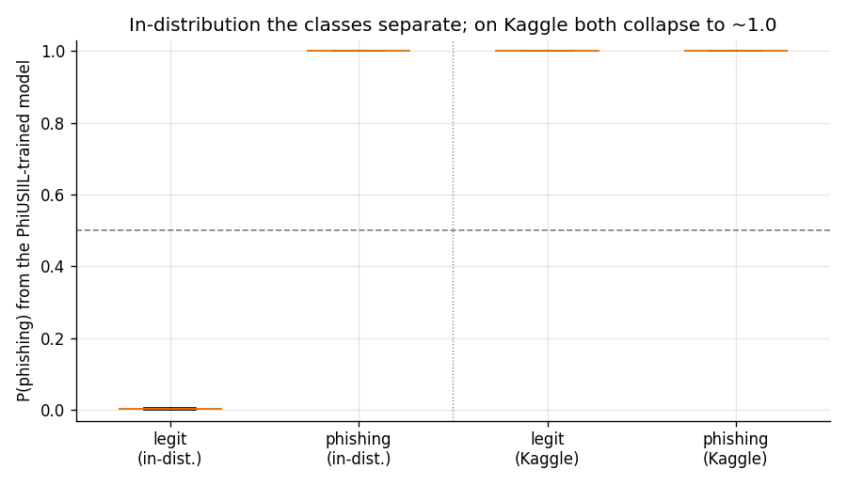
Discovery 4 — it does NOT generalise
DISCOVERY 4
• Train PhiUSIIL, test an INDEPENDENT 651k dataset: F1 0.997 → 0.666
• AUC 0.999 → 0.434 — below 0.5 = ‘confidently backwards’
– it doesn’t just lose skill; its ranking INVERTS (legit scored above phishing)
– both classes collapse to ~1.0 → the model can’t tell them apart at all
• BUT live OpenPhish phishing: recall 1.0 (today’s phishing is still messy → caught)
Notes:
[COURSE: domain shift / concept drift; AUC.] The real test — a totally different dataset. The near-perfect model collapses to F1 0.67, AUC 0.43. AUC below 0.5 is the key idea: AUC is the chance a random phishing URL scores above a random legit one; 0.5 is a coin flip. Below 0.5 means the model is systematically ranking legit ABOVE phishing — it learned a real pattern but that pattern is inverted in the new data. I call this 'confidently backwards': not clueless, but confidently wrong. The boxplot shows why: in-distribution the classes separate cleanly; on the new data both pile up at ~1.0. Yet it still catches 100% of live current phishing, because real phishing today is still structurally messy — a genuinely nuanced result.

Slide 13
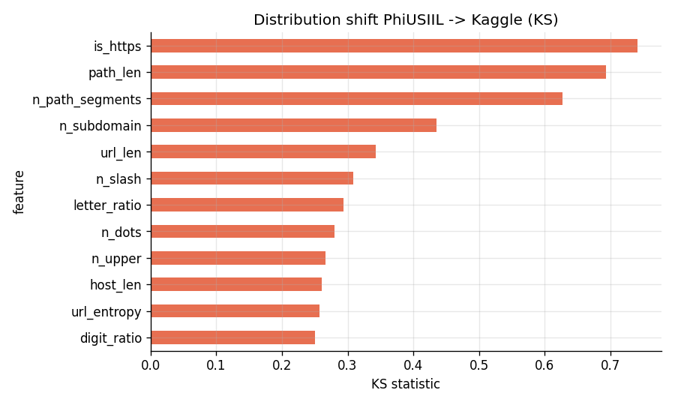
Why it inverts — distance metrics pinpoint it
KS & Wasserstein
• Measure how far each feature’s distribution SHIFTS between the two datasets
– KS statistic = biggest gap between the two cumulative distributions
– Wasserstein (earth-mover) = work to turn one distribution into the other
• Most-shifted features = is_https, path_len, n_subdomain
– …which are EXACTLY the top SHAP drivers → it built on the least transferable signals
Notes:
[COURSE: distance metrics — Kolmogorov–Smirnov, Wasserstein/EMD.] This closes the loop. I measure, feature by feature, how different the two datasets are, using two standard distances: KS (largest gap between the two cumulative distribution curves) and Wasserstein (the earth-mover distance — how much probability mass must move, and how far). The most-shifted features turn out to be precisely is_https, path_len, n_subdomain — the same features SHAP flagged as the model's top drivers. So the collapse isn't mysterious: the model built its decision on the three least-transferable signals. Two different tools (SHAP + distance metrics) corroborate one causal story.

Slide 14
Conclusion — a useful second opinion, not a solution
• URL structure alone is NOT a generalisable phishing signal:
– built on a dataset artifact (HTTPS + correlated structure) → trivially evaded, collapses OOD
• But it IS fast, private, interpretable, and robust to character obfuscation
• Right design = FUSION: this link channel + my partner’s content channel
– → beat one channel and the other still fires
Near-perfect URL benchmarks measure dataset construction, not phishing.
Notes:
The honest bottom line. The detector isn't worthless — it's fast, private, interpretable, and resists cheap character tricks, and it catches today's messy phishing. But it can't stand alone: it's an artifact-driven benchmark score that an attacker beats by using legitimate hosting, and it doesn't survive a change of dataset. Hence fusion with the content channel — the two look at completely independent evidence.

Slide 15
Course concepts used in this project
• EDA · distributions · skewness/kurtosis · robust stats
• Feature engineering · Shannon entropy (information theory) · Levenshtein edit distance
• Accuracy paradox · Precision/Recall/F1/F2/MCC/AUC · cost-sensitive thresholds
• Bootstrap confidence intervals · McNemar’s test
• Explainability (SHAP)
• Domain shift / concept drift · distance metrics (KS, Wasserstein) · error analysis
Notes:
The explicit concept map — this is the slide to point to if the lecturer asks 'where did you use what we taught?'. Every item here is earned in a specific experiment, and the mapping is also in the report appendix and the notebook's final section.

Slide 16
Thank you
github.com/segals/phishing-url-detector · reproducible: python run_all.py
Questions?
Notes:
Likely questions: (1) 'Why is your score so high?' → it's an artifact, that's the whole point. (2) 'Did you cause it by preprocessing?' → no; only dedup + split, no rebalancing, hash logged. (3) 'Biggest weakness?' → doesn't generalise (AUC 0.43) and evaded by legit hosting → fusion. (4) 'Why not deep learning / URLNet?' → interpretability, so I can name the artifact.

