Slide 1
The spiking neuron,
in hardware
What a neuron is, what LIF means, how it is built in logic, and why it fits a line-rate packet classifier
SNN-based network packet classifier · review
Notes:
Review deck. Focus: what a single spiking neuron is, how LIF works, how it is built in hardware, how it compares with other neuron models, and why it fits an in-NIC packet classifier.

Slide 2
What this review covers
1
2
3
4
5
A neuron
LIF
In hardware
Vs other models
Numbers
biological idea → artificial neuron → the spiking neuron
leak, integrate, fire; the model our chip uses
one neuron as a logic diagram; the real RTL
IF, ALIF, TTFS, Izhikevich — and why LIF fits
power & area, compared with the literature
2
Notes:
We build from the bottom: one neuron first, then compare neuron models, then the network, the hardware, and the numbers against the literature.

Slide 3
What is a neuron?
The basic decision unit of every neural network
Biological
Artificial (what we build)
Dendrites collect electrical charge from other neurons
The cell body adds it up
When the charge passes a threshold, the neuron fires a short pulse (a spike) down its axon
Then it resets and starts again
output = f( Σ wᵢ · xᵢ + b )
Inputs xᵢ × weights wᵢ, summed
Weights are what training learns
A function f decides the output
A standard (ANN) neuron outputs one number
The single neuron
3
Notes:
A neuron is a tiny decision unit. A biological neuron collects electrical charge from its inputs and fires a pulse when charged enough. An artificial neuron copies this: inputs times weights, summed, passed through a function.

Slide 4
The spiking neuron: pulses, not numbers
Standard neuron
Spiking neuron (ours)
Outputs one number (e.g. 0.73)
Inputs are numbers
Needs multiplications
No sense of time / no memory
Outputs spikes: 1 or 0 at each time step
Inputs are spikes too
Weight × spike = add the weight, or not
Keeps a charge over time (memory)
Key point: because inputs are 1-bit spikes, a spiking neuron needs NO multipliers — only adders. That is why it is cheap in silicon.
The single neuron
4
Notes:
A spiking neuron is the brain-like version. Instead of one number, it works over time and outputs short 1/0 pulses, spikes. Inputs are also spikes. This is what makes the hardware cheap: a weight times a 1-bit spike is just add-the-weight-or-not, no multiplier.

Slide 5
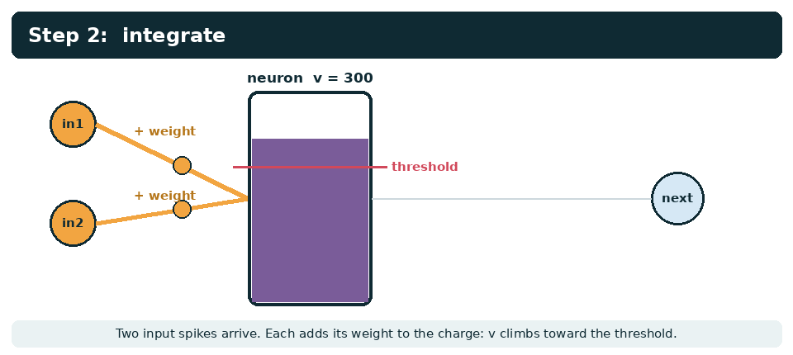
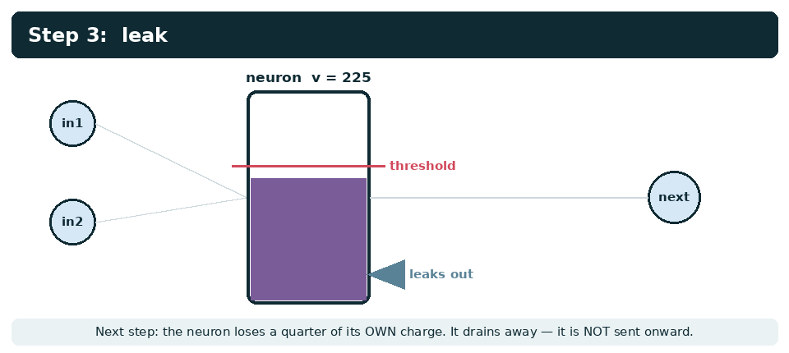
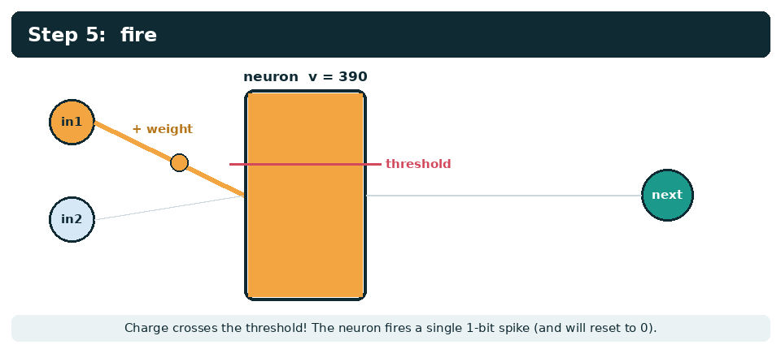
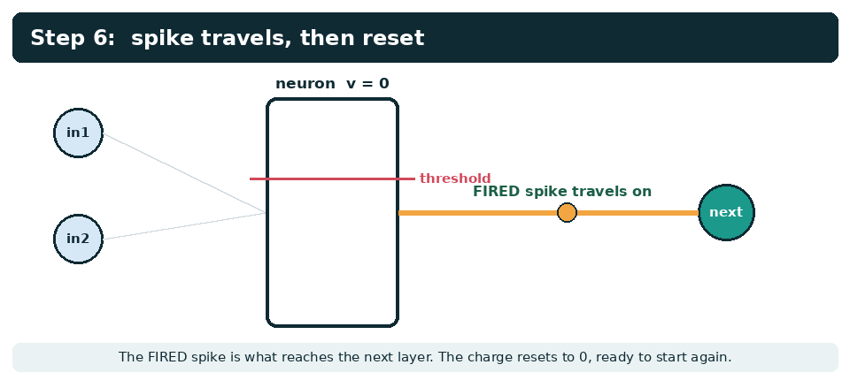
LIF = Leak, Integrate, Fire
The neuron model our chip uses, shown as a leaky bucket
The single neuron
5
Notes:
LIF = Leaky Integrate-and-Fire. The leaky bucket: inputs pour charge in (integrate), a quarter drains away each step (leak), and when it crosses the line it tips over (fire) and empties. The fired spike is what goes to the next neuron, not the leaked charge.

Slide 6
How a LIF neuron behaves
v ← v − v/4 + I
if v ≥ θ: spike, then v ← 0
What this means
No / negative input → 0 spikes (stays quiet)
Weak input → fires slowly (2 of 8)
Strong input → fires every step (8 of 8)
The spike count encodes strength.
The 'leak' makes it forget old input, so it reacts to RECENT activity — useful for spotting bursts and floods.
Hardware cost: 1 register + 2 adders + 1 comparator + 1 reset mux. No multiplier.
leak (÷4) · integrate (+I) · fire & reset, repeated 8 times
The single neuron
6
Notes:
In numbers: each step v loses a quarter then adds the input current; fire and reset at the threshold. Over 8 steps the number of spikes grows with the input strength: 0 for no/negative input, 2 for weak, 4 for medium, 8 for strong. The spike count is the neuron's output.

Slide 7
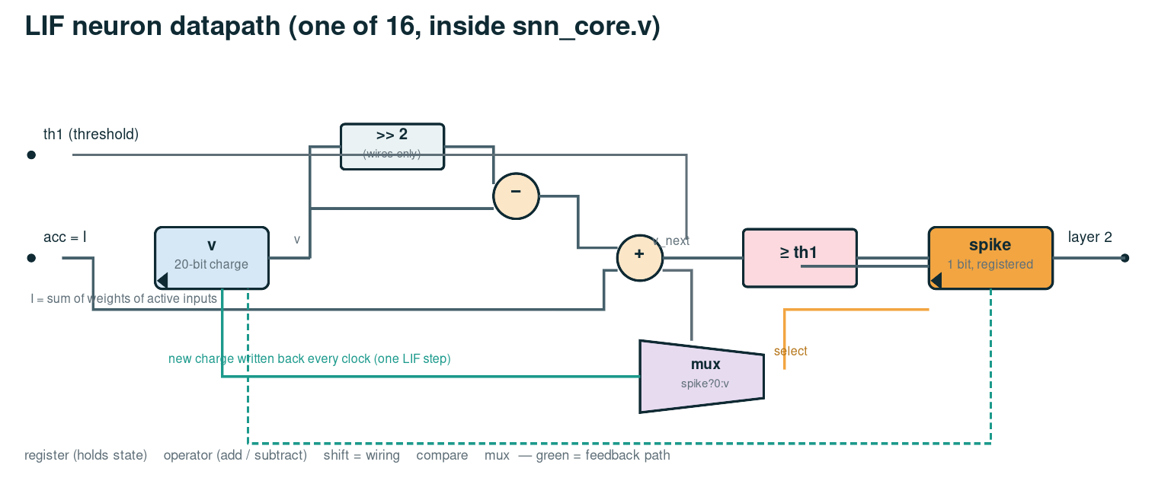
One LIF neuron in hardware (logic diagram)
register (charge) → >>2 & subtract (leak) → + I (integrate) → compare (fire) → reset mux · green = write-back each clock
The single neuron
7
Notes:
This is the whole neuron as logic: the register holds the charge; a shift (free wiring) and a subtract do the leak; an adder adds the input current; a comparator checks the threshold; a mux resets to 0 on a spike. The green path writes the new charge back each clock. Sixteen of these run in parallel in our chip.

Slide 8
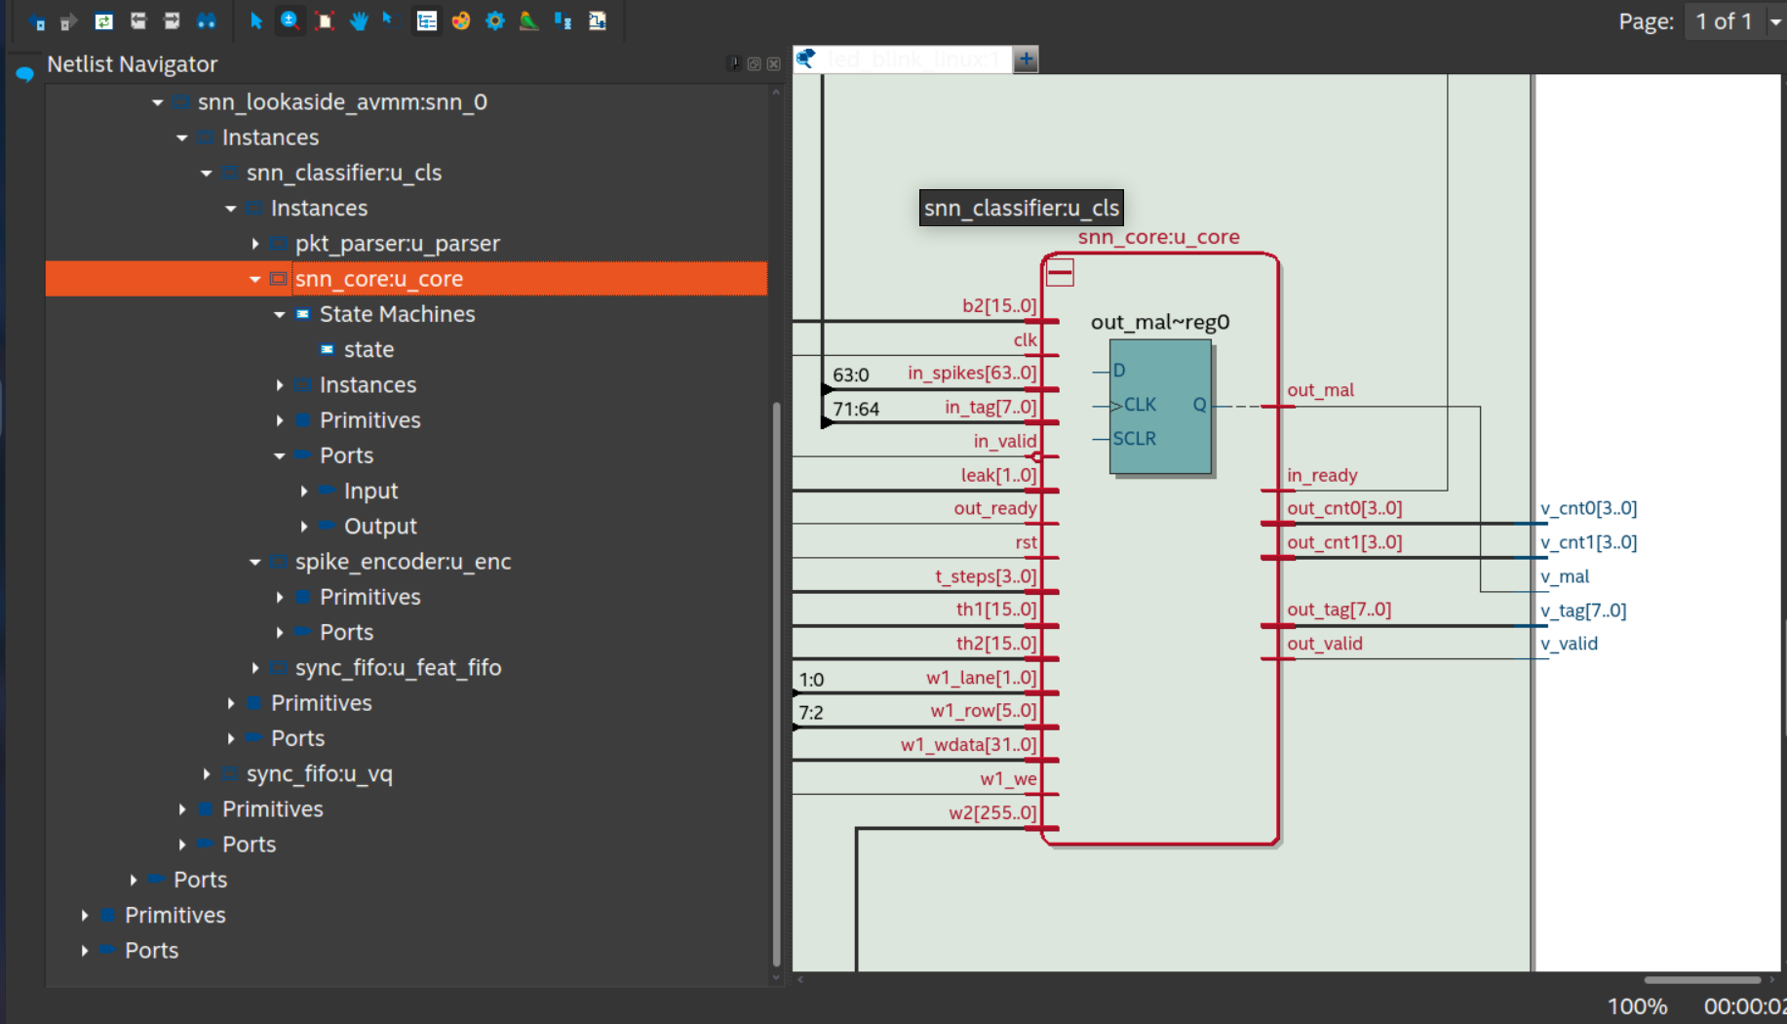
The real hardware: snn_core in Quartus RTL Viewer
What you see
Left: in_spikes[63:0] and the weights (w1, w2, b2), thresholds, leak
Right: out_cnt0/1 (spike counts), out_mal (verdict)
out_mal~reg0: the single flip-flop holding the verdict
Inside: the IDLE/ACC/LIF/OUT state machine + 16+2 LIF neurons
The single neuron
8
Notes:
The real tool-drawn schematic from Quartus RTL Viewer: snn_core, which holds 16 hidden + 2 output LIF neurons. The teal flip-flop out_mal~reg0 is the register that holds the final verdict bit.

Slide 9
LIF vs other neuron models
model | how it works | hardware per neuron | trade-off
IF (integrate-and-fire) | like LIF but no leak | register, adder, compare | cheapest; never forgets, noisy
LIF (ours) | leak ¼ each step, fire, reset | register, 2 adders, compare, mux | good balance; standard choice
Adaptive LIF (ALIF) | threshold rises after a spike | +1 register, +1 adder | longer memory; for slow scans
Time-to-first-spike | fire once, timing = value | LIF + a timer | very low power [Zhou & Li, ICPR 2020]
Izhikevich | 2 variables, quadratic (v²) | MULTIPLIER + 2 registers | biologically rich; several× larger
Diagrams of each on the next slide; the SNN-vs-CNN power question is studied by Plagwitz et al. [ACM TECS, 2023].
The single neuron
9
Notes:
LIF sits between the too-simple IF and the too-expensive Izhikevich. IF has no leak so it never forgets. ALIF adds an adaptive threshold (more memory, +1 register). TTFS fires once and encodes timing (Zhou & Li use temporal coding for intrusion detection). Izhikevich is biologically rich but needs a multiplier. We chose LIF: the standard balance, no multiplier, and it forgets old input.

Slide 10
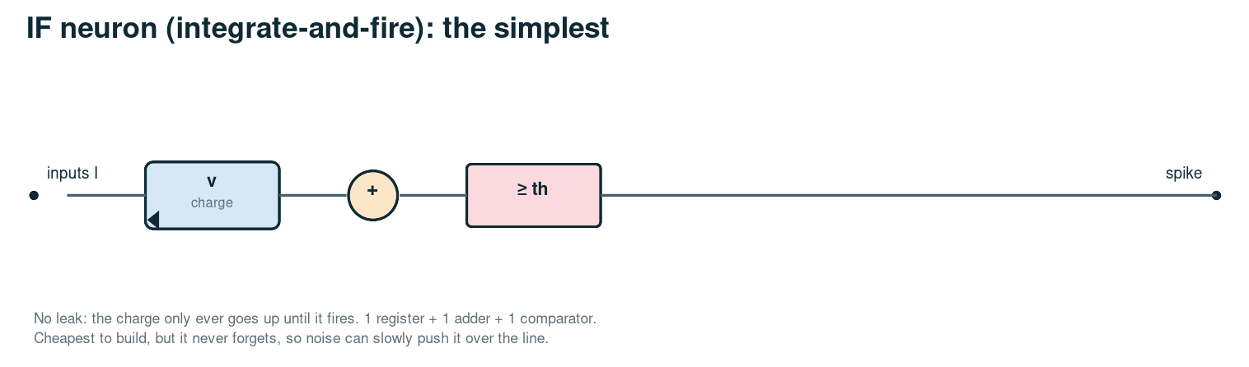
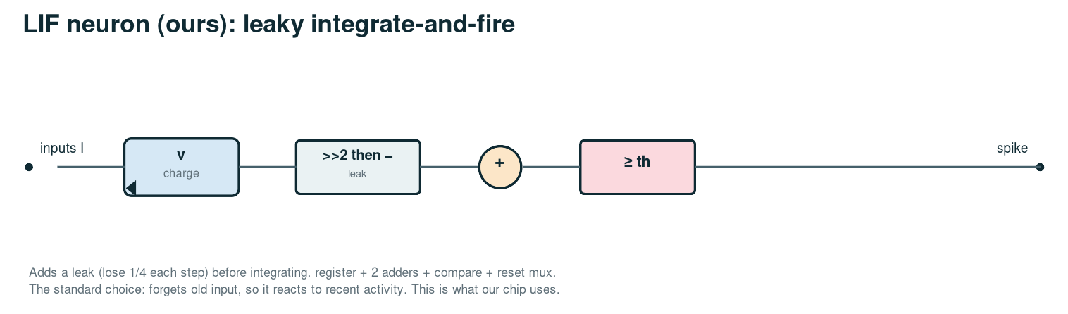
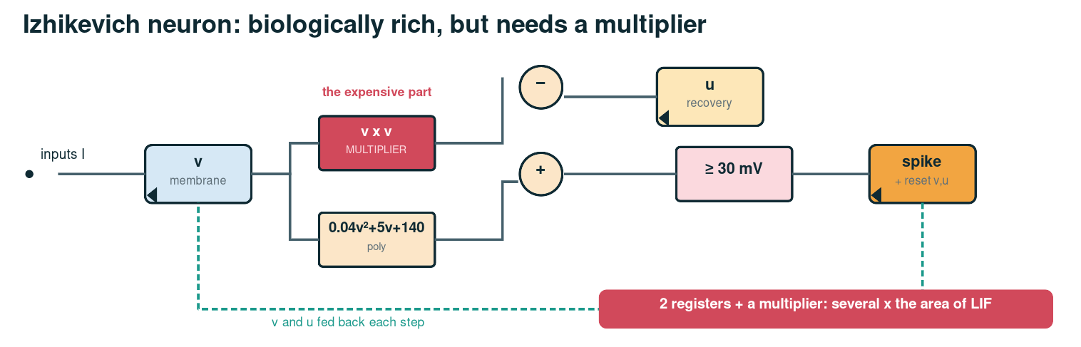
The models as logic: simplest → richest
Why LIF for us
No multiplier (unlike Izhikevich)
Has memory (unlike IF)
Small, fast, and the leak means it reacts to recent bursts — exactly what flood/scan detection needs.
Trained offline so the int8 weights run bit-exactly on the chip [Neftci et al., IEEE SPM 2019].
The single neuron
10
Notes:
The hardware of three alternatives, side by side: IF is the simplest, LIF adds the leak, Izhikevich needs a multiplier (the red block), which is why it is far larger.

Slide 11
From one neuron to a network (SNN)
Our network: 64 → 16 → 2
The decision
Each of the 18 neurons is a LIF neuron.
Run 8 time steps.
Winner = the output neuron that fired more.
Weights (int8) are loaded at run time.
benign
malicious
64 inputs (spikes)
16 hidden LIF
11
Notes:
A spiking neural network is just many of these neurons wired in layers. Ours is tiny: 64 inputs, 16 hidden LIF neurons, 2 output LIF neurons (benign / malicious). The winner is whichever output fired more over the 8 steps.

Slide 12
Why an SNN fits our application
A packet classifier inside the network card, at line rate
1
No multipliers
2
Event-driven
3
Memory over time
spikes make every weight an add; 0 DSP blocks used on FPGA → small, low power
only the ~13 of 64 'active' header features are processed per packet
the leak + a rate window catch SYN floods and scans that single packets hide
4
Fast enough
5
Retrain, don't rebuild
6
Neuromorphic path
~28 clock cycles per packet — keeps up with 1 Gb/s
weights are loaded at run time; no new chip needed
on-chip learning (STDP) possible later
12
Notes:
Our application: classify every network packet, from its header, as benign or malicious, inside the network card, before the OS sees it. Why an SNN fits: no multipliers, works only on active inputs, and its built-in memory catches floods.

Slide 13
Our hardware cost (power & area)
1.28 mm²
125 mW
0
sky130 die, placed & routed
at 100 MHz (sky130, typical)
multipliers / DSP blocks
6 %
~28
28 k
of a Cyclone V FPGA
clock cycles per packet
flip-flops (mostly buffer+weights)
sky130 synthesis: SNN core 0.39 mm². Cadence 90 nm (Genus) area/timing/power: being finalised on the uni server.
13
Notes:
Our measured hardware cost. On open-source sky130 the classifier places and routes to 1.28 mm2 and 125 mW at 100 MHz, with zero multipliers. On FPGA it is tiny: 6% of a Cyclone V, 0 DSP blocks. The Cadence 90nm (Genus) numbers are being finalised on the university server.

Slide 14
Our approach vs the literature
work | platform | multipliers | vs ours
Alom & Taha [IJCNN 2017] | TrueNorth chip | — | SNN IDS 90.1%, but off the data path (software feeds it)
Zhou & Li [ICPR 2020] | software / sim | — | temporal-coded SNN IDS; no line-rate hardware
Taurus [ASPLOS 2022] | switch ASIC | many | per-packet ML in-switch, but non-spiking (DNN/SVM)
Plagwitz et al. [ACM TECS 2023] | FPGA | SNN: none | shows SNN area/power can beat CNN only if sparse
FPGA SNN accel. [VTC 2024] | FPGA | none | image benchmarks; not fused with a NIC
Ours | ASIC/FPGA NIC | 0 | SNN fused in the NIC datapath, line rate, 0 DSP
Energy-efficient neuromorphic design: Na & Kim [Electronics 2025]; algorithm–hardware co-design: Nature Mach. Intell. 2026.
14
Notes:
How our approach compares with the literature. Most SNN intrusion-detection work runs off the data path (software or a neuromorphic chip fed by software). Taurus puts ML in a switch but uses non-spiking models. Generic FPGA SNN accelerators target images. Our step: an SNN fused into the NIC datapath, no multipliers, at line rate.

Slide 15
References
Journal papers
[J1] Neftci, Mostafa, Zenke, “Surrogate Gradient Learning in SNNs,” IEEE Signal Processing Magazine, 2019.
[J2] Plagwitz, Hannig, Teich, Keszöcze, “To Spike or Not to Spike? SNN vs CNN on FPGA,” ACM Trans. Embedded Computing Systems, 2023.
[J3] Na, Kim, “An Energy-Efficient Neuromorphic Processor … for Edge AI,” Electronics (MDPI), 2025.
[J4] “Algorithm–hardware co-design of neuromorphic networks with dual memory pathways,” Nature Machine Intelligence, 2026.
Conference papers
[C1] Alom, Taha, “Network Intrusion Detection … on Neuromorphic Computing System,” IEEE IJCNN, 2017.
[C2] Zhou, Li, “SNNs with Single-Spike Temporal-Coded Neurons for Network Intrusion Detection,” IEEE ICPR, 2020.
[C3] Swamy et al., “Taurus: A Data Plane Architecture for Per-Packet ML,” ACM ASPLOS, 2022.
[C4] “Efficient Hardware Acceleration of SNNs using FPGA,” IEEE VTC2024-Spring, 2024.
15
Datasets: Moustafa & Slay, UNSW-NB15 (MilCIS 2015); Sharafaldin et al., CIC-IDS2017 (ICISSP 2018).
Notes:
References: four journal papers and four conference papers, plus the two datasets.

