Slide 1
A spiking neural network
that guards the network card
SNN packet firewall: what it is, how the hardware works, how we tested it, and what it costs in area, power and speed
SNN_based_network_packet_classifier · explained simply
Notes:
A spiking neural network that sits inside the network card and throws away malicious packets before the operating system ever sees them. This deck explains it from zero.

Slide 2
What this deck covers
1
2
3
4
5
What is an SNN
Our design
Verification
Area, power, performance
Alternatives
Neurons, spikes, and how SNNs differ from normal and convolutional networks
From an Ethernet frame to 64 spikes to a verdict, and the HDL behind each neuron
The testbench, the test vectors, the functional verification table, the xrun signals
Measured numbers on sky130, FPGAs; SNN vs other approaches
Other neuron models and other ways to build the whole project
2
Notes:
Five parts. Each starts from zero, so skip what you already know.

Slide 3
The problem and the idea
Today
Our design
Network
Network
Network card
Network card + SNN guard
judges every frame in ~28 clock ticks
erases malicious frames
Operating system
Firewall / IDS software
Operating system: only benign frames
the attack is already inside the OS when it is checked
malicious frames never reach the OS
Introduction
3
Notes:
Today the operating system receives every packet and only then software inspects it. We move the inspection into the network card hardware.

Slide 4
1
What is a spiking neural network?
Neurons, spikes, leaks and thresholds, and how an SNN differs from the neural networks you already know.
4
Notes:
Part 1 builds the vocabulary: neuron, weight, threshold, spike, time step.

Slide 5
What is a neuron?
The building block of every neural network
weight +12
is it TCP?
1
Σ
add up
over the
threshold?
fire
(output 1)
weight +40
SYN flag set?
1
port 0?
0
weight +90
Inputs × weights, summed, compared with a threshold. The weights are the only thing training learns: positive weights push towards firing, negative weights hold it back.
1 What is an SNN
5
Notes:
A neuron is a tiny calculator: it adds up its inputs, each multiplied by a weight, and decides whether to pass something on. Weights are what training learns.

Slide 6
Normal neuron vs spiking neuron
Normal (ANN / CNN) neuron
Spiking (SNN) neuron: ours
y = f( Σ wᵢ·xᵢ + b )
v ← v − v/4 + I · spike if v ≥ θ, then v ← 0
Computes once per input
Output is a number (e.g. 0.73)
Needs multiplications (input × weight)
No memory between inputs
Runs for several time steps (we use 8)
Output is a spike: 1 or 0 at each step
Inputs are spikes, so input × weight = add or skip
Keeps a charge (membrane) between steps
1 What is an SNN
6
Notes:
A normal artificial neuron outputs a number once. A spiking neuron keeps a charge over several time steps and outputs short yes/no pulses called spikes.

Slide 7
A spiking neuron over time: the leaky bucket
Leaky integrate-and-fire (LIF), the neuron model our hardware uses
Each time step
1 leak: lose a quarter of the charge
2 integrate: add the input current I (here 100)
3 fire: if v ≥ 256, send a spike and reset to 0
Result here: spikes at t4 and t8.
A stronger input fires more often; the number of spikes carries the information.
1 What is an SNN
7
Notes:
A leaky bucket: water (input current) pours in every step, a quarter leaks out, and when the level passes the line the bucket tips: that is a spike, and it starts empty again. Numbers are the real arithmetic of our hidden neurons (leak 1/4, threshold 256) with input current 100.

Slide 8
ANN vs CNN vs SNN in software
 | MLP / ANN | CNN | SNN (ours)
Data inside | numbers (floats or int8) | numbers, on 2-D/1-D grids (images, byte sequences) | spikes: 0/1 per time step
Basic operation | multiply-accumulate | sliding filters = many multiply-accumulates | add the weight if a spike arrived, leak, compare
Time | one pass | one pass | T steps (we use 8); neurons keep state
Training | back-propagation | back-propagation | back-propagation with surrogate gradients (spikes have no slope)
Typical tools | PyTorch / TensorFlow | PyTorch / TensorFlow | PyTorch + custom integer model (model/train.py, snn_int.py)
Good at | tabular features | images, raw byte patterns | sparse, event-like inputs; low-power hardware
1 What is an SNN
8
Notes:
In software all three are trained the same broad way (gradient descent), but SNNs need a trick because a spike has no slope: surrogate gradients.

Slide 9
CNN vs SNN in hardware
CNN accelerator
Our SNN
large weight and activation buffers (10–100 KB)
small weight memory (1.1 KB, int8)
array of multipliers (MAC units / DSP blocks)
16 adders + 2-stage adder tree, no multipliers
line buffers to slide the filters
event queue: only the 'yes' inputs are visited
~10⁵–10⁶ multiply-accumulates per input
~900 additions/compares per frame
fast on dense data, but multipliers and big buffers cost area and power
0 DSP blocks used on both FPGAs; extra state: one 20-bit charge per neuron
1 What is an SNN
9
Notes:
The hardware difference is what matters for us: a CNN accelerator is an array of multipliers fed by big buffers; our SNN is a handful of adders, an event queue and some state registers.

Slide 10
Why an SNN suits this project
1
No multipliers
2
Work only on activity
3
Built-in memory over time
Inputs are 1-bit spikes, so every weight is either added or skipped. 0 DSP blocks on both FPGAs.
On average only 13.5 of the 64 inputs are 'yes' (79 % zeros). Only those weight rows are read.
Neurons keep their charge; together with the SYN/ping rate window this catches floods per packet.
4
Fast enough for 1 Gb/s
5
Weights load at run time
6
Path to on-chip learning
~28 clock ticks per decision vs 84 byte-times for the smallest frame: 3× headroom.
Retrain in Python, write 276 registers. No new chip or bitstream.
STDP (from the original snn_stdp design) could adapt the weights in the field later.
1 What is an SNN
10
Notes:
Why an SNN fits a network card: binary inputs make the arithmetic trivial, most inputs are zero, flood detection needs memory over time, and on-chip learning is possible later.

Slide 11
Limits and costs, honestly
1
Several time steps
2
Extra state
3
Harder training
8 iterations instead of one pass. Fine here (28 ≪ 84 ticks), but a one-pass network would be faster.
Each neuron needs a 20-bit charge register: ~990 flip-flops in our network. A plain MLP needs none.
Spikes are not differentiable: surrogate gradients and integer-exact simulation are needed.
4
No automatic energy win
5
Accuracy unproven on real traffic
6
Memory dominates
Plagwitz et al. 2023: on FPGAs SNNs can lose to CNNs in power on small tasks unless sparsity and clock gating are exploited.
99.7 % so far is on synthetic traffic. Real datasets (UNSW-NB15, CIC-IDS2017) come next.
Our chip is 74 % flip-flops, mostly the packet buffer and weights, not the neurons. SRAM would fix it.
1 What is an SNN
11
Notes:
Be honest about the costs: latency of several time steps, extra state, harder training, and the energy advantage is not automatic. Accuracy on real traffic is still to be measured.

Slide 12
2
Our design
From an Ethernet frame to 64 yes/no spikes to a verdict, and the hardware inside each neuron.
12
Notes:
Part 2 follows one frame through the chip.

Slide 13
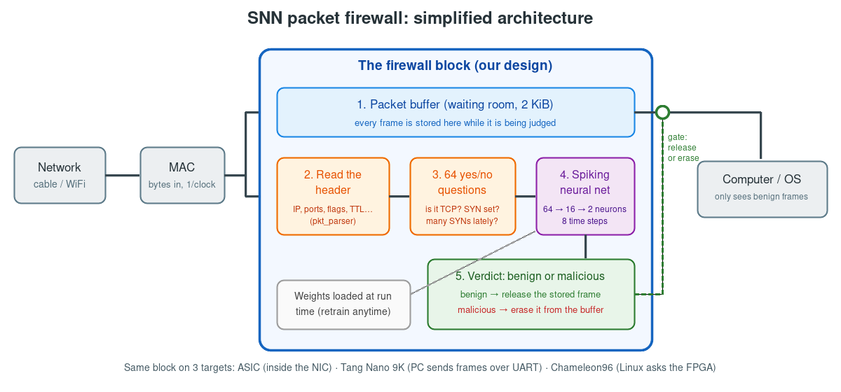
The architecture in one picture
Never blocks the network · keeps frame order · drops whole frames only when overloaded
2 Our design
13
Notes:
Frames wait in the buffer while the header is turned into 64 yes/no answers and the SNN judges them. Benign frames are released, malicious ones erased. The same block runs on three targets.

Slide 14
From a frame to 64 yes/no spikes
pkt_parser reads the header; spike_encoder asks 64 questions
bits | question | type
1–8 | IPv4? ARP? IPv6? TCP? UDP? ICMP? | protocol
15–23 | TTL bucket? IP length bucket? | size
24–26 | source = destination? bogus source? broadcast? | suspicious
27–33 | TCP flags FIN SYN RST PSH ACK URG, none set? | flags
34–41 | port 0? well-known? registered? high? | ports
57–60 | ≥ 8 / ≥ 16 SYNs or pings in the last 32 frames? | rate (memory)
62–63 | SSH / Telnet / SMB / RDP port? DNS? | services
Example: frame 0, a ping
Bytes: 02 98 ca d7 … 08 00 45 00 00 54 … 40 01 …
Spikes: 0x0022000000111283
Yes to 9 questions:
bias · IPv4 · ICMP · header length 5 · don't-fragment · TTL 9–64 · length 41–100 · echo request · payload 9–64
SNN: benign neuron 4 spikes, malicious 0 → benign
2 Our design
14
Notes:
The header is turned into 64 yes/no answers. Frame 0 of the test vectors is an ordinary ping: 9 answers are yes.

Slide 15
Our network: 64 → 16 → 2
Rules
W1: 64×16 int8 weights
W2: 16×2 int8 weights
Thresholds 256 / 128
Leak: lose 1/4 per step
8 time steps
Decision: malicious if its neuron fired more often (tie: higher charge)
benign
malicious
64 input spikes
16 hidden LIF
2 Our design
15
Notes:
64 inputs feed 16 hidden neurons, which feed two output neurons. Whichever output fires more in 8 steps wins.

Slide 16
HDL architecture of the neurons (snn_core.v)
pend[63:0]
+ lowest-'1' finder
W1 memory
4 banks × 64 × 32 bit
16 accumulators
acc[h] += W1[row][h]
16 LIF neurons
v − v>>2 + acc ≥ TH1
adder tree, 2 pipeline
stages: Σ W2 · spikes
2 output LIF + spike
counters cnt0 / cnt1
which input next?
one row = 16 weights
input current, once
8 steps, in parallel
output current
≥ TH2 → count
Control: a 4-state machine
IDLE
ACC
LIF
OUT
wait for a spike vector
1 clock per 'yes' input
8 time steps
decide, report
Latency per frame = (number of 'yes' inputs) + 8 + 6 cycles ≈ 28 cycles. No multipliers: every product is 'add the weight or not'.
2 Our design
16
Notes:
snn_core.v. The input current is computed once per frame by visiting only the yes-inputs, one weight row per clock. Then 8 LIF steps run with all 16 hidden neurons in parallel, and the output layer follows two cycles behind through a pipelined adder tree.

Slide 17
One LIF neuron in hardware
v ← v − (v >>> 2) + I ; spike = (v ≥ TH1) ; if spike: v ← 0
>>> 2
(just wiring)
v register
20 bit
subtract
v − v/4
add
+ I (acc)
compare
≥ TH1
spike
(1 bit, registered)
mux
spike ? 0 : v
new charge, written back every time step
Cost of one neuron: one 20-bit register + 2 adders + 1 comparator + 1 multiplexer · no multiplier · 16 copies run in parallel
2 Our design
17
Notes:
One hidden neuron in gates: a 20-bit register, a shift that is just wiring, two adders, a comparator and a reset multiplexer. Sixteen copies run side by side.

Slide 18
Life of one frame, clock by clock
0 … L−1
bytes arrive, 1 per clock; stored and read at the same time
L
last byte: keep the frame (commit) or roll it back (bad checksum, no room)
L+1
header fields ready (pkt_parser)
L+2
64 spikes ready (spike_encoder)
+ ~28
SNN verdict (snn_core)
then
benign: stream the stored bytes out · malicious: skip them
Smallest frame on the wire = 84 byte-times; a decision needs ~28: the classifier keeps up with 1 Gb/s.
2 Our design
18
Notes:
A frame takes as many clock ticks to arrive as it has bytes. The verdict is ready about 30 ticks after the last byte, then the stored frame is released or skipped.

Slide 19
3
Verification
What a testbench is, what the test vectors are, what each test proves, and what all those xrun signals mean.
19
Notes:
Part 3 explains the simulation you ran with xrun.

Slide 20
What is a testbench?
sim/asic/tb_snn_asic.sv: a simulated world around the design
plays the NETWORK
plays the COMPUTER
sends 600 frames byte by byte (s_axis_*)
receives frames, sometimes busy (m_axis_*)
design under test
snn_pkt_filter_asic
plays the CPU
CHECKS everything
loads weights, sets modes, reads counters (cfg_*)
verdicts, every byte, counters vs golden model
Any difference prints [ERR] …; every test ends PASS or FAIL; the run ends with RESULT: PASS (10 tests)
3 Verification
20
Notes:
The testbench is a program around the design. It pretends to be the network, the computer and the CPU, and compares everything with the answers the Python model computed in advance.

Slide 21
The test vectors: three files
written by model/export.py into sim/vectors/
frames.txt
cfg.txt
expected.txt
600 network frames
the trained brain
the answer sheet
one frame per line as hex bytes, in time order, like a recording of real traffic
276 register writes: thresholds, time steps, leak, output biases, all weights
per frame: the 64 spikes, spikes of each output neuron, verdict, true label, attack kind
expected.txt line 1: 0022000000111283 4 0 0 0 benign
spikes (hex) · benign-neuron spikes · malicious-neuron spikes · verdict (0 = benign) · true label · kind
3 Verification
21
Notes:
Test vectors are just three text files: the inputs, the trained weights, and the answer sheet. Python writes them; every simulation and the board test read them.

Slide 22
The story told by the 600 frames
port 0 ↓
normal
SYN flood
normal
ACK scan (mixed)
0
100
200
300
400
500
600
SYN flood (153 frames)
ACK scan (41 frames)
Port 0 (4 frames)
fake 'let's connect' requests to exhaust a server. One SYN looks normal; many in a row turn on the rate questions.
ACK packets that belong to no connection, used to map which ports a firewall filters.
traffic to port 0, which no real service uses: probing or fingerprinting.
402 benign + 198 malicious. The design flags 197, with 0 false alarms; the one miss (frame 128) is missed by the Python model too.
3 Verification
22
Notes:
The 600 frames tell a story: a normal day, a SYN flood, port-0 probes, an ACK scan, normal again.

Slide 23
What is inside the 600 frames
3 Verification
23
Notes:
What kinds of frames are inside. Mostly normal TCP acknowledgements and data.

Slide 24
Functional verification table (1/3)
10 tests, all PASS in xrun (RTL), Questa (RTL) and on the gate-level netlist
test | situation | what the testbench does | expected behaviour (PASS) | what you see in the waveform
T1 | Reset | reset, read every register | safe start: blocking on, defaults, counters 0, never stalls the MAC | cfg_rdata, s_axis_tready = 1
T2 | Load the brain | write 276 weights, read back | registers hold what was written | cfg_wr, cfg_addr, cfg_rdata
T3 | Normal operation | all 600 frames, gaps 12–40, host 90 % ready | every verdict = Python model; only benign frames out, byte-exact | s_axis_*, m_axis_*, verdict_*
T4 | Monitor mode | CTRL = 0, frames 0–149 | still judges and counts, forwards all 150 | verdict_mal pulses but m_axis shows all frames
3 Verification
24
Notes:
Functional verification table, part 1 of 3. Each test is a real-world situation; the right-hand column says what it looks like in the xrun waveform.

Slide 25
Functional verification table (2/3)
10 tests, all PASS in xrun (RTL), Questa (RTL) and on the gate-level netlist
test | situation | what the testbench does | expected behaviour (PASS) | what you see in the waveform
T5 | Bypass | CTRL.bypass = 1 | forwards everything (off switch) | same as T4
T6 | Corrupted frames | every 5th frame marked bad (tuser) | erased whole, no verdict, counted | s_axis_tuser pulses (only here)
T7 | Size limits | 2148 B, 8 B, 1518 B frames | too-big dropped whole; tiny and max-size pass intact | one very long input frame, no output for it
3 Verification
25
Notes:
Functional verification table, part 2 of 3. Each test is a real-world situation; the right-hand column says what it looks like in the xrun waveform.

Slide 26
Functional verification table (3/3)
10 tests, all PASS in xrun (RTL), Questa (RTL) and on the gate-level netlist
test | situation | what the testbench does | expected behaviour (PASS) | what you see in the waveform
T8 | Full speed | 250 frames, 20 idle cycles apart | keeps up with 1 Gb/s: 0 drops, bit-exact | regular frames, m_axis_tready flat
T9 | Overload | gaps 1–3, host only 35 % ready | drops whole frames, none corrupted or reordered | input dense, output throttled
T10 | Reset mid-traffic | reset during a half frame, then 60 frames | clean restart, then perfect again | rst pulse, counters read 0, weights reloaded
3 Verification
26
Notes:
Functional verification table, part 3 of 3. Each test is a real-world situation; the right-hand column says what it looks like in the xrun waveform.

Slide 27
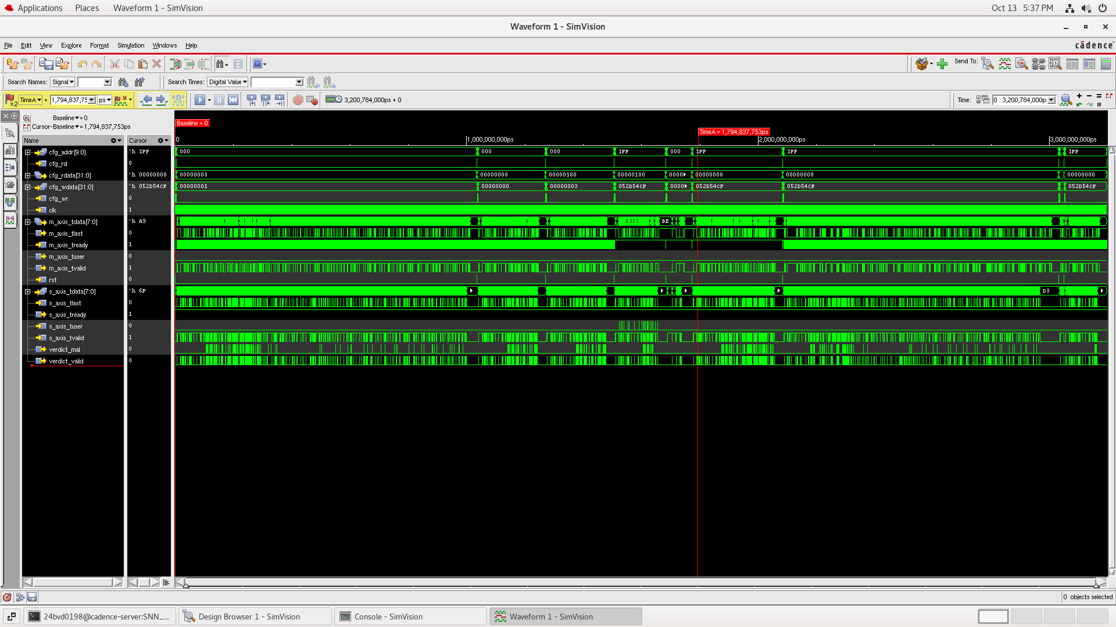
Reading your xrun waveform
0 – 1.03 ms
T1–T3: weights, 600 golden frames
≈ 1.03 ms
T4: CTRL = 0 (monitor)
≈ 1.27 ms
T5: CTRL = 3 (bypass)
1.51 – 1.69
T6: the only s_axis_tuser pulses
≈ 1.7 – 1.8
T7: one 2148-byte frame
1.8 – 2.09
T8: full speed, tready flat
2.09 – 3.1
T9: overload
Ends at 3,200,784 ns: the testbench reached $finish with RESULT: PASS (10 tests).
3.13 – 3.2
T10: reset, counters 0, reload
3 Verification
27
Notes:
Your xrun run. Read it left to right: the config writes mark the boundaries between tests.

Slide 28
What every xrun signal means
group | signals | meaning
clock / reset | clk, rst | 125 MHz clock (8 ns, 1 GbE byte clock); synchronous reset
frames IN (from network) | s_axis_tdata[7:0], tvalid, tlast | one byte per clock while tvalid = 1; tlast marks the last byte of a frame
 | s_axis_tuser | 'this frame is damaged' (bad checksum): only in T6
 | s_axis_tready | always 1: the firewall never asks the network to wait
frames OUT (to computer) | m_axis_tdata[7:0], tvalid, tlast | only benign (or, in monitor/bypass, all) frames, byte-exact
 | m_axis_tready | computer ready: random in T3–T5, T9, T10; constant 1 in T6–T8
 | m_axis_tuser | always 0: damaged frames are never forwarded
verdict | verdict_valid, verdict_mal | one pulse per judged frame; verdict_mal = 1 if it was malicious
CPU config bus | cfg_wr, cfg_rd, cfg_addr, cfg_wdata, cfg_rdata | weights (0x100–0x1FF), thresholds (0x001–0x004), mode (0x000), counters (0x020–0x025)
3 Verification
28
Notes:
Every signal in the waveform, grouped. s_ is input from the network, m_ is output to the computer.

Slide 29
Verification results
600 / 600
197 / 198
0
10 / 10
verdicts bit-exact with the Python model
attacks flagged (synthetic data)
false alarms on 402 normal frames
functional tests PASS in xrun
Same 10 tests also pass on the synthesized gate-level netlist (sky130 cells), where real logic gates replace the RTL
12 regressions in total: MAC + firewall at the GMII pins, Tang Nano 9K (RTL + netlist + PC demo), Chameleon96 accelerator
On the Chameleon96 board: snn_test runs the same vectors through the real FPGA (C1–C10, docs/board_test_cv96.md)
3 Verification
29
Notes:
What the simulations prove: the hardware matches the Python model exactly, under every condition.

Slide 30
4
Area, power, performance
Measured numbers: sky130 layout (OpenROAD), FPGA fits (Quartus, nextpnr), and how an SNN compares.
30
Notes:
Part 4: all numbers come from tools that ran on this design.

Slide 31
Headline numbers
snn_classifier placed and routed on SkyWater 130 nm (LibreLane / OpenROAD)
1.28 mm²
125 mW
≈ 99 MHz
die (1.13 × 1.14 mm), 72,032 cells
at 100 MHz, typical corner (vectorless estimate)
typical corner (136 fast, 51 slow)
28
0
0 / 0
clock cycles per decision
multipliers / DSP blocks
DRC / LVS errors
4 Area, power, performance
31
Notes:
snn_classifier placed and routed on SkyWater 130 nm: 1.28 square millimetres, 125 milliwatts at 100 MHz typical corner, 0 DRC and 0 LVS errors. Timing misses 100 MHz by 0.08 ns at the typical corner.

Slide 32
Where the area goes
full chip snn_pkt_filter_asic, sky130 synthesis, 1.16 mm²
74 %
sequential (flip-flops); 26 % combinational logic
91 %
of all flip-flops are memory (buffer 18,432 + weights 8,192)
3 %
are the SNN's own neuron state (~990 flip-flops)
4 Area, power, performance
32
Notes:
Where the silicon goes on the full chip. 74 percent of the area is flip-flops, and 91 percent of those are memory: the 2 KiB packet buffer and the weight table. The SNN's own state is about 3 percent.

Slide 33
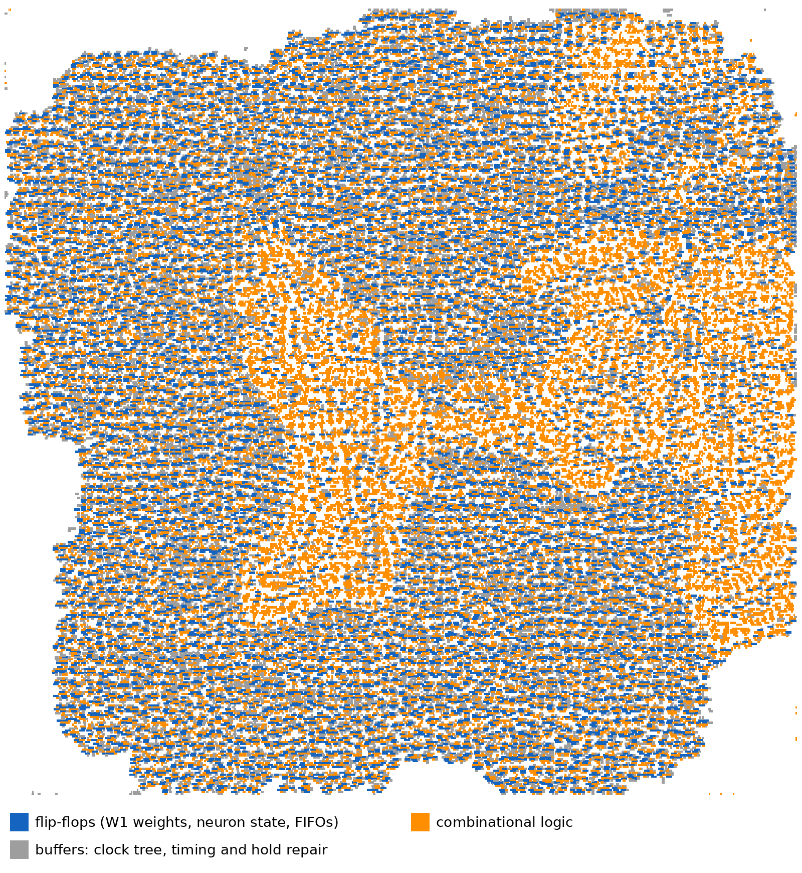
The real layout: every cell coloured by type
snn_classifier after place and route
30.9 % flip-flops (10,256 cells)
39.8 % combinational logic (25,447)
22.6 % timing-repair buffers (16,704, of them 9,494 hold buffers)
3.5 % clock tree (1,748)
3.2 % tap and antenna cells
Why so many hold buffers? 10,256 flip-flops on one clock give up to 1 ns clock skew; the tool adds small delays to keep data from racing ahead. Replacing the weight flip-flops by SRAM removes most of them.
4 Area, power, performance
33
Notes:
The real placed design, every cell coloured by type: memory flip-flops (blue) and buffers (grey) outside, the SNN arithmetic (orange) as a dense core.

Slide 34
All implementations compared
target | block | area / resources | clock | power
sky130, placed & routed | snn_classifier | 1.28 mm² die, 72,032 cells | ≈ 99 MHz (tt) | 125 mW
sky130, synthesis | full chip | 1.16 mm², 71,120 cells | n/a | n/a
Cyclone V (Chameleon96) | look-aside + HPS | 2,378 ALMs (6 %), 3,080 regs, 0 DSP | 110.8 MHz | not measured
Cyclone V (stand-alone) | in-line, 4 KiB buffer | 5,871 ALMs (14 %), 10,336 regs, 0 DSP | 111.6 MHz | not measured
Tang Nano 9K | in-line + UART | 6,966 LUT4 (80 %), 2,627 DFF, 0 DSP | 57.6 MHz | not measured
Cadence 90 nm (Genus) | full chip, 8 ns | synthesis done; numbers from qor.rpt to add
The throughput budget: 1 GbE needs one decision per 84 byte-times; we need ~28, so every target meets line rate at its clock.
4 Area, power, performance
34
Notes:
Every implementation we built, side by side.

Slide 35
SNN vs other approaches for the same job
model | work per frame | multipliers | weights | latency | notes
Our SNN (64→16→2, T = 8) | ≈ 900 adds / compares | 0 | 1.1 KB | ≈ 28 cycles | event-driven, stateful
Same-size int8 MLP | ≈ 1,056 MAC | 32 | 1.1 KB | ≈ 5–20 cycles | one pass, no state
Small 1-D CNN on 128 bytes | ≈ 10⁵ – 10⁶ MAC | many (DSP) | 10–100 KB | 100s–1000s cycles | learns features itself
Decision tree / forest | ≈ 10–20 compares | 0 | small tables | few cycles | no time dynamics
Rules / ACL | table look-ups | 0 | TCAM / hash | 1–few cycles | only known attacks
Takeaway: for this tiny job an SNN and a same-size MLP do similar work; the SNN avoids all multipliers and adds memory over time. A CNN costs 100–1000× more operations. Trees and rules are cheapest but cannot learn new temporal patterns.
4 Area, power, performance
35
Notes:
Same job, different models. Our SNN does roughly 900 additions and no multiplications per frame. A small CNN on raw header bytes would need on the order of a hundred thousand to a million multiply-accumulates. Trees and rules are cheaper still but cannot learn temporal patterns.

Slide 36
What is new compared with existing work
existing work | how it differs
SNN IDS on IBM TrueNorth (Alom & Taha) | off the data path; 90.12 % accuracy
SNN traffic classifiers (Zhou & Li 2020, others) | software / simulators, no line-rate hardware
Taurus (per-packet ML in switches) | switch pipelines, non-spiking models
Generic FPGA SNN accelerators | image benchmarks, not fused with a MAC
Our contributions
1 SNN fused into the NIC receive datapath: malicious frames erased before DMA
2 event-driven SNN: one pass over active inputs, no multipliers
3 hardware rate window feeds flood memory into per-packet spikes
4 one engine, three targets, bit-exact with one golden model
Check before publishing: N3IC (NSDI 2022), IIsy (HotNets 2019)
4 Area, power, performance
36
Notes:
Existing SNN intrusion detectors run off the data path, in software or on a neuromorphic chip fed by software. In-network ML like Taurus targets switches with non-spiking models. Our step is putting the SNN inside the network card's receive path. Check N3IC and IIsy before claiming this in a paper.

Slide 37
5
Alternatives and next steps
Other neuron models, other ways to build the whole project, and what to do next.
37
Notes:
Part 5: options for the next version, with their trade-offs.

Slide 38
Alternative neuron models
neuron | how it works | hardware per neuron | trade-off
IF (integrate-and-fire) | like LIF, no leak | 1 register, 1 adder, compare | cheapest; forgets nothing, noisier
LIF (ours) | leak 1/4 per step, fire, reset | register, 2 adders, compare, mux | good balance; standard choice
Adaptive LIF (ALIF) | threshold rises after each spike | + 1 threshold register, + adder | longer memory: slow scans, bursts
Time-to-first-spike | information in WHEN a neuron fires (1 spike max) | LIF + a timer | fewer events, lower power (Zhou & Li 2020)
Izhikevich | 2 coupled variables, quadratic | multipliers, 2 registers | rich behaviour, much bigger
Binary MLP neuron (not spiking) | XNOR + popcount, one pass | popcount tree, no state | fast one-pass alternative (N3IC style)
5 Alternatives and next steps
38
Notes:
Neuron models from simplest to richest. LIF is the usual sweet spot; IF is cheaper, adaptive LIF adds memory, Izhikevich is expensive, time-to-first-spike reduces activity.

Slide 39
Alternative project architectures
1
SRAM + clock gating
2
Time-multiplexed neuron
3
Flow-level classifier
same design, memories in SRAM, weights clock-gated: about −40 to −65 % area and a large power cut
one LIF unit reused for all 16 neurons: far smaller, 16× more cycles (lower line rate)
per-flow tables (counts, timings) instead of a 32-frame window: catches slow scans
4
Decision trees in the pipeline
5
On-chip STDP learning
6
Software baseline
match-action tables as in programmable switches (IIsy, Planter): tiny, very fast, no learning on chip
adapt weights in the field with spike-timing rules, from the original snn_stdp design
the same model in Linux XDP/eBPF on the CPU: a fair yardstick for the hardware's benefit
5 Alternatives and next steps
39
Notes:
Six ways to change the whole system, from cheap improvements of what we have to different designs entirely.

Slide 40
Where we are, and what comes next
Done
Next
SNN design, three hardware targets, all bit-exact
Board tests: snn_test on the Chameleon96, demo on the Tang Nano 9K
10/10 functional tests in xrun, Questa, gate level
Train and test on real traffic (UNSW-NB15, CIC-IDS2017)
sky130 layout: 1.28 mm², 0 DRC / 0 LVS
SRAM + clock gating; timing at the slow corner
Chameleon96 RBF built and running (heartbeat LED)
Cadence 90 nm area / timing / power into the report
40
Notes:
Summary: the hardware is proven correct in simulation and gate level; next steps are board tests, real traffic, SRAM and clock gating, and the Cadence numbers.

