Slide 1
CLOUD COMPUTING PROJECT
Pothole Detection with Edge ML
and an AWS IoT GIS Map
ESP32 + accelerometer + GPS classify road events on the device and publish them over
MQTT to AWS IoT Core; a serverless backend turns them into a live crowd-sourced map.
0.88
17 KB
≈2 s
$0
macro-F1, on-device model
random forest in flash
pothole → database
AWS Free Tier
Notes:
Edge ML on an ESP32 classifies potholes vs speed humps; AWS IoT Core + Lambda + DynamoDB + API Gateway put them on a public map. Everything shown was deployed and verified on 2026-10-22.

Slide 2
PROBLEM & GOALS
Potholes are found late — from complaints
1
Detect automatically
2
Pothole vs. speed hump
while driving, with cheap hardware mounted in any vehicle
both are big vertical jolts — tell them apart reliably
3
Map it, crowd-sourced
4
Edge first
every report gets a GPS position; repeat reports raise confidence
classify on the device, send ~350 bytes per event instead of raw data
Pothole detection · edge ML + AWS IoT
2 / 13

Slide 3
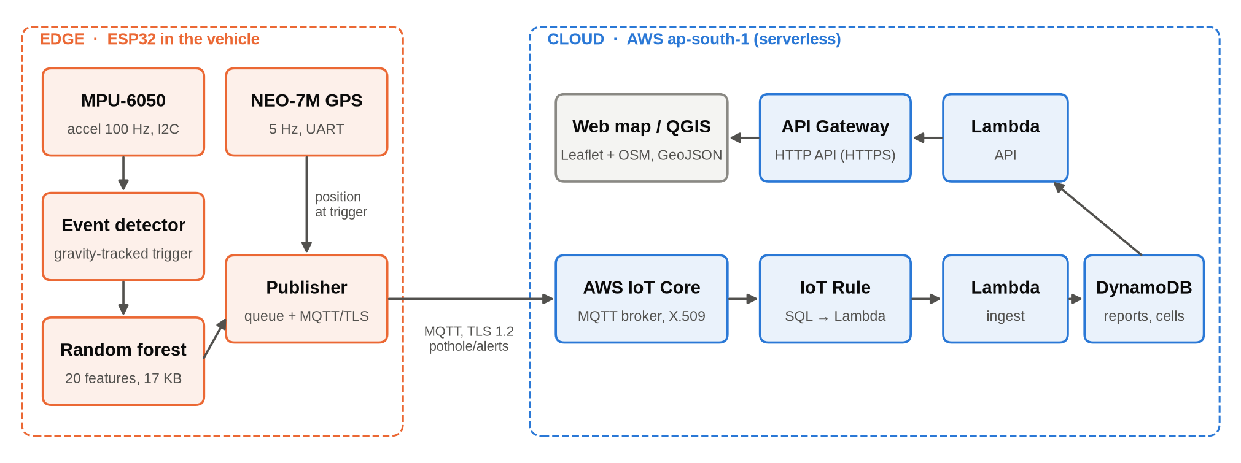
ARCHITECTURE
Edge classification, serverless cloud
Only events leave the car: raw 100 Hz × 3-axis data would be ~1 KB/s per vehicle; one classified event is ~350 bytes over MQTT/TLS.
Pothole detection · edge ML + AWS IoT
3 / 13

Slide 4
DEVICE
Hardware and firmware
ESP32 DevKit V1
MPU-6050 / ADXL345
u-blox NEO-7M
2 × 240 MHz, Wi-Fi
ESP-IDF v6.1 + FreeRTOS
accelerometer, ±8 g @ 100 Hz
I2C · auto-detected
GPS 5 Hz (UBX config)
UART2 · NMEA parser
▸ Sensor task on core 1 at high priority; detection never waits for Wi-Fi
▸ GPS captured at the trigger — the pin is where the wheel hit
▸ 32-event offline queue; sent after reconnect, QoS 1
▸ Only POTHOLE / SPEED_HUMP ≥ 60 % are published
topic pothole/alerts (QoS 1)
{"device_id":"pothole-6acecc",
"event":"POTHOLE","confidence":0.75,
"severity_g":0.98,"lat":…,"lon":…,
"gps":{"fix":true,"sats":7,"hdop":2.4},
"utc":"2026-10-21T21:38:06.800Z",
"model":"forest_n10_d8"}
Pothole detection · edge ML + AWS IoT
4 / 13

Slide 5
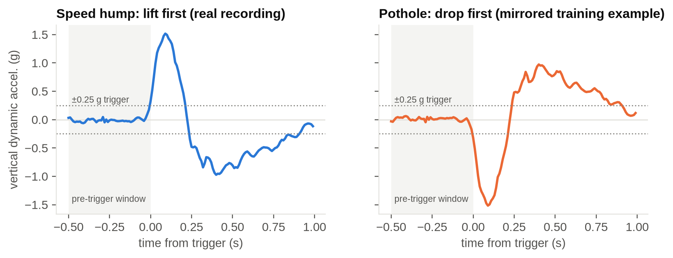
MACHINE LEARNING · DETECTION
Shape, not statistics, separates the classes
▸ Gravity tracking → works at any mounting angle
▸ Trigger at |v| > 0.25 g; window 0.5 s before + 1 s after
▸ Flat road never triggers → no false positives, ~0 CPU
▸ 20 features: size, order of peaks, duration, jerk, roll, roughness
▸ Same C code in firmware and in the Python trainer (ctypes)
Drop first = pothole, lift first = hump. The v1 pipeline used per-axis min/max/mean and learnt the mounting angle: macro-F1 0.20–0.28. The shape features reach 0.92 on the same simulated data.
Pothole detection · edge ML + AWS IoT
5 / 13

Slide 6
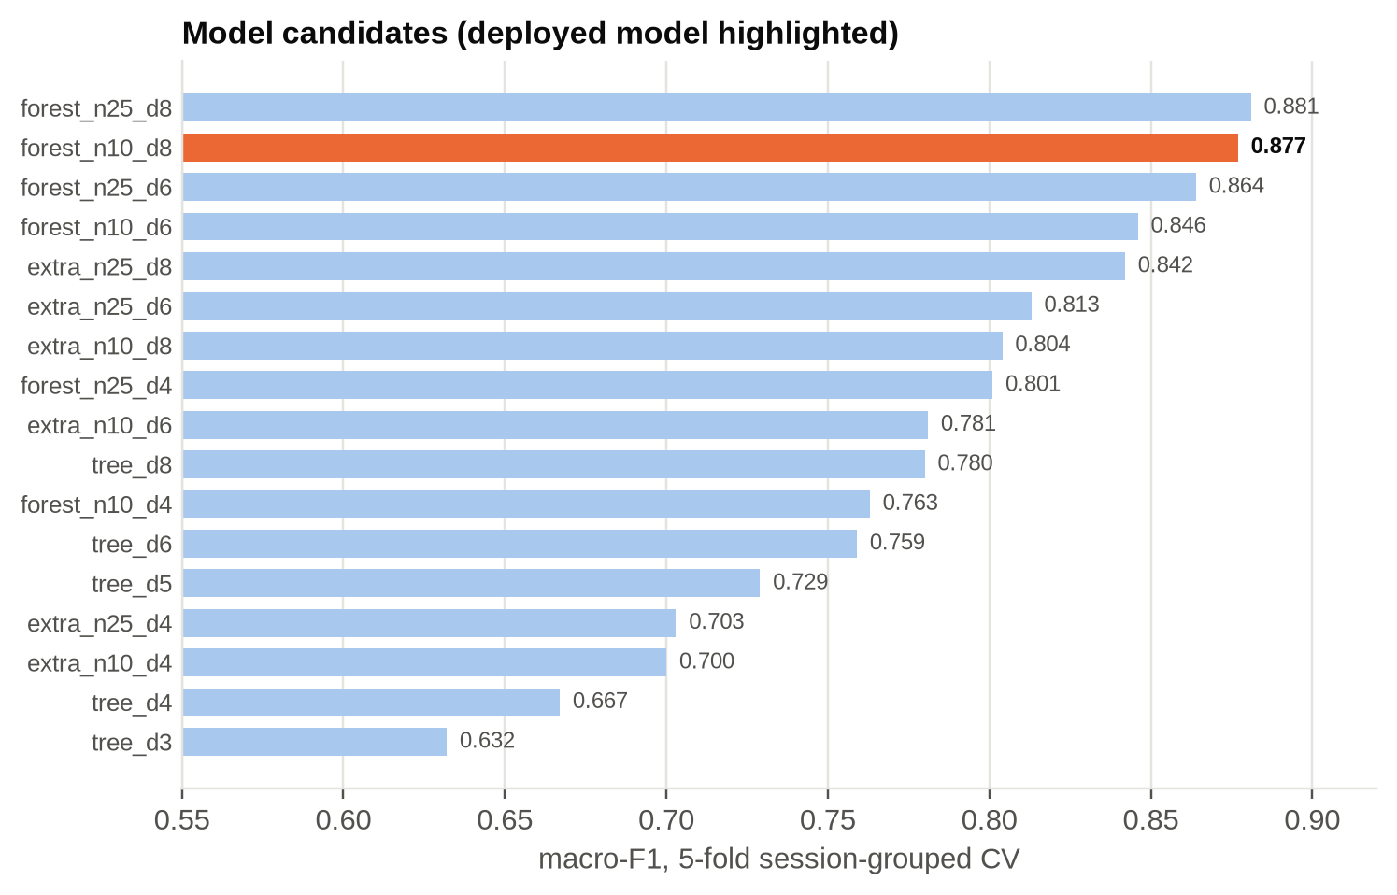
MACHINE LEARNING · MODEL
Near-best accuracy at a third of the size
0.877
macro-F1, 5-fold session-grouped CV
1 452
nodes · ~17 KB flash, uint8 leaves
100 %
C export agrees with scikit-learn
Pothole detection · edge ML + AWS IoT
6 / 13
Notes:
17 candidates: decision trees, random forests, extra-trees. Selection = smallest model within 0.01 of the best macro-F1 under session-grouped CV (no session in both train and test). 1625 events, 58 sessions.

Slide 7
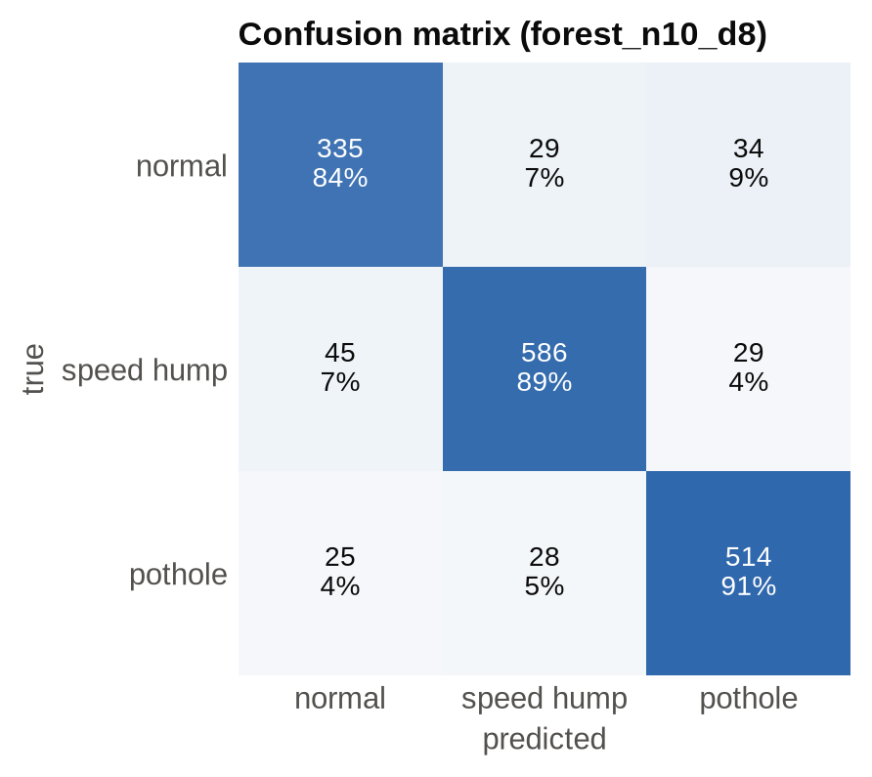
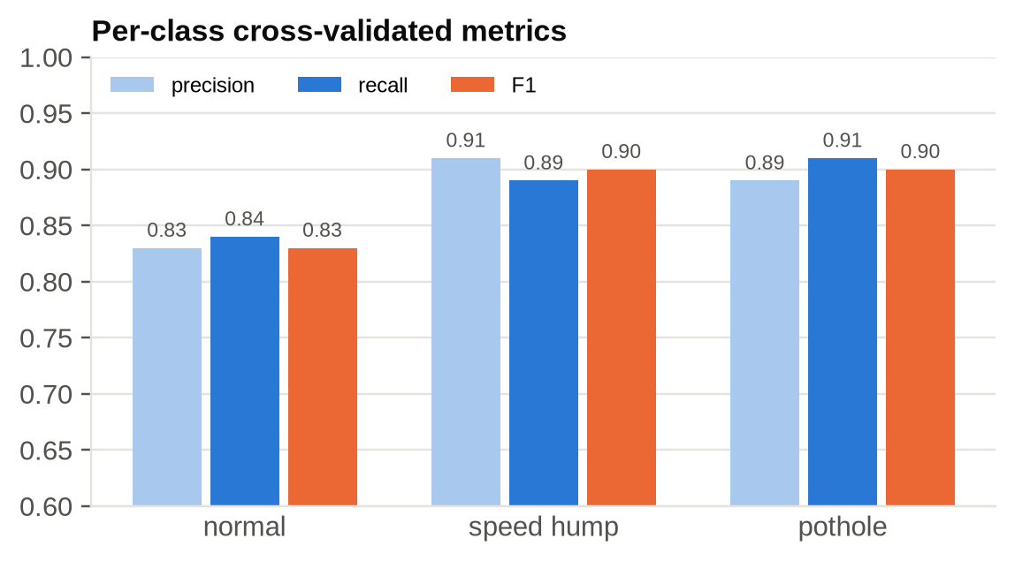
MACHINE LEARNING · RESULTS
Balanced accuracy across all three classes
Held-out real motions, never seen in any form: 91 % of drop-then-lift → pothole, 80 % of lift-then-down → speed hump. Training data: car simulator + augmented desk recordings — not yet road data.
Pothole detection · edge ML + AWS IoT
7 / 13

Slide 8
CLOUD
Six AWS services, one SAM template
1
IoT Core
2
IoT Rule
3
Lambda ×2
MQTT broker · X.509 cert per device · publish-only policy
SELECT *, timestamp(), clientid() → Lambda
Python 3.12 arm64 · ingest + map/GeoJSON API
4
DynamoDB
5
API Gateway
6
SAM / CloudFormation
on-demand single table · raw reports (90-day TTL) + map cells
HTTP API · GET / and GET /potholes
stack pothole-map · deploy, update, delete in one command
Also: S3 (deploy artefacts), CloudWatch Logs (mapped / skipped per message), IAM roles (least privilege) · region ap-south-1
Pothole detection · edge ML + AWS IoT
8 / 13

Slide 9
GIS MAP
Many reports, one pin
1
2
3
4
Validate
Store
Aggregate
Merge & serve
event is POTHOLE or SPEED_HUMP, GPS fix, HDOP ≤ 5
raw report kept 90 days, with the reason if skipped
atomic ADD into a geohash-8 cell (~38 × 19 m)
cells within 15 m merge; GeoJSON + Leaflet/OSM map
Report count = confidence. A pothole confirmed by several vehicles grows into a bigger marker; a one-off false alarm stays small and can be filtered with ?min_reports=2.
Open GIS formats. GET /potholes returns a GeoJSON FeatureCollection that loads directly into QGIS, kepler.gl or Google My Maps.
Pothole detection · edge ML + AWS IoT
9 / 13

Slide 10
RESULTS
Verified end-to-end on the real board
UTC | Event | Conf. | Severity | GPS
21:34:14 | SPEED_HUMP | 0.72 | 0.79 g | 7 sats · HDOP 2.4
21:37:43 | SPEED_HUMP | 0.78 | 0.89 g | 8 sats · HDOP 0.9
21:38:06 | POTHOLE | 0.75 | 0.98 g | 7 sats · HDOP 2.4
21:40:07 | SPEED_HUMP | 0.71 | 0.99 g | fix
21:40:34 | POTHOLE | 0.73 | 0.66 g | fix
21:41:09 | POTHOLE | 0.64 | 0.80 g | fix
6 / 6
device reports stored and mapped
3 → 1
potholes merged into one pin, reports: 3
≈ 2 s
trigger → DynamoDB (1 s window + MQTT + Lambda)
Also verified: offline Lambda tests, sam validate --lint, synthetic publish via the AWS CLI, HTTP 200 on the map.
Pothole detection · edge ML + AWS IoT
10 / 13

Slide 11
STACK
Tools and technologies
Embedded
ML & data
Cloud
GIS & docs
ESP-IDF v6.1, FreeRTOS
esp-mqtt, mbedTLS (TLS 1.2)
xtensa GCC 15, esptool
C99 shared detector code
Python, NumPy, pandas, SciPy
scikit-learn (trees, forests)
ctypes bridge to firmware C
pyserial, matplotlib, pytest
AWS IoT Core, Lambda
DynamoDB, API Gateway
CloudFormation, S3, CloudWatch, IAM
AWS CLI, SAM CLI, boto3
Leaflet 1.9 + OpenStreetMap
GeoJSON, geohash
QGIS / kepler.gl compatible
Git/GitHub, Markdown + Mermaid
Pothole detection · edge ML + AWS IoT
11 / 13

Slide 12
ENGINEERING LOG
What broke, and how it was fixed
Labels didn't match the signal
MPU-6050 FIFO desync
v1 recorder read stale serial data → event-aligned windows, guided collection
random ±8 g sessions → read each sample on DATA_RDY
False humps at rest
Pothole never predicted
0 g first sample after reset → fast gravity convergence at warm-up
35 % of hump labels were failed attempts → shape-filtered, mirrored humps
Board on a foreign AWS account
Potholes hidden on the map
new thing/cert/policy via provision_device.sh, reflashed
hump marker drawn on top → potholes rendered last
Pothole detection · edge ML + AWS IoT
12 / 13

Slide 13
CONCLUSION & NEXT STEPS
Sensor to map works today; the model now needs real roads
Done
Next
On-device pothole / hump classification (17 KB)
Secure MQTT to AWS IoT Core with X.509
Serverless ingest, storage, GeoJSON API, live map
Crowd aggregation: repeat reports → one pin
Record real drives, retrain on road data
Mark-as-fixed + ageing of old reports
OTA model updates via device shadow
IAM user instead of root key; narrower IoT policy

