Slide 1
Embeddings
1 2 3 4 5 … 1280
… …
…
…
…
x33
ESM-2
ESM-2
AA Sequence
…NVKTLSQAVKNI…
ESM-2
ESM-2
ESM-2 Layer
Remove
CLS/EOS
x L

Slide 2
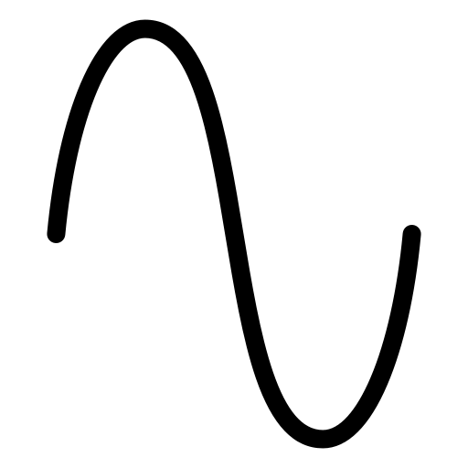



Slicing
$$S_{1}$$
Positional
Encoding
…
$$S_{2}$$
…
$$S_{T}$$
1x1280
T x d

Slide 3
Embeddings
…
…
…
…
x33
1 2 3 4 5 … 1280
ESM-2
ESM-2
ESM-2
ESM-2
ESM-2 Layer
AA Sequence
…NVKTLSQAVKNI…
Remove
CLS/EOS
x L

Slide 4



Slicing
Positional
Encoding
$$S_{1}$$
$$S_{2}$$
…
…
$$S_{T}$$
1x1280
T x d

Slide 5

Encoder Layer
xH
Q
Layer Norm
Layer Norm
Linear
ReLU
Linear
K
Dropout
+
Residual
Connection
Dropout
+
Residual
Connection
V
$$\text{softmax}\left(\frac{QK^{T}}{\sqrt{d_{k}}}\right)$$
d →X
X →d
Multi-Head Attention
Feed-Forward Network
xN

Slide 6



Mean Pooling
Final MLP Head
$$S_{1}$$
$$S_{2}$$
Predicted SS
…CCCCCEEEEHHH…
Mean
Linear
GELU
Linear
…
$$S_{T}$$
T x d
1 x d
d →Y
Y →C

Slide 7



Slicing
AA Sequence
…NGNFTINFK…
$$S_{1}$$
ESM-2
$$S_{2}$$
Embedding
ESM-2
ESM-2
ESM-2
T x d
Remove
CLS/EOS
ESM-2 Layer
…
…
$$S_{T}$$
1x1280
x33

Slide 9

Encoder Layer
xH
FFN
Q
K
V
$$\text{softmax}\left(\frac{QK^{T}}{\sqrt{d_{k}}}\right)$$
Multi-Head Attention
xN

Slide 10
Mean
1 x d
Linear
d →Y
GELU
MLP
Linear
Y →C
Softmax
Predicted SS
…CCEEEEEEE…

