Slide 1
Embeddings
1 2 3 4 5 … 1280
… …
…
…
…
x33
ESM-2
ESM-2
AA Sequence
…NVKTLSQAVKNI…
ESM-2
ESM-2
ESM-2 Layer
Remove
CLS/EOS
x L

Slide 2
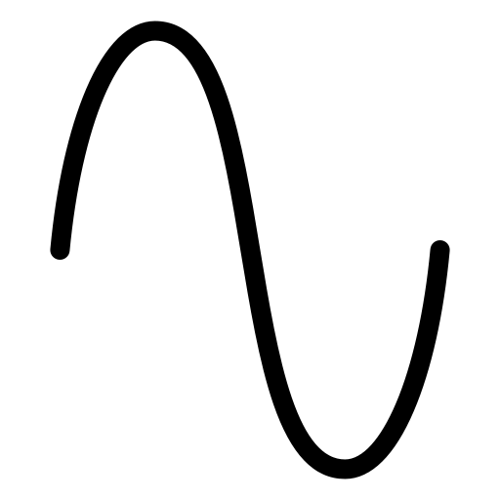



Slicing
$$S_{1}$$
Positional
Encoding
…
$$S_{2}$$
…
$$S_{T}$$
1x1280
T x D

Slide 3

Encoder Layer
xH
Q
Layer Norm
Layer Norm
Linear
ReLU
Linear
K
Residual
Connection
Residual
Connection
V
$$\text{softmax}\left(\frac{QK^{T}}{\sqrt{d_{k}}}\right)$$
D →X
X →D
Multi-Head Attention
Feed-Forward Network
xN

Slide 4



Mean Pooling
$$S_{1}$$
$$S_{2}$$
Linear
Predicted SS
…CCCCCEEEEHHH…
GELU
Linear
Mean
…
$$S_{T}$$
1xD
256 →1536
1536→256
D →Y
Y → C
T x D
Feed-Forward Network
Final MLP Head

