Slide 1

Frozen Bytes: NuGet 101
Blazing Fast Overview
.NET Package Management for the Enterprise

Slide 2
Agenda
What is NuGet? What does it mean to me as a developer?
What is the goal of NuGet?
How do I get started?
Consume NuGet and embracing Package Manager Console.
What is a NuGet package?
Configure NuGet sources. Hosting own NuGet feeds.
How does this benefit the team?
How does this benefit the CI process?

Slide 3
What is NuGet?
.NET Package Manager
Original OSS Project Nu now NuGet
Ships with ASP.NET MVC3
OS Managed by Outercurve Foundation hosted on nuget.codeplex.com
32,000+ Packages
Current version 1.6
Extendable and is a protocol

Slide 4
What is Package Management?
Tools to simplify discovering, obtaining, installing and updating project references.
Eliminate dependency hell.
Similar to Ruby Gems and OpenWrap – http://openwrap.org
Not like a system package manager like, Linux apt-get.
Windows System Package Managers
Chocolatey – http://chocolatey.org
CoApp – http://coapp.org

Slide 5
What is the goal of NuGet?
Promotion of projects and libraries to ensure great software is readily available and usable.
Eliminate discovering, obtaining, and complex configuration as a barrier to entry for leveraging powerful software.
Make Open Source Software ( OSS ) easy as “Add Reference”.
Eliminate dependency hell.
Improve developer experience and productivity.
Leverage Conventions over configuration
Tight integration with Visual Studio IDE and leverage power of PowerShell.

Slide 6
How do I get started?
Recommend installing NuGet Visual Studio Extension, NuGet Command Line and NuGet Explorer http://nuget.codeplex.com
Visit http://nuget.org
Do a one over the NuGet Documentation - http://docs.nuget.org/
Create a new VS 2010 solution or open an existing solution then hack away on the Open Package Manager Console consuming packages
Start small, replacing a few references with NuGet Package References.
Watch Scott Hansleman’s screen casts on NuGet for in depth knowledge ( references section )

Slide 7
NuGet Package Gallery
Official NuGet Package Gallery - http://nuget.org
Provides official community package library.
Publish Packages with a FREE account
Main NuGet Feed for consuming packages
Package Stats – http://stats.nuget.org
NuGet Team Blog - http://blog.nuget.org/
32,000+ packages

Slide 8
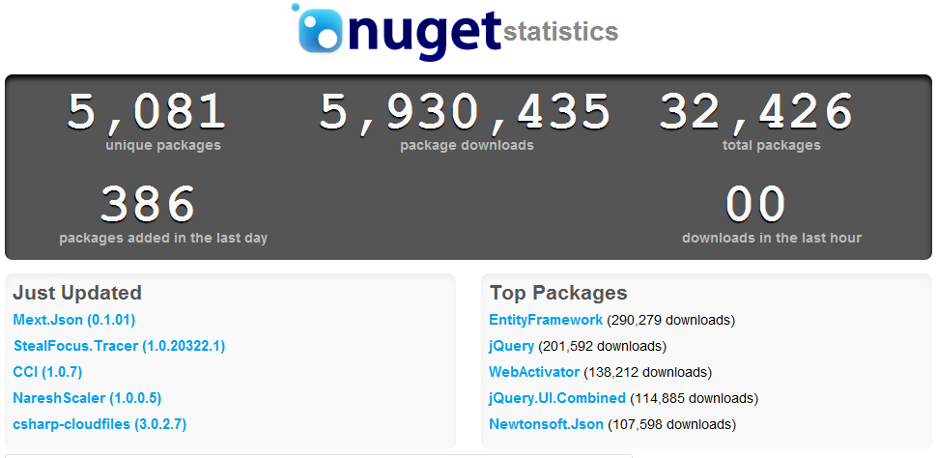

Slide 9
Why Create Own Packages?
Distribute .NET assemblies and dependencies.
Eliminate dependencies from VCS.
Perform complex configuration and setup to ease adoption.
Distribute
JavaScript Libraries
Samples
Scripts
Support Extensions
Extend Package Mgr Console
Extend NuGet Command Line
Extend NuGet Explorer

Slide 10
What makes up a NuGet Package?
Meta Data
Dependencies
Content
Transforms
Templates
Libs
dlls
Tools
Init.ps1
Install.ps1
Uninstall.ps1

Slide 11
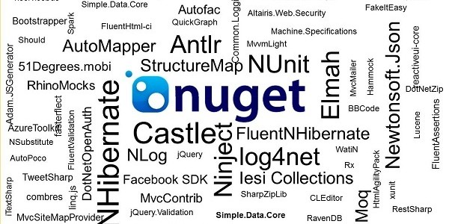

Slide 12
Web Start-Up Code
Simple way to enable start-up of your library in Web Apps
WebActivator NuGet library
Replacements of the .NET 4 attributes
[PreApplicationStartMethod]
[PostApplicationStartMethod]
Content
App_Start
Examples
IoC libraries like Ninject and StructureMap
Commmon
$rootnamespace$

Slide 13
Creating NuGet Packages?
Create Manifest
Manual
Command line
Assembly
Visual Studio Project
Create Packages
Manually using command line
NuGet Explorer
Visual Studio Project
Package Manager Console using New-Package
TeamCity

Slide 14
Package Source
NuGet Visual Studio Extension supports multiple Package Sources in hierarchy order.
NuGet Source Options
Nuget.org
Own Local or Network Directories
Local Cache
Own Read Only Server
Own NuGet Gallery
Own NuGet Orchard Gallery
.NET Community Source Options
MyGet.org
NuGetFeed.org
TeamCity

Slide 15
Why host internal NuGet Gallery?
Open Source - https://github.com/NuGet/NuGetGallery
Provides full ownership
Publish proprietary internal packages
Publish backups of external packages
Browse able gallery
Manage internal/external packages
Extend or integrate with own requirements
Extending NuGet Gallery
Baseline Feed
Client/Project Feeds
Community Feeds
Enterprise Feeds
Personal Feeds

Slide 16
What about Continuous Integration?
No Commit Strategy
Tracking Package Metadata
Package Restoration
TeamCity Pull, Package and Publish Support
Automated Deployment with Octopus
Convention Based
Shipping Application in NuGet Package
Deploying Applications to servers

Slide 17
What is the value to the team, .NET COP, enterprise, client?
Reduce project dependency management. Simplify setup and onboarding. Improving version management.
Promote reuse, standardization, discovery, collaboration regarding packages across all levels of the organization.
Removal of dependencies from VCS saving valuable disk space.
Improves continuous integration process and opens the opportunity or automated deployments with products like Octopus.
Offers extension points with Chocolatey to improve developer experience regarding machine setup and overall maintenance.
Integration with commercial vendor NuGet feeds like DevExpress

Slide 18
Questions

Slide 19
References
Site – http://nuget.org
Documentation – http://docs.nuget.org
Project – http://nuget.codeplex.com
NuGet Gallery - https://github.com/NuGet/NuGetGallery
Channel 9 – Scott Hanselman – NuGet In Depth: Empowering Open Source on .NET Platform - http://bit.ly/kDpzVM
Tech Ed 2011 – Scott Hanselman – NuGet: Microsoft .NET Package Management for Enterprise - http://bit.ly/leXTTy
Setup Own NuGet Gallery in Minutes - http://bit.ly/GJGvp7

Slide 20
References
Chocolatey - http://chocolatey.org/
Chocolatey Series - http://bit.ly/GHIcNW
CoApp – http://coapp.org
MyGet.org – http://myget.org
NuGetFeed.org – http://nugetfeed.org
TeamCity - http://www.jetbrains.com/teamcity/
Octopus - http://octopusdeploy.com/

Slide 21

Author
Frozen Bytes - Sean Gilbert
Email – im.code.g@gmail.co
GitHub - https://github.com/segilbert
Blog – http://i-m-code.com/blog
Twitter - @imcode

