Slide 1
Bahir dar university faculty of electrical and computer ip project
Dahlak high School
Management System

Slide 2
introduction
As we all know it is difficult to manage time for our daily needs in this fast moving world.
In regard with this problem we need to go with the world and modernize our daily objectives in order to survive this world.
And so website is one of the solutions that used to modernize our selves.
Today websites are so common since they can save our times and also our resources.

Slide 3
Objectives

Slide 4
Main objective
To create communication platform for all school society
To change paper work to online and easy score management system
To create platform that make easy for parents to access their childe info and interact with stuff

Slide 5
Specific objectives
Provide simple, universal access to information and services for all staff, and students
Improve the online communications ability for individuals and groups associated with the School of Education
Obtain feedback from users on satisfaction levels of current services, as well as, new services and implement changes accordingly
Maintain current technology hardware, software and network infrastructure so that it is reliably available.

Slide 6
Stating the problems
Registration with paper is so hard and take time and costy
Paper-based processes
Students take so match time to see their score
Student will hide their score from their parent Student Monitoring.
Teacher Evaluation.
Communication & Collaboration.
Student Monitoring

Slide 7
Methodology
We have used Agile methdology
And we have pass through 5 sprints
In the 1st sprint we have discover admin roles and design UI then develop and test
  In this sprint we discover admins role
  Register new teacher
  Register new parent and link with student
  Approve new registration of students
  Can access every user and delete if necessary

Slide 8
Conn…
In the 2nd sprint we have discover teacher roles and design UI then develop and test
  In this sprint we discover teacher role
  Update student score
  Communicate with student and parent

Slide 9
Conn…
In the 3rd sprint we have discover student roles and design UI then develop and test
  In this sprint we discover student role
  Can see their score online
  They can chat with other school students
  They can communicate with stuff
  Student can see the year timeline online

Slide 10
Conn…
In the 4th sprint we have discover parent roles and design UI then develop and test
    In this sprint we discover parent role
    Parents can be accessed their children information any where
    Parents can access their children score
    Parents can communicate with staff members with online using our web platform

Slide 11
Conn…
The 5th and final sprint
We add some final sprint and in this we discover some additional feature and improver some style UI
  To make able all the school society communicate

Slide 12
Software and languages used
Programing language we use
  PHP
  Js
Software we use
  XAMP
  WAMP
Database
  MySQL

Slide 13
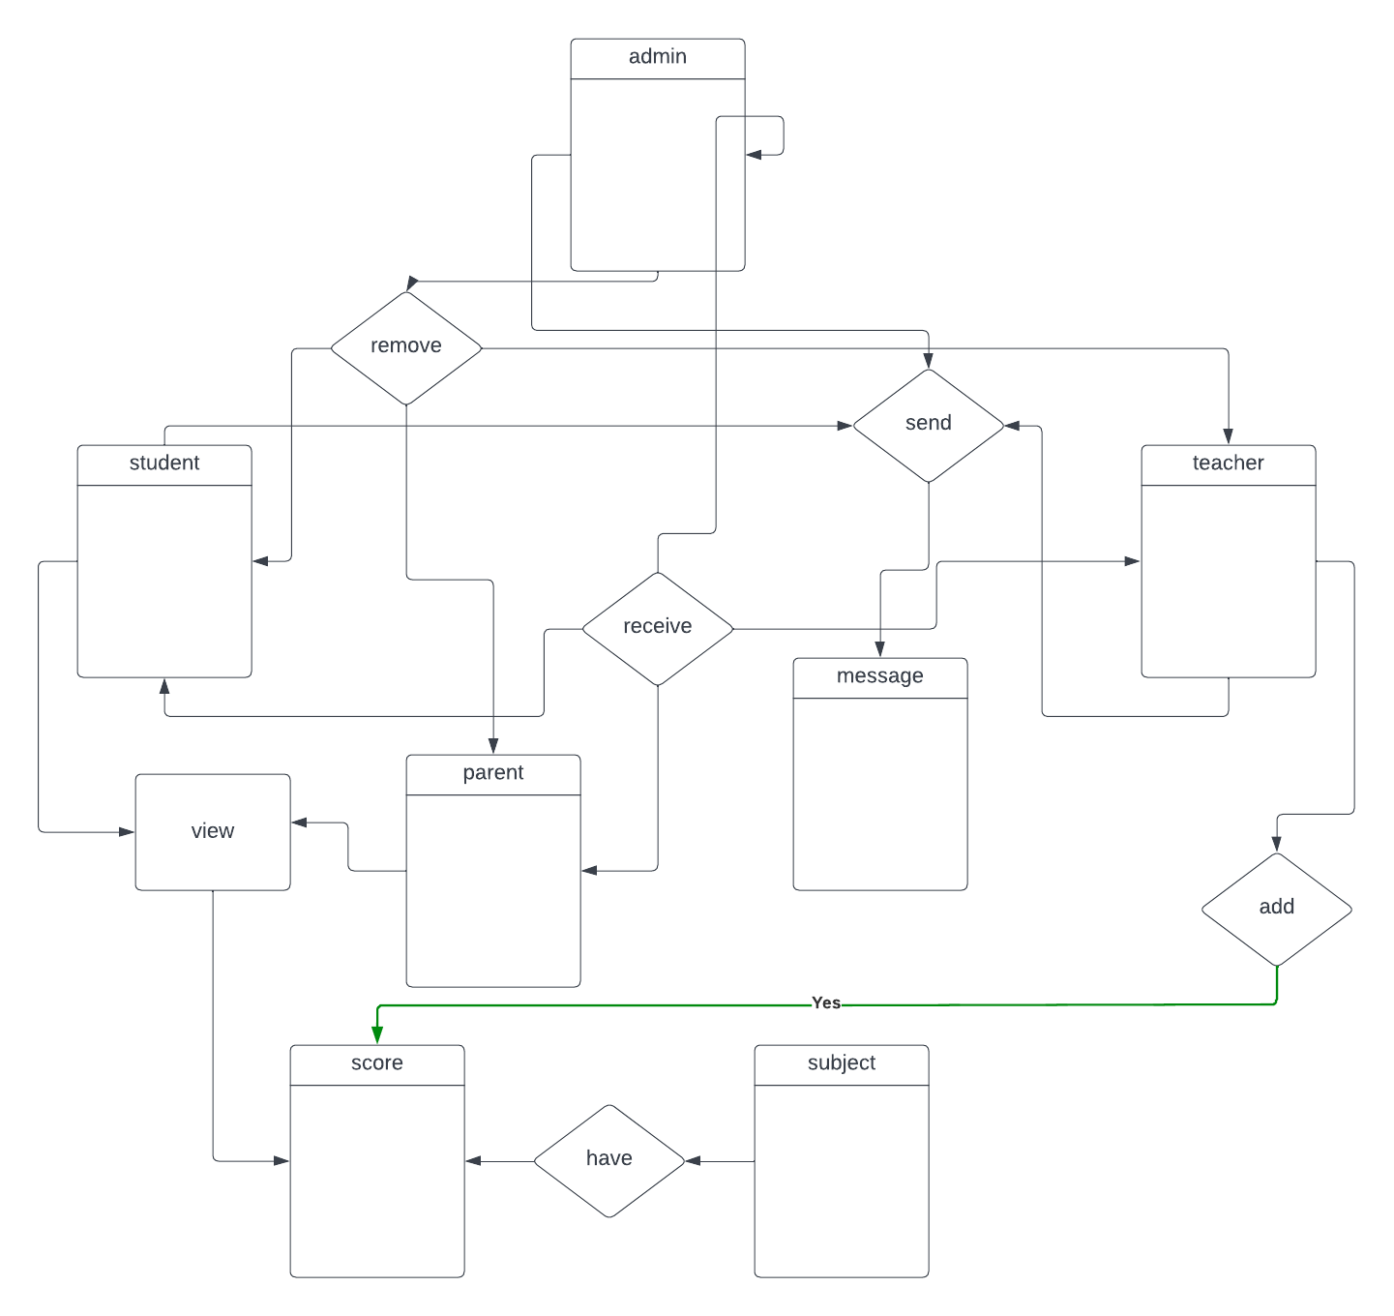

Slide 14
implementation
Teacher to add score
  Login
  Go to my student page
  From the table search and enter the student score
  Press save if it is for the first time and update for change this score

Slide 15
Student to see their score
  Login
  Go to profile page
  Then go to score page

Slide 16
Parent to see their children score
  Login
  Go to profile page
  Then go to score page

Slide 17
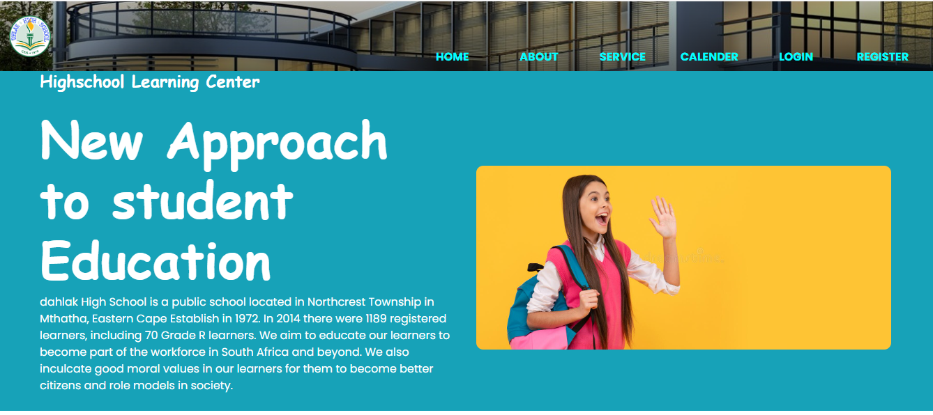
Demonstration

Slide 18
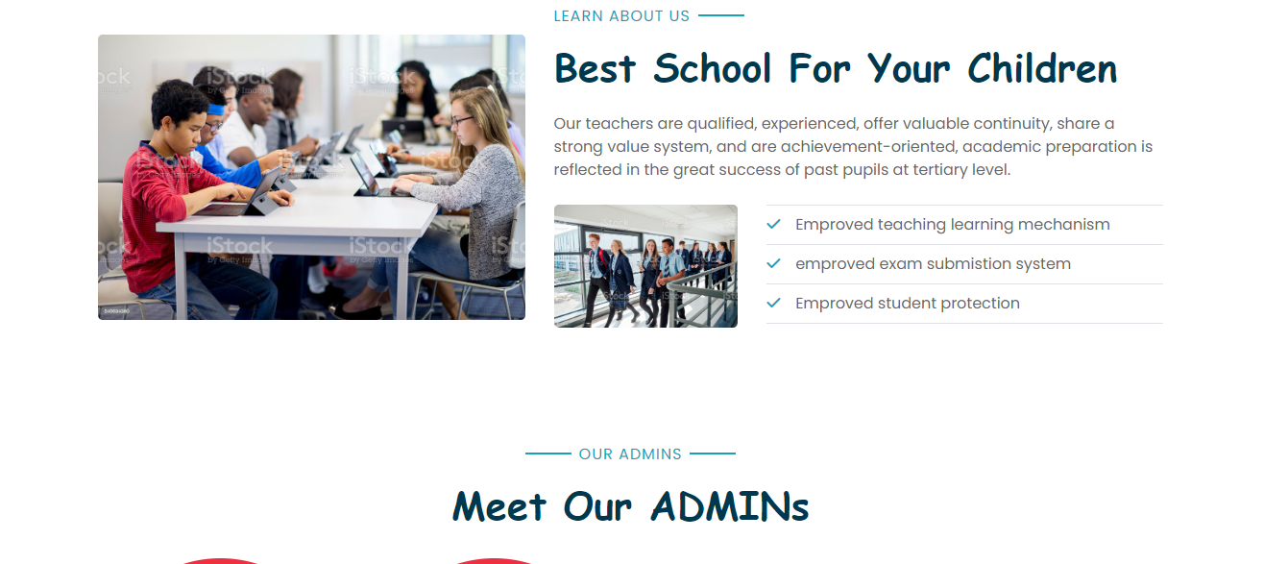

Slide 19
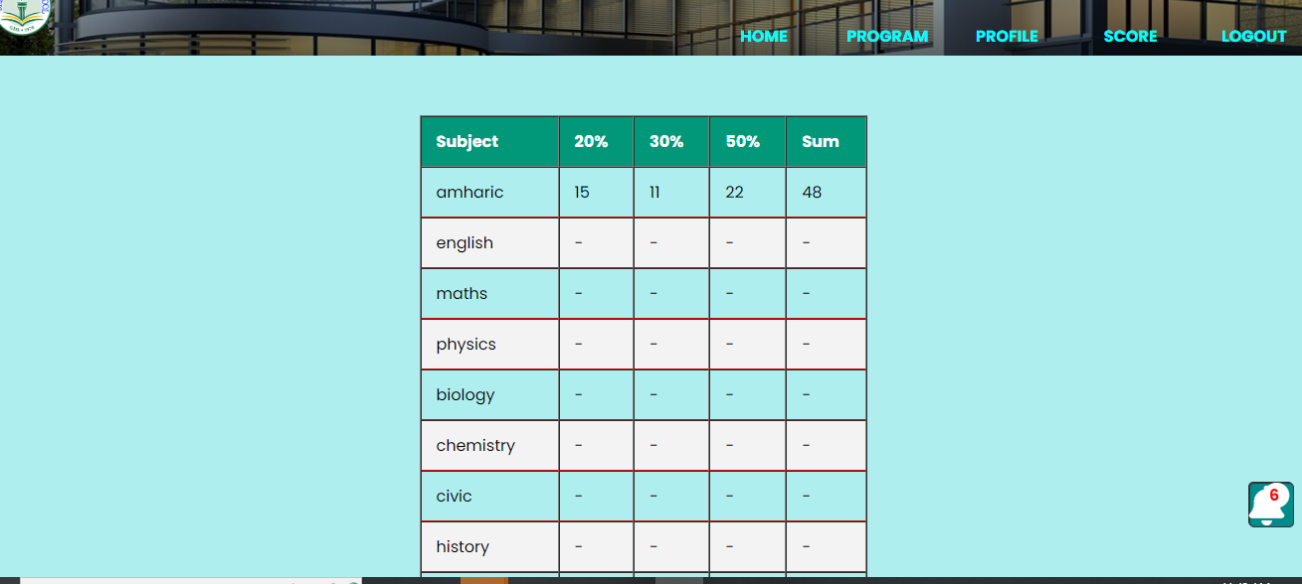

Slide 20
