Slide 1
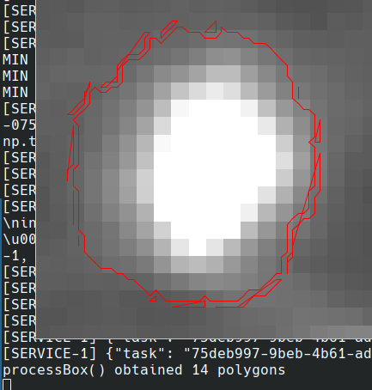
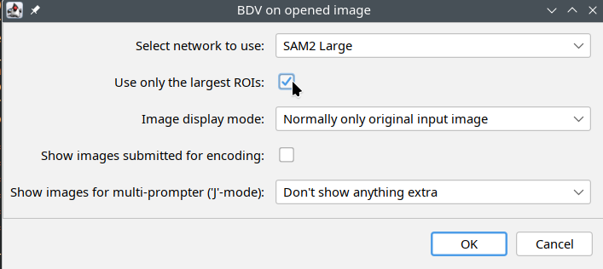
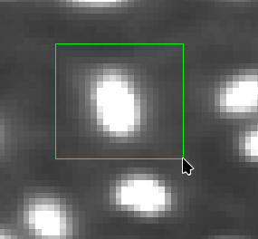
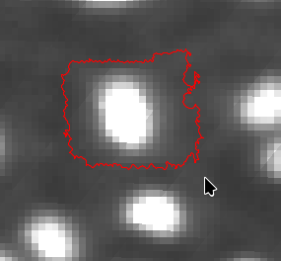
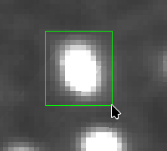
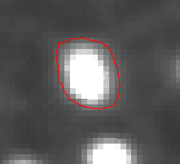
SAM2 is great, but:
SAM2 networks over-segment (produce too many polygons/segments for one object)
  At least this is the case for SAM2 Tiny and Large
  Sooo:
  Taking largests polygon works well, but ultimately means:
  (at most) one obj is annotated per one prompt
There exist data when one has to be carefull with prompts
...not to make them too large, too “vague” around the obj of interest
VS.

Slide 2
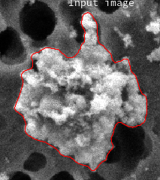
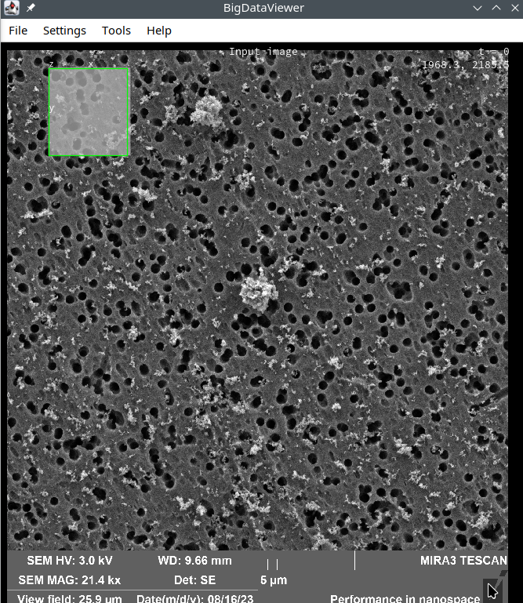
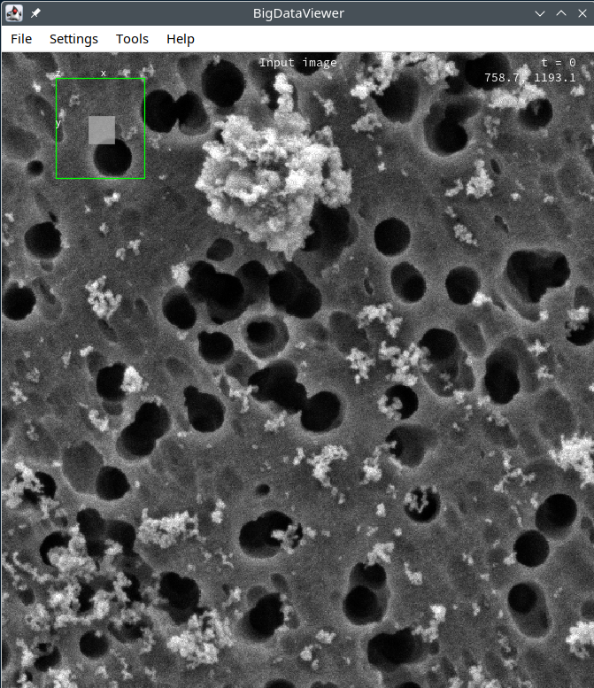
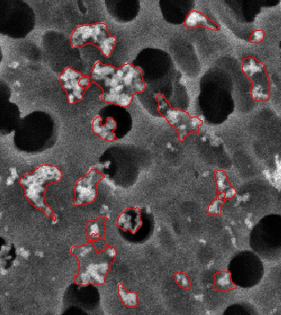
Dust-particles electron microscopy example where one wants to avoid “careless prompting”:
Works well
on “big ones”
let’s annotate this bottom-right corner
missed
full image
too big
zoomed-in

Slide 3
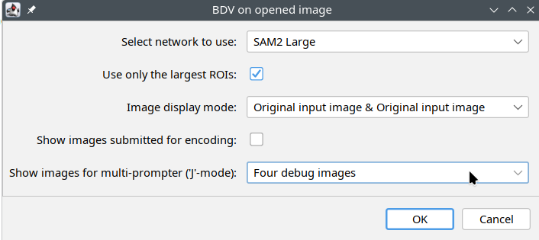
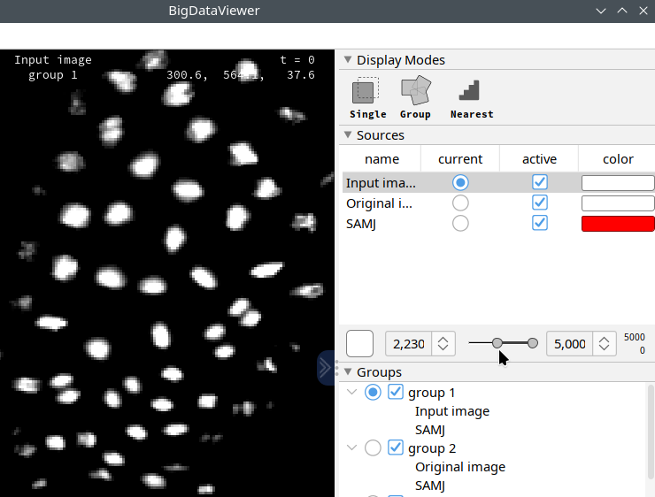
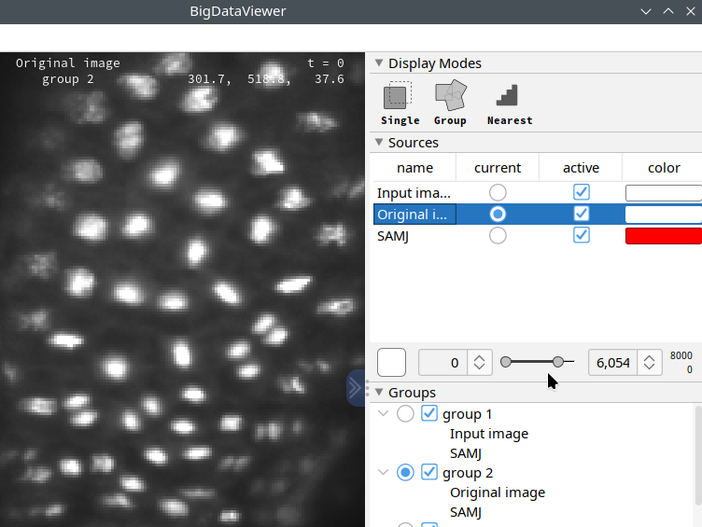
What to do about it?
Annotator has to be careful (and patient) → takes very long
Or, have system that fine-tunes annotator’s prompt:
...by creating seeds where user originally prompted,
and runs SAM iteratively per each seeds separately
  Here, IMPLICIT/internal fine-tuner is used, for which:
    It is better to show the same original image twice
      Once (left fig.) as contrast-adjusted so that “seeds” are apparent
      Once (right fig.) with “normal view” which is here _only_ for visual check if the annotation went well
      Note: BDV automatically sets up viewing groups, display mode etc.; user “only” adjusts contrast settings

Slide 4
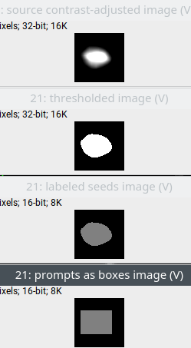
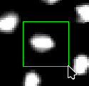
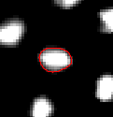
What to do about it?
Annotator has to be careful (and patient) → takes very long
Or, have system that fine-tunes annotator’s prompt:
...by creating seeds where user originally prompted,
and runs SAM iteratively per each seeds separately
  Here, IMPLICIT/internal fine-tuner is used, for which:
    It is better to show the same original image twice
      Once (left fig.) as contrast-adjusted so that “seeds” are apparent
      Once (right fig.) with “normal view” which is here _only_ for visual check if the annotation went well
      Note: Obviously, you don’t have to have debug images displayed at all….
Careless user prompt Debug images 1 & 2 /4 Debug images 3 & 4 /4 Obtained annotation
Pipeline:
User-given GreenBox cropped out the by-user-contrast-adjusted image, threshold >0, CCA, bounding box → SAM on orig image→ yay! :-)
Inside BDV

Slide 5
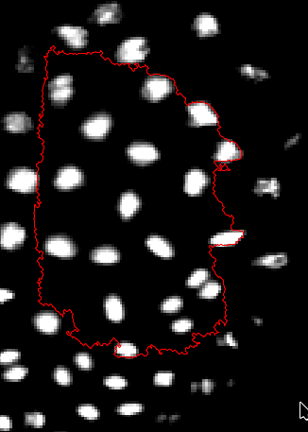
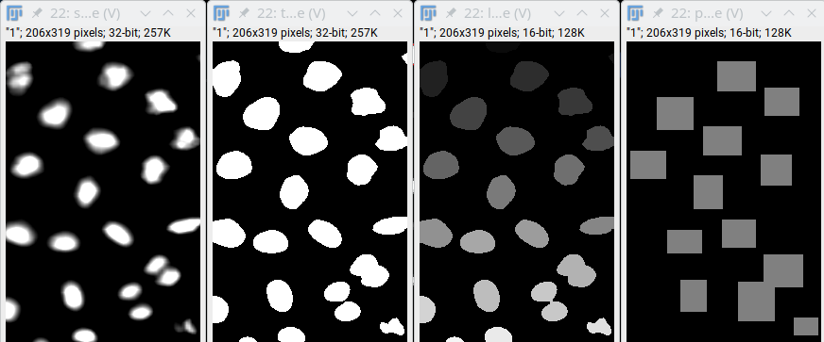
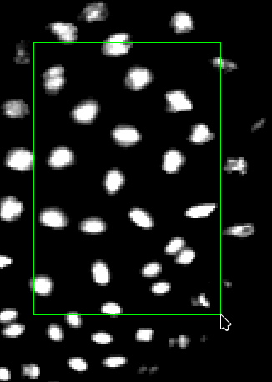
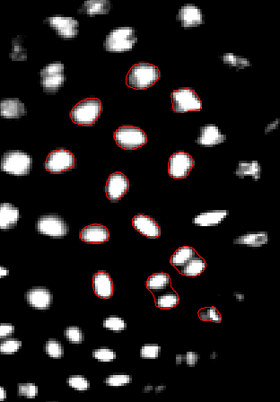
Multi-prompting as a Side-effect (it’s exactly the same pipeline as for the fine-tuning)
Standard SAMJ:
--------------------->
The same INTERNAL image processing
to create seeds to obtain prompts.
Multi-prompting:
Small and boundary-touching prompts/boxes are ignored.

Slide 6
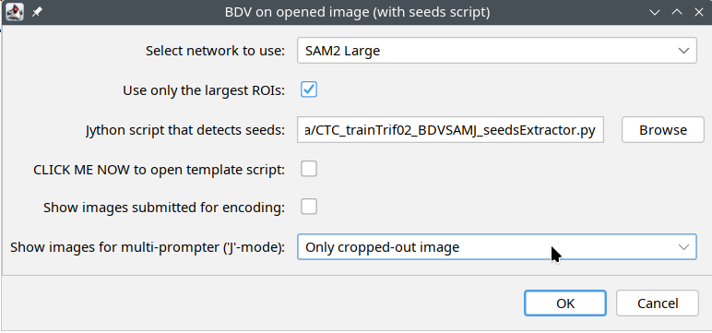
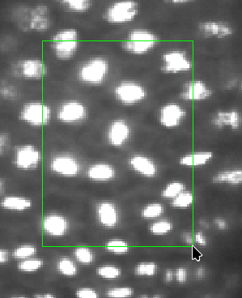
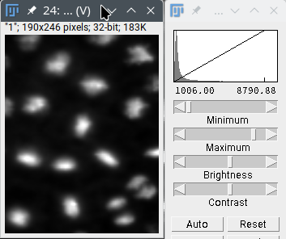
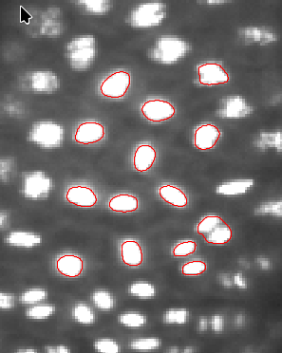
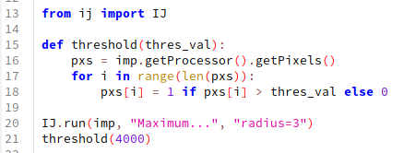
What if I don’t wanna adjust contrast and/or don’t wanna use thresholding to create seeds?
→ Just point BDV on a script that converts crop-out of
the original image to an image with seed(s):
Here, EXPLICIT/external fine-tuner is used, for which:
  The mechanism works exactly the same
  Except that instead of internal thresholding,
  an external script is executed to obtain seed image
  Except that original, not-contrast-adjusted crop is used
  Seeds CCA and SAM prompting happens again in BDV
SAM Prompting
Bounding boxes
CCA’ing seeds
Inside BDV:

Slide 7
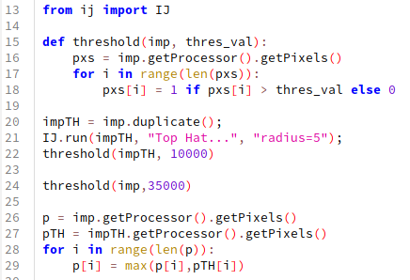
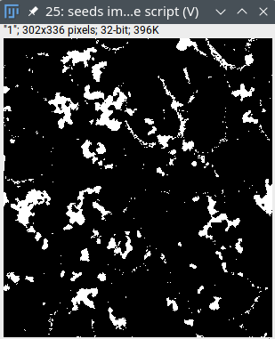
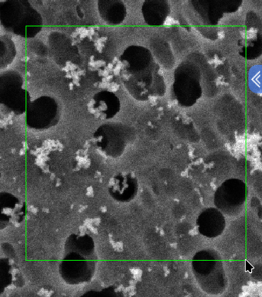
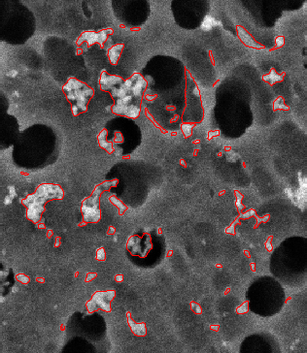
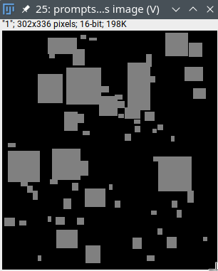
Dust-particles electron microscopy example again
where externally-obtained seeds guided the multi-prompting:
Result is more detailed (compare with Slide 2),
but not perfect either (has false positives – a lousy script I prepared).
false
positive

Slide 8
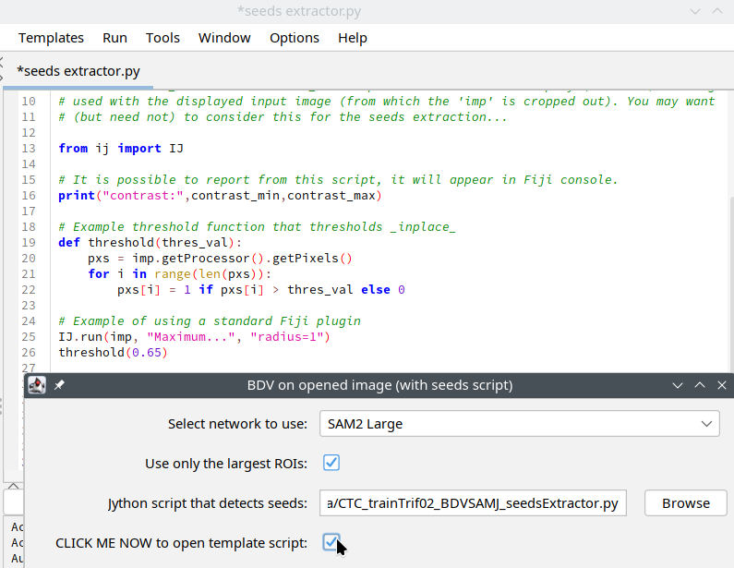
Is there a template script to start with?
Yes.
(
Just don’t know how to create button
in IJ2 auto-generated dialogs, so
one has to toggle the “CLICK ME NOW”
checkbox….
And the script editor comes out.
)
One cancels/closes the
“BDV on opened…” dialog
Edit the script
Save-as the script somewhere
Re-open the “BDV on opened…”
Point on the edited script
The script is re-read from disk prior
every use of it, so one can adjust the
seeds-extracting-pipeline during the
same annotation session. This is useful,
e.g., when different thresholding values
work in different corners of the data.

Slide 9
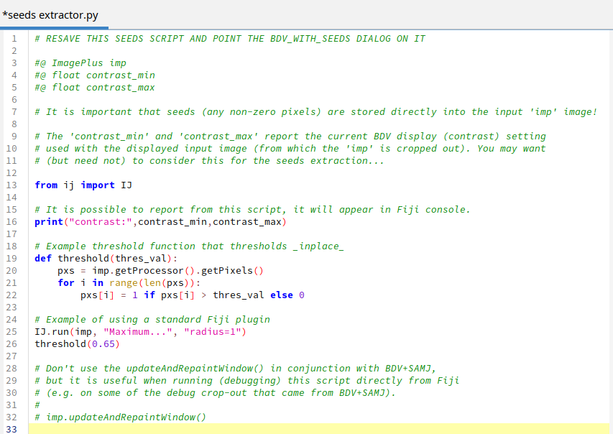
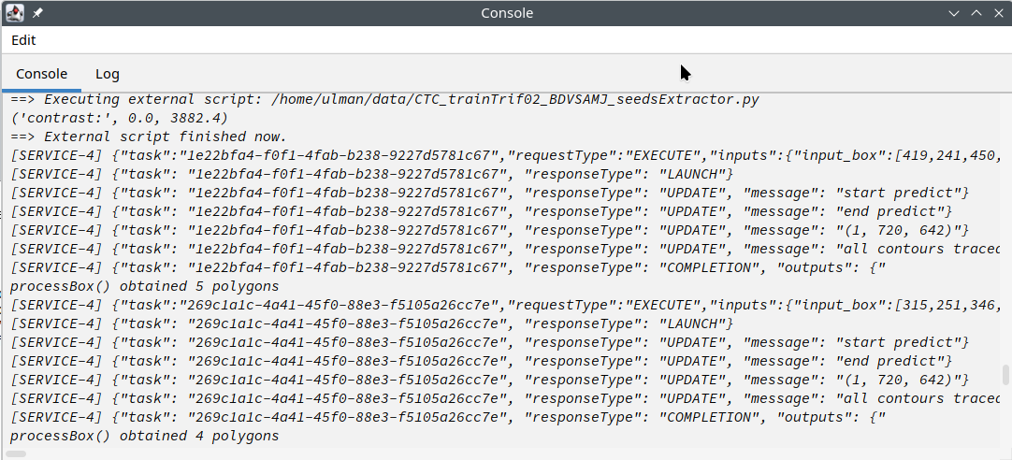
The full initial/template script:
Note:
One can excercise and
fine-tune the script
outside BDV. It’s a normal
Jython script afterall...

