Slide 1
DILLA UNIVERSITY
College of Engineering & Technology
School of Electrical and Computer Engineering
(Department computer Engineering)
INTERNETPROGRAMMING MINI PROJEECT

Slide 2
Abstract
According to our project I.e our website perform the following activities
➢Identify symptoms related to covid-19 infections
Preventive measures against covid-19
Introduction
Corona viruses are a large family of viruses, some cause illness in humans, and others cause illness in animals, such as bats, camels, and civets.

Slide 3
cont....
Human corona viruses cause mild illness, such as the common cold.
Corona represents crown-like spikes on the outer surface of the virus; thus, it was named as a corona virus
The most commonly reported symptoms include a fever, dry cough and tiredness, and in mild cases people may get just a runny nose or a sore throat.
In the most severe cases, people with the virus can develop difficulty breathing, and may ultimately experience organ failure. Some cases are fatal.

Slide 4
Background
the most likely ecological reservoirs for corona viruses are bats, but it is believed that the virus jumped the species barrier to humans from another intermediate animal host.
This intermediate animal host could be a domestic food animal, a wild animal, or a domesticated wild animal which has not yet been identified.

Slide 5
cont.....
Previous Corona viruses have included SARS- CoV and MERS-CoV
Severe acute respiratory syndrome corona virus 2 (SARS-CoV-2) is a new strain of corona virus that has not been previously identified in humans.
It appears to have first emerged in Wuhan, China, in late 2019.
The outbreak has since spread across China to other countries around the world. By the end of January, the new coronavirus had been declared a public health emergency of international concern by the WHO.

Slide 6
Objectives of the project
To know symptoms:-which is peoples treat themselves(like don't present many peoples appear)
Prevent themselves
To manage news:-this is done by administrator

Slide 7
Methodology
Some of main procedures that are followedby our
project include:-
We gather information about covid from different sites through the following ways
We ask some questions for Example:-
What are symptoms of corona virus?(I.e previously affected persons)
How long it take to develop symptoms
How to prevent this diseases?
How can we protect others and ourselves if we don’t know who is infected ?
What we should we do if we have covid 19 symptoms

Slide 8
System development tool
Development tools are used to propose our project can be explained as:
Software used
Visual studio code Editor: - to write different codes (HTML,PHP, CSS, and JavaScript).
Wps word:- to prepare power point
Web browsers
xamp:-Server which functions as a server in one computer
Significance of the Project
The project has many significant for us and for the users of the systems. Get more information about corona virus and prevent before we affected by this virus

Slide 9
Functional requirements
Functional requirement explains and describes the interaction between the system and the users or in general with the environment.
it determines what the system can do as well as input and Output of the System. The product consists of the following the functional requirements:- Possible Actors are
Admin
add and delete news
read message
user
view prescription details(symptoms,preventions
give comments
view news
view current covid status

Slide 10
Webpage paths
Corona Awareness
home
Symptom
Treatment and preventation
News
admin
Message
Upload News
Global covid status
Uploaded news
About US
Contact US
Areyousick

Slide 11
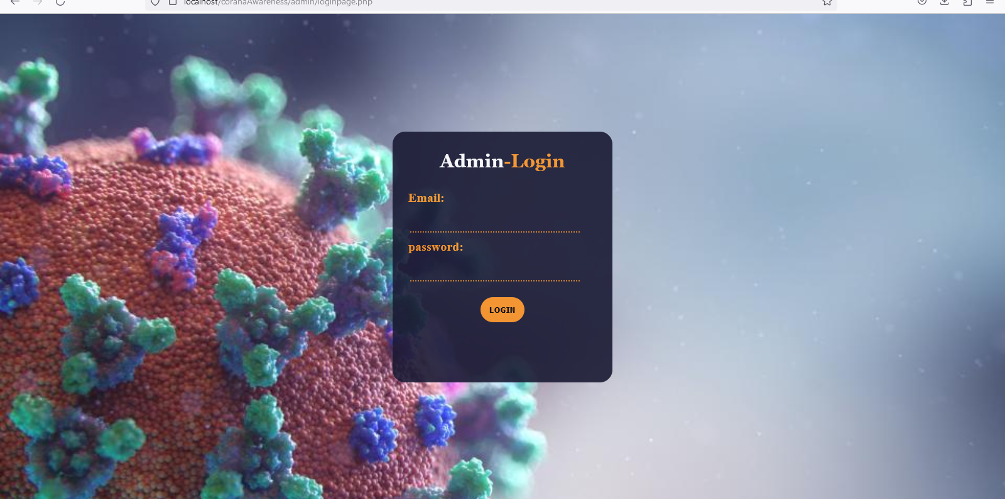
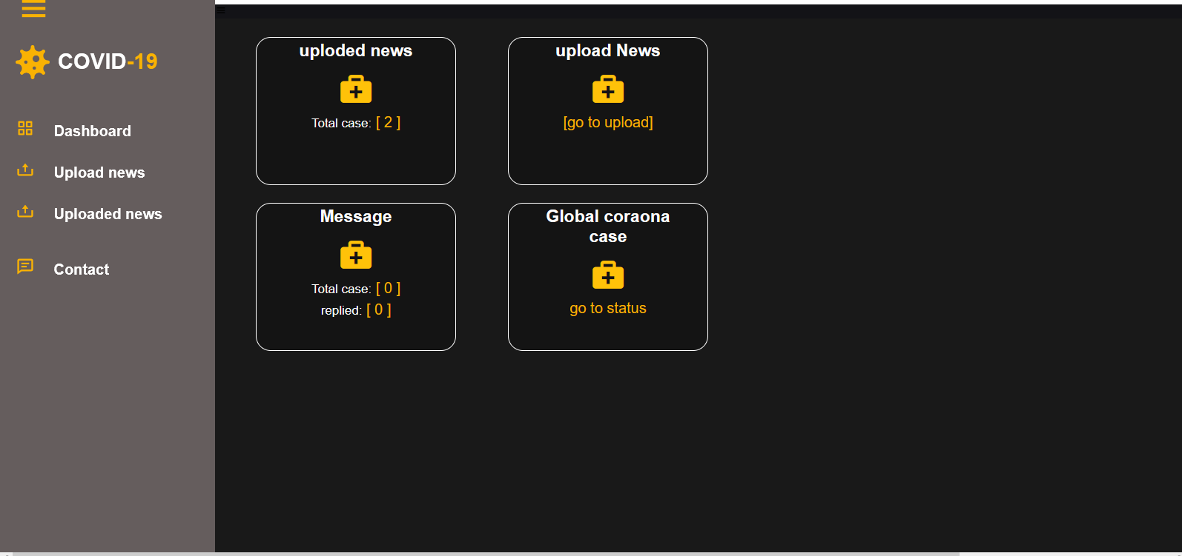
Admin pages

Slide 12
Database design
Databases are the store houses of data used in the software system.
A database is a collection of stored data organized in such a way that the data requirements are satisfied by the database. The data is stored in tables inside a database.

Slide 13
cont...
The general theme of database design is to handle information as an integrated whole, with a minimum redundancy and improved performance. Regardless of the type of data structure used, the objectives of the database are accuracy and integrity and successful recovery from failure, privacy and security of data, and good overall performance.
A table is designed as a collection of rows and columns, which are in turn called as tuples and attributes

Slide 14
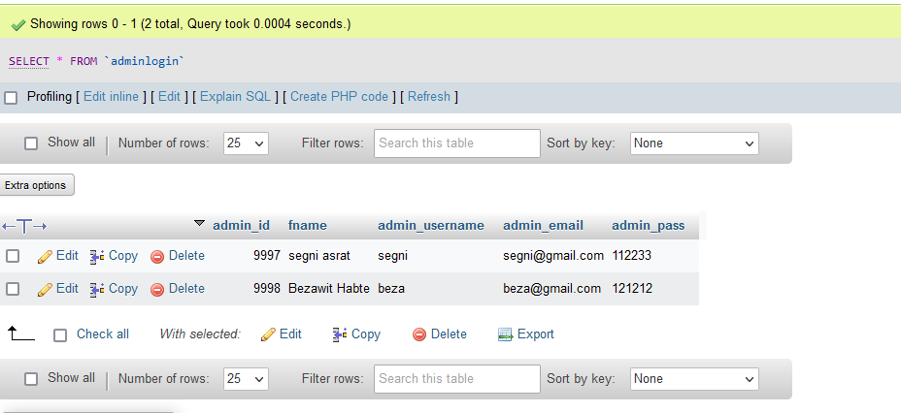
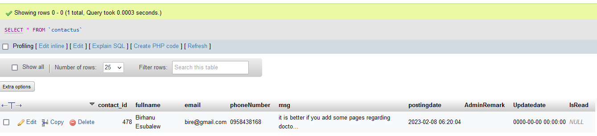
database tables

Slide 15
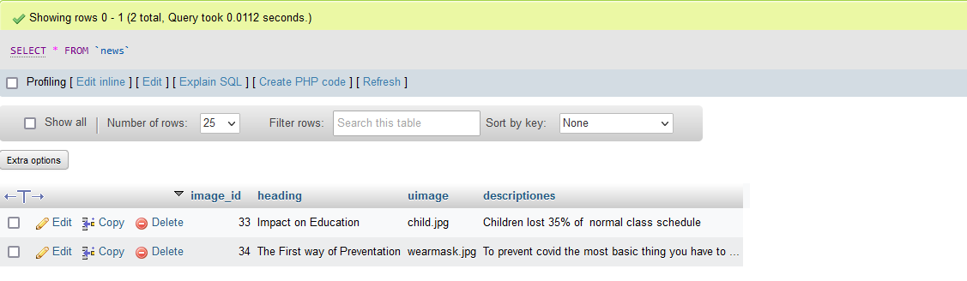

Slide 16


