Slide 1

Optimizing Big Mountain Resort
by Steven Goldsmith

Slide 2
Problem Identification
Big Mountain Resort has top-tier facilities, including 105 runs, 4 terrain parks, and a 2,353 ft vertical drop, yet charges only $81 per ticket.
Is Big Mountain Resort's ticket price consistent with its position in the market compared to other resorts or is it underpricing its tickets?
Determine how Big Mountain Resort can capitalize on its facilities to support raising ticket prices above the market average to increase revenue, and determine what features going forward they should invest in to continue this trend.
Notes:
-Address the features of Big Mountain Resort
-Expand on each step of the the problem identification.

Slide 3
Recommendation and Key Findings
Increase Ticket Prices to at least $86 season revenue increase of 8.75 million dollars
Potentially raise Prices up to $95.
season revenue increase of 24.5 million dollars
17.28% Increase
$95
11.11% increase
24.5 million
166.25 Million
$90
Key features driving ticket prices
6.17% Increase
157.5 Million
-Vertical Drop
-Number of Runs
-Total chairs/ fast quads
-Area covered with snow making machines
$86
15.75 million
Total Revenue
0 % Increase
150.5 Million
$81
8.75 million
The resort should continue
investing in these features to
further justify higher ticket prices.
141.75 Million
Notes:
Explain that the analysis and models that you will show support ticket increase to a minimum $86 with margin up to $95.
When referencing the visual on the right, explain that the ticket price is in the circles, the numbers below are the total revenue at each ticket price, the numbers above is the percentage increase in total revenue for each ticket price.

Slide 4
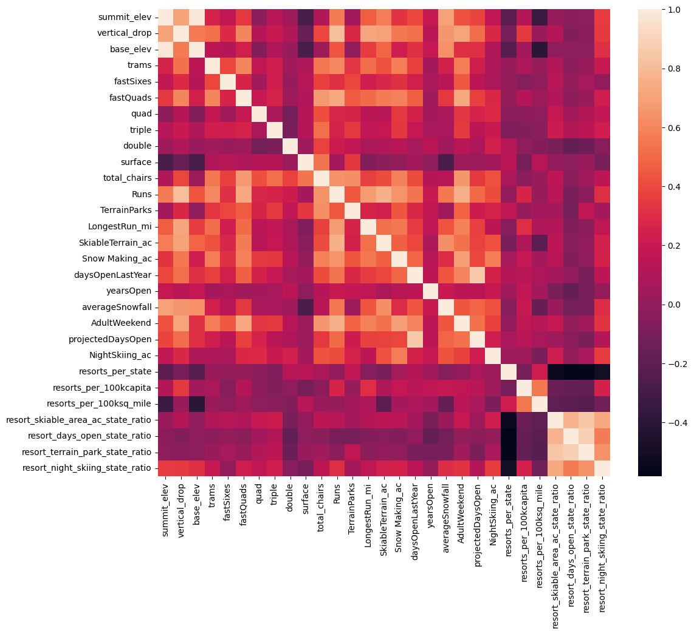
Data Analysis
Heatmap
Features most correlated to ticket price::
Vertical Drop
Number of Runs
Total chairs/ fast quads
Area covered with snow making machines
There were no meaningful patterns of ticket pricing by state.
Notes:
Reference the visual and briefly explain how the heatmap works. Point out where the should look specifically for the data points spoken about
Explain that we analyzed the data to see if the state played a role in determining ticket pricing, and we found that it did not. Favious states had both high and low ticket prices.

Slide 5
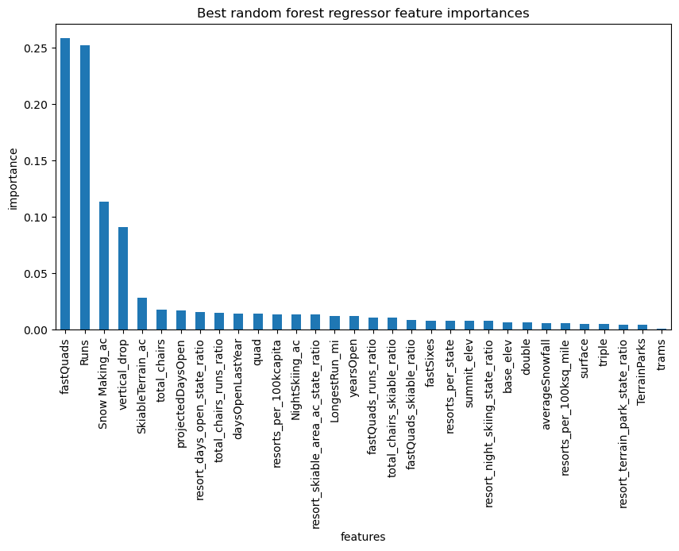
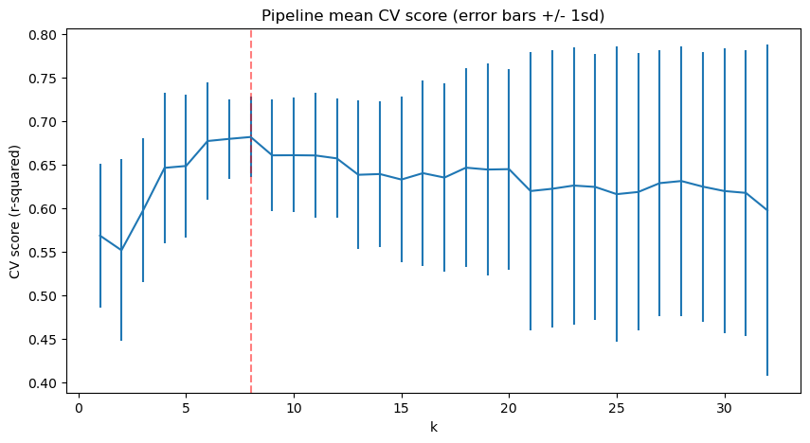
Modeling
Random Forest Regressor
Linear Regression
Feature | Coefficient
vertical_drop | 10.767857
Snow Making_ac | 6.290074
total_chairs | 5.794156
fast Quads | 5.745626
Runs | 5.370555
LongestRun_mi | 0.181814
trams | -4.142024
SkiableTerrain_ac | -5.24978
Both models reinforce the important features that we determined in the initial analysis.
Both models performed better than the baseline set using the average mean ticket price.
Random Forest performed best with a predicted ticket price of $95.87, with an MAE of $10.39
Notes:
Reference the graphs to show how they explain the important features. For Linear Regression, point out the “kbest” line, and that as you add more, there is a higher variance in model performance.
Briefly explain the MAE, and what it was for the baseline test and each model.

Slide 6
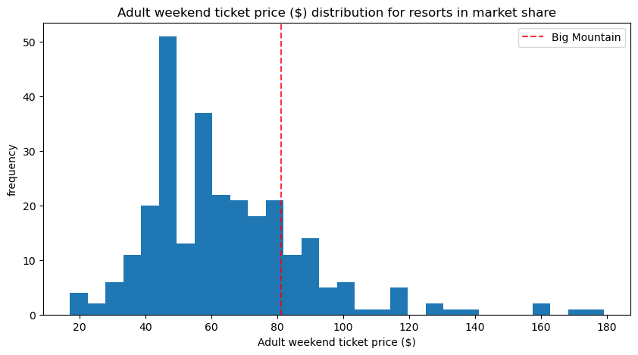
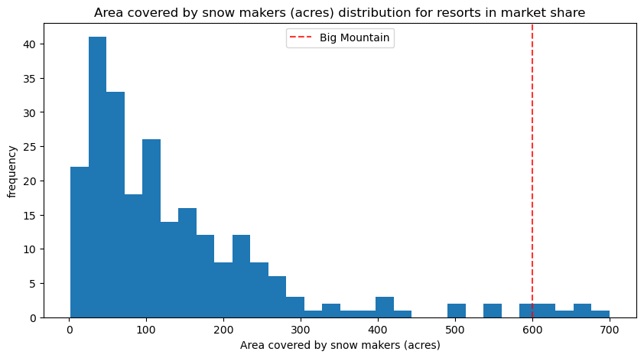
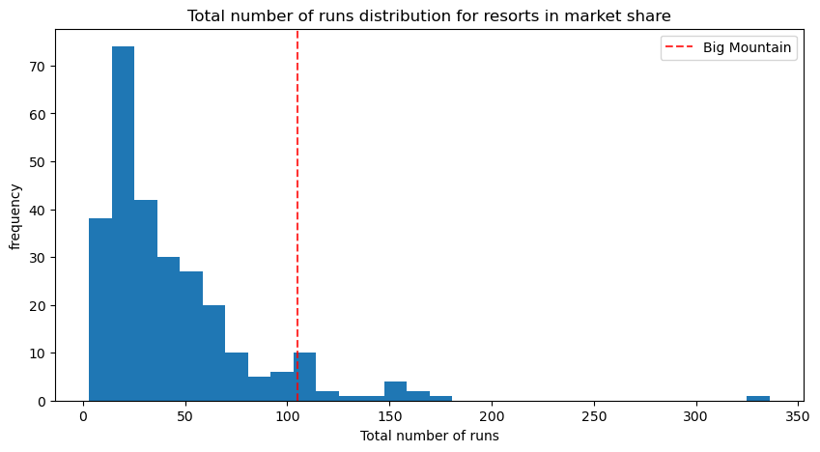
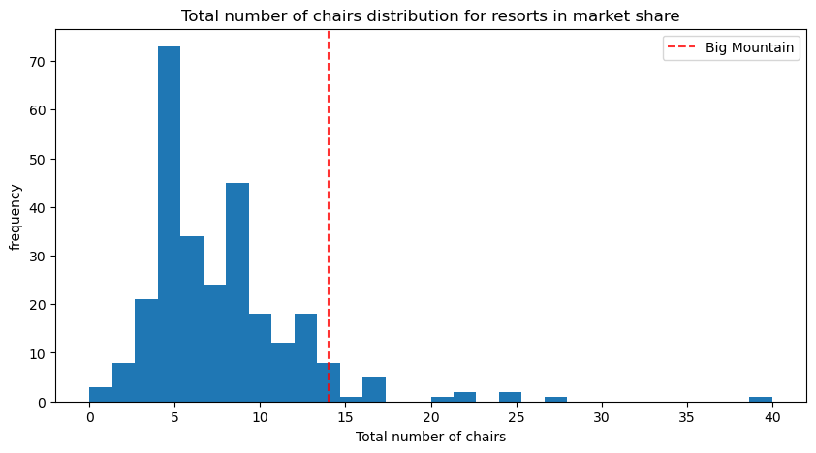
Results and Recommendations
Big Mountain Resort is at the high end in most of the major categories
Ticket price: $81
Vertical Drop: 2353 ft.
Number of Runs: 105
Total chairs: 14
Fast quads: 3
Acres covered with snow making machines: 600
Notes:
Go through each of the four top features, referencing the graphs when applicable to show that Big Mountain resort is at the top of most categories. Segue this as the justification for the significant increase the model recommends.

Slide 7
Results and Recommendations
Ticket Pricing
The current ticket price is undervaluing the resort. The resort can charge at least $86, with support for closer to $90-$95.
88 cents of the increased price will go towards covering the cost of the new lift.
Short Term Investments
Adding another run and lift to increase the vertical drop is the most advantageous option.
Doing this supports a ticket price increase of $1.99, which equals a revenue increase of $3,474,638 per season.
Long Term Investments
Continue investing in ways to increase the vertical drop, number of runs, and add more chairs.
Start tracking operating and maintenance costs for the least used runs, to see if the reduction in costs outweighs the loss of revenue for closing some of the least used runs.
Notes:
Mention the operational costs of the new lift and how ticket pricing covers it. Talk about the best shortlisted option for increasing revenue. briefly mention why the other options are not as effective.

Slide 8
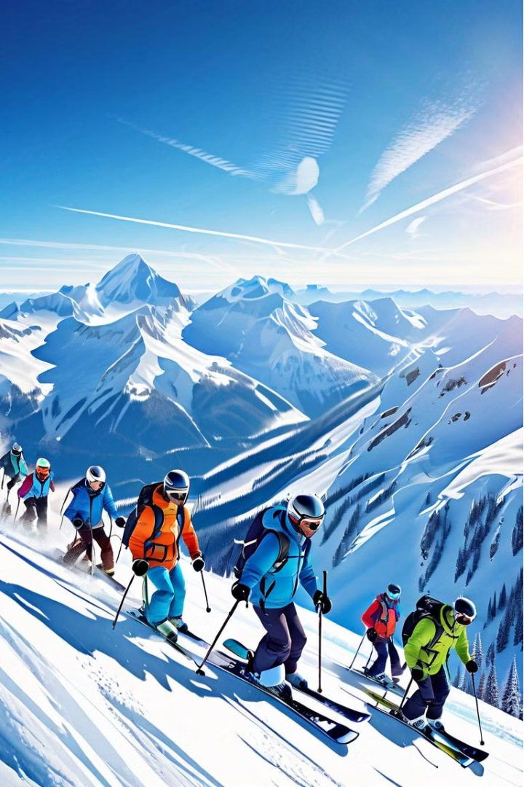
Summary and Conclusion
Big Mountain Resort is underpricing its tickets compared to similar resorts with comparable facilities. By increasing ticket prices to $86-$95.87 and investing in the vertical drop, runs, and lifts, the resort can significantly improve its profitability and long-term sustainability.

