Slide 1
Cellulase Paper: High-Res Figures

Slide 2
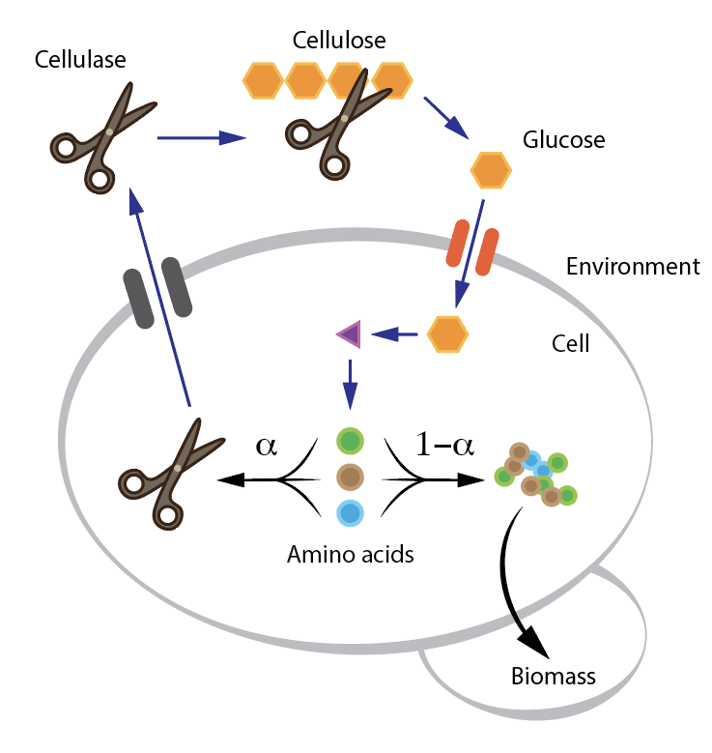
Figure 1
File: data_for_paper\figs\fig1\metabolite_network.ai, data_for_paper\figs\fig1\fig1.png
Status: complete
Generation File: non (Adobe Illustrator)
Data:
Revisions:

Slide 3
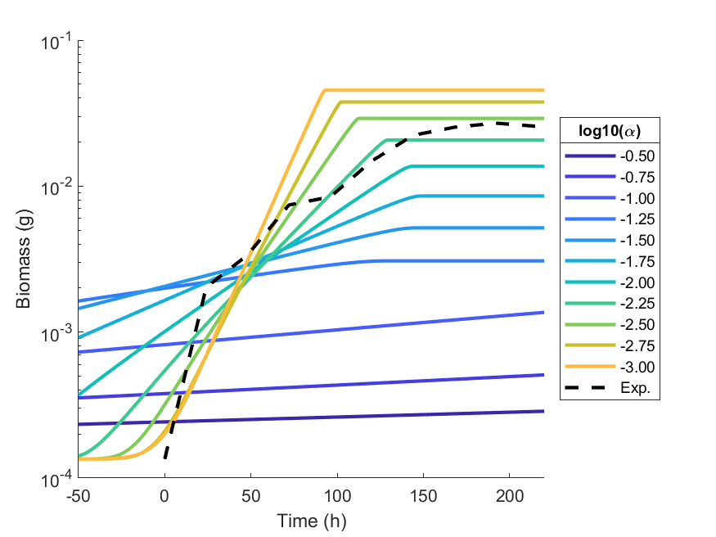
Figure 2
File: figs/fig2.* (eps/png/fig)
Status:
Generation File: Pipeline2.mlx
Data: dat2_litParams_fullCellulose_NGAM
Revisions:

Slide 4
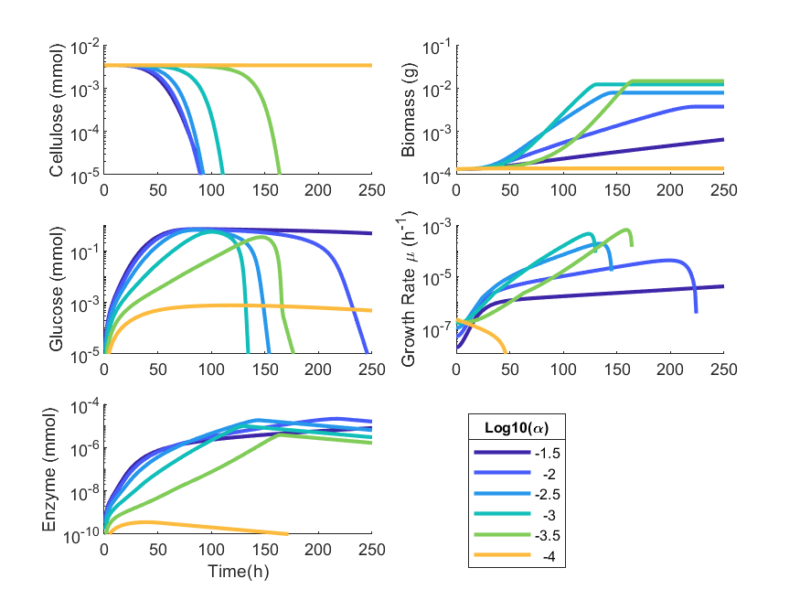
Figure 3
File: fig3/exampletimeseries.*
Status:
Generation File: plots_enzympaper1e.mlx
Data: dat3_litParams_7-1-2020
Revisions:
* Add ABCDE Labels

Slide 5
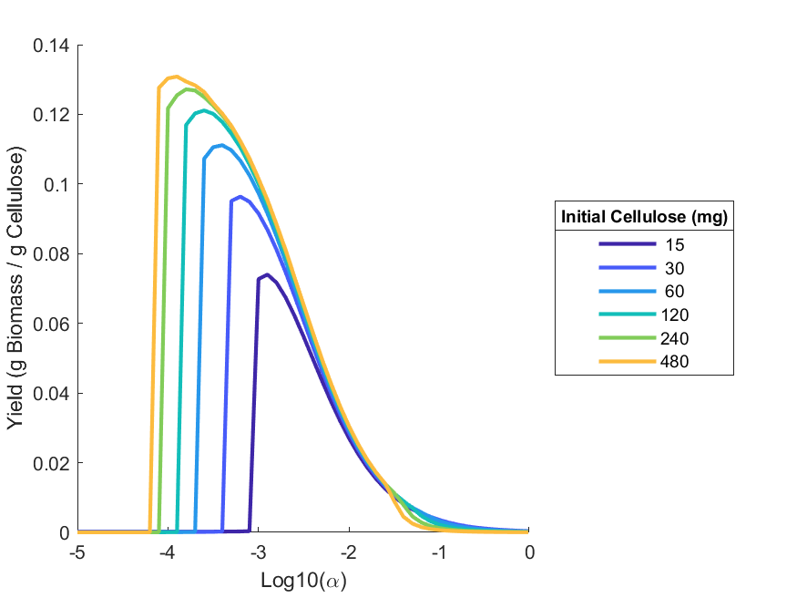
Figure 4a
File: fig4/optimal_yield.*
Status:
Generation File: pipeline3
Data: dat3_litParams_7-1-2020
Revisions:

Slide 6
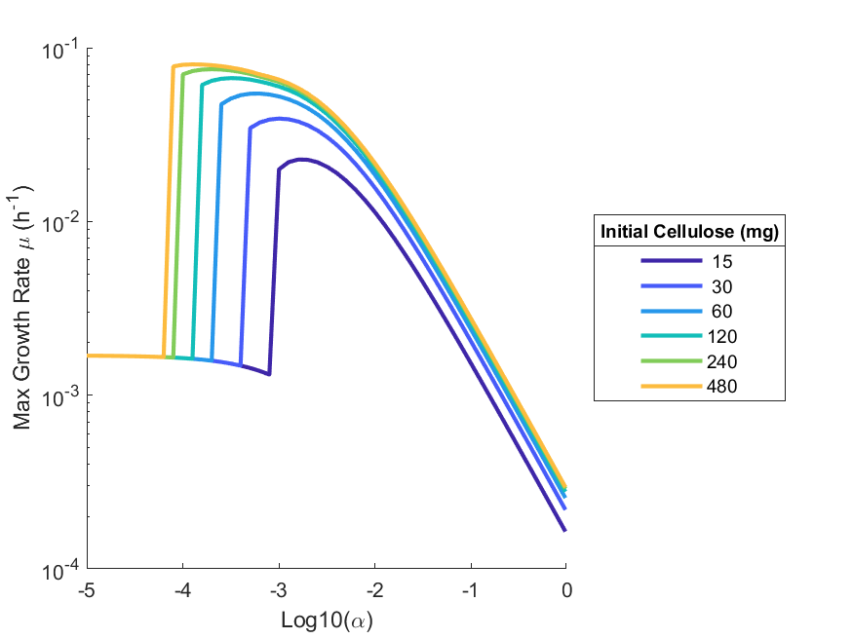
Figure 4b
File: fig4/optimal_rate.*
Status:
Generation File: pipeline3
Data: dat3_litParams_7-1-2020
Revisions:

Slide 7
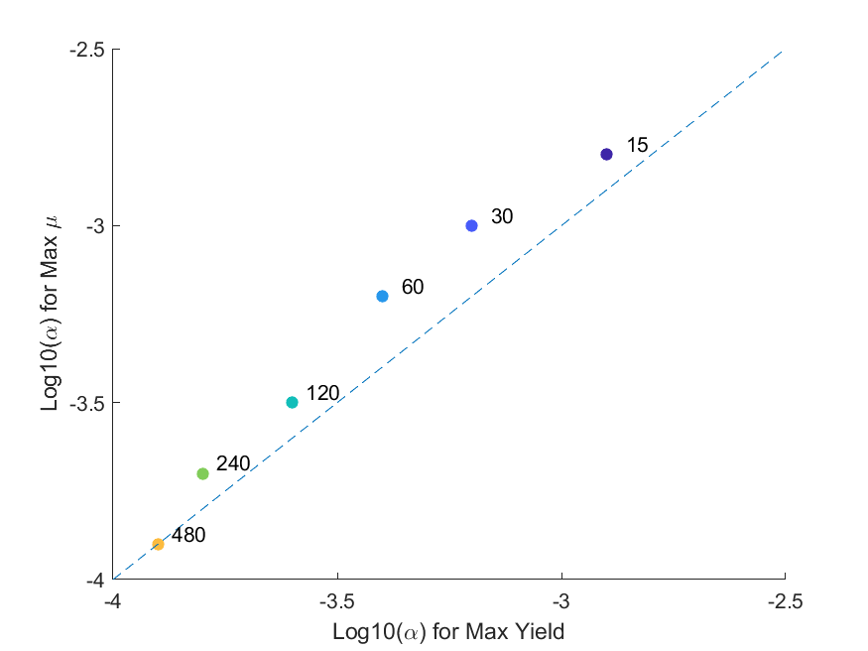
Figure 4c
File: fig4/alpha_comparison*
Status:
Generation File: pipeline3
Data: dat3_litParams_7-1-2020
Revisions:

Slide 8
Figure S1
File: figS1/decay.*
Status:
Generation File: pipeline1
Data: dat1.mat
Revisions:

Slide 9
Figure S2
File:
Status:
Generation File:
Data:
Revisions:

Slide 10
Figure S3
File:
Status:
Generation File:
Data:
Revisions:

Slide 11
Figure
File:
Status:
Generation File:
Data:
Revisions:

Slide 12
Figure
File:
Status:
Generation File:
Data:
Revisions:

Slide 13
Figure
File:
Status:
Generation File:
Data:
Revisions:

Slide 14
Figure
File:
Status:
Generation File:
Data:
Revisions:

Slide 15
Figure
File:
Status:
Generation File:
Data:
Revisions:

Slide 16
Figure
File:
Status:
Generation File:
Data:
Revisions:

