Slide 1

Marketing Research: An Applied Orientation
Seventh Edition
Chapter 16
Analysis of Variance and Covariance
Copyright © 2019, 2010, 2007 by Pearson Education, Inc. All Rights Reserved.
Notes:
If this PowerPoint presentation contains mathematical equations, you may need to check that your computer has the following installed:
1) MathType Plugin
2) Math Player (free versions available)
3) NVDA Reader (free versions available)

Slide 2
Chapter Outline (1 of 3)
Overview
Relationship Among Techniques
One-Way Analysis of Variance
Statistics Associated with One-Way Analysis of Variance
Conducting One-Way Analysis of Variance
Identification of Dependent & Independent Variables
Decomposition of the Total Variation
Measurement of Effects
Significance Testing
Interpretation of Results

Slide 3
Chapter Outline (2 of 3)
Illustrative Data
Illustrative Applications of One-Way Analysis of Variance
Assumptions in Analysis of Variance
N-Way Analysis of Variance
Analysis of Covariance
Issues in Interpretation
Interactions
Relative Importance of Factors
Multiple Comparisons
Repeated Measures ANOVA

Slide 4
Chapter Outline (3 of 3)
Nonmetric Analysis of Variance
Multivariate Analysis of Variance
Summary

Slide 5

Relationship Among Techniques (1 of 2)
Analysis of variance (ANOVA) is used as a test of means for two or more populations. The null hypothesis, typically, is that all means are equal.
Analysis of variance must have a dependent variable that is metric (measured using an interval or ratio scale).
There must also be one or more independent variables that are all categorical (nonmetric). Categorical independent variables are also called factors.

Slide 6
Relationship Among Techniques (2 of 2)
A particular combination of factor levels, or categories, is called a treatment.
One-way analysis of variance involves only one categorical variable, or a single factor. In one-way analysis of variance, a treatment is the same as a factor level.
If two or more factors are involved, the analysis is termed n-way analysis of variance.
If the set of independent variables consists of both categorical and metric variables, the technique is called analysis of covariance (ANCOVA). In this case, the categorical independent variables are still referred to as factors, whereas the metric-independent variables are referred to as covariates.

Slide 7
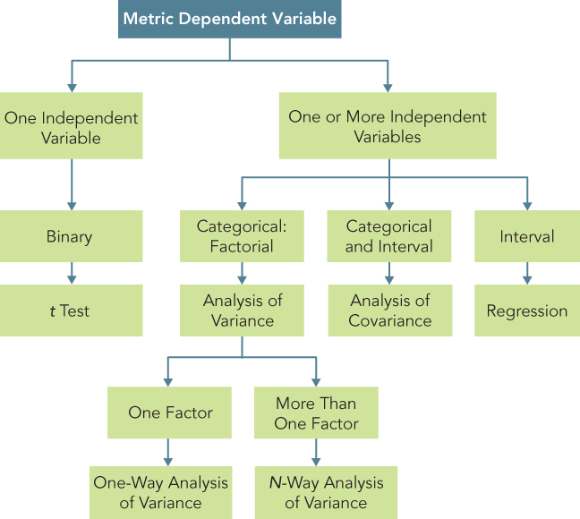
Relationship Amongst Test, Analysis of Variance, Analysis of Covariance, & Regression
Figure 16.1 Relationship Between t Test, Analysis of Variance, Analysis of Covariance, and Regression

Slide 8
One-Way Analysis of Variance
Marketing researchers are often interested in examining the differences in the mean values of the dependent variable for several categories of a single independent variable or factor. For example:
Do the various segments differ in terms of their volume of product consumption?
Do the brand evaluations of groups exposed to different commercials vary?
What is the effect of consumers' familiarity with the store (measured as high, medium, and low) on preference for the store?

Slide 9
Statistics Associated with One-Way Analysis of Variance (1 of 2)
eta² (η ²). The strength of the effects of X (independent variable or factor) on Y (dependent variable) is measured by eta² (η ²). The value of η ² varies between 0 and 1.
F statistic. The null hypothesis that the category means are equal in the population is tested by an F statistic based on the ratio of mean square related to X and mean square related to error.
Mean square. This is the sum of squares divided by the appropriate degrees of freedom.

Slide 10
Statistics Associated with One-Way Analysis of Variance (2 of 2)
SS_{between}. Also denoted as SS_{x}, this is the variation in Y related to the variation in the means of the categories of X. This represents variation between the categories of X, or the portion of the sum of squares in Y related to X.
SS_{within}. Also referred to as SS_{error}, this is the variation in Y due to the variation within each of the categories of X. This variation is not accounted for by X.
SS_{y}. This is the total variation in Y.

Slide 11
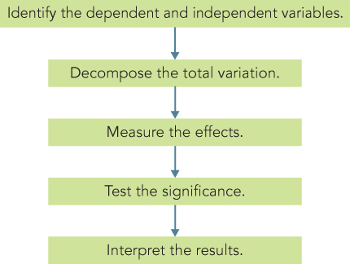
Conducting One-Way ANOVA
Figure 16.2 Conducting One-Way ANOVA

Slide 12
Conducting One-Way Analysis of Variance Decompose the Total Variation (1 of 2)
The total variation in Y, denoted by SS_{y}, can be decomposed into two components:
SS_{y} = SS_{between} + SS_{within}
where the subscripts between and within refer to the categories of X. SS_{between} is the variation in Y related to the variation in the means of the categories of X. For this reason, SS_{between} is also denoted as SS_{x}. SS_{within} is the variation in Y related to the variation within each category of X. SS_{within} is not accounted for by X. Therefore it is referred to as SS_{error}.

Slide 13
Conducting One-Way Analysis of Variance Decompose the Total Variation (2 of 2)
The total variation in Y may be decomposed as:
SS_{y} = SS_{x} + SS_{error}
Where
Y_{i} = individual observation
= mean for category j
= mean over the whole sample, or grand mean
Y_{ij} = ith observation in the jth category

Slide 14
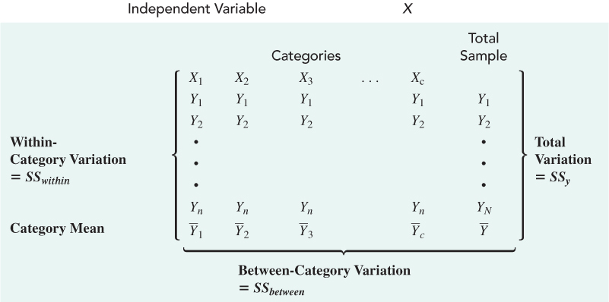
Decomposition of the Total Variation: One-Way ANOVA
Table 16.1 Decomposition of the Total Variation: One-Way ANOVA

Slide 15
Conducting One-Way Analysis of Variance
In analysis of variance, we estimate two measures of variation: within groups (SS_{within}) and between groups (SS_{between}). Thus, by comparing the Y variance estimates based on between-group and within-group variation, we can test the null hypothesis.
Measure the Effects
The strength of the effects of X on Y are measured as follows:
η ² = SS_{x}/SS_{y} = (SS_{y} − SS_{error})/SS_{y}
The value of η ² varies between 0 and 1.

Slide 16
Conducting One-Way Analysis of Variance Test Significance (1 of 2)
In one-way analysis of variance, the interest lies in testing the null hypothesis that the category means are equal in the population.
H₀: µ₁ = µ₂ = µ₃ = ........... = µ_{c}
Under the null hypothesis, SS_{x} and SS_{error} come from the same source of variation. In other words, the estimate of the population variance of Y,

Slide 17
Conducting One-Way Analysis of Variance Test Significance (2 of 2)
The null hypothesis may be tested by the F statistic based on the ratio between these two estimates:
This statistic follows the F distribution, with (c − 1) and (N − c) degrees of freedom (df).

Slide 18
Conducting One-Way Analysis of Variance Interpret the Results
If the null hypothesis of equal category means is not rejected, then the independent variable does not have a significant effect on the dependent variable.
On the other hand, if the null hypothesis is rejected, then the effect of the independent variable is significant.
A comparison of the category mean values will indicate the nature of the effect of the independent variable.

Slide 19
Illustrative Applications of One-Way Analysis of Variance
We illustrate the concepts discussed in this chapter using the data presented in Table 16.2.
The department store is attempting to determine the effect of in-store promotion (X) on sales (Y). For the purpose of illustrating hand calculations, the data of Table 16.2 are transformed in Table 16.3 to show the store sales (Y_{ij}) for each level of promotion.
The null hypothesis is that the category means are equal:
H₀: µ₁ = µ₂ = µ₃

Slide 20
Effect of Promotion and Clientele on Sales (1 of 2)
Table 16.2 Coupon Level, In-Store Promotion, Sales, and Clientele Rating
Store Number | Coupon Level | In-Store Promotion | Sales | Clientele Rating
1 | 1 | 1 | 10 | 9
2 | 1 | 1 | 9 | 10
3 | 1 | 1 | 10 | 8
4 | 1 | 1 | 8 | 4
5 | 1 | 1 | 9 | 6
6 | 1 | 2 | 8 | 8
7 | 1 | 2 | 8 | 4
8 | 1 | 2 | 7 | 10
9 | 1 | 2 | 9 | 6
10 | 1 | 2 | 6 | 9
11 | 1 | 3 | 5 | 8
12 | 1 | 3 | 7 | 9
13 | 1 | 3 | 6 | 6
14 | 1 | 3 | 4 | 10
15 | 1 | 3 | 5 | 4

Slide 21
Effect of Promotion and Clientele on Sales (2 of 2)
[Table 16.2 Continued]
Store Number | Coupon Level | In-Store Promotion | Sales | Clientele Rating
16 | 2 | 1 | 8 | 10
17 | 2 | 1 | 9 | 6
18 | 2 | 1 | 7 | 8
19 | 2 | 1 | 7 | 4
20 | 2 | 1 | 6 | 9
21 | 2 | 2 | 4 | 6
22 | 2 | 2 | 5 | 8
23 | 2 | 2 | 5 | 10
24 | 2 | 2 | 6 | 4
25 | 2 | 2 | 4 | 9
26 | 2 | 3 | 2 | 4
27 | 2 | 3 | 3 | 6
28 | 2 | 3 | 2 | 10
29 | 2 | 3 | 1 | 9
30 | 2 | 3 | 2 | 8

Slide 22
Illustrative Applications of One-Way Analysis of Variance (1 of 7)
Table 16.3 Effect of In-Store Promotion on Sales
Blank | Blank | Level of In-Store Promotion | Blank
Store No. | High | Medium | Low
Blank | Blank | Normalized Sales | Blank
1 | 10 | 8 | 5
2 | 9 | 8 | 7
3 | 10 | 7 | 6
4 | 8 | 9 | 4
5 | 9 | 6 | 5
6 | 8 | 4 | 2
7 | 9 | 5 | 3
8 | 7 | 5 | 2
9 | 7 | 6 | 1
10 | 6 | 4 | 2
Column totals | 83 | 62 | 37
Category means: | 83 / 10 = 8.3 | 62 / 10 = 6.2 | 37 / 10 = 3.7
Grand mean, | Blank | = (83+62+37) / 30 = 6.067 | Blank

Slide 23
Illustrative Applications of One-Way Analysis of Variance (2 of 7)
To test the null hypothesis, the various sums of squares are computed as follows:
SS_{y} = (10−6.067)² + (9−6.067)² + (10−6.067)² + (8−6.067)² + (9−6.067)²
+ (8−6.067)² + (9−6.067)² + (7−6.067)² + (7−6.067)² + (6−6.067)²
+ (8−6.067)² + (8−6.067)² + (7−6.067)² + (9−6.067)² + (6−6.067)²
(4−6.067)² + (5−6.067)² + (5−6.067)² + (6−6.067)² + (4−6.067)²
+ (5−6.067)² + (7−6.067)² + (6−6.067)² + (4−6.067)² + (5−6.067)²
+ (2−6.067)² + (3−6.067)² + (2−6.067)² + (1−6.067)² + (2−6.067)²
= (3.933)² + (2.933)² + (3.933)² + (1.933)² + (2.933)²
+ (1.933)² + (2.933)² + (0.933)² + (0.933)² + (−0.067)²
+ (1.933)² + (1.933)² + (0.933)² + (2.933)² + (−0.067)²
(−2.067)² + (−1.067)² + (−1.067)² + (−0.067)² + (−2.067)²
+ (−1.067)² + (0.9333)² + (−0.067)² + (−2.067)² + (−1.067)²
+ (−4.067)² + (−3.067)² + (−4.067)² + (−5.067)² + (−4.067)²
= 185.867

Slide 24
Illustrative Applications of One-Way Analysis of Variance (3 of 7)
SS_{x} = 10(8.3−6.067)² + 10(6.2−6.067)² + 10(3.7−6.067)²
= 10(2.233)² + 10(0.133)² + 10(−2.367)²
= 106.067
SS_{error} = (10−8.3)² + (9−8.3)² + (10−8.3)² + (8−8.3)² + (9−8.3)²
+ (8−8.3)² + (9−8.3)² + (7−8.3)² + (7−8.3)² + (6−8.3)²
+ (8−6.2)² + (8−6.2)² + (7−6.2)² + (9−6.2)² + (6−6.2)²
+ (4−6.2)² + (5−6.2)² + (5−6.2)² + (6−6.2)² + (4−6.2)²
+ (5−3.7)² + (7−3.7)² + (6−3.7)² + (4−3.7)² + (5−3.7)²
+ (2−3.7)² + (3−3.7)² + (2−3.7)² + (1−3.7)² + (2−3.7)²

Slide 25
Illustrative Applications of One-Way Analysis of Variance (4 of 7)
= (1.7)² + (0.7)² + (1.7)² + (−0.3)² + (0.7)²
+ (−0.3)² + (0.7)² + (−1.3)² + (−1.3)² + (−2.3)²
+ (1.8)² + (1.8)² + (0.8)² + (2.8)² + (−0.2)²
+ (−2.2)² + (−1.2)² + (−1.2)² + (−0.2)² + (−2.2)²
+ (1.3)² + (3.3)² + (2.3)² + (0.3)² + (1.3)²
+ (−1.7)² + (−0.7)² + (−1.7)² + (−2.7)² + (−1.7)²
= 79.80

Slide 26
Illustrative Applications of One-Way Analysis of Variance (5 of 7)
It can be verified that
SSy = SSx + SSerror
as follows:
185.867 = 106.067 +79.80
The strength of the effects of X on Y are measured as follows:
η ² = SSx/SSy
= 106.067/185.867
= 0.571

Slide 27
Illustrative Applications of One-Way Analysis of Variance (6 of 7)
In other words, 57.1% of the variation in sales (Y) is accounted for by in-store promotion (X), indicating a modest effect. The null hypothesis may now be tested.

Slide 28
Illustrative Applications of One-Way Analysis of Variance (7 of 7)
From Table 5 in the Statistical Appendix we see that for 2 and 27 degrees of freedom, the critical value of F is 3.35 for α = 0.05. Because the calculated value of F is greater than the critical value, we reject the null hypothesis.
We now illustrate the analysis of variance procedure using a computer program. The results of conducting the same analysis by computer are presented in Table 16.4.

Slide 29
One-Way ANOVA: Effect of In-Store Promotion on Store Sales
Table 16.4 One-Way ANOVA: Effect of In-Store Promotion on Store Sales
Source of Variation | Sum of Squares | df | Mean Square | F Ratio | F Prob.
Between groups (In-store promotion) | 106.067 | 2 | 53.033 | 17.944 | 0.000
Within groups (Error) | 79.800 | 27 | 2.956 | Blank | Blank
TOTAL | 185.867 | 29 | 6.409 | Blank | Blank
Cell Means Level of In-store Promotion | Count | Mean
High (1) | 10 | 8.300
Medium (2) | 10 | 6.200
Low (3) | 10 | 3.700
TOTAL | 30 | 6.067

Slide 30
Assumptions in Analysis of Variance
The salient assumptions in analysis of variance can be summarized as follows:
Ordinarily, the categories of the independent variable are assumed to be fixed. Inferences are made only to the specific categories considered. This is referred to as the fixed-effects model.
The error term is normally distributed, with a zero mean and a constant variance. The error is not related to any of the categories of X.
The error terms are uncorrelated. If the error terms are correlated (i.e., the observations are not independent), the F ratio can be seriously distorted.

Slide 31
N-Way Analysis of Variance (1 of 5)
In marketing research, one is often concerned with the effect of more than one factor simultaneously. For example:
How do advertising levels (high, medium, and low) interact with price levels (high, medium, and low) to influence a brand's sale?
Do educational levels (less than high school, high school graduate, some college, and college graduate) and age (less than 35, 35-55, more than 55) affect consumption of a brand?
What is the effect of consumers' familiarity with a department store (high, medium, and low) and store image (positive, neutral, and negative) on preference for the store?

Slide 32
N-Way Analysis of Variance (2 of 5)
Consider the simple case of two factors X₁ and X₂ having categories c₁ and c₂. The total variation in this case is partitioned as follows:
SS_{total} = SS due to X₁ + SS due to X₂ + SS due to interaction of X₁ and X₂ + SS_{within}
or
SS_{y} = SS_{x1} + SS_{x2} + SS_{x1x2} + SS_{error}
The strength of the joint effect of two factors, called the overall effect, or multiple η ², is measured as follows:
multiple η ² = (SS_{x1} + SS_{x2} + SS_{x1x2}) / SS_{y}

Slide 33
N-Way Analysis of Variance (3 of 5)
The significance of the overall effect may be tested by an F test, as follows:
where
df_{n} = degrees of freedom for the numerator
= (c₁ − 1) + (c₂ − 1) + (c₁ − 1) (c₂ − 1)
= c₁c₂ − 1
df_{d} = degrees of freedom for the denominator
= N − c₁c₂
MS = mean square

Slide 34
N-Way Analysis of Variance (4 of 5)
If the overall effect is significant, the next step is to examine the significance of the interaction effect. Under the null hypothesis of no interaction, the appropriate F test is:
Where
df_{n} = (c₁ − 1) (c₂ − 1)
df_{d} = N − c₁c₂

Slide 35
N-Way Analysis of Variance (5 of 5)
The significance of the main effect of each factor may be tested as follows for X₁:
Where
df_{n} = c₁ − 1
df_{d} = N − c₁c₂

Slide 36
Two-Way Analysis of Variance (1 of 2)
Table 16.5 Two-Way Analysis of Variance
Source of Variation | Sum of squares | df | Mean square | F | Sig. of F | ω²
Main Effects | Blank | Blank | Blank | Blank | Blank | Blank
In-store promotion | 106.067 | 2 | 53.033 | 54.862 | 0.000 | 0.557
Coupon | 53.333 | 1 | 53.333 | 55.172 | 0.000 | 0.280
Combined | 159.400 | 3 | 53.133 | 54.966 | 0.000 | Blank
Two-way interaction | 3.267 | 2 | 1.633 | 1.690 | 0.206 | Blank
Model | 162.667 | 5 | 32.533 | 33.655 | 0.000 | Blank
Residual (Error) | 23.200 | 24 | 0.967 | Blank | Blank | Blank
TOTAL | 185.867 | 29 | 6.409 | Blank | Blank | Blank

Slide 37
Two-Way Analysis of Variance (2 of 2)
[Table 16.5 Continued]
Cell Means In-store Promotion | Coupon | Count | Mean
High | Yes | 5 | 9.200
High | No | 5 | 7.400
Medium | Yes | 5 | 7.600
Medium | No | 5 | 4.800
Low | Yes | 5 | 5.400
Low | No | 5 | 2.000
Factor Level Means Promotion | Coupon | Count | Mean
High | Blank | 10 | 8.300
Medium | Blank | 10 | 6.200
Low | Blank | 10 | 3.700
Blank | Yes | 15 | 7.400
Blank | No | 15 | 4.733
Grand Mean | Blank | 30 | 6.067

Slide 38
Analysis of Covariance (1 of 2)
When examining the differences in the mean values of the dependent variable related to the effect of the controlled independent variables, it is often necessary to take into account the influence of uncontrolled independent variables. For example:
In determining how different groups exposed to different commercials evaluate a brand, it may be necessary to control for prior knowledge.
In determining how different price levels will affect a household's cereal consumption, it may be essential to take household size into account. We again use the data of Table 16.2 to illustrate analysis of covariance.
Suppose that we wanted to determine the effect of in-store promotion and couponing on sales while controlling for the effect of clientele. The results are shown in Table 16.6.

Slide 39
Analysis of Covariance (2 of 2)
Table 16.6 Analysis of Covariance
Source of Variation | Sum of Squares | df | Mean Square | F | Sig. of F
Covariates | Blank | Blank | Blank | Blank | Blank
Clientele | 0.838 | 1 | 0.838 | 0.862 | 0.363
Main effects | Blank | Blank | Blank | Blank | Blank
Promotion | 106.067 | 2 | 53.033 | 54.546 | 0.000
Coupon | 53.333 | 1 | 53.333 | 54.855 | 0.000
Combined | 159.400 | 3 | 53.133 | 54.649 | 0.000
2-way interaction | Blank | Blank | Blank | Blank | Blank
Promotion × coupon | 3.267 | 2 | 1.633 | 1.680 | 0.208
Model | 163.505 | 6 | 27.251 | 28.028 | 0.000
Residual (error) | 22.362 | 23 | 0.972 | Blank | Blank
TOTAL | 185.867 | 29 | 6.409 | Blank | Blank
Covariate | Raw coefficient | Blank | Blank | Blank | Blank
Clientele | −0.078 | Blank | Blank | Blank | Blank

Slide 40
Issues in Interpretation
Important issues involved in the interpretation of ANOVA
results include interactions, relative importance of factors, and multiple comparisons.
Interactions
The different interactions that can arise when conducting ANOVA on two or more factors are shown in Figure 16.3.
Relative Importance of Factors
Experimental designs are usually balanced, in that each cell contains the same number of respondents. This results in an orthogonal design in which the factors are uncorrelated. Hence, it is possible to determine unambiguously the relative importance of each factor in explaining the variation in the dependent variable.

Slide 41
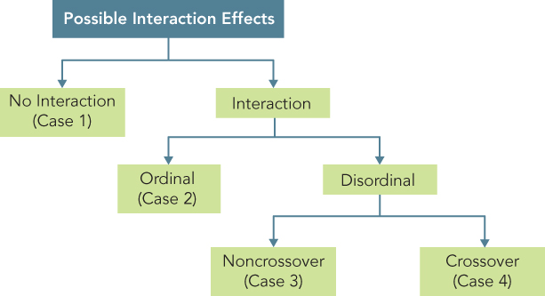
A Classification of Interaction Effects
Figure 16.3 A Classification of Interaction Effects

Slide 42
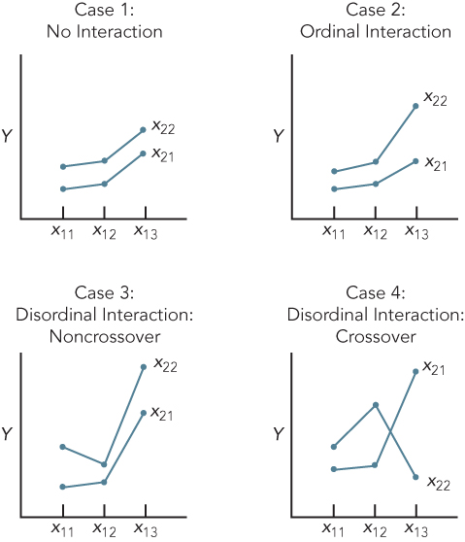
Patterns of Interaction
Figure 16.4 Patterns of Interaction

Slide 43
Issues in Interpretation (1 of 2)
The most commonly used measure in ANOVA is omega squared, ω². This measure indicates what proportion of the variation in the dependent variable is related to a particular independent variable or factor. The relative contribution of a factor X is calculated as follows:
Normally, ω² is interpreted only for statistically significant effects. In Table 16.5, ω² associated with the level of in-store promotion is calculated as follows:

Slide 44
Issues in Interpretation (2 of 2)
Note, in Table 16.5, that
SS_{total} = 106.067 + 53.333 + 3.267 + 23.2
= 185.867
Likewise, the ω² associated with couponing is:
As a guide to interpreting, a large experimental effect produces an index of 0.15 or greater, a medium effect produces an index of around 0.06, and a small effect produces an index of 0.01. In Table 16.5, while the effect of promotion and couponing are both large, the effect of promotion is much larger.

Slide 45
Issues in Interpretation - Multiple Comparisons (1 of 2)
If the null hypothesis of equal means is rejected, we can only conclude that not all of the group means are equal. We may wish to examine differences among specific means. This can be done by specifying appropriate contrasts, or comparisons used to determine which of the means are statistically different.
A priori contrasts are determined before conducting the analysis, based on the researcher's theoretical framework. Generally, a priori contrasts are used in lieu of the ANOVA F test. The contrasts selected are orthogonal (they are independent in a statistical sense).

Slide 46
Issues in Interpretation - Multiple Comparisons (2 of 2)
A posteriori contrasts are made after the analysis. These are generally multiple comparison tests. They enable the researcher to construct generalized confidence intervals that can be used to make pairwise comparisons of all treatment means. These tests, listed in order of decreasing power, include least significant difference, Duncan's multiple range test, Student-Newman-Keuls, Tukey's alternate procedure, honestly significant difference, modified least significant difference, and Scheffe's test. Of these tests, least significant difference is the most powerful, Scheffe's the most conservative.

Slide 47
Repeated Measures ANOVA
One way of controlling the differences between subjects is by observing each subject under each experimental condition (see Table 16.7). Since repeated measurements are obtained from each respondent, this design is referred to as within-subjects design or repeated measures analysis of variance. Repeated measures analysis of variance may be thought of as an extension of the paired-samples t test to the case of more than two related samples.

Slide 48
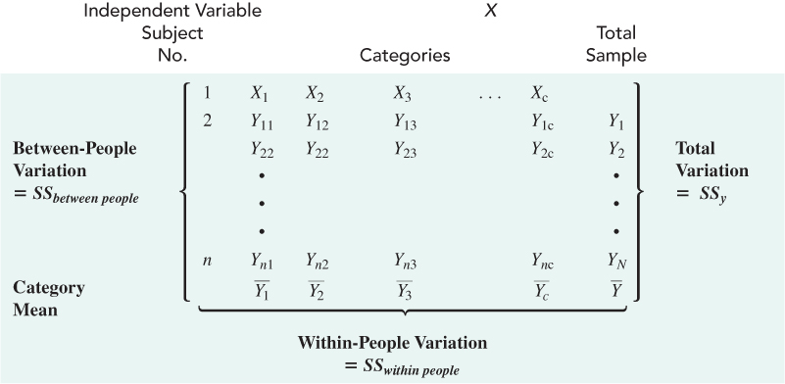
Decomposition of the Total Variation: Repeated Measures ANOVA
Table 16.7 Decomposition of the Total Variation: Repeated Measures of ANOVA

Slide 49
Repeated Measures ANOVA (1 of 2)
In the case of a single factor with repeated measures, the total variation, with nc − 1 degrees of freedom, may be split into between-people variation and within-people variation.
SS_{total} = SS_{between people} + SS_{within people}
The between-people variation, which is related to the differences between the means of people, has n − 1 degrees of freedom. The within-people variation has n (c − 1) degrees of freedom. The within-people variation may, in turn, be divided into two different sources of variation. One source is related to the differences between treatment means, and the second consists of residual or error variation. The degrees of freedom corresponding to the treatment variation are c − 1, and those corresponding to residual variation are (c − 1) (n − 1).

Slide 50
Repeated Measures ANOVA (2 of 2)
Thus,
SS_{within people} = SS_{x} + SS_{error}
A test of the null hypothesis of equal means may now be constructed in the usual way:
So far we have assumed that the dependent variable is measured on an interval or ratio scale. If the dependent variable is nonmetric, however, a different procedure should be used.

Slide 51
Nonmetric Analysis of Variance (1 of 2)
Nonmetric analysis of variance examines the difference in the central tendencies of more than two groups when the dependent variable is measured on an ordinal scale.
One such procedure is the k-sample median test. As its name implies, this is an extension of the median test for two groups, which was considered in Chapter 15.

Slide 52
Nonmetric Analysis of Variance (2 of 2)
A more powerful test is the Kruskal-Wallis one-way analysis of variance. This is an extension of the Mann-Whitney test (Chapter 15). This test also examines the difference in medians. All cases from the k groups are ordered in a single ranking. If the k populations are the same, the groups should be similar in terms of ranks within each group. The rank sum is calculated for each group. From these, the Kruskal-Wallis H statistic, which has a chi-square distribution, is computed.
The Kruskal-Wallis test is more powerful than the k-sample median test as it uses the rank value of each case, not merely its location relative to the median. However, if there are a large number of tied rankings in the data, the k-sample median test may be a better choice.

Slide 53
Multivariate Analysis of Variance
Multivariate analysis of variance (MANOVA) is similar to analysis of variance (ANOVA), except that instead of one metric dependent variable, we have two or more.
In MANOVA, the null hypothesis is that the vectors of means on multiple dependent variables are equal across groups.
Multivariate analysis of variance is appropriate when there are two or more dependent variables that are correlated.

Slide 54
SPSS Windows
One-way ANOVA can be efficiently performed using the program COMPARE MEANS and then One-way ANOVA. To select this procedure using SPSS for Windows, click:
Analyze>Compare Means>One-Way ANOVA …
N-way analysis of variance and analysis of covariance can be performed using GENERAL LINEAR MODEL. To select this procedure using SPSS for Windows, click:
Analyze>General Linear Model>Univariate …

Slide 55
SPSS Windows: One-Way ANOVA
Select ANALYZE from the SPSS menu bar.
Click COMPARE MEANS and then ONE-WAY ANOVA.
Move “Sales [sales]” in to the DEPENDENT LIST box.
Move “In-Store Promotion[promotion]” to the FACTOR box.
Click OPTIONS.
Click Descriptive.
Click CONTINUE.
Click OK.

Slide 56
SPSS Windows: Analysis of Covariance
Select ANALYZE from the SPSS menu bar.
Click GENERAL LINEAR MODEL and then UNIVARIATE.
Move “Sales [sales]” in to the DEPENDENT VARIABLE box.
Move “In-Store Promotion[promotion]” to the FIXED FACTOR(S) box. Then move “Coupon[coupon]” also to the FIXED FACTOR(S) box.
Move “Clientel[clientel]” to the COVARIATE(S) box.
Click OK.

Slide 57
SAS Enterprise Guide
One-way ANOVA can be efficiently performed using One-Way ANOVA within the ANOVA task. To select this task, click:
Analyze>ANOVA>One-Way ANOVA
N-way analysis of variance, analysis of covariance, MANOVA, and repeated measures ANOVA can be performed using Linear Models within the ANOVA task. To select this task, click:
Analyze>ANOVA>Linear Models

Slide 58
SAS Enterprise Guide: One-Way ANOVA
Open SAS Table_16_2 using SAS Enterprise Guide.
Select ANALYZE from the menu bar.
Click ANOVA and then One-Way ANOVA.
Move SALES to the DEPENDENT variable task role.
Move PROMOTION to the INDEPENDENT variable task role.
Click RUN.

Slide 59
SAS Enterprise Guide: Analysis of Covariance
Open SAS Table_16_2 using SAS Enterprise Guide.
Select ANALYZE from the menu bar.
Click ANOVA and then Linear Models.
Move SALES to the DEPENDENT variable task role.
Move PROMOTION and COUPON to the QUANTITATIVE variables task role.
Move CLIENTEL to the CLASSIFICATION variable task role.
Click Model in the box to the left.
Select PROMOTION and COUPON and then click Main.
Select PROMOTION and COUPON and then click Cross.
Click RUN.

Slide 60

Copyright

