Slide 1
Optimizing Term Deposit
Marketing Campaigns
For a European Retail Bank
Colin Segura . Springboard Data Science Career Track . Capstone Three Final Presentation

Slide 2
THE PROBLEM
Every call that does not convert still costs money
A Portuguese retail bank runs phone campaigns to convert existing customers into term deposit holders. The baseline conversion rate is roughly 11 to 16 percent.
The other 85 percent of calls still cost agent time, telephony, and operational overhead. For every subscription, five or more calls are effectively wasted.
Business question: can we predict who is likely to say yes before dialing, and rank the base so the call center works high-propensity customers first?
SUCCESS CRITERIA
. Model beats baselines by a comfortable margin on cross-validated ROC AUC
. Delivers 2x or better conversion lift at the top of the ranked list
. Produces interpretable feature importance for marketing stakeholders
5.3:1
The ratio of non-subscribers to subscribers
in every current campaign

Slide 3
WHO BENEFITS AND WHAT LIMITS US
Three stakeholders, four honest constraints
$
@
%
Marketing analytics
Call center ops
Finance
Owns the targeting logic
Dials the list
Owns the ROI number
Needs a ranked prospect list to feed the next campaign.
Agent capacity is finite. Every low-propensity call is a lost opportunity.
Needs to defend marketing spend to the executive team.
FOUR HONEST CONSTRAINTS
Data vintage: 2008-2010 covers the financial crisis but is 15+ years old
Class imbalance: 5.3 to 1 rules out accuracy as a metric
No CRM depth: No balances, no transactions, no internal customer history
Time budget: 80 to 120 hours across wrangling, EDA, modeling, reporting

Slide 4
FORMULATION
A supervised binary classification problem
The task
EVALUATION METRICS
Given customer attributes known before the call, predict a probability that the customer will subscribe to a term deposit. Rank the base by that probability, cut at a threshold the call center can staff.
PRIMARY, CV
Threshold invariant, robust to class imbalance. Average of 3-fold stratified CV scores on training set.
ROC AUC
TEST SET
Why not plain accuracy?
More informative than ROC AUC for rare positive classes. Reported on held-out test set.
PR AUC
With a 15.8 percent positive rate, a model that always says no scores 84 percent accuracy and is useless to the business. We need metrics that measure ranking quality on imbalanced data.
BUSINESS
What fraction of the top-k ranked customers actually subscribe. The number marketers care about.
Precision at top-k
Why not time series?
BUSINESS
Each row is one customer being contacted once. There is no dependency between rows a random split would break. Macroeconomic features already capture the when.
Dollars at optimal threshold given cost per call and revenue per subscription assumptions.
Expected profit

Slide 5
THE DATASET
UCI Bank Marketing (Moro, Cortez and Rita, 2014)
41,188
20
45
15.8%
RECORDS
FEATURES
MONTHS COVERED
POSITIVE RATE
THREE FEATURE GROUPS
Client attributes
Campaign attributes
Macroeconomic context
age, occupation, marital, education, credit/loan status
contact channel, month, day, prior contact history
euribor3m, emp.var.rate, consumer price and confidence indices

Slide 6
DATA WRANGLING
41,211 raw rows into 41,188 cleaned rows
'unknown' to NaN
pdays = 999 recoded
Six categorical columns use 'unknown' as a missing sentinel. Converted to true NaN, with indicator flags for default (21%) and education (4%).
The value 999 encodes 'never previously contacted'. Preserved via was_contacted_before indicator; numeric column is median imputed.
Dropped call duration
Removed 23 duplicates
A zero-second call implies 'no' by definition. The feature leaks the outcome and cannot be used before the call is placed.
Exact duplicate rows from source system re-exports. These are system artifacts, not real second observations.
Target encoded 0/1
Calendar order
The 'yes'/'no' string target was encoded numerically for all downstream modeling tools.
Month and day_of_week converted to ordered categoricals so charts and tree models render them chronologically.
KEY TAKEAWAY . Dropping the leaky call duration feature was the single most consequential wrangling decision

Slide 7
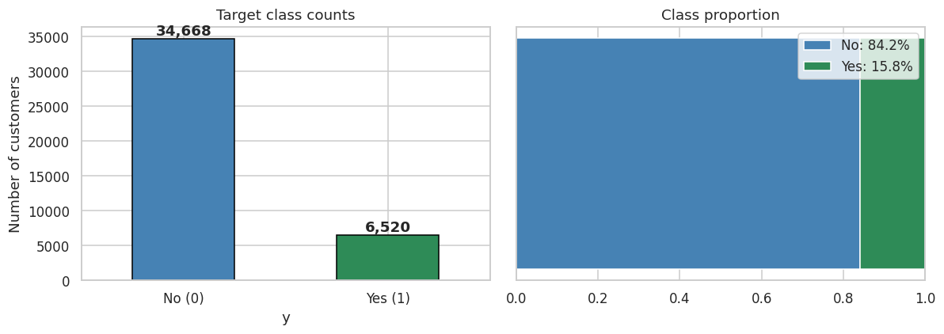
EDA . TARGET
The target is imbalanced at 5.3 to 1
15.8%
POSITIVE RATE
5.3:1
IMBALANCE
41.2K
TOTAL ROWS
TAKEAWAY . Class imbalance rules out plain accuracy. ROC AUC, PR AUC, and precision at top-k are the metrics that matter.

Slide 8
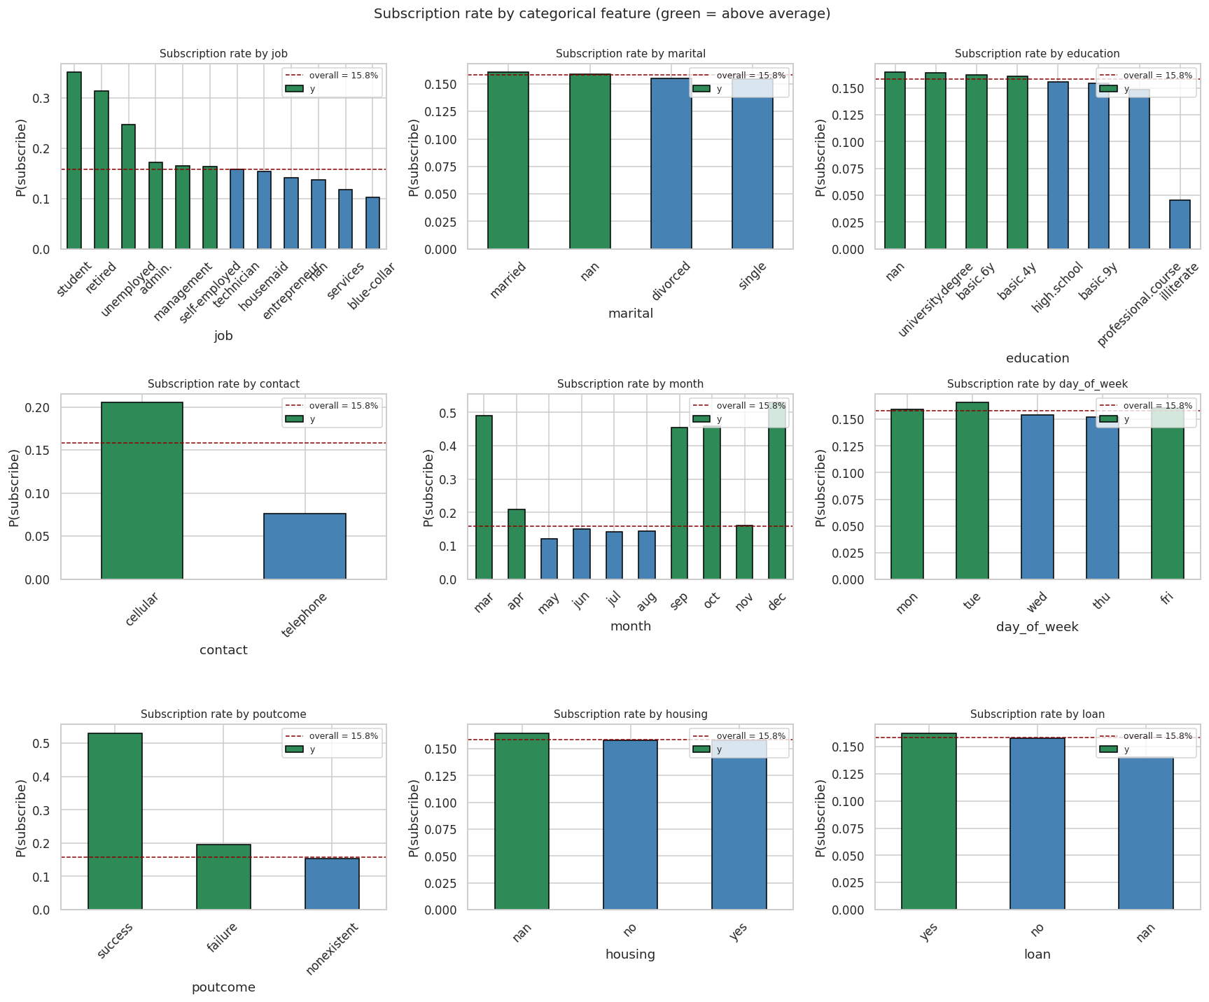
EDA . THE HEADLINE CHART
Four categorical features drive almost all the signal
WHAT TO SEE
2.7x
Contact
Cellular (20.5%) vs telephone (7.6%). The single most actionable lever.
4.4x
Month
Dec/Mar/Sep/Oct convert 45-53%, versus May at just 12%.
3.4x
Job
Students (35%), retired (31%), unemployed (25%). Blue collar at 10%.
3.5x
Poutcome
Prior success converts 53% versus 15% for no prior contact.

Slide 9
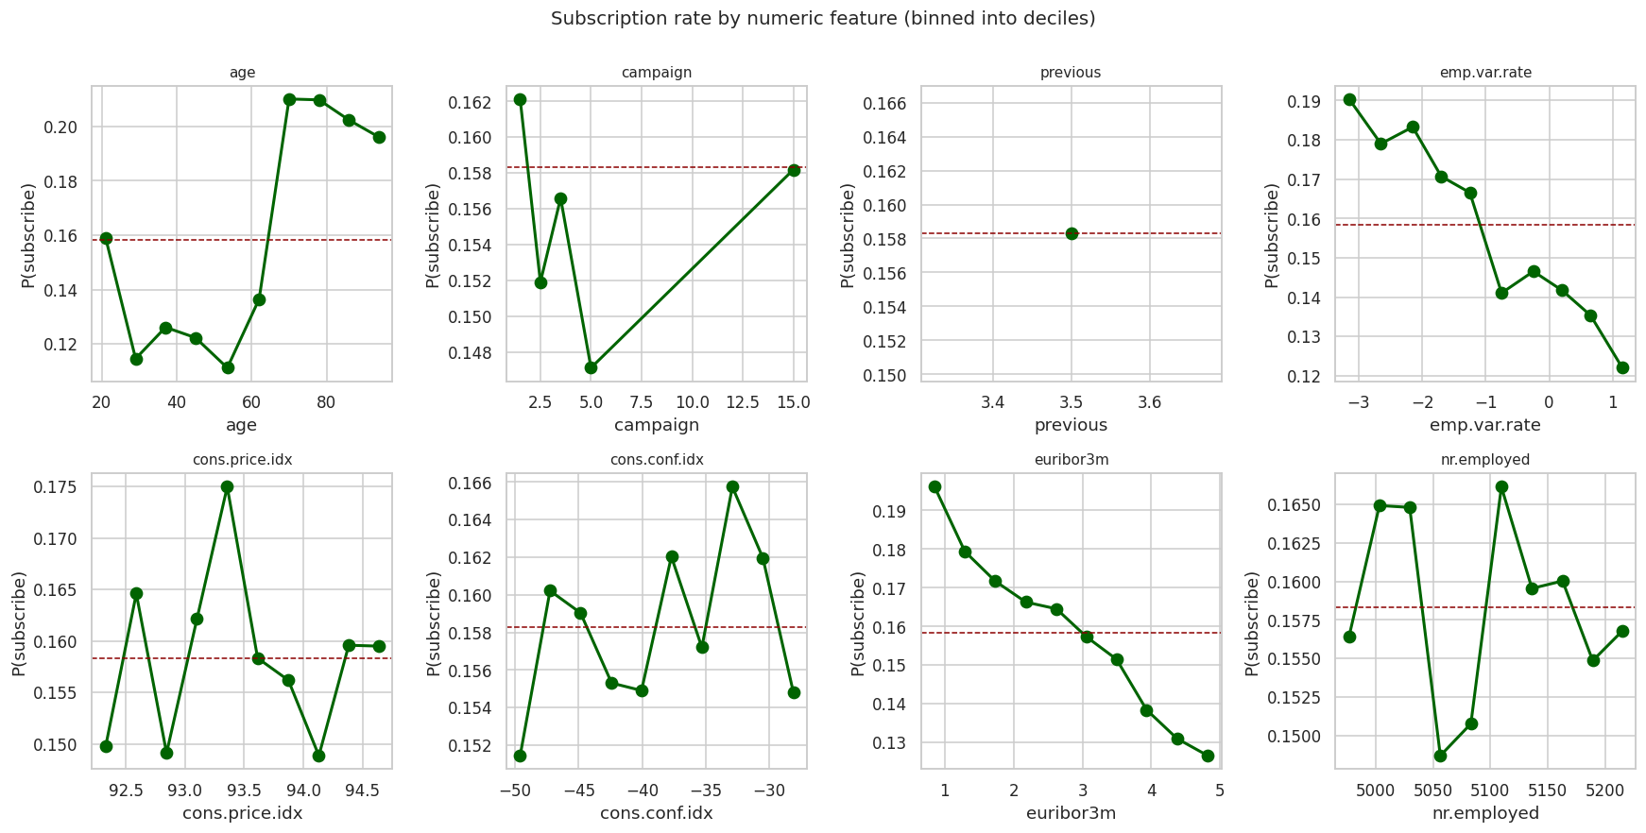
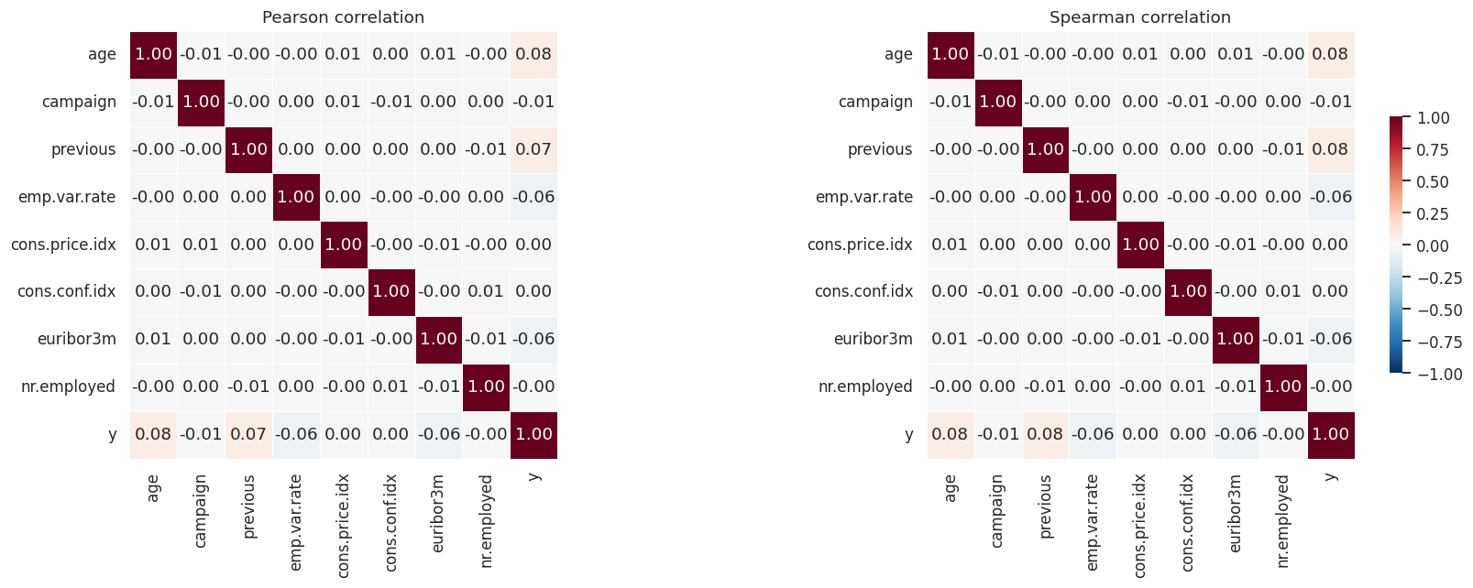
EDA . NUMERIC + CORRELATION
Numeric signal is modest; age is non-linear
THREE OBSERVATIONS
01
Age is U-shaped
Both under 25 and over 65 convert well above baseline. Tree models capture this natively; linear models would need binning.
02
Macro cluster is redundant
euribor3m, emp.var.rate, and nr.employed are near-perfect correlates. Keeping one is enough; drop the other two.
03
Numeric correlations top ~0.08
No numeric feature carries standalone signal. The real signal lives in the categoricals (prior slide).

Slide 10
STEP 4 . PREPROCESSING
From clean data to model-ready splits
1
Impute remaining missing values
Categoricals filled with 'missing' category. pdays median imputed. Indicator flags from wrangling preserved.
2
Drop 3 redundant socio-economic columns
cons.price.idx, cons.conf.idx, nr.employed are near-duplicates of euribor3m. Keep one, drop the rest.
3
One-hot encode with drop_first=True
Expands 19 features to 52. drop_first avoids numerical instability for linear models; trees do not care.
4
80/20 stratified train/test split
random_state=42. Stratified preserves the 15.8% positive rate in both partitions. 32,950 train / 8,238 test.
5
StandardScaler fit on training only
Fitting on the full data would leak test statistics into training. Linear models need it; tree models do not.

Slide 11
STEP 5 . MODELING APPROACH
Two baselines, three ML models
B1
BASELINE
B2
BASELINE
01
INTERPRETABLE
Majority Class
Rule-Based
Logistic Regression
Always predicts no. ROC AUC = 0.500 by construction. Defines the mathematical floor.
The three-feature rule from EDA. What a marketer could ship in an afternoon.
L2 regularized. GridSearchCV over C. class_weight='balanced' for the imbalance.
02
BAGGED TREES
03
BOOSTED TREES
Random Forest
Gradient Boosting
Captures non-linear patterns and interactions natively. Tuned depth and leaf size.
Sequential trees. Typically strongest on tabular data. The proposal's committed architecture.
SELECTION METRIC . Cross-validated ROC AUC on the training set, with 3-fold stratified splits. Winner evaluated once on held-out test.

Slide 12
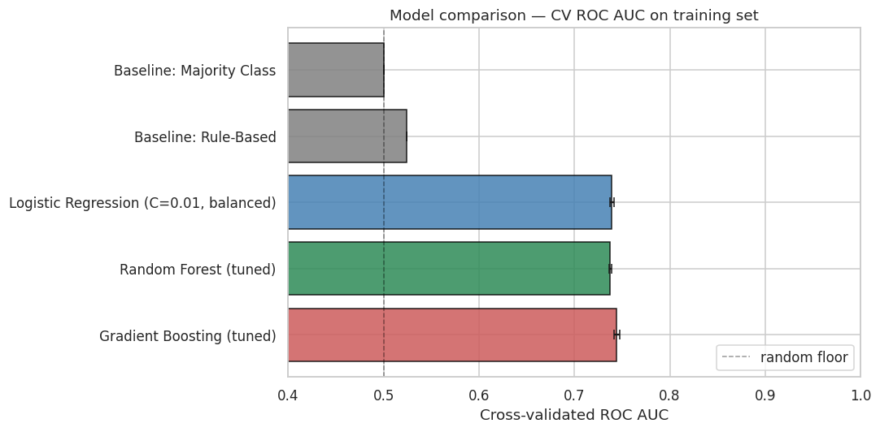
ANALYSIS . RESULTS
Gradient Boosting wins by a narrow margin
WINNER
Gradient Boosting
Classifier (tuned)
CV ROC AUC 0.745
n_estimators=200
max_depth=3
learning_rate=0.1
All three ML models land within 0.7 points of each other. Signal is close to linear once categoricals are encoded.
0.745
0.740
0.381
2.8x
CV ROC AUC
Test ROC AUC
Test PR AUC
Top 10% lift

Slide 13
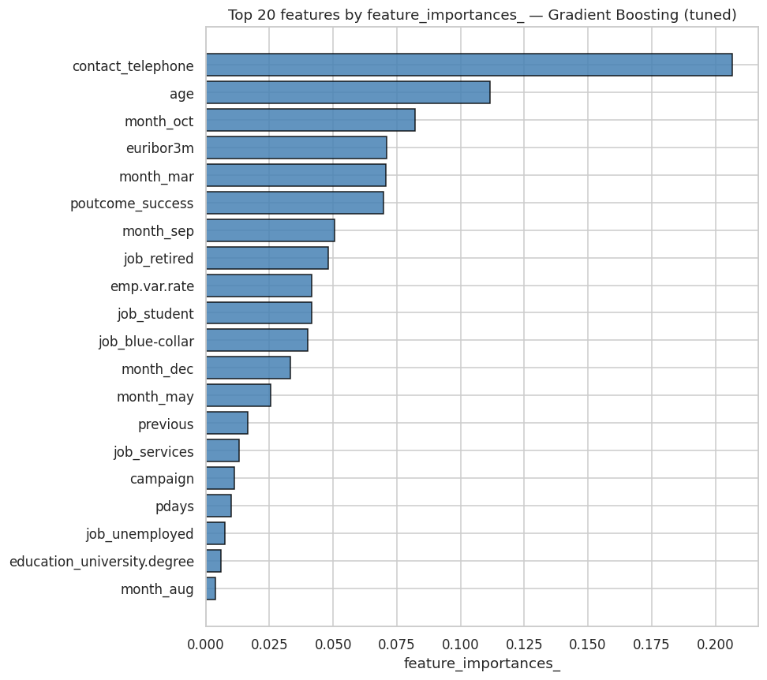
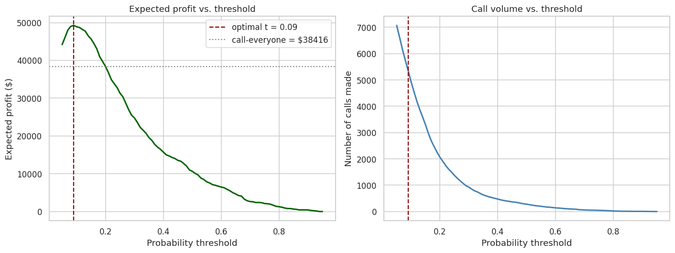
ANALYSIS . WHAT THE MODEL RELIES ON
+28% expected profit over call-everyone
BUSINESS IMPACT . AT $8/CALL AND $80/SUB
$49,280
$38,416
+$10,864
Model profit
Call-everyone
LIFT
Optimal threshold: 0.09. Top 10% precision: 45% (2.8x lift over random targeting).

Slide 14
RECOMMENDATION 1 . MARKETING ANALYTICS
1
Use the ranked model output as the primary targeting input
THE INSIGHT
THE ACTION
THE IMPACT
At a 10 percent cutoff, model-targeted calls convert 2.8 times better than random. The ranked list gives operations the flexibility a hard rule cannot.
Score the full eligible customer base at the start of each campaign. Cut at the threshold Finance picks based on current cost per call and revenue per subscription.
Expected profit lift of 28 percent at illustrative pricing. Even modest adoption on a single campaign produces lift in the low tens of thousands of dollars.

Slide 15
RECOMMENDATION 2 . CALL CENTER OPERATIONS
2
Shift campaign volume into the high conversion months
THE INSIGHT
THE ACTION
THE IMPACT
December (53%), March (49%), September (46%), October (46%) convert 3 to 4 times higher than May (12%). The current pattern of concentrating in May is backwards.
Redistribute dial volume into those four high conversion months. This is a timing change, not a model dependency; implementable without ML deployment.
Zero infrastructure cost, immediate conversion lift. Pairs with Recommendation 1 but captures value even if the model is not deployed on day one.

Slide 16
RECOMMENDATION 3 . PRODUCT TEAM
3
Design a dedicated offer for the high propensity segments
THE INSIGHT
THE ACTION
THE IMPACT
Students (35%), retired (31%), and unemployed (25%) subscribe at 2 to 3 times the overall baseline. The job segments split cleanly along life stage lines.
Evaluate a segment specific term deposit offer or communication tier for these groups. Product team owns design; marketing analytics provides targeting.
Deepens the natural advantage already present in the data. Lower acquisition cost per subscription in a cohort that already converts well above baseline.

Slide 17
Limitations and next steps
What's here works. What's next makes it deployable.
LIMITATIONS
NEXT STEPS
Data vintage. 2008-2010 covers the financial crisis but is 15+ years old. Specific segment findings are directional.
1
Add SHAP explanations
Per-customer explanations for the marketing team.
Missing features. No account balance, no transactions, no full CRM. Internal bank data would push test AUC higher.
2
A/B test in production
First-campaign test with conversion rate as primary KPI.
Production stack. sklearn's GradientBoosting used for portability. XGBoost/LightGBM are drop-in replacements for production.
3
Quarterly retraining
Calibration. Tree ensemble probabilities are miscalibrated by default. CalibratedClassifierCV fixes this.
Macroeconomic features shift materially across quarters.
Thank you.

