Slide 1
Optimizing Term Deposit
Marketing Campaigns
For a European Retail Bank
Colin Segura . Springboard Data Science Career Track . Capstone Three

Slide 2
THE PROBLEM
Every call that does not convert still costs money
5.3:1
A Portuguese retail bank runs phone campaigns to convert existing customers into term deposit holders. The baseline conversion rate is roughly 11 to 16 percent.
The other 85 percent of calls still cost agent time, telephony, and operational overhead. For every subscription, five or more calls are effectively wasted.
The question: can we predict who is likely to say yes before dialing?
The ratio of non-subscribers to subscribers
in every current campaign

Slide 3
WHO BENEFITS FROM A BETTER ANSWER
Three stakeholders are already paying for the gap
$
@
%
Marketing analytics
Call center ops
Finance
Owns the targeting logic
Dials the list
Owns the ROI number
Needs a ranked prospect list to feed the next campaign. Current rules-based targeting is static and leaves lift on the table.
Agent capacity is finite. Every low-propensity call is a lost opportunity to make a higher-propensity one.
Needs to defend marketing spend to the executive team. A model-driven lift is a defensible answer in a rate case.

Slide 4
THE DATASET
UCI Bank Marketing (Moro, Cortez and Rita, 2014)
41,188
20
45
15.8%
RECORDS
FEATURES
MONTHS COVERED
POSITIVE RATE
THREE FEATURE GROUPS
Client attributes
Campaign attributes
Macroeconomic context
age, occupation, marital, education, credit/loan status
contact channel, month, day, prior contact history
euribor3m, emp.var.rate, consumer price and confidence indices

Slide 5
THE APPROACH
The Data Science Method, applied
1
Data wrangling
Recode 'unknown' sentinels, drop the leaky duration column, encode target, dedupe.
2
Exploratory analysis
Univariate distributions, subscription rate by segment, correlations, chi-square tests.
3
Preprocessing
Impute missing, one-hot encode, 80/20 stratified split, scale on training set only.
4
Modeling
Compare 3 ML models and 2 baselines with 3-fold CV, tune hyperparameters via GridSearchCV.
5
Evaluation
Hold-out test, precision at top-k, expected profit at optimal threshold, feature importance.

Slide 6
DATA WRANGLING
41,211 raw rows into 41,188 cleaned rows
'unknown' to NaN
pdays = 999 recoded
Six categorical columns use the string 'unknown' as a missing sentinel. Converted to true NaN, with indicator flags for default (21%) and education (4%).
The value 999 encodes 'never previously contacted'. Preserved via was_contacted_before indicator; the numeric column is median imputed.
Dropped call duration
Removed 23 duplicates
A zero-second call implies 'no' by definition. The feature leaks the outcome and must not be used by a model that scores customers before the call.
Exact duplicate rows from source system re-exports. These are system artifacts, not real second observations.
Target encoded 0/1
Calendar order
The 'yes'/'no' string target was encoded numerically for all downstream modeling tools.
Month and day_of_week converted to ordered categoricals so charts and tree models render them chronologically.

Slide 7
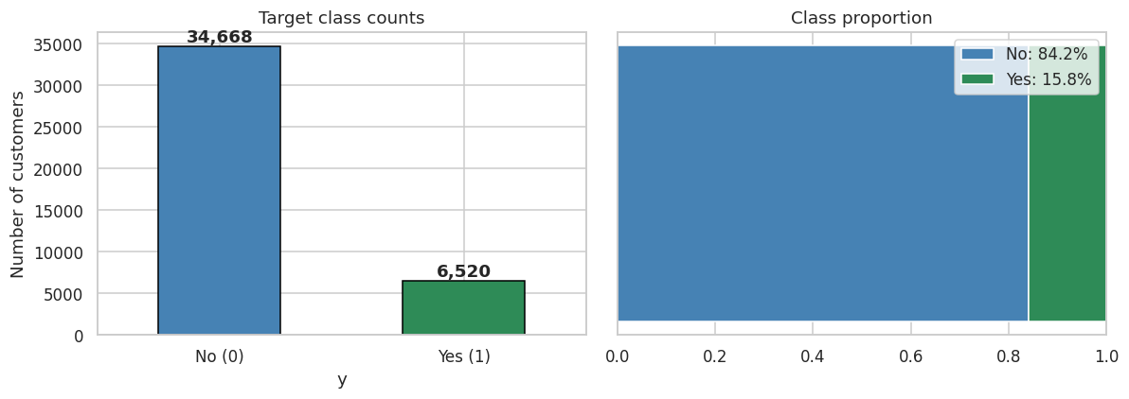
EDA . UNIVARIATE
The target is imbalanced at 5.3 to 1
15.8%
POSITIVE RATE
5.3:1
IMBALANCE
41.2K
TOTAL ROWS
TAKEAWAY . Class imbalance rules out plain accuracy. ROC AUC, PR AUC, and precision at top-k are the metrics that matter.

Slide 8
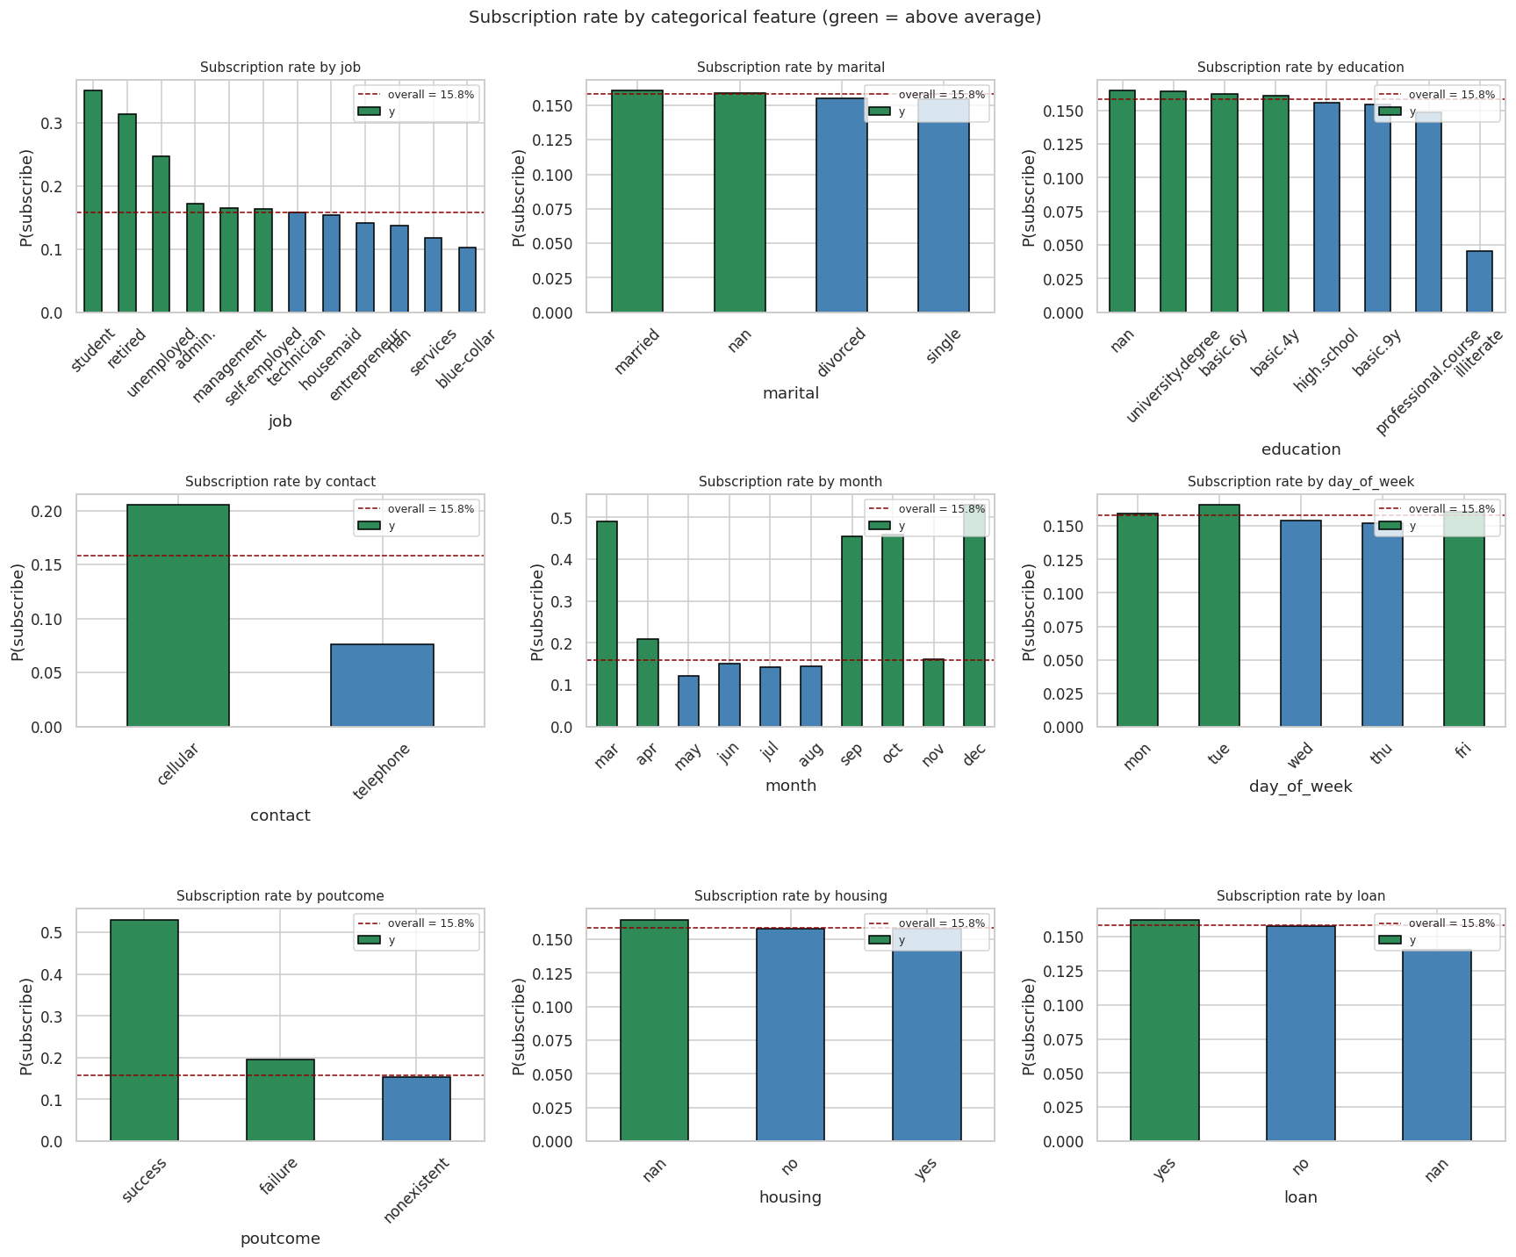
EDA . THE HEADLINE CHART
Four categorical features drive almost all the signal
WHAT TO SEE
2.7x
Contact
Cellular (20.5%) vs telephone (7.6%). The single most actionable lever.
4.4x
Month
Dec/Mar/Sep/Oct convert 45-53%, versus May at just 12%.
3.4x
Job
Students (35%), retired (31%), unemployed (25%). Blue collar at 10%.
3.5x
Poutcome
Prior success converts 53% versus 15% for no prior contact.

Slide 9
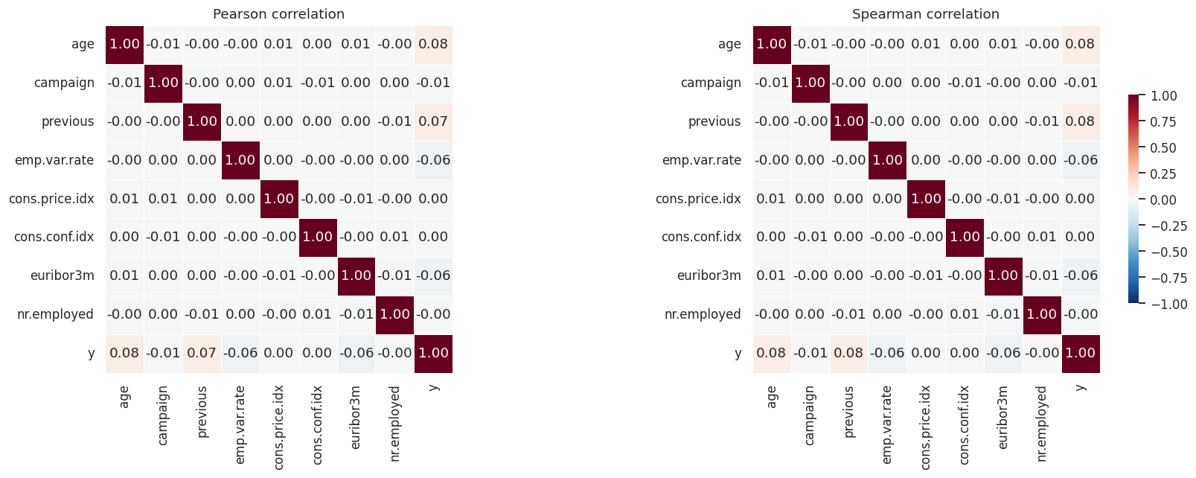
EDA . CORRELATIONS
Numeric features are modest; signal is in the categoricals
KEY FINDINGS
modest
Numeric correlations top out around +0.08
Age and the socio economic cluster are the strongest numeric predictors, but no numeric feature is a standalone signal.
0.90+
Socio economic cluster is redundant
euribor3m, emp.var.rate, and nr.employed are near-perfect correlates of each other. Keeping one of the three is enough.
U-shape
Age is non-linear
Both under 25 and over 65 convert well above baseline. Tree models capture this natively; linear models need binning.

Slide 10
STEP 4 . PREPROCESSING
From clean data to model-ready splits
1
Impute remaining missing values
Categoricals filled with 'missing' category. pdays median imputed. Already have indicator flags from wrangling.
2
Drop 3 redundant socio-economic columns
cons.price.idx, cons.conf.idx, nr.employed are near-duplicates of euribor3m. Keep one, drop the rest.
3
One-hot encode with drop_first=True
Expands 19 features to 52. drop_first avoids numerical instability for linear models; trees do not care.
4
80/20 stratified train/test split
random_state=42. Stratified preserves the 15.8% positive rate in both partitions. 32,950 train / 8,238 test.
5
StandardScaler fit on training only
Fitting on the full data would leak test statistics into training. Linear models need it; tree models do not.

Slide 11
STEP 5 . CANDIDATES
Two baselines, three ML models
B1
BASELINE
B2
BASELINE
01
ML . INTERPRETABLE
Majority Class
Rule-Based Targeting
Logistic Regression
Always predicts no. ROC AUC = 0.500 by construction. Defines the mathematical floor every ML model must clear.
The three-feature rule from EDA: cellular AND high-conversion month AND high-conversion job. What a marketer could ship in an afternoon.
L2 regularized linear model. Hyperparameter C tuned over GridSearchCV. class_weight='balanced' for the imbalance.
02
ML . BAGGED TREES
03
ML . BOOSTED TREES
Random Forest
Gradient Boosting
Captures non-linear patterns and feature interactions natively. Tuned n_estimators, max_depth, min_samples_leaf.
Sequential trees, each correcting the previous. Typically strongest on tabular business data. The proposal's committed architecture.

Slide 12
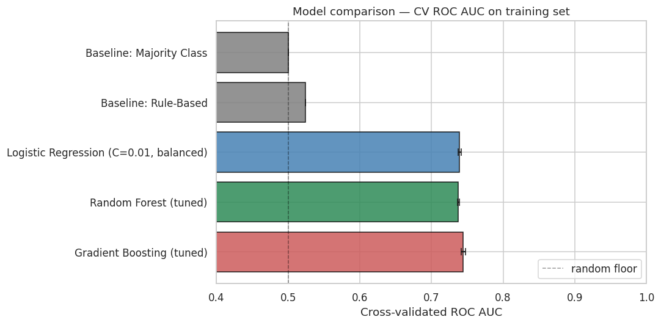
STEP 5 . RESULTS
Gradient Boosting wins by a narrow margin
WINNER
Gradient Boosting
Classifier (tuned)
CV ROC AUC 0.745
n_estimators=200
max_depth=3
learning_rate=0.1
All three ML models land within 0.7 points of each other. The signal is close to linear once categoricals are one hot encoded.
0.745
0.740
0.381
2.8x
CV ROC AUC
Test ROC AUC
Test PR AUC
Top 10% lift

Slide 13
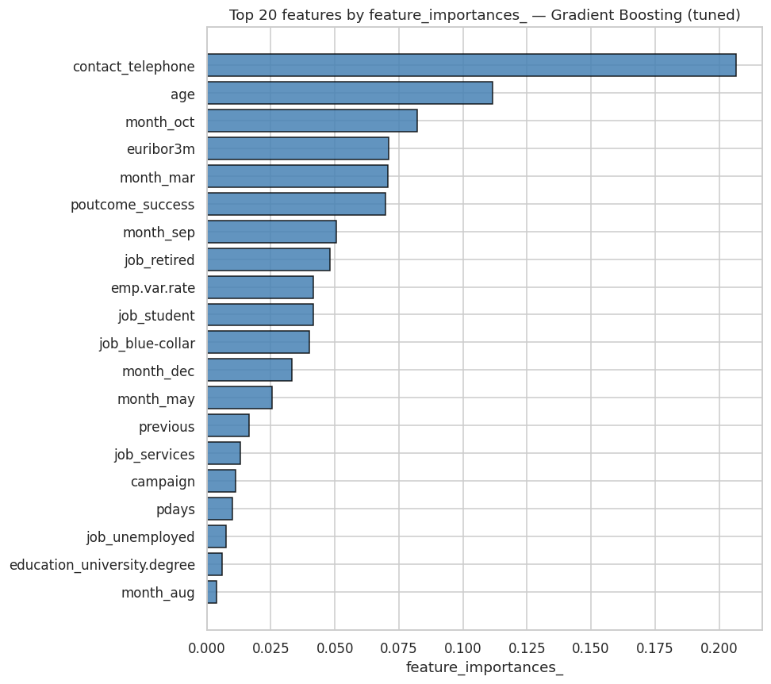
STEP 5 . INTERPRETATION
What the model actually relies on
READING THE CHART
#1
contact_telephone
Negative sign. Cellular is far better than telephone, confirming the EDA's biggest finding.
#2
age
U-shape across the age distribution. The non-linearity is captured natively by tree splits.
#3-6
month seasonality
mar, sep, oct, dec all rank in the top 7. Confirms the EDA seasonal signal.
#7
poutcome_success
Small segment but powerful: prior-success customers convert at 53%.

Slide 14
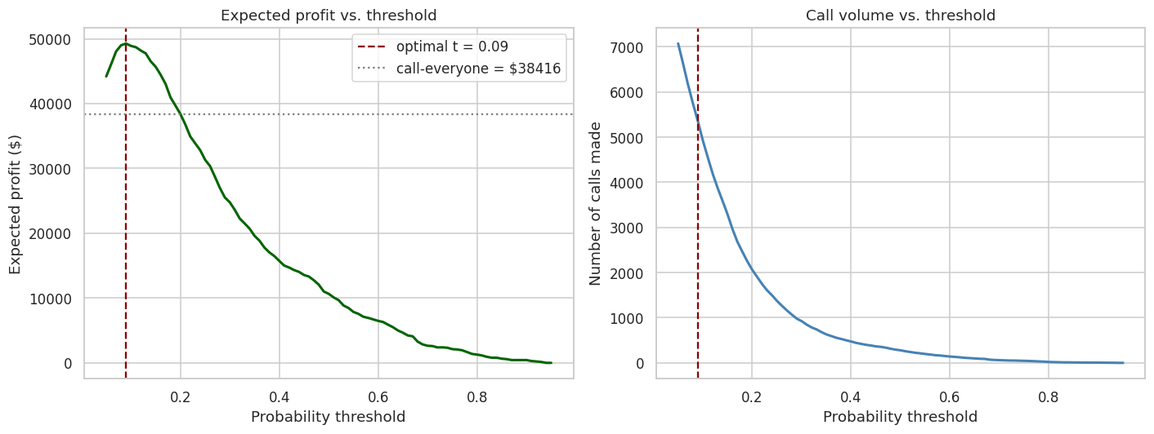
BUSINESS IMPACT
+28% expected profit over call-everyone
UNDER $8/CALL, $80/SUB
$49,280
expected profit at optimal threshold
vs call-everyone $38,416
Lift +$10,864
optimal threshold: 0.09
54%
45%
36%
16%
TOP 5%
TOP 10%
TOP 20%
RANDOM
3.4x lift
2.8x lift
2.3x lift
baseline

Slide 15
RECOMMENDATION 1 . MARKETING ANALYTICS
1
Use the ranked model output as the primary targeting input
THE INSIGHT
THE ACTION
THE IMPACT
At a 10 percent cutoff, model-targeted calls convert 2.8 times better than random. The ranked list gives operations the flexibility a hard rule cannot.
Score the full eligible customer base at the start of each campaign. Cut at the threshold Finance picks based on current cost per call and revenue per subscription figures.
Expected profit lift of 28 percent at illustrative pricing. Even modest adoption on a single campaign produces lift in the low tens of thousands of dollars.

Slide 16
RECOMMENDATION 2 . CALL CENTER OPERATIONS
2
Shift campaign volume into the high conversion months
THE INSIGHT
THE ACTION
THE IMPACT
December (53%), March (49%), September (46%), October (46%) convert 3 to 4 times higher than May (12%). The current pattern of concentrating campaign volume in May is backwards.
Redistribute dial volume into those four high conversion months. This is a timing change, not a model dependency, and can be implemented without any ML deployment work.
Zero infrastructure cost, immediate conversion lift. Pairs well with Recommendation 1 but captures value even if the model is not deployed on day one.

Slide 17
RECOMMENDATION 3 . PRODUCT TEAM
3
Design a dedicated offer for the high propensity segments
THE INSIGHT
THE ACTION
THE IMPACT
Students (35%), retired (31%), and unemployed (25%) subscribe at 2 to 3 times the overall baseline. The job segments split cleanly along life stage lines.
Evaluate a segment specific term deposit offer or communication tier for these groups. The term deposit product team owns the design; marketing analytics provides the targeting.
Deepens the natural advantage already present in the data. Lower acquisition cost per subscription in a cohort that already converts well above baseline.

Slide 18
Limitations and next steps
What's here works. What's next makes it deployable.
LIMITATIONS
NEXT STEPS
Data vintage. 2008-2010 covers the financial crisis but is 15+ years old. Specific segment findings are directional.
1
Add SHAP explanations
Per-customer explanations for the marketing team.
Missing features. No account balance, no transactions, no full CRM. Internal bank data would push test AUC higher.
2
A/B test in production
First-campaign test with conversion rate as primary KPI.
Production stack. sklearn's GradientBoosting is used for portability. XGBoost/LightGBM are drop-in replacements for production.
3
Quarterly retraining
Calibration. Tree ensemble probabilities are miscalibrated by default. CalibratedClassifierCV fixes this.
Macroeconomic features shift materially across quarters.
Thank you.

