Slide 1
Predicting Residential
Solar Adoption
Across U.S. Counties
Colin Segura • Springboard Data Science Career Track • Capstone Two — Final Report

Slide 2
The Problem
U.S. residential solar has grown 23× since 2010 — from 30,000 to over 700,000 installs per year.
But growth is deeply uneven. Two counties with nearly identical sunshine, income, and home ownership can differ by 10× in installations per capita.
The industry has no clean explanation for why.
$
Installers
Spend 15–20% of revenue on CAC. Everyone targets the same high-income zip codes.
⚡
Utilities
Under-forecasting distributed solar creates voltage issues on feeders and unplanned upgrades.
§
State energy offices
Spend billions on incentives. Can't cleanly separate policy effect from income or price.

Slide 3
Data & Method
THREE PUBLIC DATA SOURCES
LBNL Tracking the Sun
U.S. Census ACS
EIA Open Data
3M+ residential PV installs
with date, size, location, cost
County-level income, housing units,
owner-occupied count, year built
State-level residential retail
electricity price by year
→ Modeling target
→ Features + denominator
→ Key economic feature
METHOD
1
Data wrangling: merge on county FIPS, aggregate to county-level target
2
EDA: distribution, correlations, subgroup analysis
3
Preprocessing: impute missing, engineer features, standardize, 80/20 train/test split
4
Modeling: compare 4 regressors with 5-fold CV, hyperparameter tune, select on RMSE

Slide 4
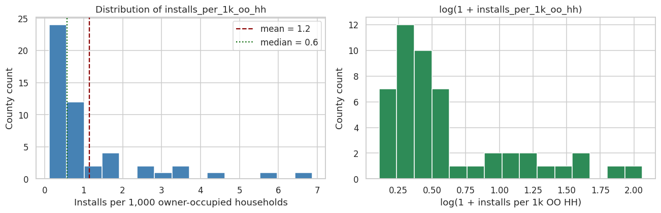
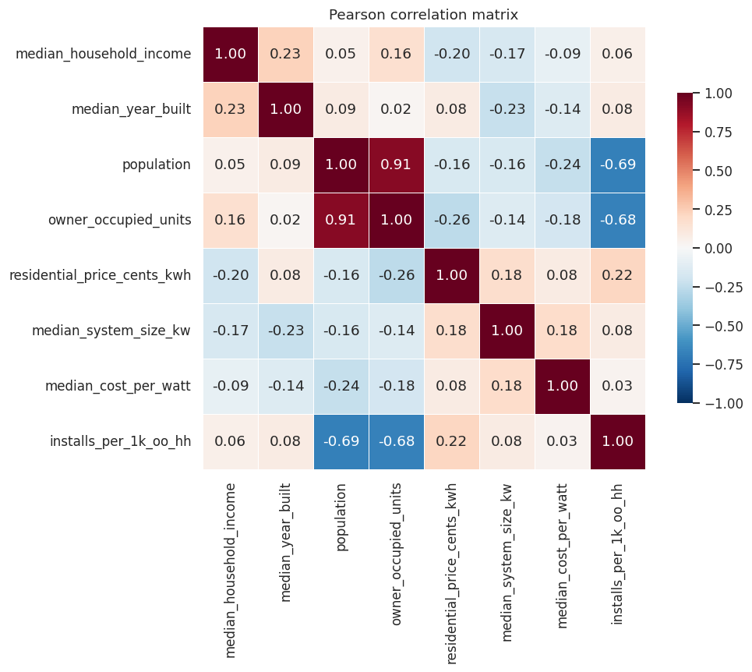
Key EDA finding: population dominates
Contrary to the industry heuristic, county population — not electricity price or income — is the strongest single correlate of per-capita adoption. And the sign is negative.
TAKEAWAYS
• Target is right-skewed (skewness = 2.4) → log-transform for linear models
• Population r = −0.69 with target (strong negative)
• Electricity price r = +0.22, Spearman ρ = +0.31
• Income r ≈ +0.06 → no linear relationship

Slide 5
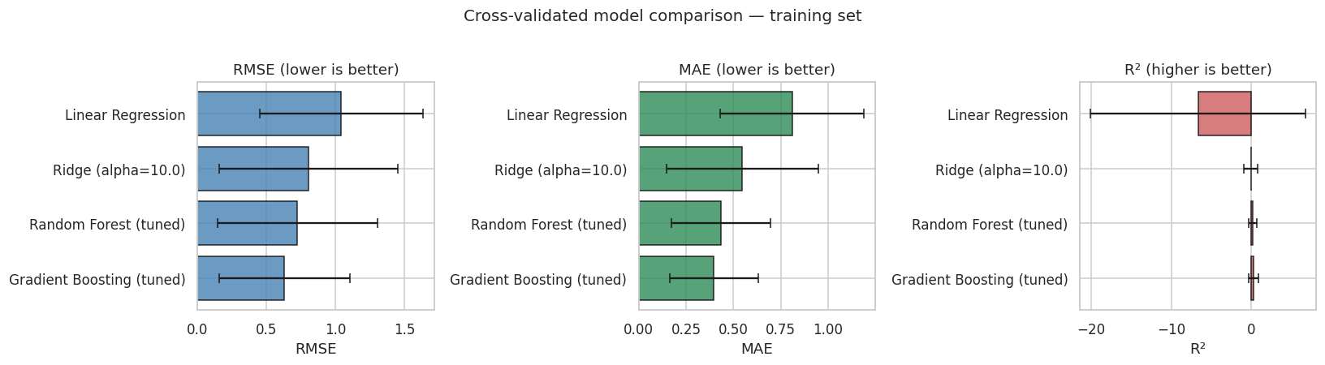
Four models compared, one winner
WINNER
Gradient Boosting
Regressor (tuned)
CV RMSE 0.63
CV R² +0.28
n_estimators=300
max_depth=2
learning_rate=0.1
Both tree ensembles beat the linear models. Gradient Boosting wins by a comfortable margin — exactly the model architecture the project proposal committed to for the final version.
0.63
+0.28
0.92
+0.76
Cross-Val RMSE
Cross-Val R²
Test RMSE
Test R²

Slide 6
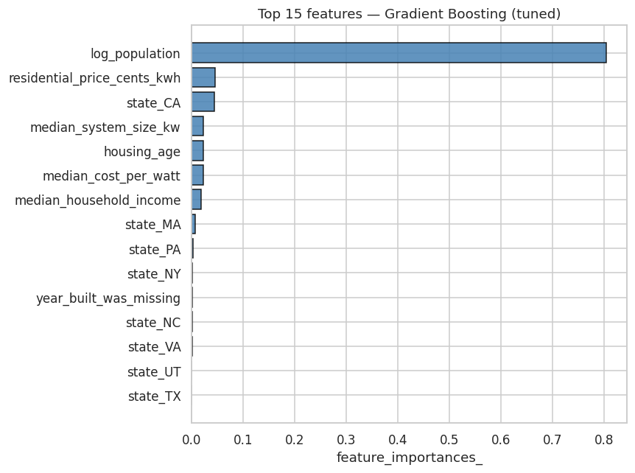
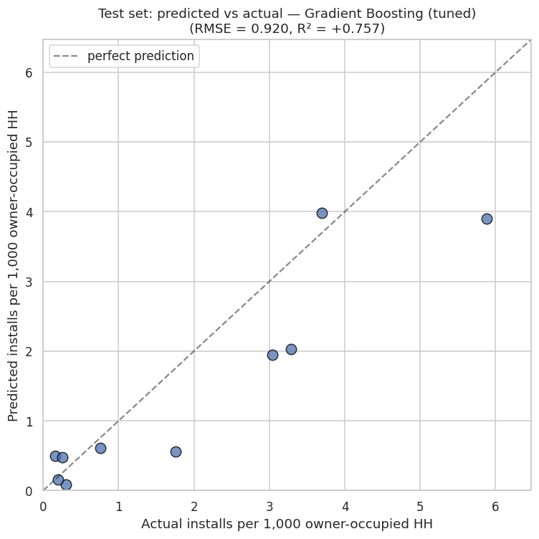
What drives the model's predictions?
Left: feature importance from the final Gradient Boosting model. Right: predicted vs. actual on the held-out test set.
log_population = 80% importance · residential electricity price is #2 · Test R² = +0.76

Slide 7
Three recommendations
1
2
3
SOLAR INSTALLERS
UTILITIES
STATE ENERGY OFFICES
Use model residuals to find underserved markets
Plan for distributed solar in mid-sized service areas
Reconsider income-targeted incentives
Counties where actual adoption is running below the model's prediction are underserved high-propensity markets. The residuals produce a rankable target list for market entry.
Population is negatively correlated with per-capita adoption. Feeder-level planning should prioritize mid-sized county service areas with elevated electricity prices — not the densest urban areas.
Income shows essentially no independent linear signal (r ≈ +0.06). Price and housing stock look like stronger levers. Next incentive-program evaluation should test price- or tenure-based targeting.

Slide 8
Limitations & next steps
What's here works. What's next makes it deployable.
LIMITATIONS
NEXT STEPS
Sample size. 50 counties in demo; ~3,100 available on full dataset. Confidence intervals will tighten dramatically.
1
Run on full dataset
Same pipeline against ~3,100 counties nationwide.
Missing features. NREL irradiance and DSIRE policy indicators deferred to follow-up. Both named in the proposal.
2
Add irradiance + policy features
NSRDB + DSIRE indicators, then re-tune.
Cross-sectional only. Single most-recent-year snapshot. Panel model would let us study within-county change.
3
Deliver to stakeholders
Tenure proxy. Population is likely a proxy for housing tenure. Explicit tenure/unit-type feature would separate effects.
Residual-ranked target lists for the three audiences.
Thank you.

