Slide 1

Predictive Modeling for COVID-19 in Public Health
Data Science Capstone Project by Abiola Segun

Slide 2
Introduction
This project addresses the challenges posed by the COVID-19 pandemic.
Goals:
- Provide insights for public health policies.
- Predict future outbreaks.
- Enhance resource allocation using data-driven strategies.

Slide 3
Dataset Overview
Top Most Affected WHO Region
The dataset includes comprehensive COVID-19 metrics:
- Confirmed cases, deaths, recoveries, active cases.
- Data spans multiple countries and WHO regions.
- No missing values; ready for analysis.
WHO Region | Confirmed
Americas | 8,839,286
Europe | 3,299,523
South-East Asia | 1,835,297
Eastern Mediterranean | 1,490,744
Africa | 723,207
Western Pacific | 292,428
QUICK OVERVIEW OF DATA INSIGHT
TOTAL COMFIRMS: 16,480,485
TOTAL DEATHS: 654,035
TOTAL RECOVERED: 9,468,087
TOTAL ACTIVE CASES: 6,358,362

Slide 4
Exploratory Data Analysis
Univariate Analysis:
- Distribution of metrics like confirmed cases, deaths, and recoveries.
Confirmed Cases: Range from 10 to 4,290,259 with a median of 5,059. Deaths: Range from 0 to 148,011 with a median of 108. Recovered Cases: Range from 0 to 1,846,641 with a median of 2,815. Active Cases: Range from 0 to 2,816,444 with a median of 1,600. New Cases: Range from 0 to 56,336 with a median of 49. New Deaths: Range from 0 to 1,076 with a median of 1. New Recovered Cases: Range from 0 to 33,728 with a median of 22. Deaths per 100 Cases: Range from 0 to 28.56 with a median of 2.15. Recovered per 100 Cases: Range from 0 to 100 with a median of 71.32.
These metrics highlight significant variability in COVID-19 impacts across different regions, with notable median values indicating central tendencies. Median was use due to it is not affected by outliers and provides a more robust measure of central tendency. The median is a better measure for skewed data because it represents the value that separates the higher half from the lower half of the data set.

Slide 5
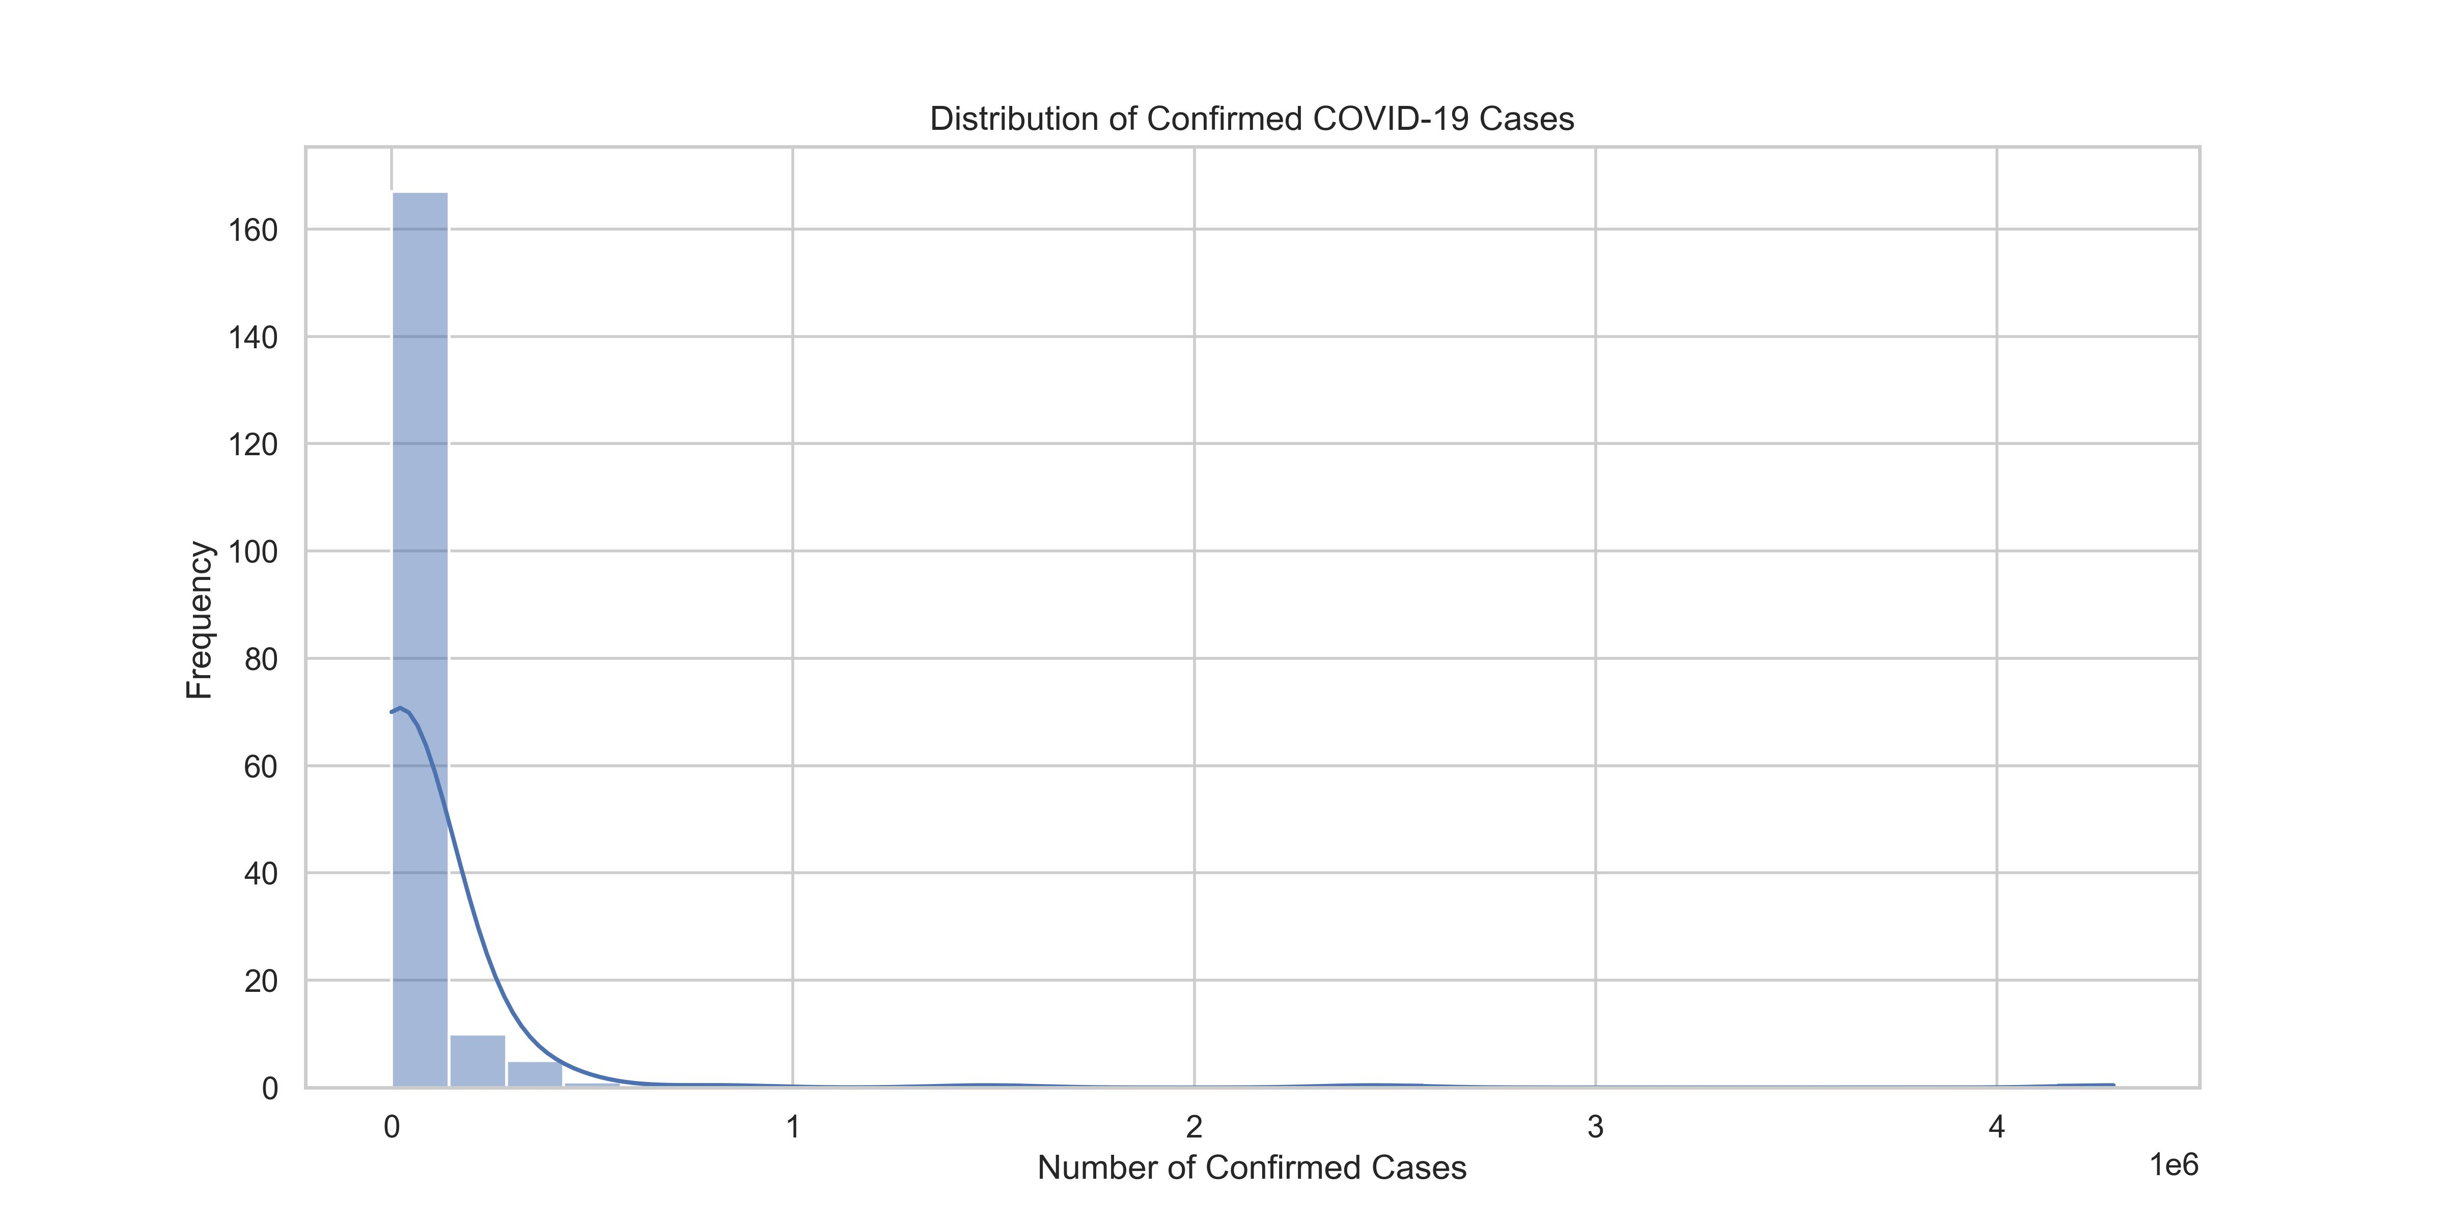
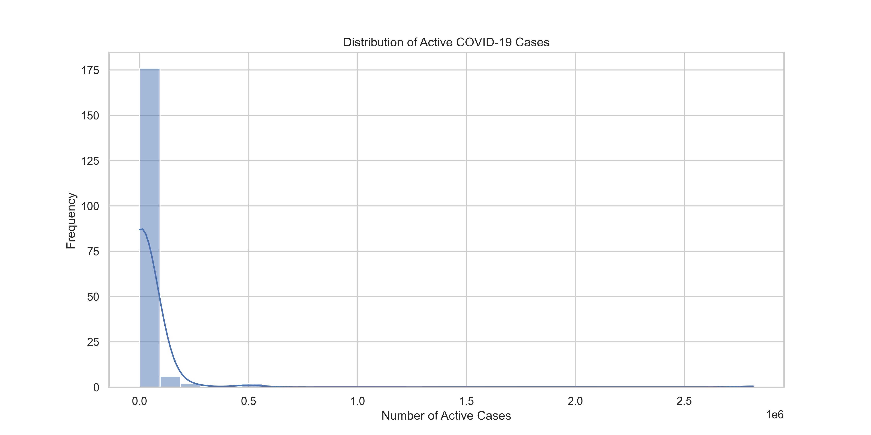
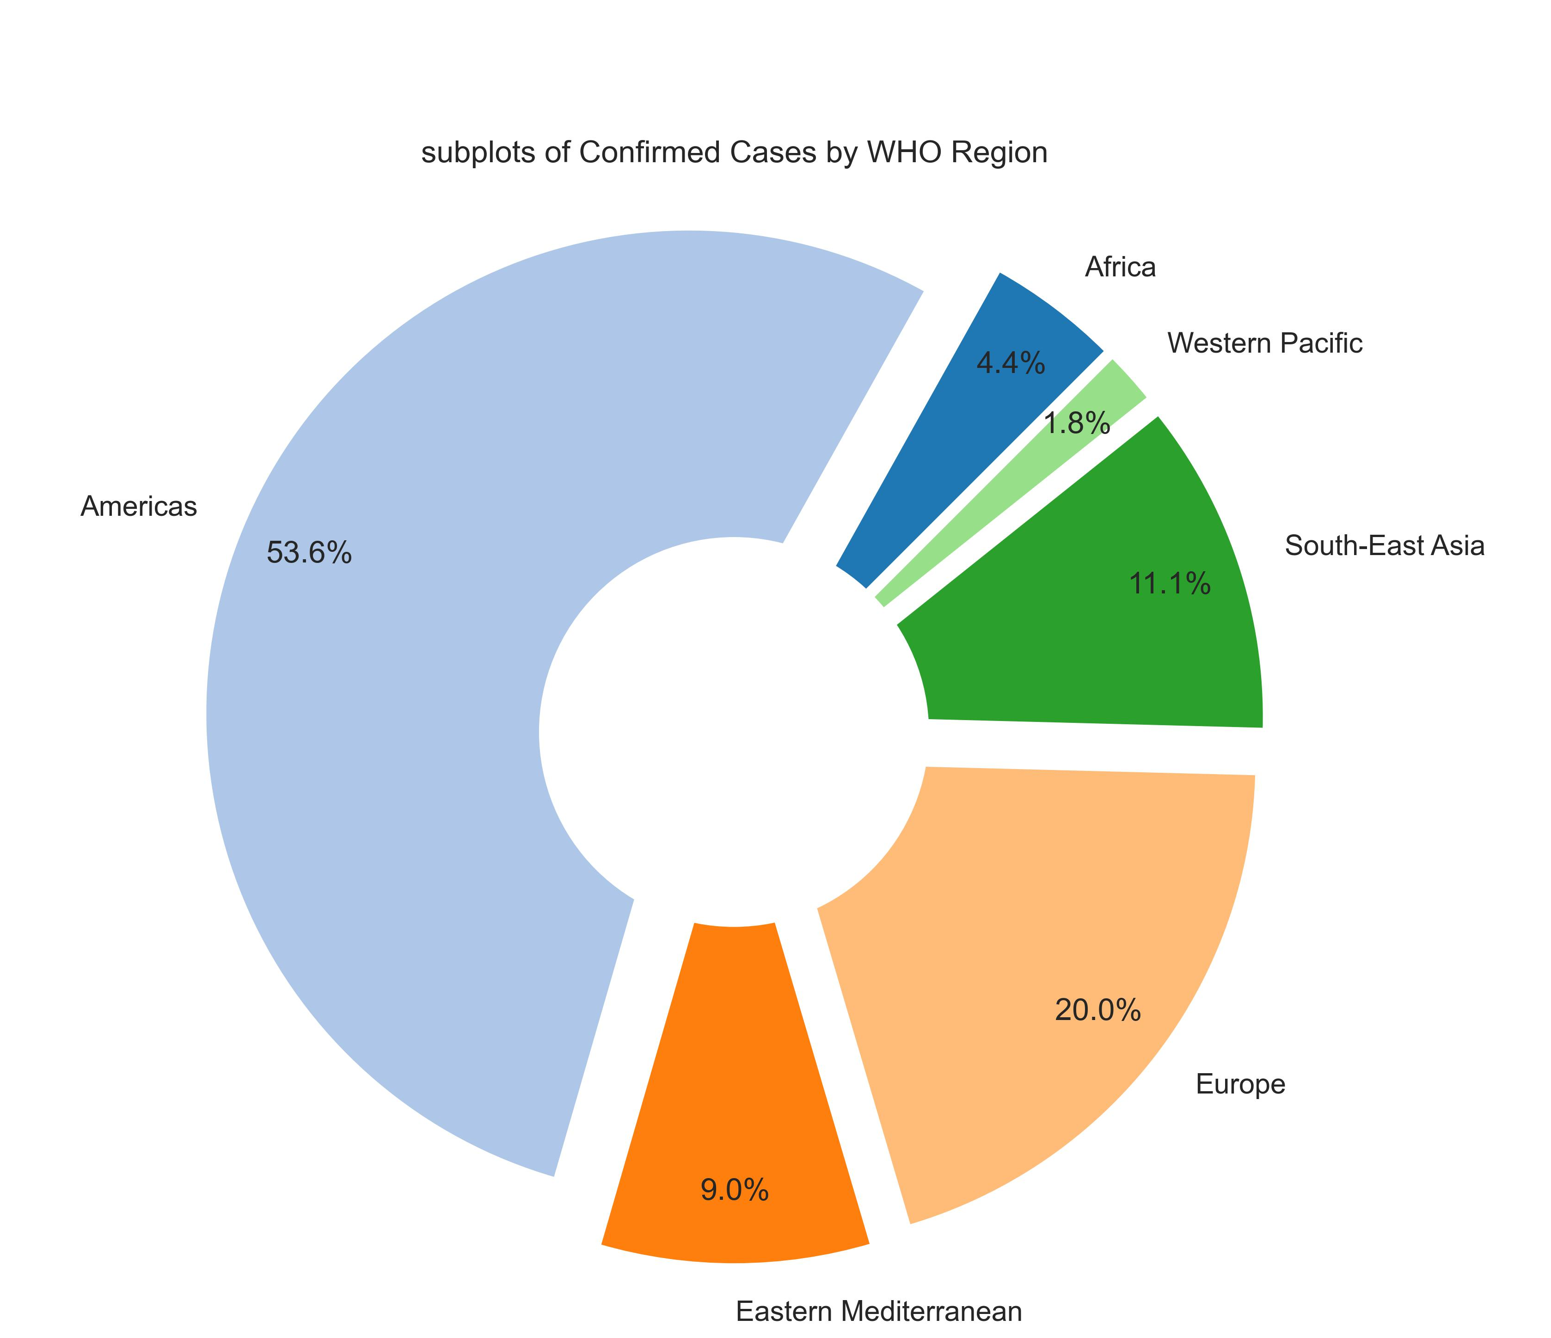
Regional Analysis
The data we are examining, such as the number of confirmed COVID-19 cases, is right-skewed. This means that most of the data points are clustered on the left side of the distribution, with a long tail extending to the right. In other words, while most regions have a relatively low number of cases, a few regions have significantly higher numbers.
The chart effectively highlights that the Americas are the most affected region, while the Western Pacific region is the least affected. This distribution suggests disparities in the spread of cases across different global regions, potentially influenced by population density, healthcare infrastructure, or public health measures.

Slide 6
Top 10 Countries Analysis
Top 10 Most affected countries: Top 10 Countries By Recovery Rate Top 10 countries by Death Rate
The data shows that the pandemic has hit certain countries particularly hard, with the United States, Brazil, and India being the most affected.
Countries like the Holy See, Grenada, and Dominica have achieved a 100% recovery rate, indicating effective management and containment of the virus.
Yemen has an alarmingly high death rate of 28.56%, indicating severe challenges in healthcare infrastructure and pandemic response.
European countries like the United Kingdom, Belgium, Italy, and France have relatively high death rates, suggesting significant impacts despite advanced healthcare systems.
Country Region | Confirmed
US | 4290259
Brazil | 2442375
India | 1480073
Russia | 816680
South Africa | 452529
Mexico | 395489
Peru | 389717
Chile | 347923
United Kingdom | 301708
Iran | 293606
Country/Region | Recovery Rate (%)
Holy See | 100.000000
Grenada | 100.000000
Dominica | 100.000000
Djibouti | 98.379126
Iceland | 98.327940
Brunei | 97.872340
New Zealand | 97.238279
Qatar | 97.017254
Malaysia | 96.597035
Mauritius | 96.511628
Country/Region | Death Rate
Yemen | 28.562980
United Kingdom | 15.194824
Belgium | 14.785934
Italy | 14.256596
France | 13.710790
Hungary | 13.399281
Netherlands | 11.532773
Mexico | 11.131030
Spain | 10.436787
Western Sahara | 10.000000

Slide 7
Model Development
Predictive Model: Random Forest Regressor The Random Forest Regressor was chosen for the predictive model due to its ability to handle but linear and non-linear relationships and complex interactions between features. It reduces the risk of overfitting by averaging predictions across multiple decision trees, ensuring robust generalization. The model evaluates feature importance, providing valuable insights into feature relevance and their contributions to predictions. This interpretability enhances the understanding of the key drivers of the target variable. Random Forest is also well-suited for high-dimensional datasets, efficiently handling irrelevant features and maintaining strong performance. Its resistance to missing data and outliers minimizes their impact on predictions, while its flexibility in hyperparameter tuning allows for optimization tailored to specific tasks. These attributes make it a reliable choice for delivering accurate, robust, and interpretable results.
- Features: Deaths, Recovered, Active, New cases, New deaths, New recovered, Confirmed last week, 1 week change,1 week % increase, WHO Region
Target: Confirmed Cases.
The selected features quantify trends and patterns, while the categorical feature (WHO Region) captures regional variations, ensuring the model accounts for both detailed and grouped insights. The target variable, Confirmed, represents the total confirmed cases and is predicted using these features for comprehensive analysis.

Slide 8
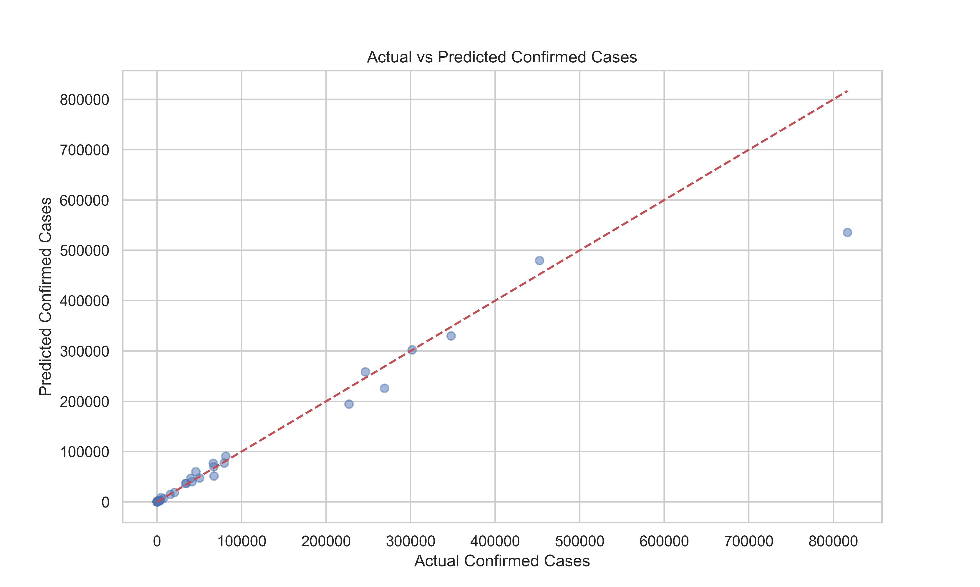
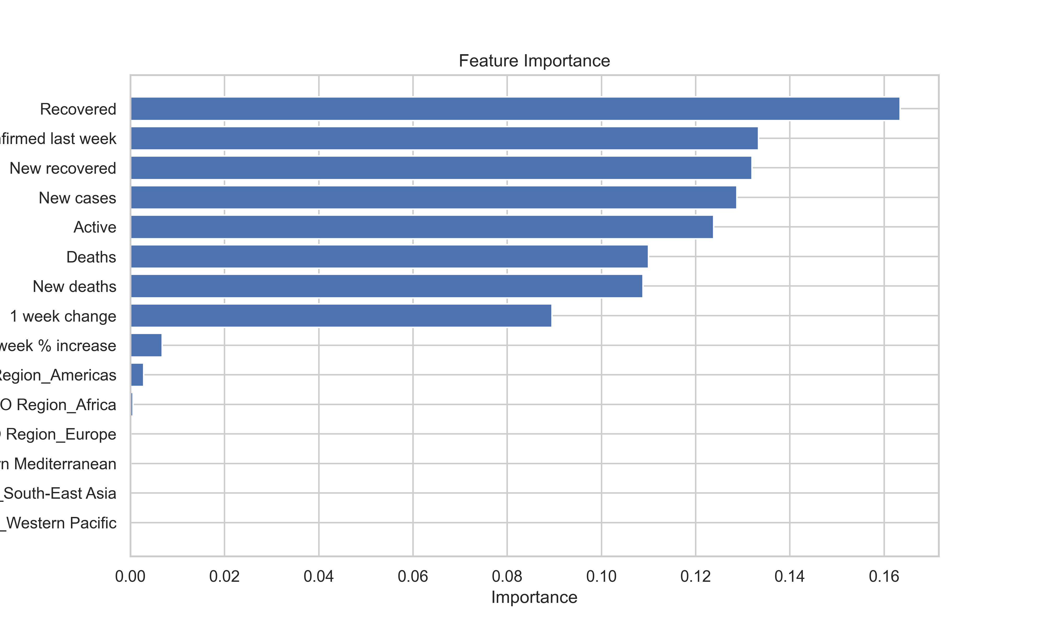
Model Performance
Performance Metrics
Mean Squared Error (MSE) | 2209244513.201462
Root Mean Squared Error (RMSE) | 47002.60113229333
Mean Absolute Error (MAE) | 13152.535063247838
R-squared (R²) | 0.9171769734135651
Mean Absolute Percentage Error (MAPE) | 213.5227228787135%
The RMSE of 47,002.60 indicates that our predictions are, on average, off by about 47,002 cases, providing a practical measure of model accuracy. An R² value of 0.917 shows that our model explains approximately 91.7% of the variability in the data, indicating strong performance. The scatter plot reveals that while most predictions align closely with actual cases, some deviations and outliers suggest areas for model improvement. The bar chart identifies "Recovered," "Confirmed last week," and "New recovered" as the most influential features, with geographical regions and percentage changes having minimal impact.

Slide 9
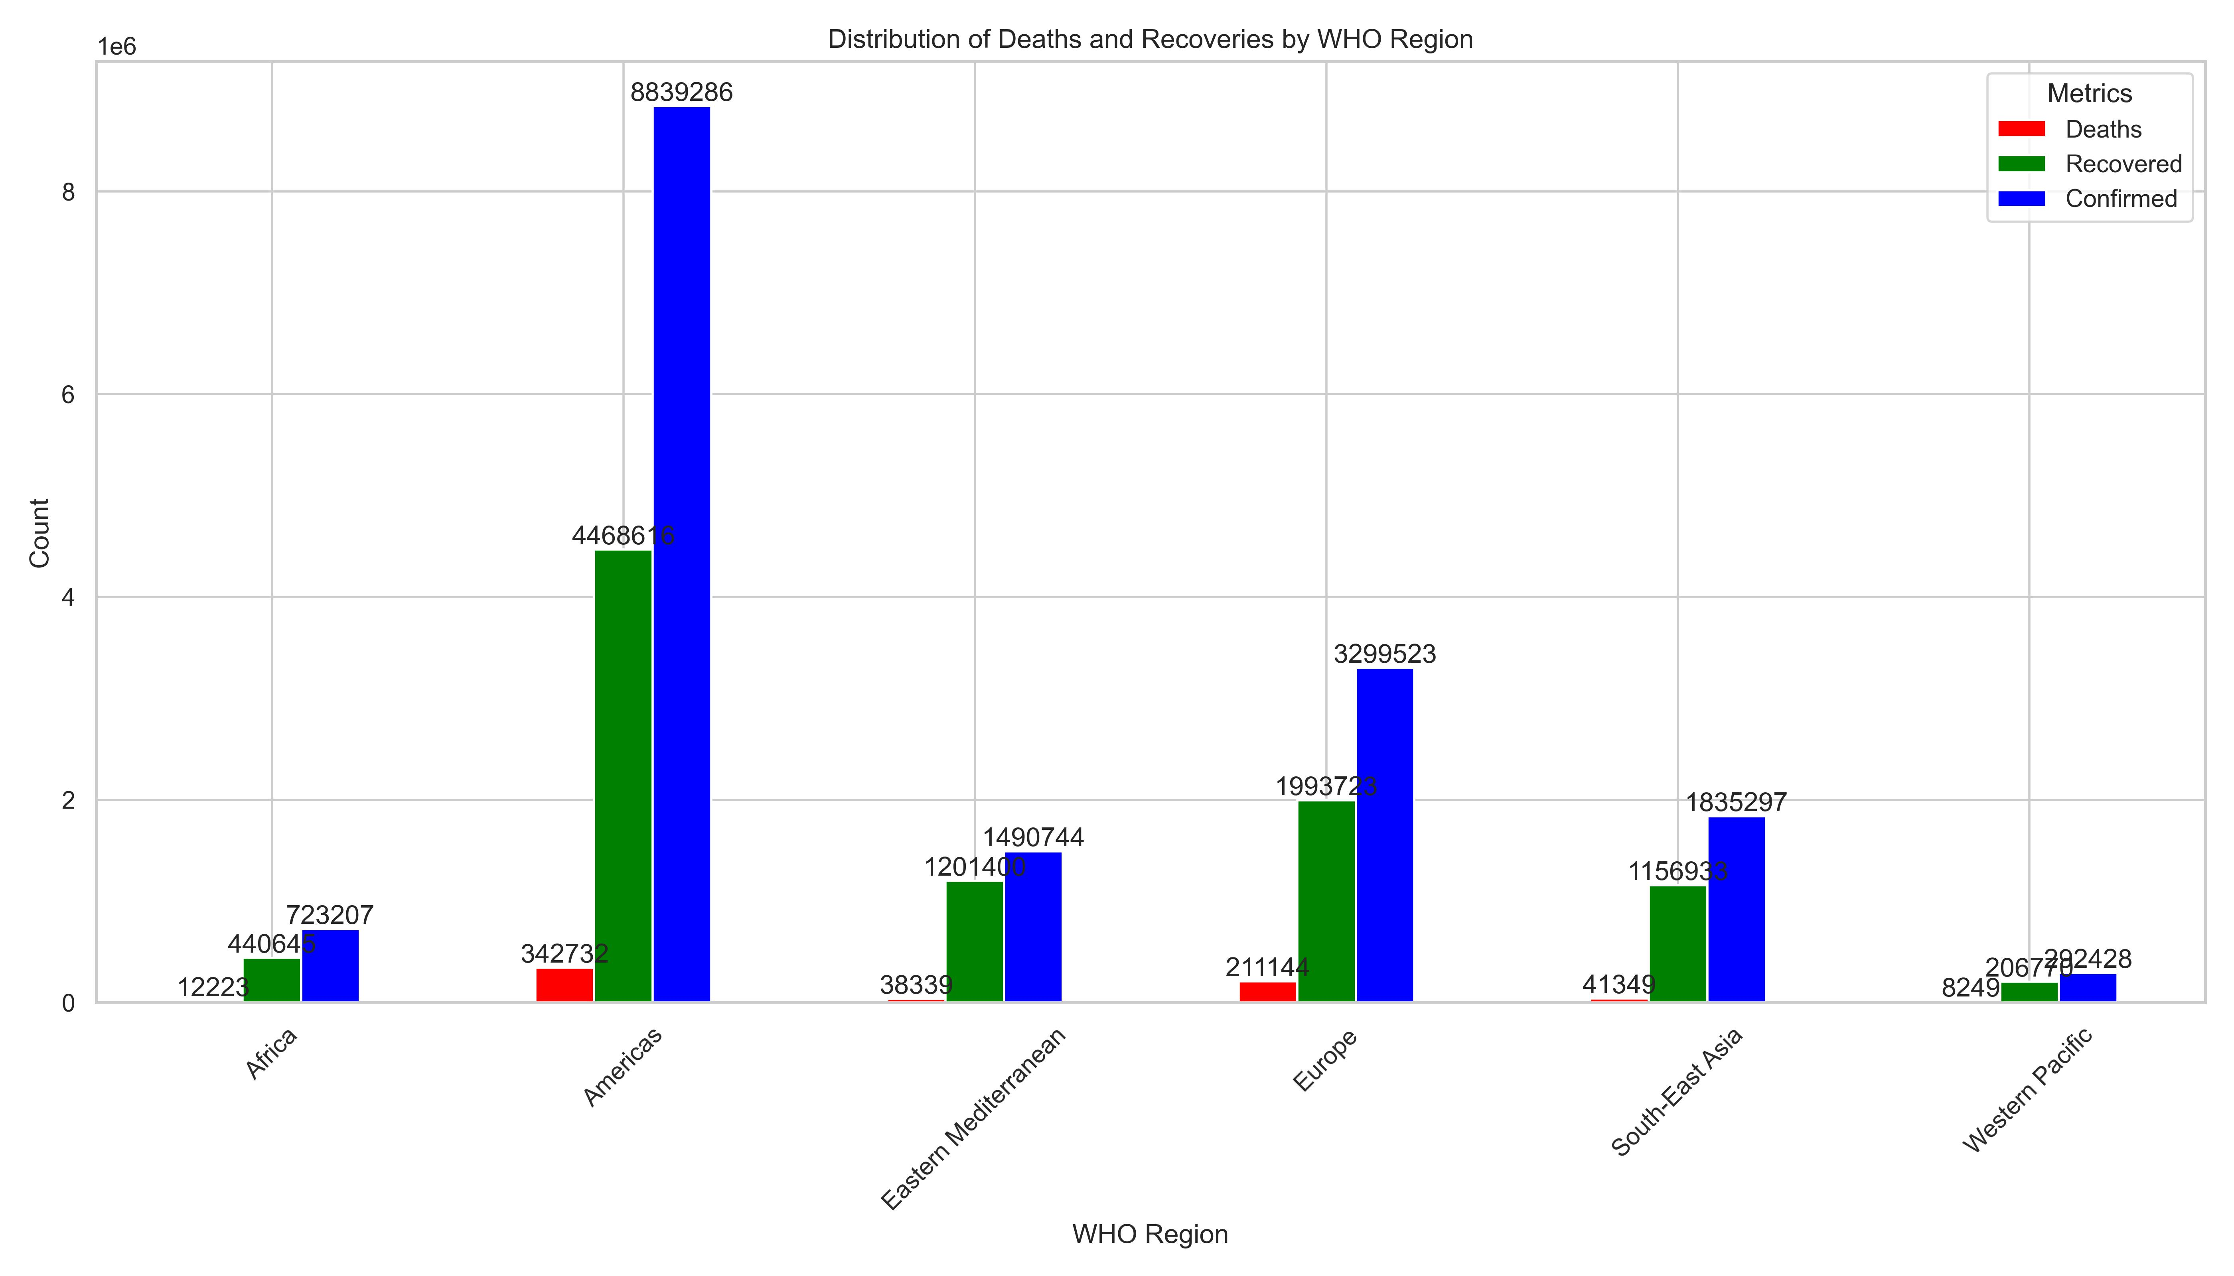
Key Insights and Recommendations
Findings:
- Regional variability in COVID-19 impacts.
Strengthen Healthcare Infrastructure: in America and Europe regions Enhance hospital capacities, including ICU beds, ventilators, and medical supplies, to handle the high number of confirmed cases and deaths. Provide additional support to regions with overwhelmed healthcare systems to ensure they can manage the influx of patients effectively. Why iin regions like Africa and Western Pacific Improve basic healthcare infrastructure to ensure readiness for potential surges in cases.
Equitable Vaccine Distribution: Prioritize regions with high case numbers and limited healthcare resources, such as Africa and South-East Asia. Ensure equitable distribution of vaccines to all regions, prioritizing those with the highest need. Support vaccine rollout campaigns and address vaccine hesitancy through public awareness and education. Collaborate with international organizations and pharmaceutical companies to secure and distribute vaccines efficiently.
Data Collection and Analysis: Improve data collection systems to ensure accurate and timely reporting of cases, recoveries, deaths and also add more feature to the data collect like Demographic Features, Socio-Economic Features.Use data analytics to identify hotspots, track trends, and inform decision-making.
The data shows wide variations in COVID-19 death rates across regions. Yemen has an exceptionally high death rate of 28.56%, possibly due to underreporting or strained healthcare systems. In contrast, countries like Paraguay, Cabo Verde, and Madagascar have lower death rates, which may reflect better management or demographic differences. Immediate action is needed in Yemen to address the crisis by improving healthcare infrastructure, increasing testing, and providing essential medical support.
Country/Region | Death Rate (%)
Yemen | 28.562980
Paraguay | 0.945471
Cabo Verde | 0.945017
Madagascar | 0.939112
Jordan | 0.935374
Venezuela | 0.913185
Tajikistan | 0.829302
Belarus | 0.799988
Israel | 0.740799
West Bank and Gaza | 0.734394
Costa Rica | 0.725964

Slide 10
Conclusion
In conclusion, the analysis underscores the global disparities in COVID-19 impacts, with significant regional variability in confirmed cases, death rates, and recoveries. The predictive model, leveraging a Random Forest Regressor, effectively identifies key drivers such as recovered cases, confirmed cases from the previous week, and new recoveries, explaining 91.7% of the variability in the data. Recommendations focus on strengthening healthcare infrastructure in highly affected regions, ensuring equitable vaccine distribution, and enhancing data collection for informed decision-making. Immediate interventions are required in critically impacted regions like Yemen, while countries with lower death rates provide insights into effective management strategies.
Thanks you

