Slide 1

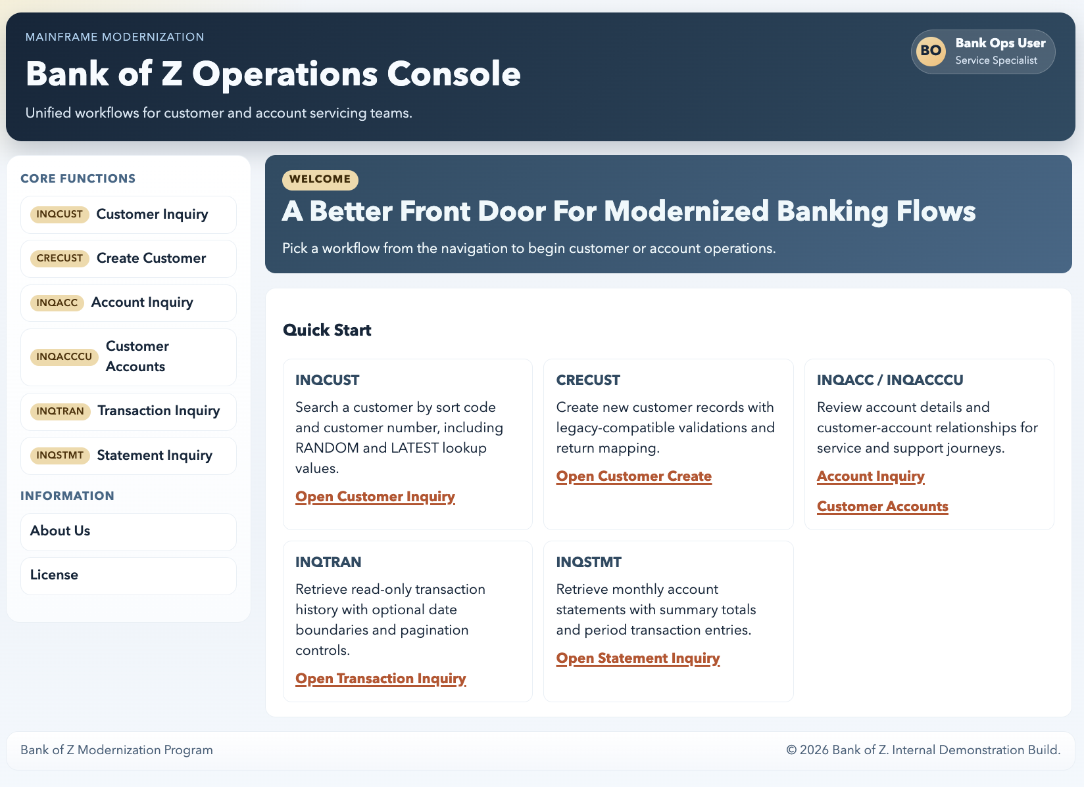
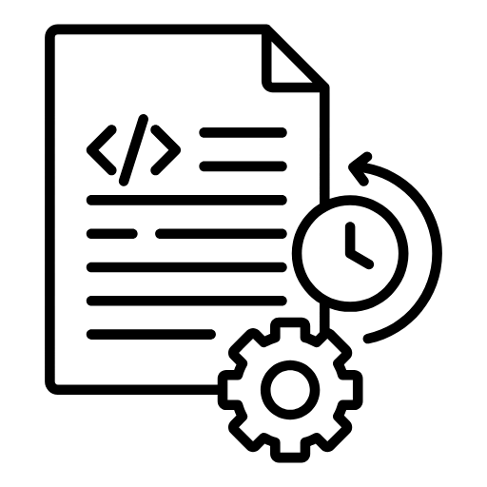

Specs-driven mainframe modernization
LEGACY KNOWLEDGE
COBOL
Modernization agents
Extracts business rules,
Dependencies and data mappings
Programs
Copybooks
Human review
Reviewed specifications
Define expected behaviour,
test requirements
Spec-driven build
+ verification
Spring Boot + React
Generate code from the specifications,
then review and test it
Modern banking application
Fix issues and retest
Preserves the business rules
Modernizes the implementation
Notes:
The pod established the modernization foundation before my additions. It used AI-assisted analysis and a modernization agent framework to interpret COBOL programs and copybooks, recover business rules and mappings, and produce reviewable specifications. Specification-driven development then guided the Spring Boot services and React frontend, with reviews and tests tied to the requirements. This is a working proof of concept with local and mock integration boundaries. The objective is to preserve legacy behaviour while moving implementation to a modern application. We are not presenting a completed production migration or verified cost savings.
Sources
/Users/temp/Downloads/Mainframe Modernization Powered by AI‑Enabled SDLC.pptx, slides 3, 7, 9, 11 and 18
/Users/temp/Documents/pod/MainframeModernization/PROJECT_ONBOARDING_GUIDE.md, sections 1–5 and 7–9

Slide 2
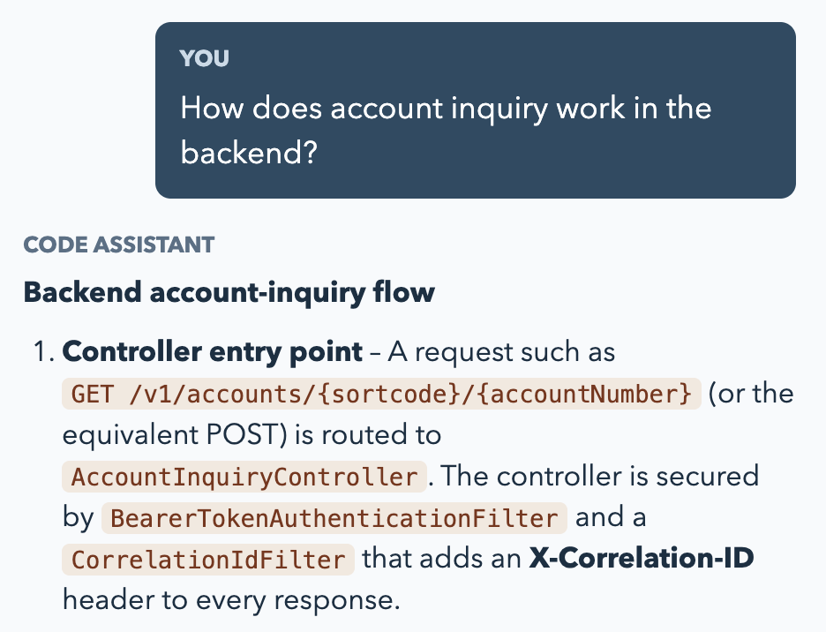
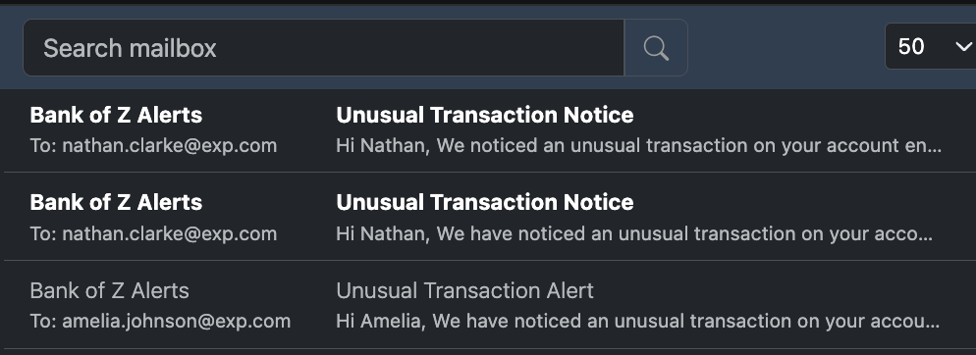
Addition to the modernized application
Developer understanding and transaction oversight
01
Code Assistant
02
Anomaly monitoring
Helps developers understand unfamiliar features and workflows
Detects unusual transactions and notifies customer
Transaction activity
New anomaly
Live simulation
Alert recorded
Explanation + code snippets + source files
Customer gets notified via email in real-time
Notes:
My work adds two capabilities to the application the pod already built. The Code Assistant helps new developers and colleagues working on unfamiliar features ask natural-language questions about the frontend, backend, APIs and end-to-end workflows. Its explanations include code snippets and supporting file references. The second capability demonstrates transaction anomaly detection, persistent alert tracking and customer email notifications. The transaction data is synthetic, and Mailpit captures test emails locally. These are capability demonstrations, without a measured onboarding-time reduction or production fraud-detection claim.
Sources
/Users/temp/Documents/pod/MainframeModernization/rag/README.md
/Users/temp/Documents/pod/MainframeModernization/rag/api.py
/Users/temp/Documents/pod/MainframeModernization/anomaly_detection/README.md
Codex task: Recall RAG implementation work, 01a0a5a7-67d3-75a0-b53b-b2b54de438d2
Codex task: Investigate anomaly monitoring, 01a0a15a-49ab-7cb2-b5b7-36aef8a526af

Slide 3



RAG indexing: code-base becomes searchable vectors
Retrieval-augmented generation (RAG) starts with the codebase
01
02
03
04
Source code
Chunk + Index
Create embeddings
Store in LanceDB
React frontend +
Spring Boot backend
Tree-sitter parses code
with hierarchical structure
Code meaning
represented as numbers
Vectors, code and
source references
CodeRankEmbed
Frontend + Backend
LanceDB
Code chunk +
Indexing
Vector database
[ v₁ v₂ … v₇₆₈ ]
INCREMENTAL REFRESH
NEW OR EDITED
UNCHANGED
DELETED
< git pull >
CocoIndex detects changes
Re-embed affected chunks
Reuse existing vectors
Remove stale chunks
Notes:
RAG means retrieval-augmented generation: the assistant first finds project evidence before generating an explanation. This slide covers knowledge preparation. CocoIndex detects additions, edits and deletions. Tree-sitter identifies code structure, and chunks retain links to their files and callable nodes. Groq creates file and function summaries, which enrich the chunks. CodeRankEmbed converts them into vectors stored in LanceDB. Incremental refresh reuses unchanged vectors, updates new or changed chunks and removes deleted chunks. Refreshing the index is an explicit pipeline operation after code changes, rather than an always-running synchronization service.
Sources
/Users/temp/Documents/pod/MainframeModernization/rag/README.md, Full Incremental Pipeline and Chunking And Incremental Identity
/Users/temp/Documents/pod/MainframeModernization/rag/ingestion.py
/Users/temp/Documents/pod/MainframeModernization/rag/sync_embedding_table.py
Codex task: Design RAG indexing strategy, 01a00fff-937d-78e1-a308-a0fa4a73a0d4
User-supplied indexing workflow image: codex-clipboard-eda13267-d0b7-4dcb-8785-1d80f56b4148.png

Slide 4



RAG answers: retrieve, generate, validate
The question and code use the same embedding model
< guardrails >
Match by meaning
Ask a question
Screen request
Embed question
Similarity search
Natural language
CodeRankEmbed
LanceDB vectors
Clarify or decline if needed
Grounded answer
Pass
Validate answer
Generate answer
Top 10 chunks
Code + source files
Gemini checks evidence
Groq + OSS GPT
Code + summaries
Revise once, then recheck
Notes:
A developer asks a question in the integrated React Code Assistant. Gemini first decides whether the request can be answered, needs clarification or should be declined. For an answerable question, CodeRankEmbed and LanceDB retrieve the top ten semantic code chunks. Groq generates a response using that evidence. Gemini then checks the response against the retrieved code and chooses pass, revise or block. If needed, Groq revises once using the feedback and Gemini checks it again. Only an approved answer is returned as the substantive explanation. Validation reduces unsupported answers but is not a guarantee of correctness. Promptfoo and a separate grounded test set support offline evaluation. Hybrid retrieval and reranking were experiments and are not the live retrieval path.
Diagram detail: The question and indexed code use the same pinned CodeRankEmbed model. Retrieval matches normalized vectors using cosine similarity and returns the top 10 chunks. Evidence contains raw code, file and node summaries, file paths and line ranges. The answer validator sees the question, answer and retrieved evidence. Offline Promptfoo evaluation is separate from this runtime loop.

Slide 5
Anomaly detection and customer notifications
Live transaction simulation with explainable detection on each scan
Bank review
Simulated transactions
Large credits retained
Normal activity + anomalies
Rule-based detection
Unusual amount
New alert
Customer email
Unusual time
SQLite registry
Groq drafts email
Python scripts notifies
Application API
Rapid activity
Spring Boot + H2
Detection runs per scan
Mailpit inbox
Synthetic data
One alert per transaction
Local test delivery
Track delivery status and prevent repeat notifications
Notes:
The simulator creates synthetic transactions through the real Spring Boot API while the banking interface can display the data. The detector scans the current API records whenever the processing command runs. It flags unusually large debits or credits, early-hour activity and rapid transaction bursts. SQLite persists findings with a unique transaction ID to prevent duplicate registration. Large credits are retained for bank review and do not enter automatic customer email delivery. For eligible new customer alerts, Groq drafts the wording, and Python validates required transaction facts before sending to Mailpit. Mailpit is a local test inbox, not delivery to real customers. Successful delivery changes the status to SENT. The default end-to-end demo sends the newest customer alert from the current scan. Detection is rule-based. Isolation Forest and UI alert badges in the earlier diagram are future work, not implemented capabilities.
Sources
/Users/temp/Documents/pod/MainframeModernization/anomaly_detection/README.md
/Users/temp/Documents/pod/MainframeModernization/anomaly_detection/realtime.py
/Users/temp/Documents/pod/MainframeModernization/anomaly_detection/detect.py
/Users/temp/Documents/pod/MainframeModernization/anomaly_detection/alerts.py
/Users/temp/Documents/pod/MainframeModernization/anomaly_detection/notification.py
/Users/temp/Documents/pod/MainframeModernization/anomaly_detection/main.py
Codex task: Investigate anomaly monitoring, 01a0a15a-49ab-7cb2-b5b7-36aef8a526af
User-supplied anomaly workflow image: codex-clipboard-5231e874-b5c5-41e1-9c80-eaa27bcf8e7a.png

