Slide 1
Character-Aware Neural Language Model
Based on Yoon Kim’s 2016-AAAI Paper
2017-2 Deep Learning Course Term Project
2011120298
2015410029
2015410108
김래현
김진희
도지윤

Slide 2
Contents
00
Why this
Model?
01
Intro
02
Problem
03
Solution
04
Model
05
Result

Slide 3
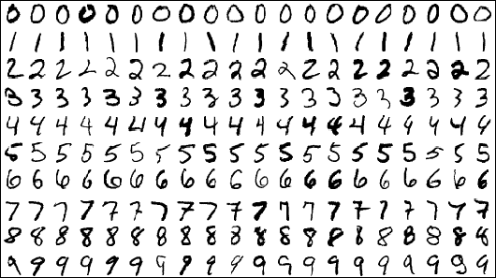
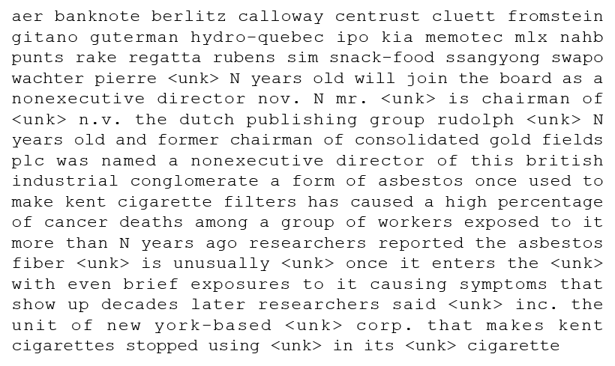
00 Why this model?
(1) We already used CIFAR-10, MNIST datasets. How about text data?

Slide 4
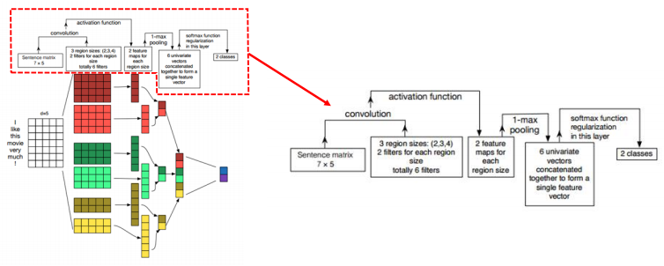
00 Why this model?
(2) Professor pointed out we can use CNN for NLP.

Slide 5
00 Why this model?
(3) Only Character embedding was used in this model.
We do not need to use word embedding that someone has created.
It uses 60% of the parameters compared to the state of the art model, but has similar performance.
It is easier to make character embedding than word embedding.

Slide 6
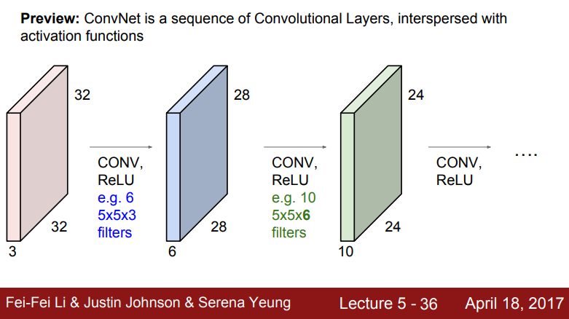
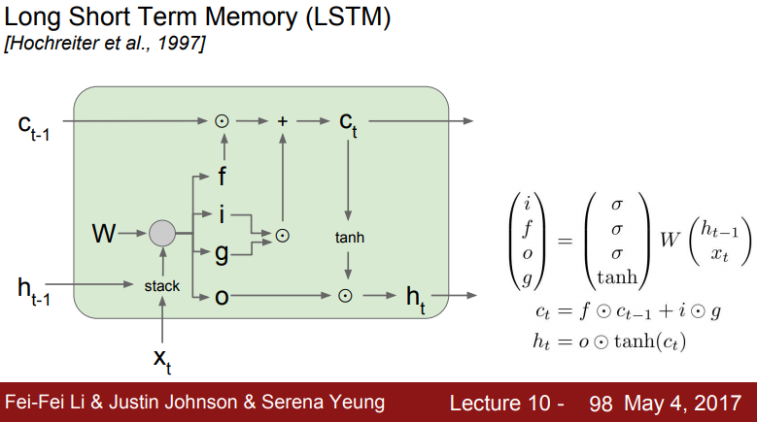
00 Why this model?
(4) Topics that we covered in this course <CNN and LSTM> are used.

Slide 7
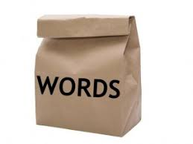
01 Intro
- Language Modeling is a fundamental task in NLP.
Count-Based Model
Neural Language Model
CBOW
Skip-Gram
Word Embedding
NLM outperforms Traditional models

Slide 8
02 Problem
- While word Embedding approach performs well on various task,
it still has some week points.
1. Cannot utilize subword information (prior).
ex) eventful, eventfully, uneventful, uneventfullly
Embeddings of rare words be estimated poorly.
Problematic in morphologically rich language.
2. Relatively large number of parameters required.

Slide 9
03 Solution - Idea
- Word representation without any word embedding.
Word vector
Character level embedding
0.03
0.152
..
..
..
..
..
“Deep”
D
E
E
P

Slide 10
03 Solution - contribution
Model with only character-level embedding has fewer parameters
with comparable accuracy.
Neural language model with only character-level inputs
By replacing word embeddings as an input to the conventional RNN-LM
with the output from a character-level convolutional neural network
Require fewer parameters than conventional models with word embeddings

Slide 11
04 Model
CNN with 6 different size filters
Generated
word embedding
MaxPool
 |  |  |  |  |  |  |  |  | 0
 |  |  |  |  |  |  |  |  | 0
 |  |  |  |  |  |  |  |  | 0
 |  |  |  |  |  |  |  |  | 0
 |  |  |  |  |  |  |  |  | 0
 |  |  |  |  |  |  |  |  | 0
 |  |  |  |  |  |  |  |  | 0
 | 15
Character
embedding
Input word
a | b | s | u | r | d | i | t | y | pad

Slide 12
04 Model
Highway network with ReLU
+
R
Highway
Result
Of
CNN
(MaxPool)
Generated
word embedding
Input word
a | b | s | u | r | d | i | t | y | pad

Slide 13
04 Model
LSTM for instant result
is
X
X
R
R
absurdity
is

Slide 14
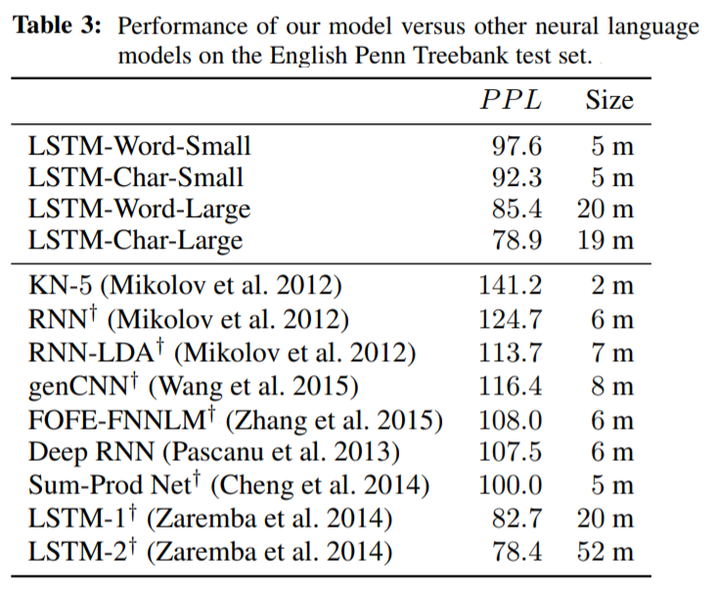
05 Result
Performance achieved existing state-of-the-art on English
PPL (lower is better)
Large model :
the performance of existing state-of-the art
Small model :
outperforms other NLMs of similar size
Size
Models have approximately 60% fewer parameters than other models

Slide 15
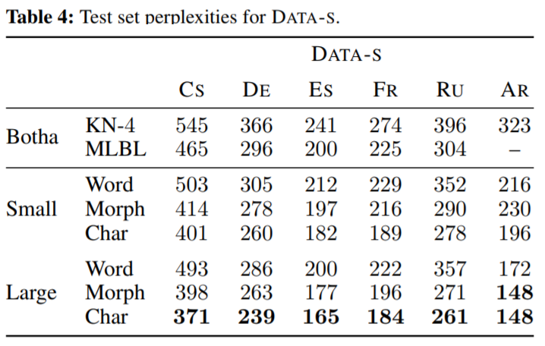
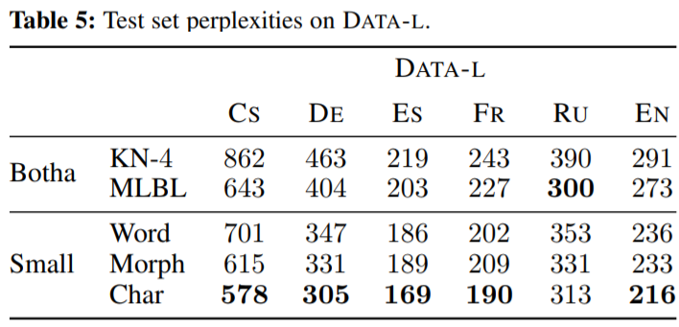
05 Result
Performance outperforms on morphologically rich languages
Morphologically rich languages
Arabic, Czech, French, German, Spanish, and Russian
Word/Morph/Char
words/morphemes/characters as inputs respectively
Perplexity
Clear that models outperforms other models
Comparing Word/Morph/Char,
character-level models outperform their word-level counterparts

