Slide 1

Charity Matching Connecting Donors with projects they care about
INF 553 Project Proposal
Dhanashri Tidke, Seher Khan, Jeffy Merin Jacob,

Slide 2
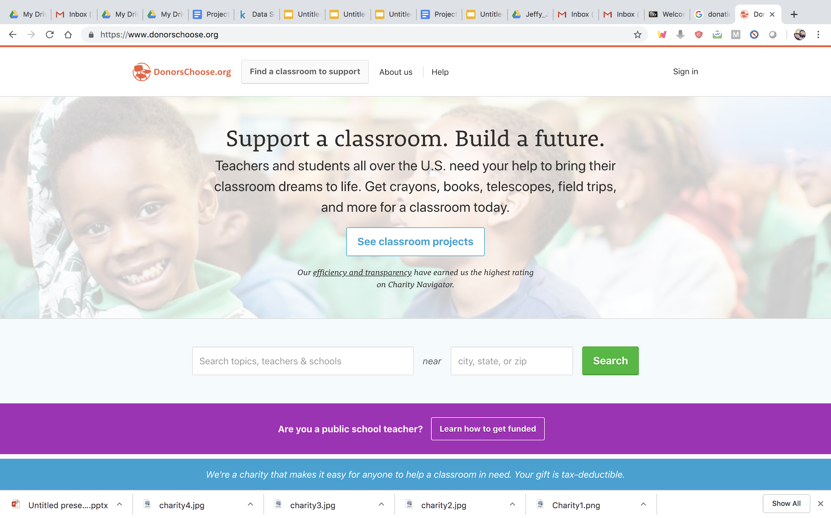
Motivation
DonorsChoose.org contacts previous donors for further donation opportunities
Donors are more likely to contribute if it’s for a cause they care about
Goal: Recommend donors the right projects to maximize donations
Notes:
DonorsChoose.org contacts previous donors for further donation opportunities.
Donors are more likely to contribute if it’s for a cause they care about.
If emails/ calls can be targeted to the right donors, donations could be maximized
Spend very little time here

Slide 3
The Dataset
TABLES (SIZE) | DESCRIPTION (MAIN ATTRIBUTES)
Donations (4.69m x 7) | Date, donor, amount and benefiting project of each donation
Donors (2.12m x 5) | Location of donor and whether or not donor is a teacher
Projects (1.11m x 18) | Teacher, School, Date posted and expiration date, Further details (Project Type, Title, Essay, Short Description, Need Statement, Category, Grade Level, Cost, Project Posted Date, Project Current Status (Expired, Fully Funded, Live), Project Fully Funded Date
Resources (7.21m x 5) | Name, quantity, price, vendor of resource to be bought for a particular project
Schools (73.0k x 9) | Name, type of area % of students on free lunch, location of the school
Teachers (403k x 3) | Date when a particular teacher first posted a project on donorschoose.org

Slide 4
The Dataset
Data Preprocessing:
Joined tables “Donations”, “Donors” and “Projects” after deleting duplicate records.
Geographically target donors based in Oakland
Final Datasets:
Projects table (1,110,015 rows)
Donations by donors who are based in Oakland (15,924 rows)

Slide 5
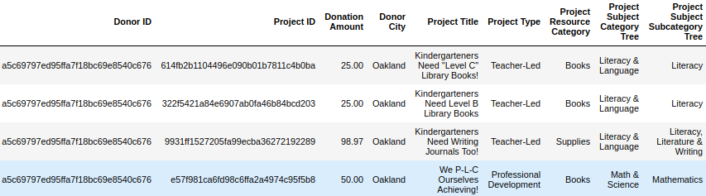
Recommending Projects to Donors in Oakland
Content Based Recommendation
Collaborative Filtering
Let’s consider the following donation data for a donor from Oakland:

Slide 6
Content Based Recommendation
Build Project Profile
Vectorize features ‘Project Title’, ‘Project Type’, ‘Project Resource Category’, ‘Project Subject Category Tree’ and ‘Project Subject Subcategory Tree’ using TF-IDF.
Build Donor Profile
Weighted average of project profiles that the donor has donated to by the donations amount.
Recommend projects
Recommend the top most similar projects by computing the cosine similarity between the donor profile and all project profiles.
Notes:
-vectorize features that capture the essence of the domain
-No ratings, unlike movie recommendation systems, so we weight by amount of donation paid
-top 10 most similar projects (top n in algorithm)

Slide 7
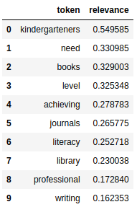
Insights from Content Based Recommendations
Let’s consider a user profile sorted by relevance score of features.
User has donated primarily to kindergarten projects with categories
‘books, literacy, writing’

Slide 8
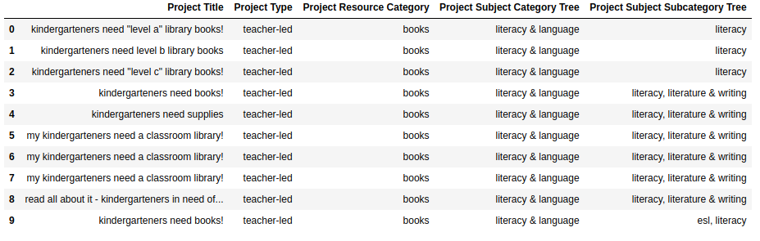
Recommendations
for the user
Donor’s projects:
Recommended projects:

Slide 9
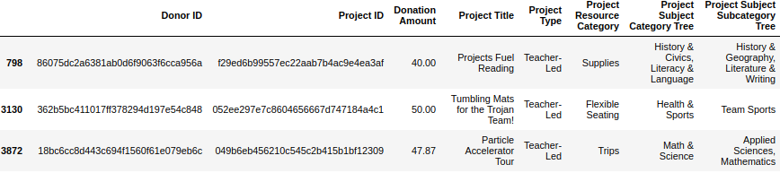
Collaborative Filtering
Projects
(Project IDs)
ProjTypes
(ProjType IDs)
ProjTypes
(ProjType IDs)
Removed empty rows and columns
Group projects into “ProjTypes”
Donors
(Donor IDs)
7221 X 9744
7221 X 2259
1781 X 1303
Notes:
Binary Matrix
Taking Project IDs on the columns
Most donors had not donated to any projects at all
Matrix was 99.98% sparse
Did not find any candidate pairs with LSH

Slide 10
Locality Sensitive Hashing
Compute donor signatures
Partitioned utility matrix and and computed signatures, of length 20, of donors in each partitions
Find similar donors
Divided all signatures in four bands (of 5 rows each)
Any donor pair with same signatures in at least one band was considered a candidate pair
A candidate pair with Jaccard similarity >= 0.5 was considered similar
Recommend projects
Recommend the projects most frequently donated to by similar donors
Notes:
Other approach [deleted]
If very few recommendations found, get more by doing the following
Get recommended project types (Most frequently donated to project types of this and similar donors)
Get most frequently donated to unique projects by similar donors in these categories
Number of recommendations = 10
['4a013156e3fd68083b646186bed8a8bf', 'e4936cc428bd5ca5cafb58839820cf53', '27533d66162b16909e21b109021a7524', 'af704ba3af4e6be7cc7944cb8e8325b7', '4a3ca8ed1dff19d8365a524cbfc8c730', '736feed186c96f70ab761ff2e9f66e89', 'c8efe19e8450001e872f9b46601a9731', 'b359551a2b1954b3ea7e7b77b262543d', 'f453e2364f389937ff2b276ac16798da', '6b95e0df5ac502f051c075a4c55dd8bb']

Slide 11
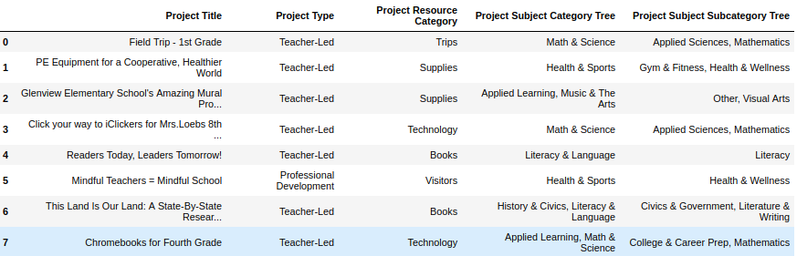
Recommendations
for the user
Donor’s projects:
Recommended projects:

Slide 12
Final Recommendations
Project Title | Project Type | Project Resource Category | Project Subject Category Tree | Project Subject Subcategory Tree
Kindergarteners need “level a” library books! | Teacher-led | Books | Literacy & Language | Literacy
Kindergarteners need “level b” library books! | Teacher-led | Books | Literacy & Language | Literacy
Kindergarteners need “level c” library books! | Teacher-led | Books | Literacy & Language | Literacy
Field Trip - 1st Grade | Teacher-led | Trips | Math & Science | Applied Sciences, Mathematics
PE Equipment for a Cooperative, Healthier World | Teacher-led | Supplies | Health & Sports | Gym Fitness, Health and Wellness
Glenview Elementary School’s Amazing Mural Project | Teacher-led | Supplies | Applied Learning, Music & The Arts | Other, Visual Arts
Notes:
A union of recommendations made by Content Based (top 3) and Collaborative Filtering (top 3) approaches:
Projects that appear in the intersection are more highly ranked than those that do not
Top 3 projects that are recommended by CB appear before top 3 projects recommended by CF

Slide 13
Challenges
Collaborative Filtering: Latent Factor Decomposition using ALS
Constructed Ratings Matrix:
ProjTypes
(ProjType IDs)
Where,
R[donor i, proj j] = amount donated by donor i to proj j
amount donated by donor i to all projects
R =
Donors
(Donor IDs)
1781 X 1303
Final R’ = U*V approached a zero matrix
Notes:
Most of the

